Slide 1
Assessment of Biosafety Cabinetry in Kenya
9th IPNET Conference , Lake Naivasha Resort
March 23rd – 25th , 2022
George Omondi, Victoria Ouma, Ernest Makokha

Slide 2
Introduction
Biological Safety cabinets (BSCs) are primary means of containment that use motor blowers and HEPA filters to provide protection to healthcare workers, products and environment
Used in medical/research, pharmaceutical laboratories and oncology departments worldwide
To ensure correct functionality, BSCs need proper maintenance and annual certification beyond daily user care. We set out to assess the status of BSCs to ascertain their safe operation

Slide 3
Classification of BSCs
Class | Type of BSC | Type of protection | Application
I | N/A | Personnel, environment | Low to moderate risk biological agent
II | A I, A2, B1, B2 and C1 | Personnel, product& environment | Low to moderate risk biological agent
III | N/A | Personnel, product& environment | High risk biological agent

Slide 4
A well maintained, certified& located BSC will operate smoothly to give the required protections

Slide 5
Method
Between February -June 2019, we conducted functionality assessments on 74 BSCs spread across Ministry of Health (MOH) facilities in Kenya
We used the two main international standards checklists, the NSF/ANSI 49 and EN 12469-2000 - to conduct the assessments
Based on the two checklists, we assessed the following elements:
  Down flow velocity profile test
  Inflow velocity profile test
  HEPA filter leak test
  Smoke pattern
  Site installation tests
As per checklist guidance, failed elements were retested after necessary adjustment and indicators were recorded as pass/fail
Assessment data were recorded, analyzed and presented as frequency and proportions using Microsoft Excel software

Slide 6
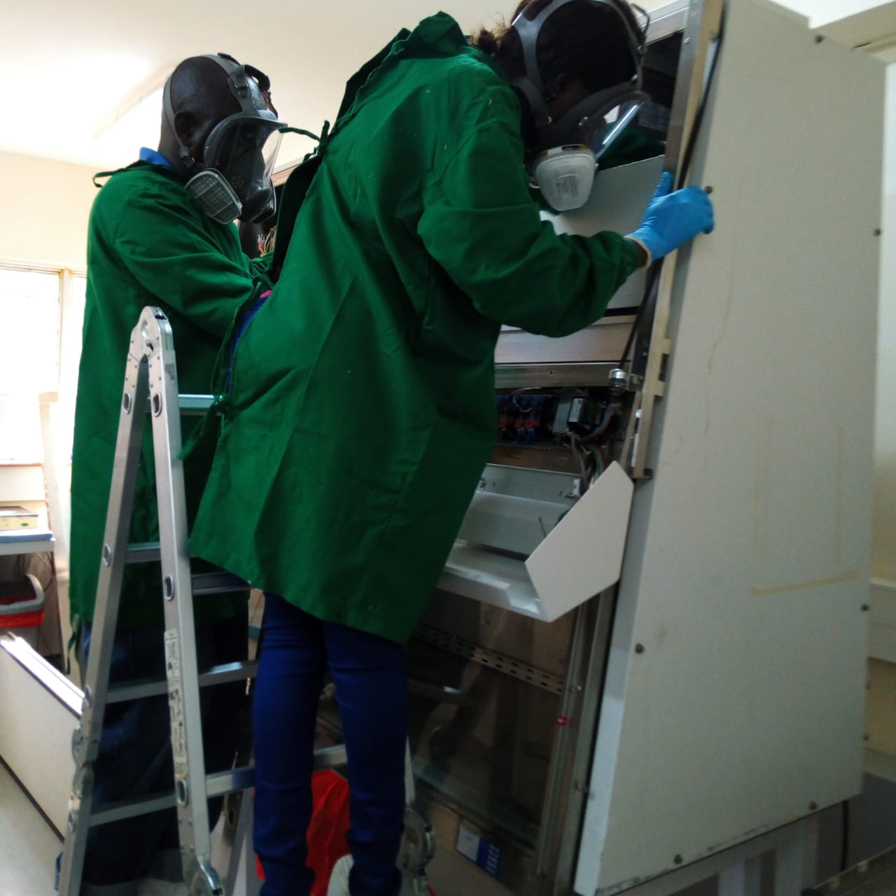
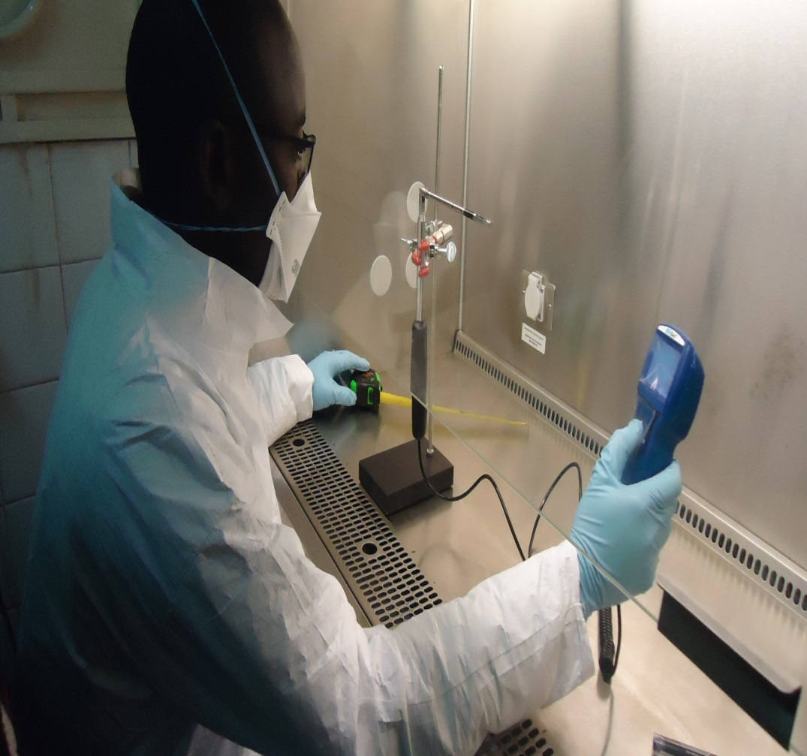
BSC CERTIFICATION
Here is a certifier testing for down flow velocity profile a test in a class IIA2 BSC
Certification is the testing process used to verify proper continuous functionality of BSCs using duly calibrated equipment by a qualified certifier

Slide 7
WHEN DO WE CERTIFY BSCs?
Consider the following
Equipment used must be calibrated, they include
When installed for first use
Annually
When relocated
When major repairs are done/ change of HEPA filters, motor blowers etc
Thermal anemometer/hot wire
Aerosol photometer
Aerosol generator
Air data meter/ Direct instrument measurement (DIM)
Smoke pattern testing equipment
Particle counter( for isolators)

Slide 8
Results
Across the six counties Nairobi, Kiambu, Siaya, Homa-bay, Migori and Bungoma (n=74)
Element/tests | Outcome % |  | Comment
 | Pass | Fail
Downflow velocity profile test | 78% | 15% | New supply HEPA filters recommended for failed units on this individual test
Inflow velocity profile test | 78% | 15% | New exhaust HEPA filter recommended for failed units on this individual test
HEPA filters leak test | 89% | 10% | Recommended replacement of HEPA filters
Smoke pattern test | 99% | 1% | One BSC dropped from usage
Site Installation test | 96% | 4% | Most errors corrected

Slide 9
Results cont…
Other assessment outcome | Percent
BSC that failed certification and needed spare-parts | 15 (20%)
BSCs that passed after adjustment | 58 (78%)
BSCs found with user errors | 3 (4%)
BSC dropped (beyond repair) | 1 (1%)

Slide 10
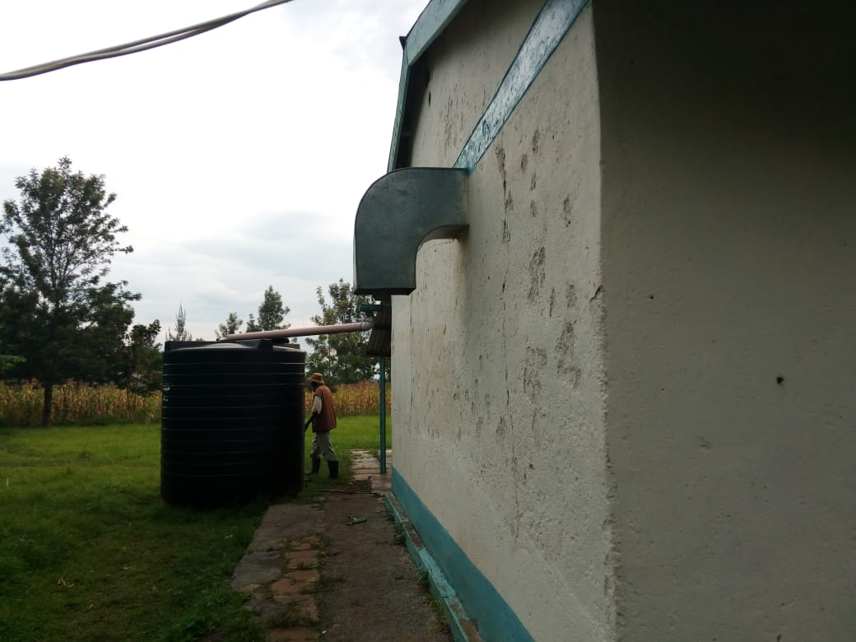

Incorrectly installed ductwork, corrected
Before
After

Slide 11
Conclusion
Annual BSC certification based on well-established standards ascertained continued containment and informed the need for the facilities to procure required parts and users able to avoid simple errors which help reduce on equipment down time
A failed BSC kills user morale while a passing BSC promotes user confidence

Slide 12





Acknowledgements

