Slide 1

Antimicrobial Stewardship Updates
Nyeri County
Dr Oscar Agoro

Slide 2

Introduction
Establishment of the CASIC (March 2019)
Appointment of an AMS Focal person (Health and Agriculture)
Baseline assessments of AMS/MTC activities at facility and management levels (June 2019) – (USAID MTaPS, IDDS)
MTC committees revitalized in hospitals and CHMT (Private & Faith based hospitals involved)
Training of MTC members in target facilities (Oct 2019, May 2020, Feb 2021) (USAID MTaPS, IDDS)

Slide 3
AMS Activities Cont’d
Annual entity specific work plans developed, updated and implemented
Antibiotic prescribing audits underway in hospitals
  Nyeri County Referral Hospital (42% - 61%)
  Karatina County Hospital (31.3% – 52.4%)
Quarterly AMS support supervision visits to facilities (some integrated; some standalone)
Sensitizing newly recruited officers on AMS/IPC during induction sessions
Incorporation of MTC/AMS activities in the SP, AWP, PC and SPAs
Biannual (now Quarterly) CASIC meetings (County, FAO and IPNET)

Slide 4
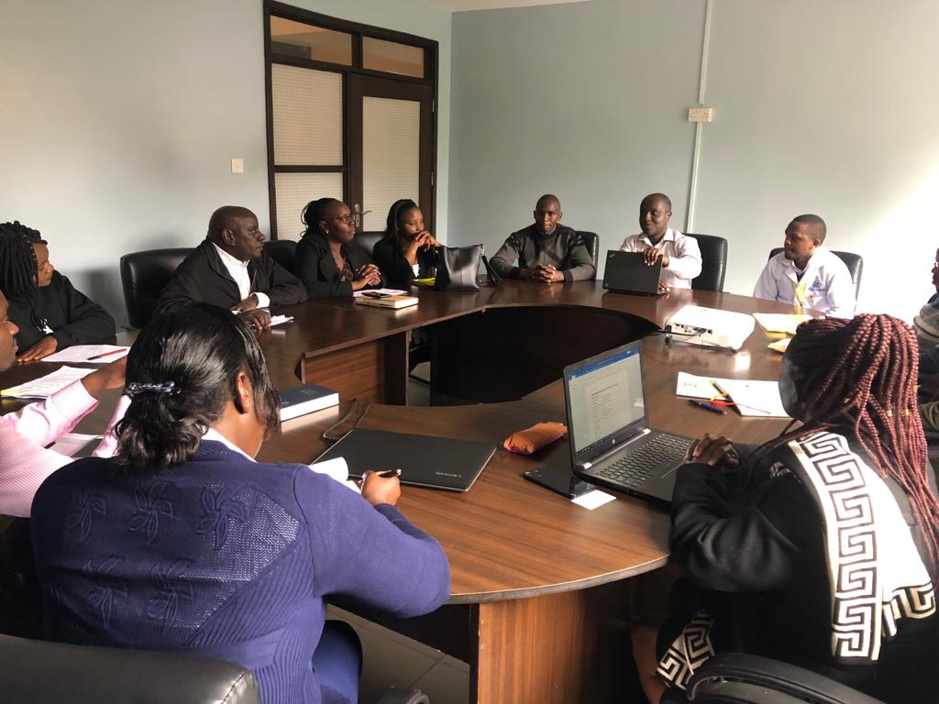
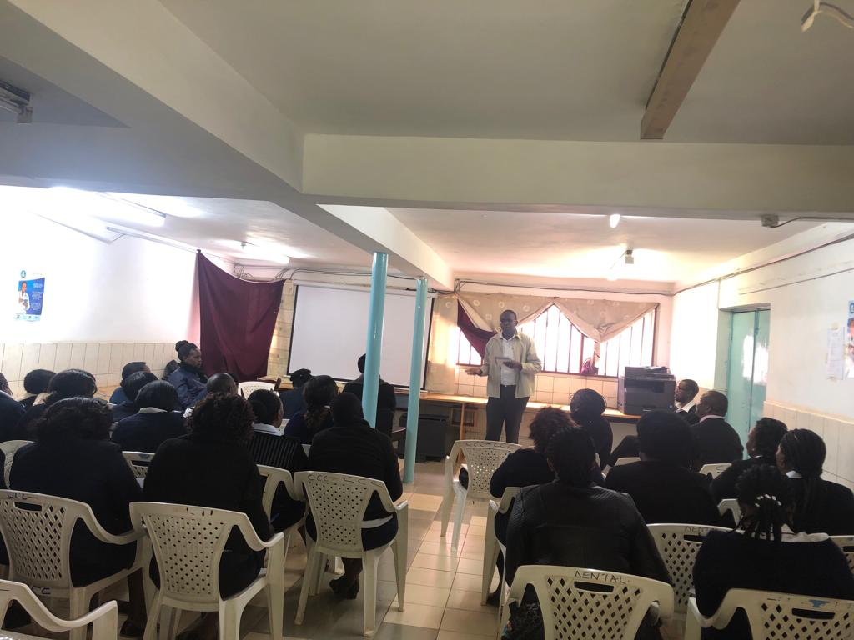
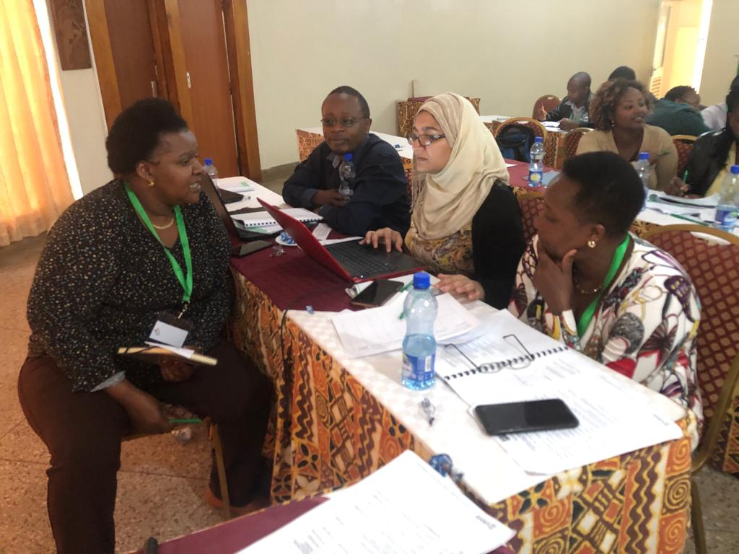
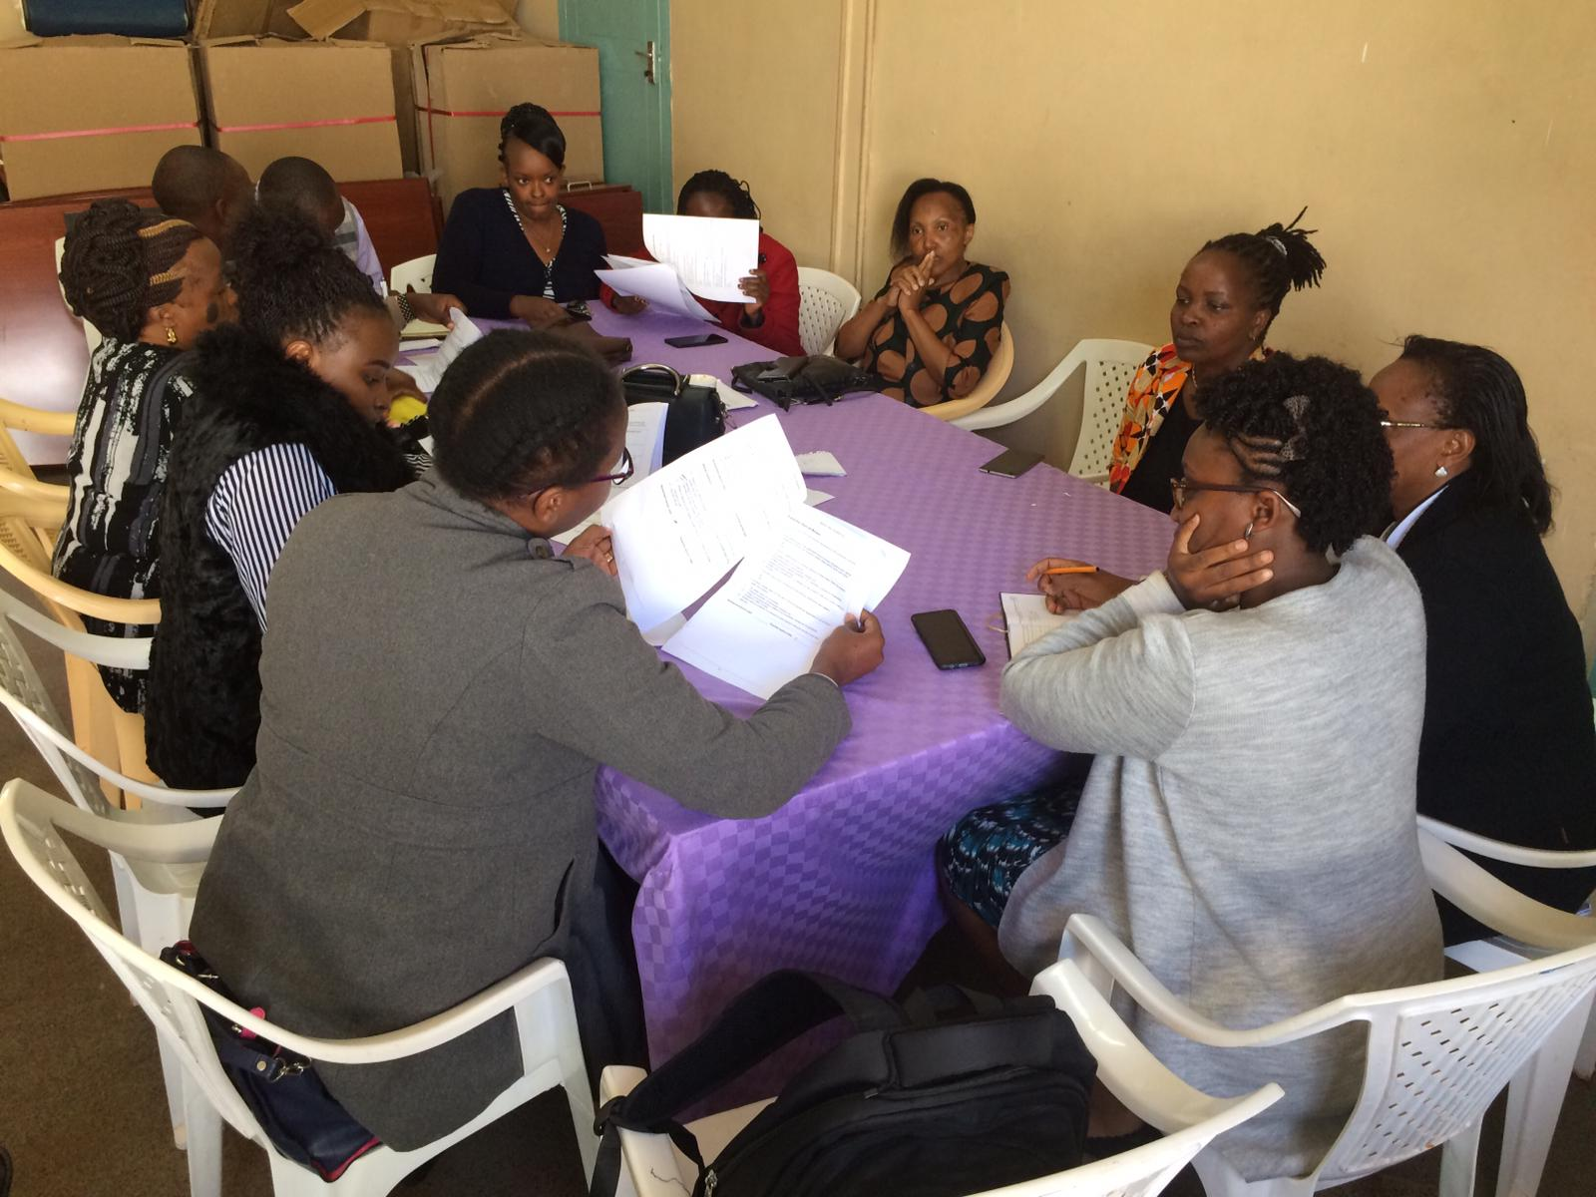

Slide 5

Other Activities
Workshop to standardize AMS tools used in Nyeri hospitals (IPNET):
  Antibiotic Prescribing Audits in hospitals
  PPS
  AWaRE re-categorizing
  Antibiotic Pre-authorization
  Surgical Prophylaxis
Quarterly joint MTC meetings (planned)
Strengthening CASIC collaborative activities (IPNET, FAO)
The Nyeri CASIC Workplan 2020 – 2022 Finalized (FAO, USAID)

Slide 6
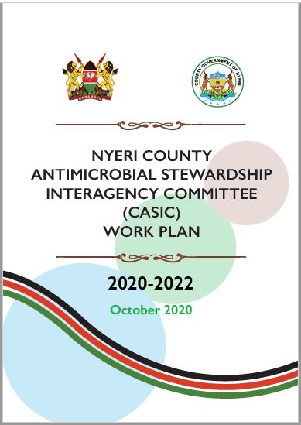
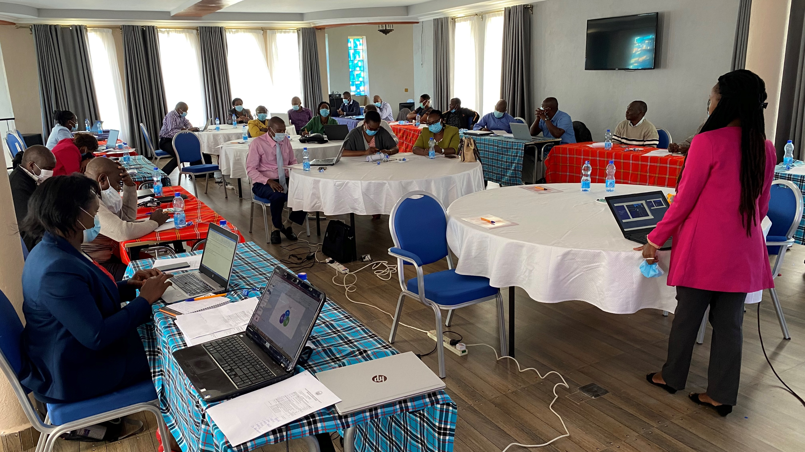

Slide 7
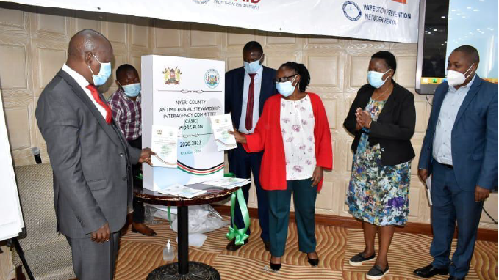
Nyeri CASIC Work Plan Launch

Slide 8
Other AMS Activities
Marked the World Antimicrobial Awareness Week 2020
  Health Talks
  Social media engagement (Twitter, Facebook)
  Banners, Brochures
Cascading AMS to other staff members through facility-based CMEs
Nyeri CRH completed developing an Antibiogram from 2019/2020 Lab data (USAID IDDS)
Sharing our AMS work through conferences (IPNET 2019, ISIUM 2020 Conferences)
Nyeri CASIC supporting other counties to develop CASIC Work Plans (Murang’a & Bungoma)

Slide 9
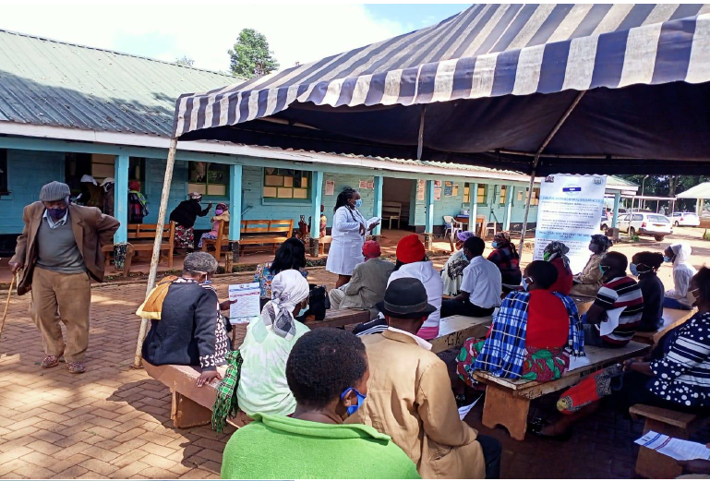
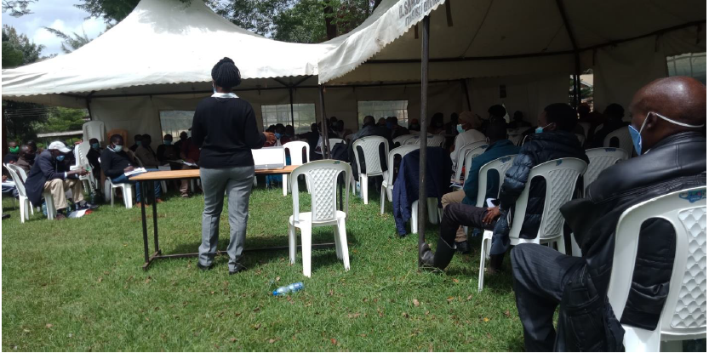
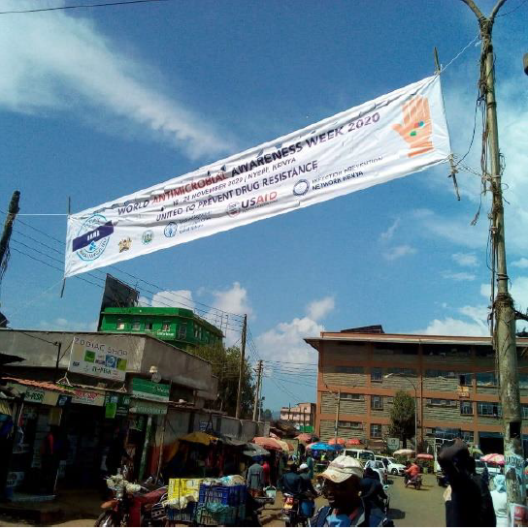
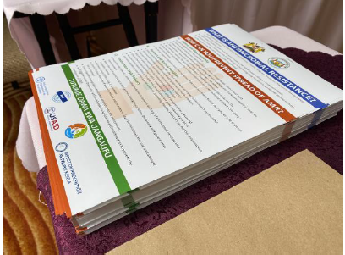
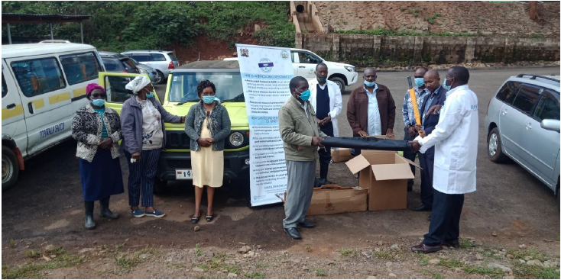
WAAW 2020 Activities

Slide 10
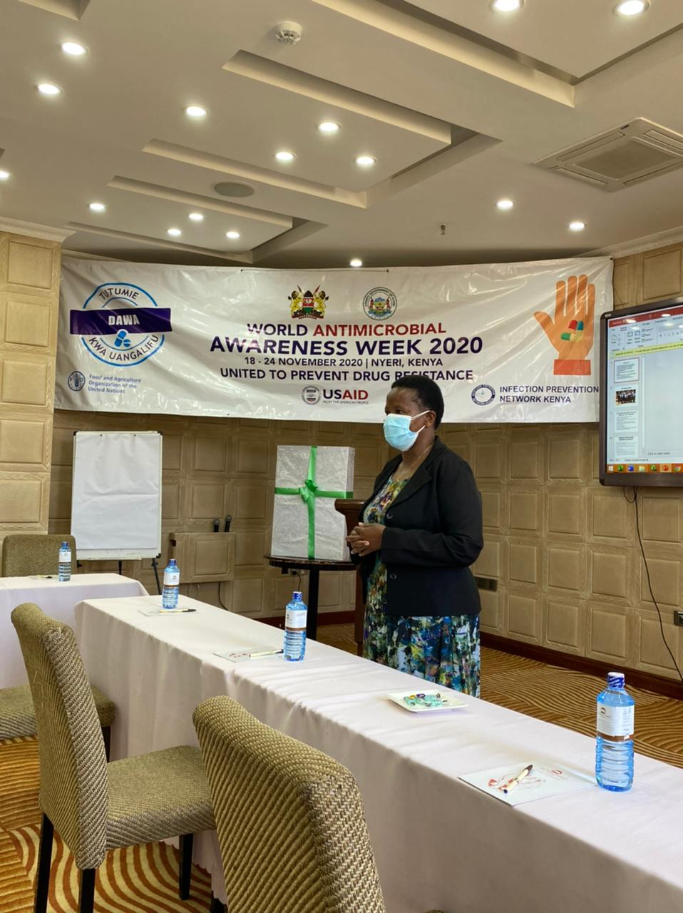

County Leadership Support

Slide 11



Partner Support
Partners supporting AMS activities since June 2019:
  Medical Technologies and Pharmaceutical Services (MTaPS) - focusing on AMS and IPC
  Infectious Diseases Detection and Surveillance (IDDS) – focusing on laboratory strengthening for improved AMR surveillance.
  Food and Agriculture Organization of the UN (FAO) – cross cutting AMR/AMS support
Other partner: ReACT Africa, IPNET/MoH (Pfizer)
Notes:
8 Health facilities (5 public hospitals, Outspan, Tumutumu, Naromoru HC) and 1 Community Pharmacy

Slide 12

Challenges
Medical Officers/Consultant Doctors yet to adequately embrace AMS
CASIC membership (too large?)
Consolidation and coordination of partner support
Surveillance, monitoring and reporting. More locally generated data on AMR needed
Lack of a Work Plan (initially) to guide activities
Financing AMS activities
Other competing roles for AMS Focal Persons
Covid-19 disruption

Slide 13

End

