Slide 1
  WASH in Health Care Facilities; Survey from Kenyan County Hospitals
Dr Michuki Maina
IPNET 2018

Slide 2
Broader Study Objectives
Overarching Aim
To develop contextual knowledge that can inform (complex) comprehensive intervention design to improve IPC-ABS in Kenyan hospitals, and to identify indicators of IPC-ABS behaviours, performance and health outcomes that can be used to evaluate and monitor future interventions.

Slide 3
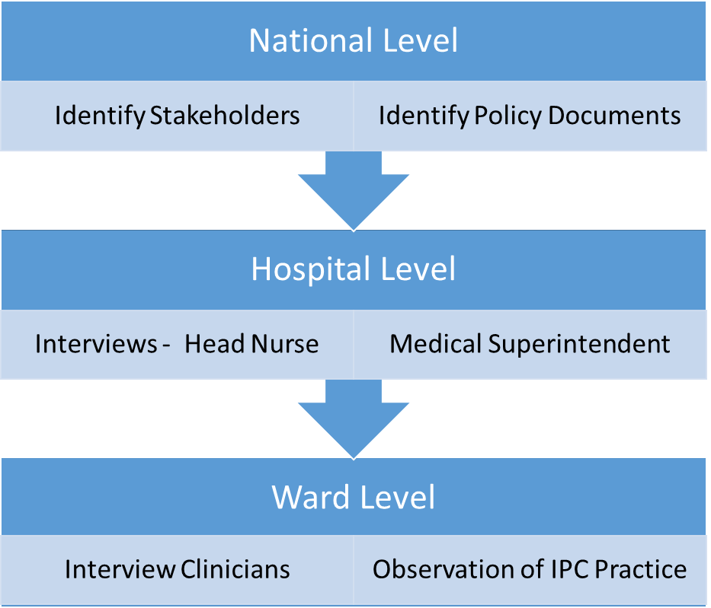
Study Arms
Qualitative
Quantitative
  The Antibiotic Consumption Survey
  The Water, Sanitation and Hygiene in Healthcare Facilities (WASH-FIT) survey

Slide 4
Methods
Modified the WASH tool applied to survey;
  Facility and Ward indicators for ward and facility assessments.
Develop a meaningful aggregate score grouped into different levels
  By hospital; by domain; and by indicator
Develop meaningful data visualisation methods for managers and policy makers to monitor progress.

Slide 5
WASH Survey

Slide 6
WASH FIT -Water, Sanitation and Hygiene in Healthcare Facilities (HCFs) Improvement Tool
First developed in 2015. Has been piloted in a number of different countries and contexts;
Used to strengthen WASH;
Covers four broad domains: water, sanitation, hygiene and management;
Each domain includes indicators and targets for achieving minimum standards for maintaining a safe and clean environment ¹;
Some standards taken from the WHO ‘Guidelines for the Core Components of Infection Prevention and Control Programmes’ (WHO, 2016).
¹ WHO Essential Environmental Health Standards in Health Care (WHO 2008).

Slide 7
Adapted WASH Indicators for Ward-Level and Facility Level Assessments
Indicator Types
Scoring System for Indicators
Data collection tool to be reformatted to measure indicators at
Facility Level
Department / Ward level ¹
¹ System-level collation to be coherent with classification used in antibiotic consumption survey
Notes:
The assessment took place at the inpatient wards- and at the facility- levels.
The ward-level assessment was conducted for each inpatient ward separately.
The facility level assessment considered pooled observations from individual inpatient wards + outpatient areas, other service areas (e.g. kitchen, laundry, laboratory, waste management facilities, other) and the outdoor environment; informed the overall WASH service performance for the hospital.

Slide 8
WASH Indicators
 | Ward | Facility
Water | 6 | 14
Sanitation and Healthcare Waste | 11 | 22
Sanitation | 7 | 10
Healthcare Waste | 4 | 12
Hand hygiene, Environmental Management, Cleanliness and Disinfection | 12 | 18
Hand Hygiene | 4 | 5
Environmental Management, Cleanliness and Disinfection | 8 | 13
Organisation Management | 5 | 11
Total | 34 | 65

Slide 9
Data Collection Sites
16 hospitals across 11 counties
Mainly level 4 and 5 county hospitals
Neonatal Unit in the national referral hospital.
Sites located in high and low malaria endemic regions.
Selection based on ongoing work in these facilities under a KWTRP and Ministry of health collaboration.

Slide 10
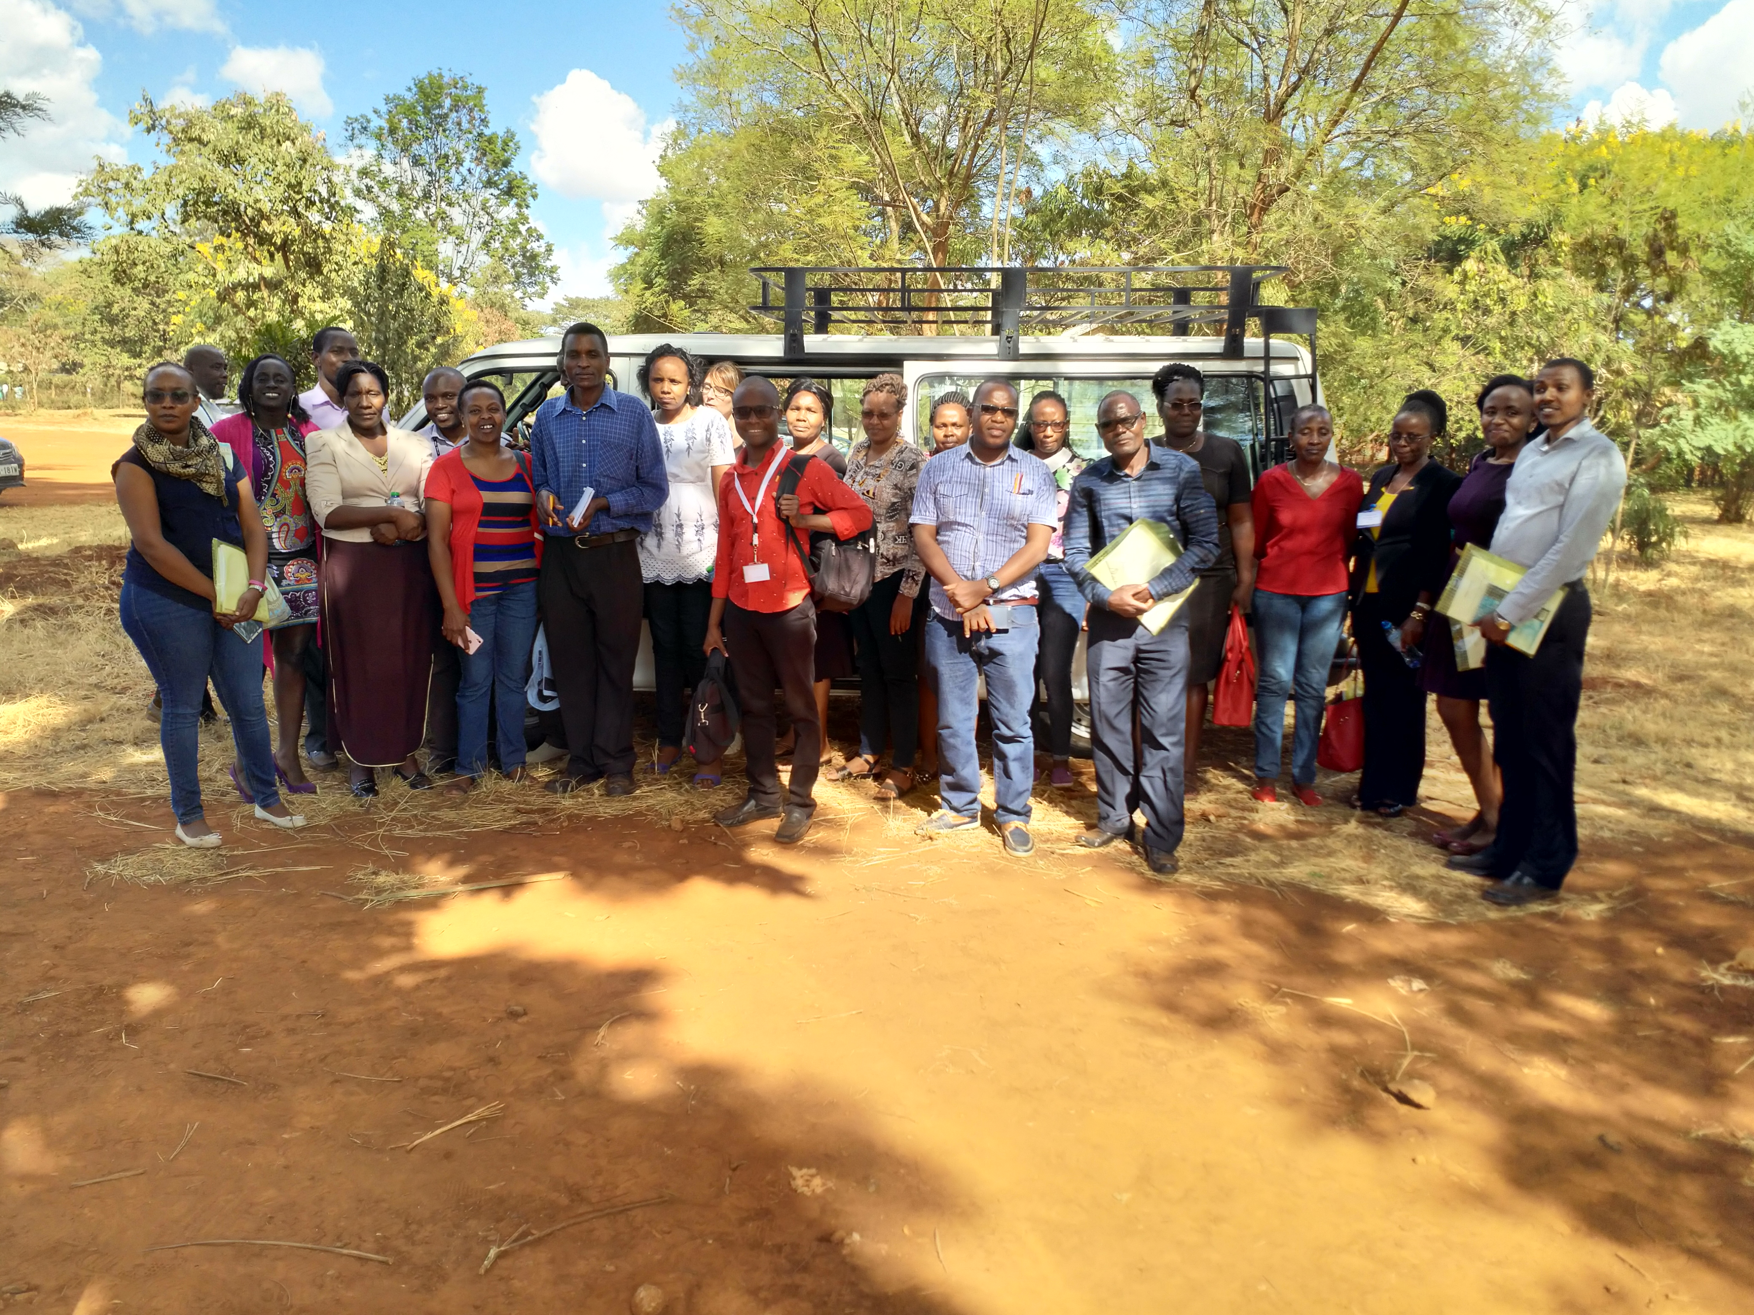
Data collection
Trained data collection team for one week including a pilot
The data collection team - nurses, medical officers, pharmacists.
Actual data collection included hospital representatives – IPC leads, Public health officers, nursing officers.
Data collection-February-April 2018
Data collection team

Slide 11
Results

Slide 12
Bar Chart of Facility aggregate scores by Domain

Slide 14
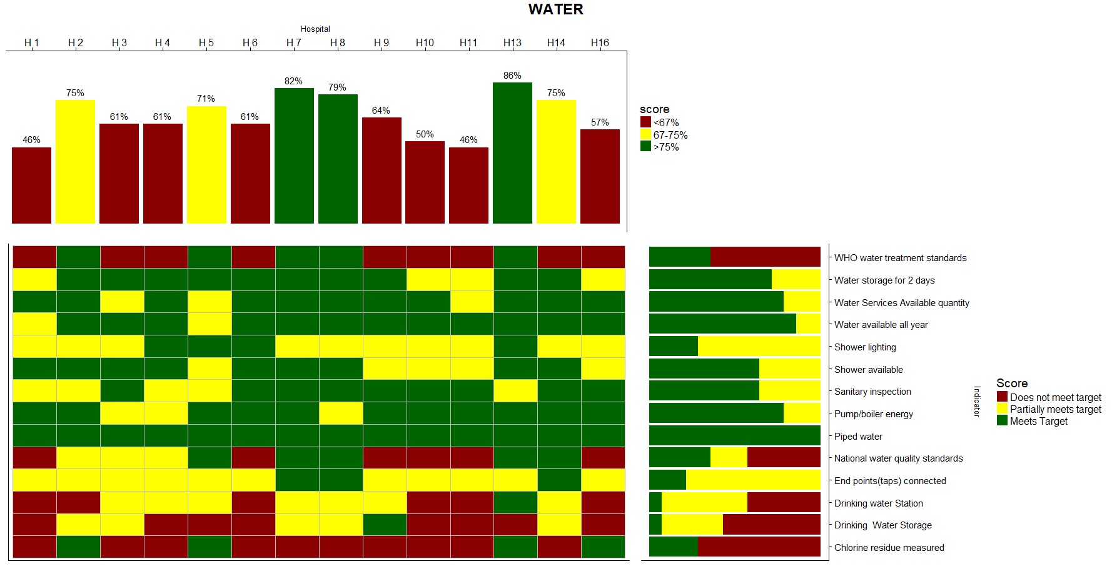

Slide 15
Combined hospital and ward chart showing variability
Notes:
This highlights the variability across wards and domain.
These were mainly in the facilities with multiple inpatient units (H2,H3,H9,H10 and H13)
Mainly in the sanitation and management domains.

Slide 16
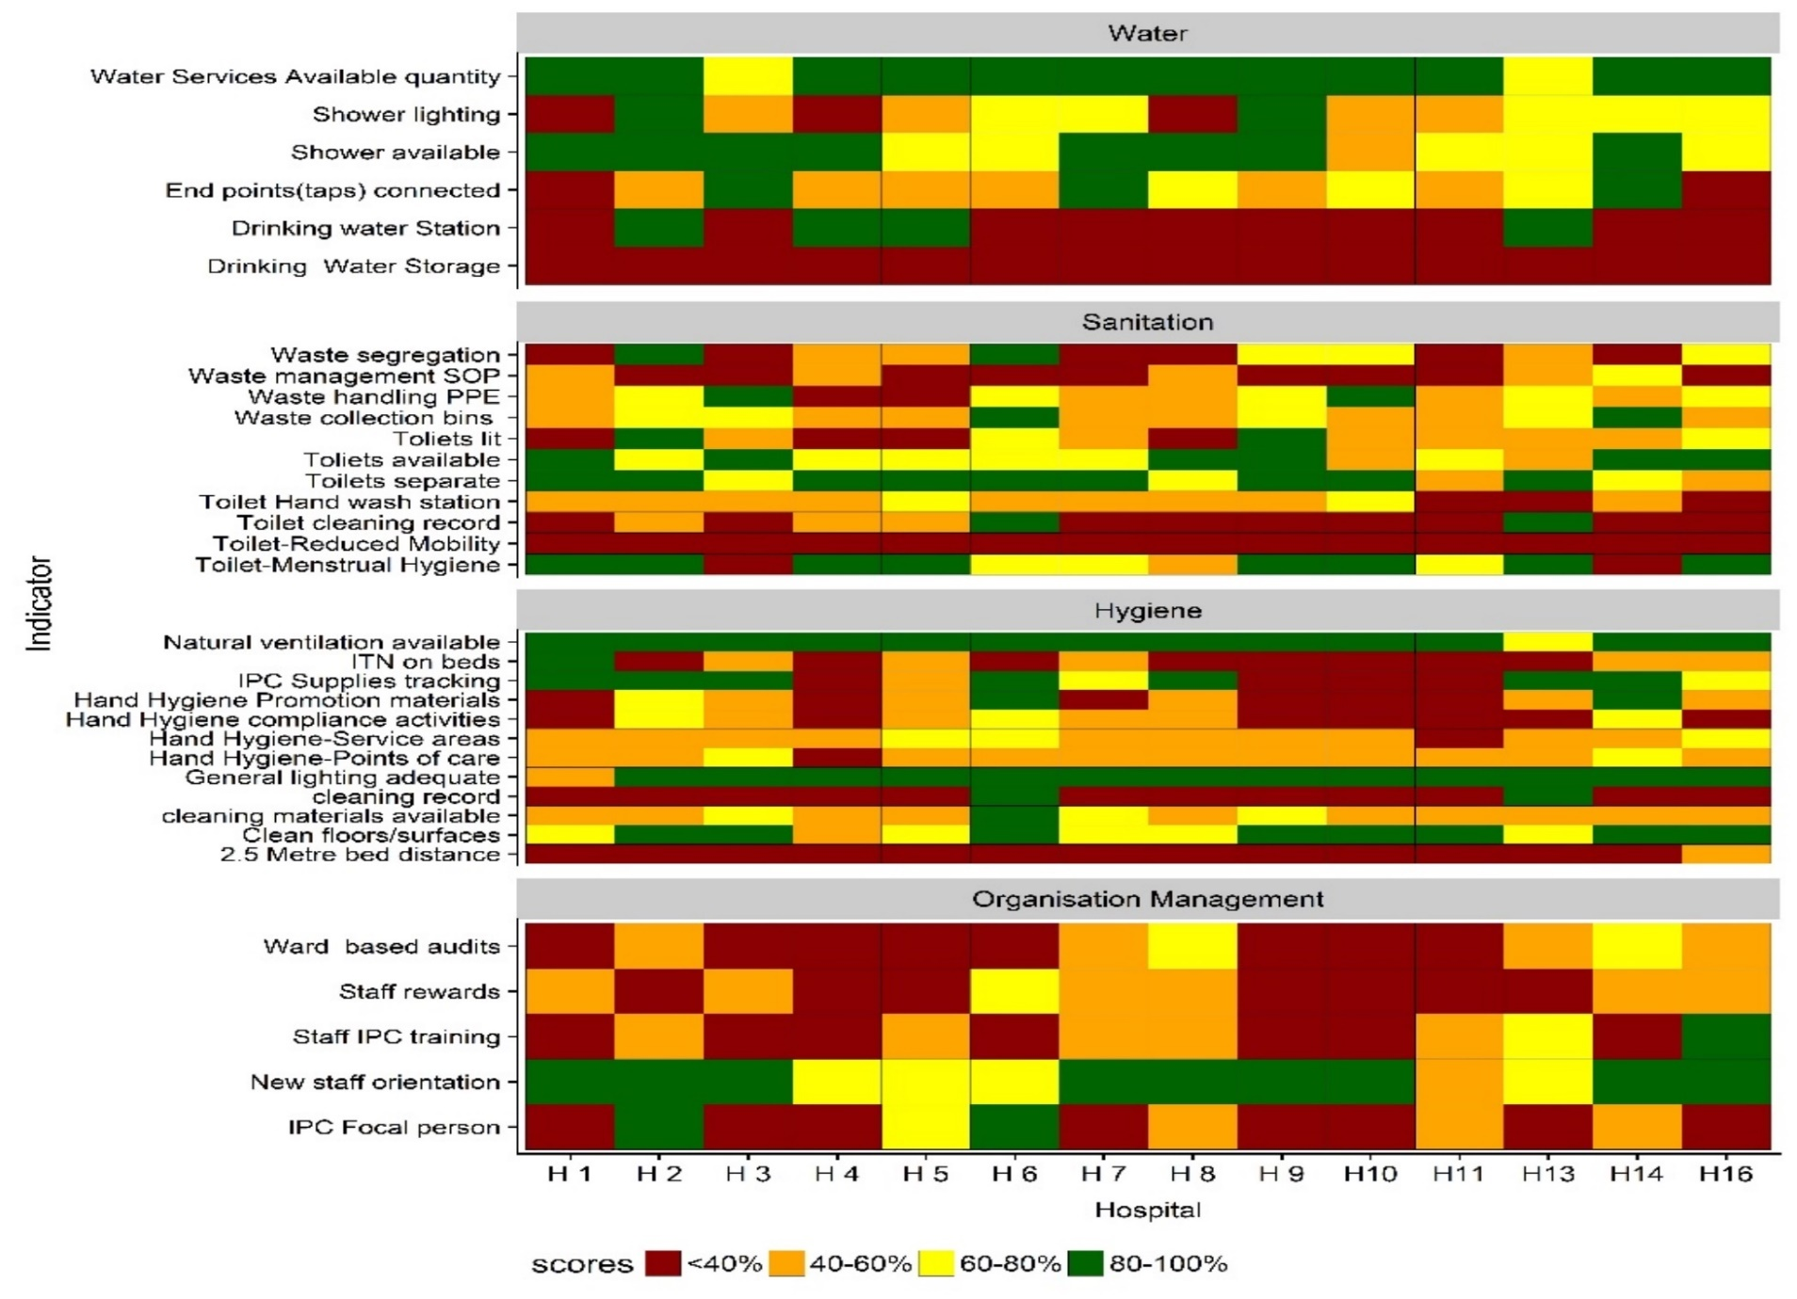
Ward Level Aggregate- Colour codes

Slide 17
Summary
Modified WASH tool to highlight ward and Facility differences.
Gaps exist in the state of WASH in within and across healthcare facilities.
Need to assign more responsibility across the health system to improve WASH

Slide 18





Acknowledgment
Council of Governors

