Slide 1


The importance of infection prevention control in a Tuberculosis Reference laboratory in Kenya
Authors: Jennifer Njuhigu^{1**,} Zipporah Mwongera¹,Joseph Osoga², Beatrice Khamala¹, Margaret Mburu^{3,} Christina Mwachari ^{2,} Nellie Mukiri¹, Mamo Umuro⁴
Author Affiliations
1. Kenya National Tuberculosis Reference Laboratory (KNTRL)
2. University of Maryland Baltimore (UMB-K), Nairobi Kenya
3. Division of Global HIV & TB (DGHT), United States Centre for Disease Control and Prevention
(CDC),Kenya
4. National Public Health Laboratory (NPHL)
IPNET 2018 Conference, Nyeri, Kenya
IPNET 2018 Conference, Nyeri, Kenya

Slide 2
Disclaimer & Attribution of support
The findings and conclusions in this publication are those of the authors and do not necessarily represent the official position of the funding agency.
This project publication has been supported by the President’s Emergency Plan for AIDS Relief (PEPFAR) through the Centers for Disease Control and Prevention (CDC) under the terms of cooperative agreement Number -6NUGGH001953

Slide 3
Presentation Outline
Background
Methods
Results
Conclusions

Slide 4
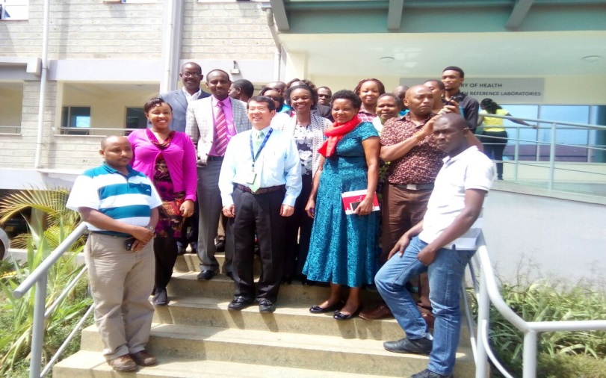
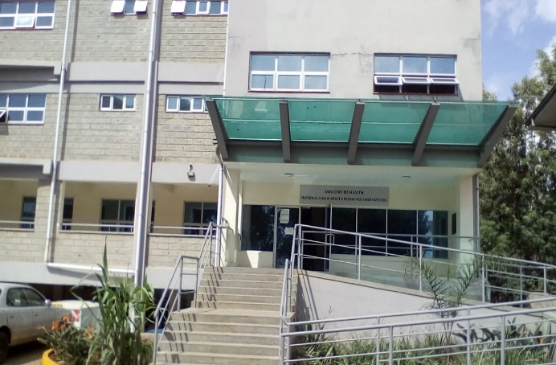
Background
National Tuberculosis Reference laboratory (NTRL)is a unit within Division of National Public Health laboratory, Ministry of Health - Kenya
Key activities :
Conduct tuberculosis culture and drug susceptibility testing
Develop policy and guidelines on tuberculosis diagnosis
Coordinate external quality assurance for Xpert MTB/RIF assay and smear microscopy
Conduct operational research

Slide 5

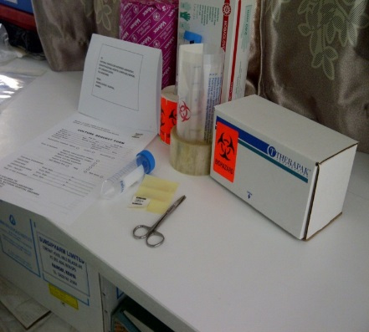
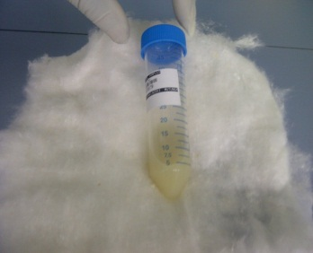
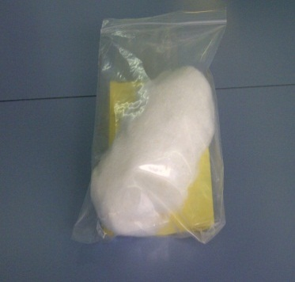
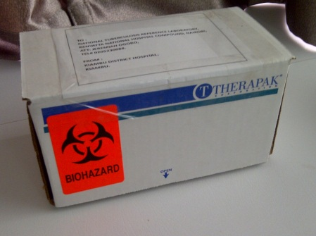
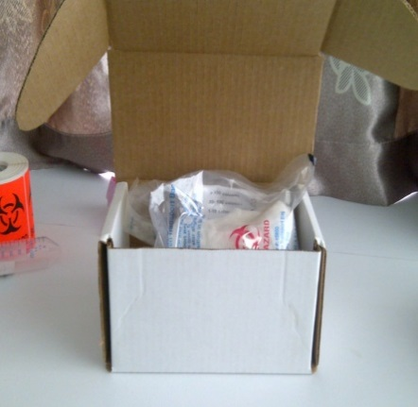


Sputum packaging procédures
2. wrap specimen with enough absorbent material
3. Insert wrapped specimen into a zip-lock bag with a pouch
1. List of supplies
5. Affix onto the tertiary container the sender, receiver and biohazard label
4. Put the specimen contained in secondary container into the tertiary container

Slide 6
National TB Reference laboratory testing workflow
SPECIMEN RECEPTION
SPECIMEN PROCESSING
SMEAR EXAMINATION
POSITIVE
NEGATIVE
Feedback
Line probe Assay
Culture
ALIQUOTE (STORAGE)
MTB RAPID ID
DST
SUSCEPTIBLE
MDR
Second line DST
Results feedback

Slide 7
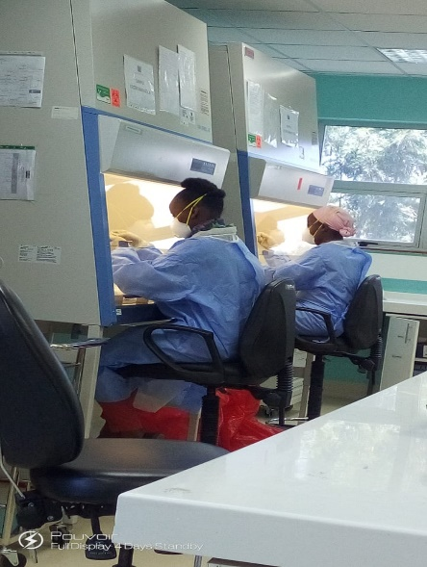
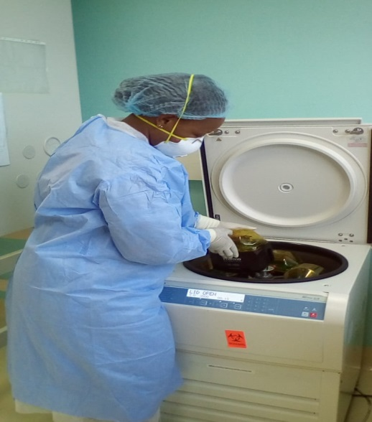
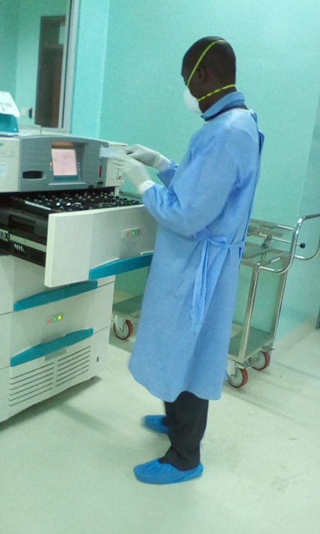
Risk Factors Increasing Tuberculosis Transmission at a Reference Laboratory
Sample reception-unpackaging
Specimen processing
Culture characterization
Drug susceptibiliy testing

Slide 8
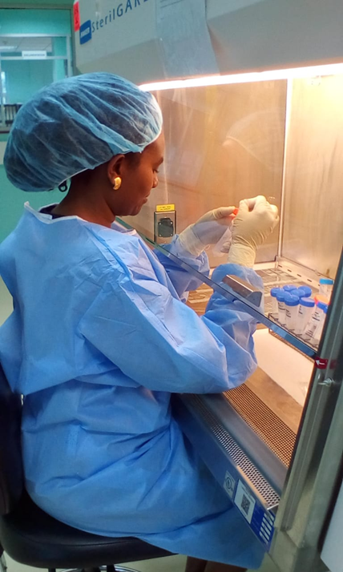
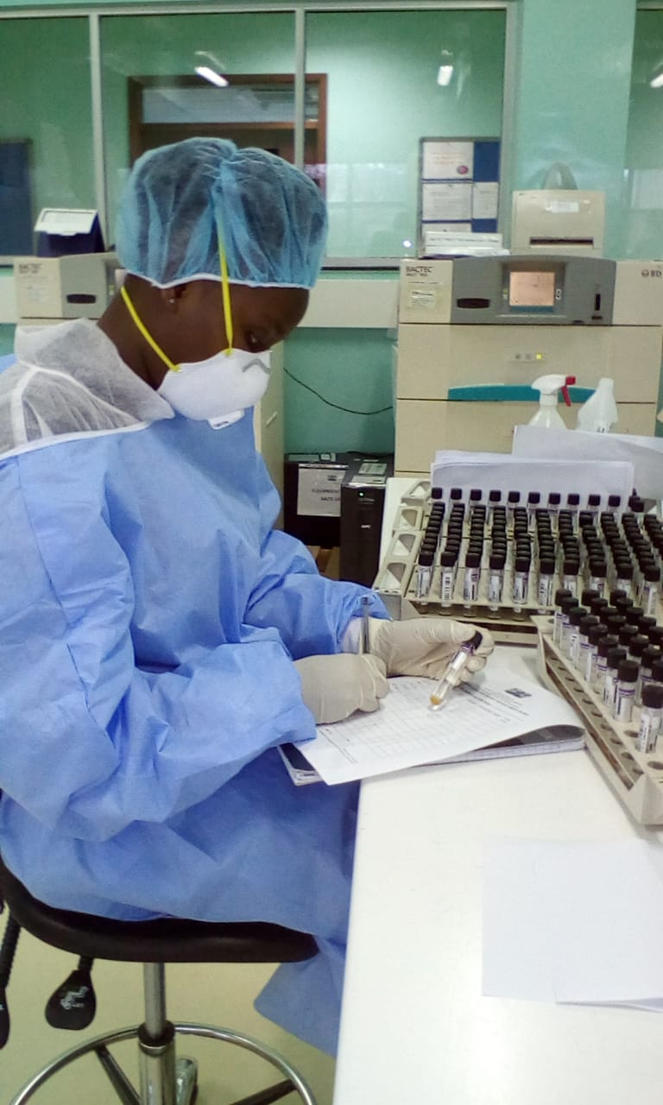
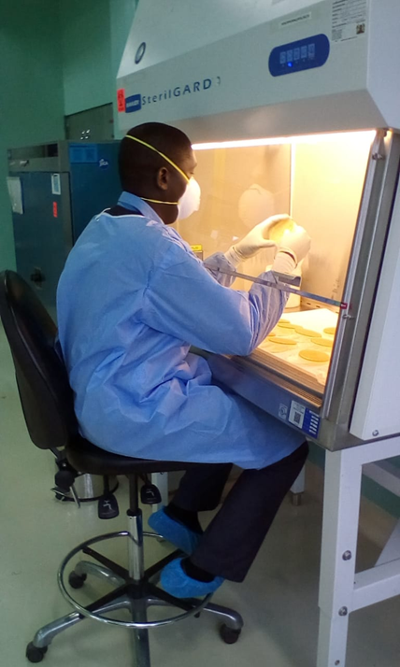
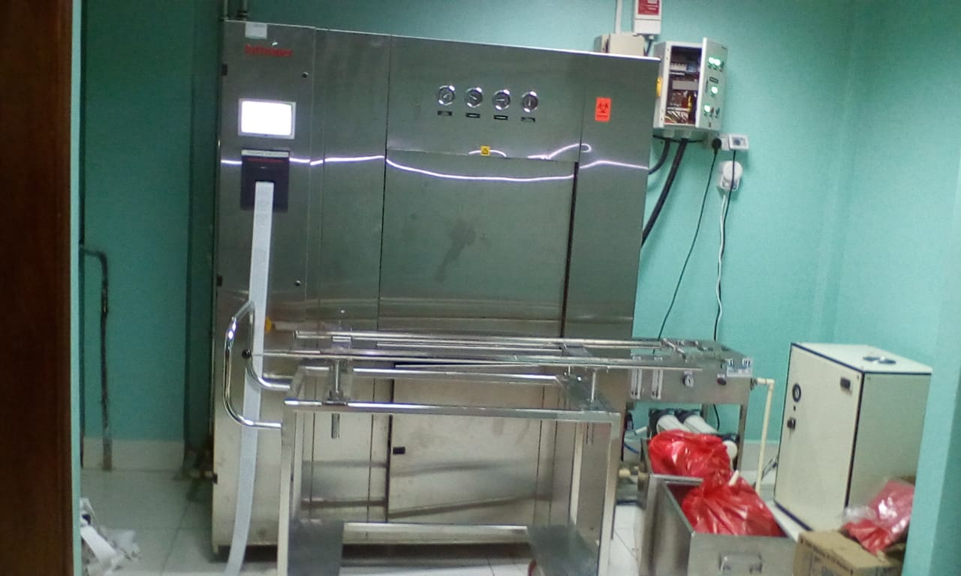
Risk Factors Increasing Tuberculosis Transmission at a Reference Laboratory Cont’

Slide 9
Infection Prevention Implementation at National Tuberculosis Laboratory
Establish biosafety standards – Safety Manual (6)
Train personnel on biosafety Standards (22/22)
Monitor routinely on the implementation of biosafety standards:
conduct biological risk assessment (Bi-Annual)

Slide 10
Methods
How was this study conducted?
Biological risk assesment was conducted to determine existence of any tuberculosis infection prevention gaps:
Reviewed the following:
  The sputum specimens recieved at NTRL in the year 2017
    Condition of the specimen on receipt
    Patient category
  Personnel technical competencies
  Annual personnel screening for tuberculosis
  Key quipment calibration and service contract status
  Analysed the data using simple statistics: frequency tables and charts

Slide 11
Analysis of NTRL data from LIMS
Tuberculosis culture outcomes given Sputum Smear Microscopy status
Patient category whose samples were received at NTRL
# of specimens received | SSM+ve Culture +ve | SSM +ve Culture -ve | SSM –ve culture +ve | SSM –ve culture -ve
7980 | 3192 | 1595 | 314 | 3708
% | 40% | 20% | 3.9% | 46.5%

Slide 12
Sample rejections

Slide 13
Patient category from leaked samples

Slide 14
What the study find from non-patient specimen data review
Data variables | # reviewed | Findings | Comments
Personnel competency assessment | 22 | 100% had competency assessment done | 100% were competent
Personnel annual TB screening | 22 | 100% had documented annual TB screening | 100% did not have TB
Personnel N95 respirator fit test reports | 22 | 100% had documented N95 respirator fit test | 5/22( 22.7%) had failed fit test 17/22(77.3%) had passed fit test
Annual biosafety cabinet certification reports | 7 | 100% had current annual certification status

Slide 15
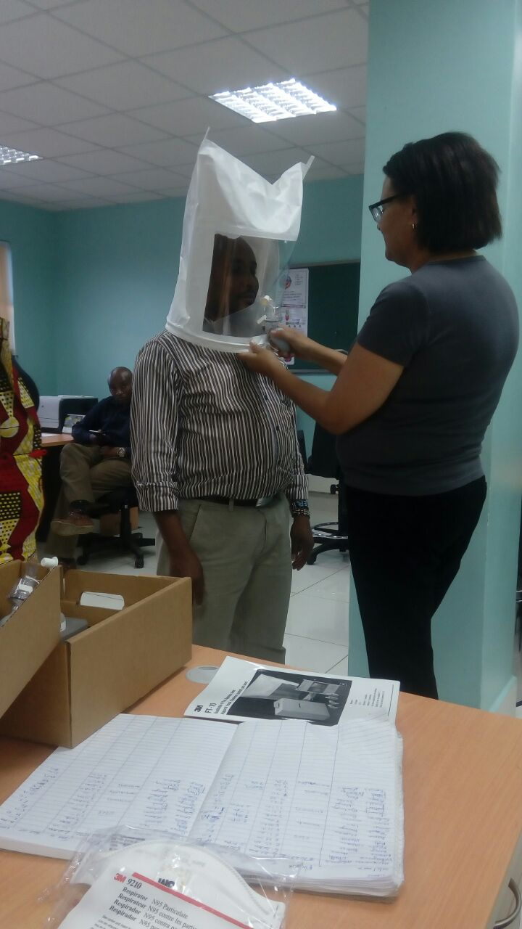
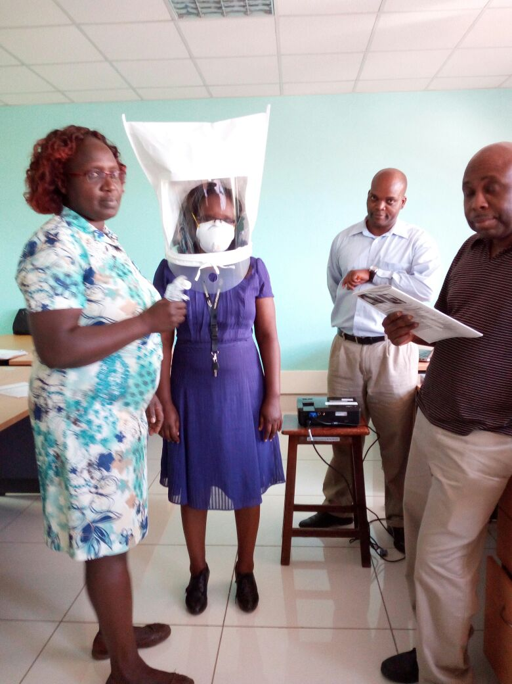
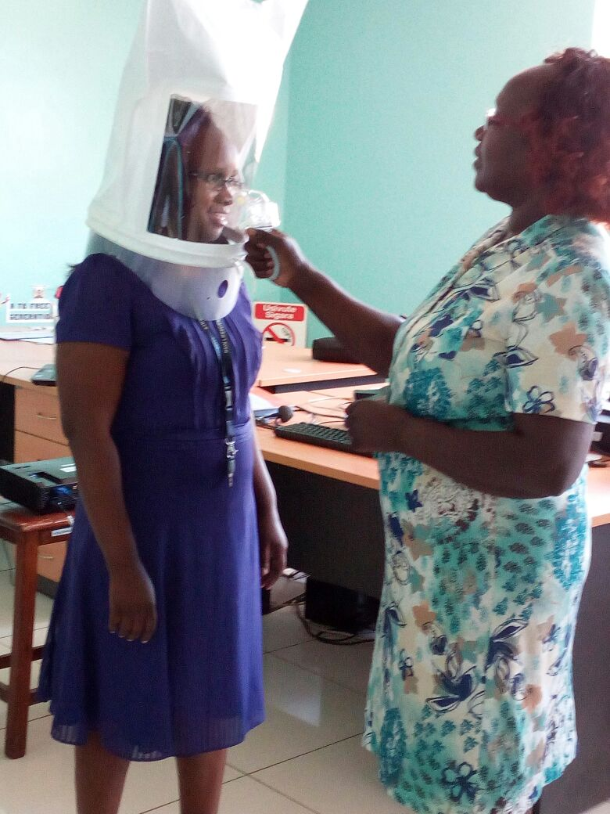
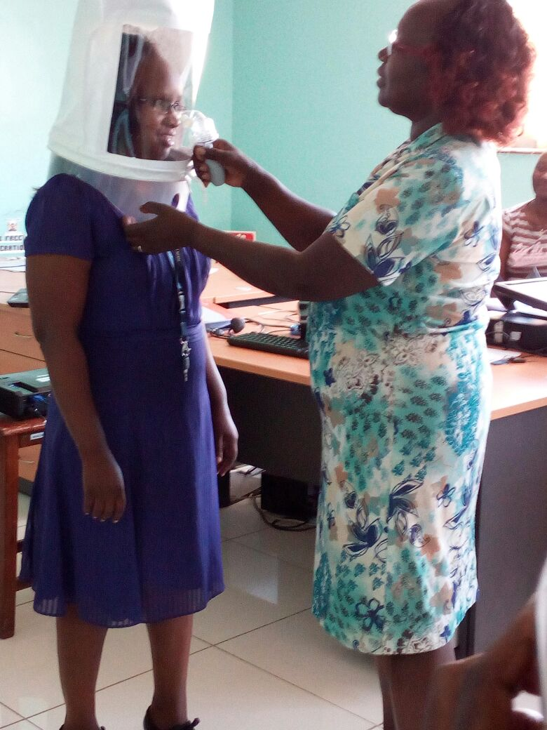
N95 Fit testing

Slide 16
CONCLUSION
National tuberculosis reference laboratoy recieves highly infectious samples
There were Infection Prevention Control gaps identified in leaking samples while on transit
Periphery facilities should be trained on good sample packaging prodedures
Provide powered air purification respirator (PAPR) to NTRL personnel who failed N95 fit test

Slide 17
Acknowledgments
MOH
NPHL
NTRL
PEPFAR-Through CDC
Global Fund
World Bank
University of Maryland

