Slide 1




Strengthening Health Care Waste Management (HCWM) systems in Kakamega County
7th INFECTION PREVENTION & CONTROL (IPC) SCIENTIFIC CONFERENCE
By
Fred Okuku, PATH

Slide 2
Outline
Background
HCWM situation
Interventions
Results
Challenges
Conclusions & Recommendations
Acknowledgement
APHIAplus Western Kenya | TOGETHER FOR BETTER HEALTH IN WESTERN KENYA

Slide 3
Background
The AIDS, Population and Health Integrated Assistance, (APHIAPlus) Zone 1 is a project funded by The US President’s Emergency Plan for AIDS Relief (PEPFAR) through the US Agency for International Development (USAID).
The project is implemented by PATH, currently in 3 counties in western Kenya- Kakamega, Vihiga and Busia

Slide 4
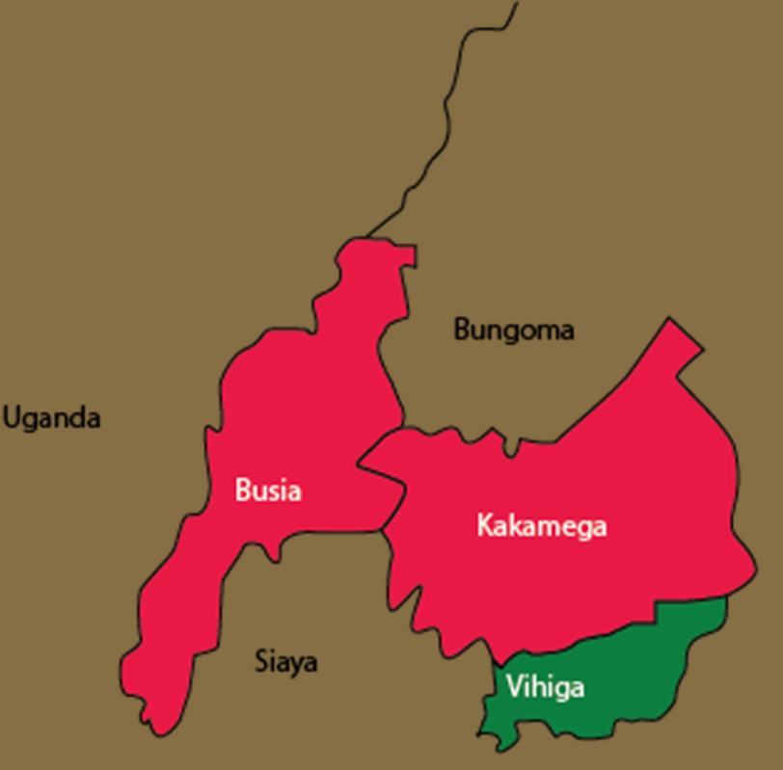
Background: Kakamega County
Population: 1940,149
Sub counties: 12
Health facilities: 292
APHIAplus Western Kenya | TOGETHER FOR BETTER HEALTH IN WESTERN KENYA

Slide 5
Background: Why?
Environmental mitigation, monitoring and reporting (EMMR) is compliance requirement by USAID
Do No Harm
Quality of health-care
  Clean care is safe care
The Kenya Constitution…
Every person has the right to a clean and healthy environment
(Article 42, Bill of Rights - Constitution of Kenya)
APHIAplus Western Kenya | TOGETHER FOR BETTER HEALTH IN WESTERN KENYA

Slide 6
Background: Why …
The WHO- contaminated syringes and needles contribute:
  21 million HBV infections (32 % of all new infections),
  2 million HCV infections (40 % of all new infections),
  260,000 HIV infections (5 % of all new infections).
APHIAplus Western Kenya | TOGETHER FOR BETTER HEALTH IN WESTERN KENYA

Slide 7
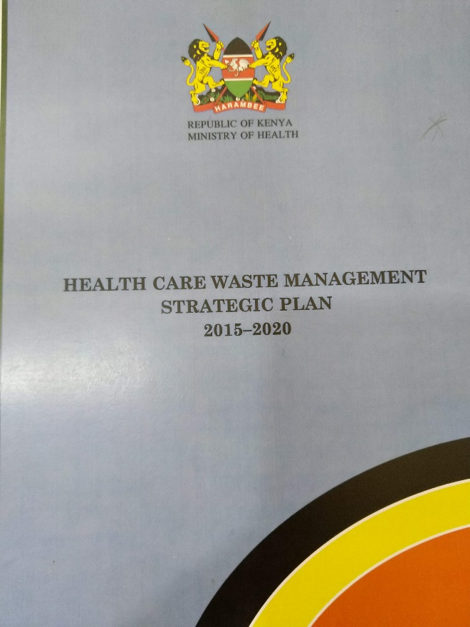
HCWM Situation
HCWM Strategic Plan 2015- 2020 -findings
  Overall HCWM score – 14 %
  Policies & procedure – 5.6%
  Management & oversight – 16.2%
  Logistics – 20%
APHIAplus Western Kenya | TOGETHER FOR BETTER HEALTH IN WESTERN KENYA

Slide 8
Interventions
  Broad Approaches
Integration of IPC & HCWM interventions
Implementation guided by national policies, standards & guidelines
Leveraging County – structures and HCWM infrastructure
APHIAplus Western Kenya | TOGETHER FOR BETTER HEALTH IN WESTERN KENYA

Slide 9
Interventions
Sensitization of CHMT, SCHMTs and health facility in-charges all 12 sub counties
Integrated facility HCWM and IPC action plans
Disseminated national IPC guidelines and HCWM guideline
Infrastructure improvement
HCWM commodities support
Support supervision, CME and mentorships
APHIAplus Western Kenya | TOGETHER FOR BETTER HEALTH IN WESTERN KENYA

Slide 10
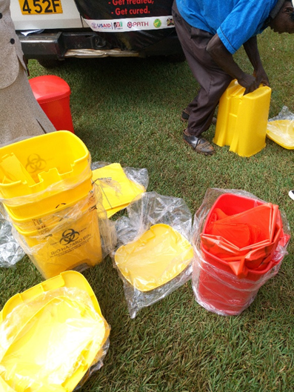
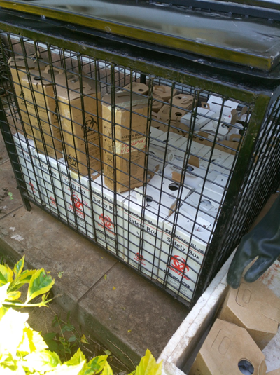
Interventions
Color coded bins: to enhance waste segregation as a best practice
“Caging sharps”
Storage for used sharps
APHIAplus Western Kenya | TOGETHER FOR BETTER HEALTH IN WESTERN KENYA
Notes:
Safety Box Cage: Innovation to provide secure storage for safety boxes pending transportation to disposal site
Low cost, fabricated using locally available material

Slide 11
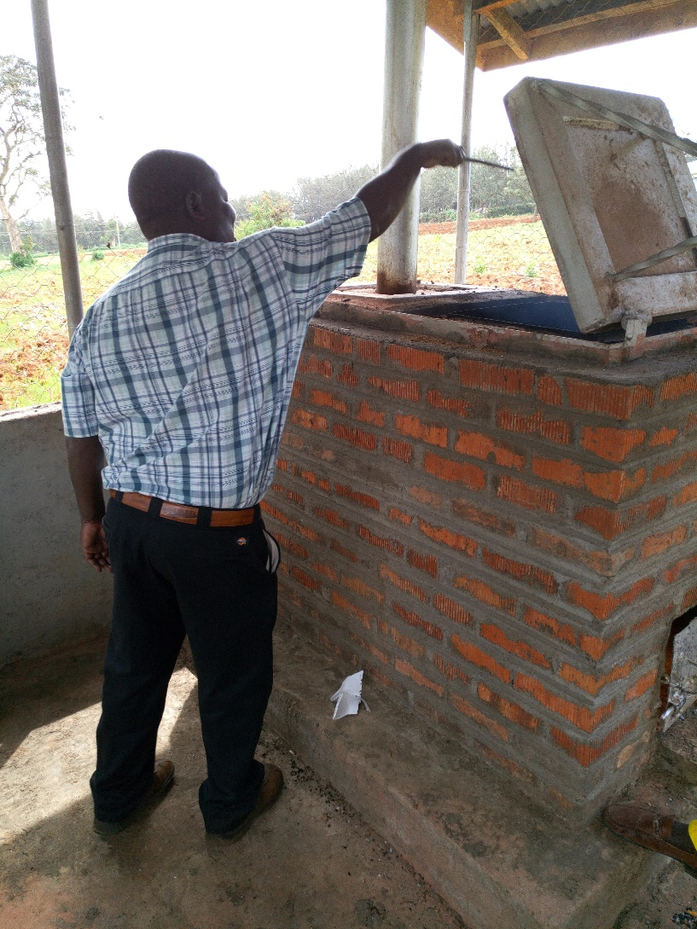
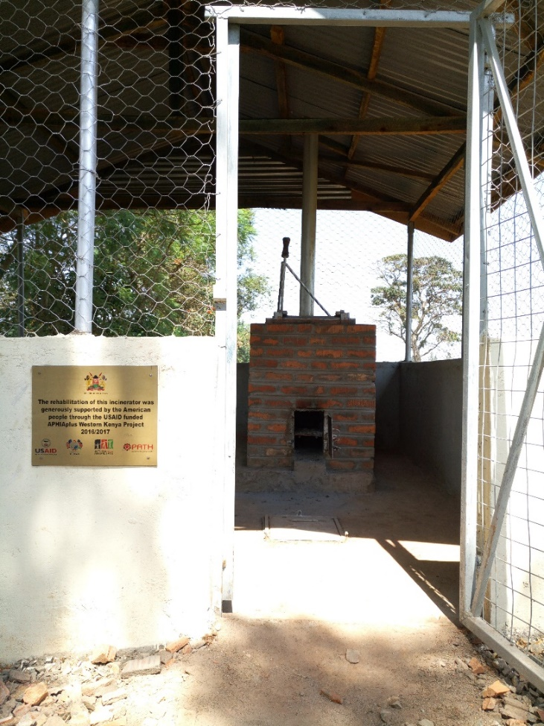
Waste treatment..Incineration
Secure and safer waste disposal in selected facilities

Slide 12
Results: Supervision data
Supervision was conducted by SCHMTs in 7 sub counties.
  Summary mean score by thematic area: a) Policy and governance b) Standard precautions c) Environmental management (CHART)
Used abridged national IPC supervision checklist and results summarized:
  Performance by each facility & ranking: <50% -red; 50-75%-yellow, 76-90%-green & 91+ dark green
  Summary mean score by sub county
  Score by thematic area
APHIAplus Western Kenya | TOGETHER FOR BETTER HEALTH IN WESTERN KENYA

Slide 13
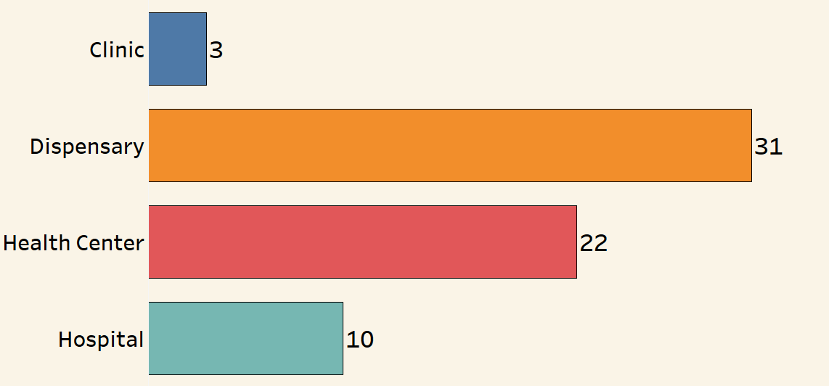
Results: Supervision data
66 HF in 7 sub counties assessed
APHIAplus Western Kenya | TOGETHER FOR BETTER HEALTH IN WESTERN KENYA

Slide 14
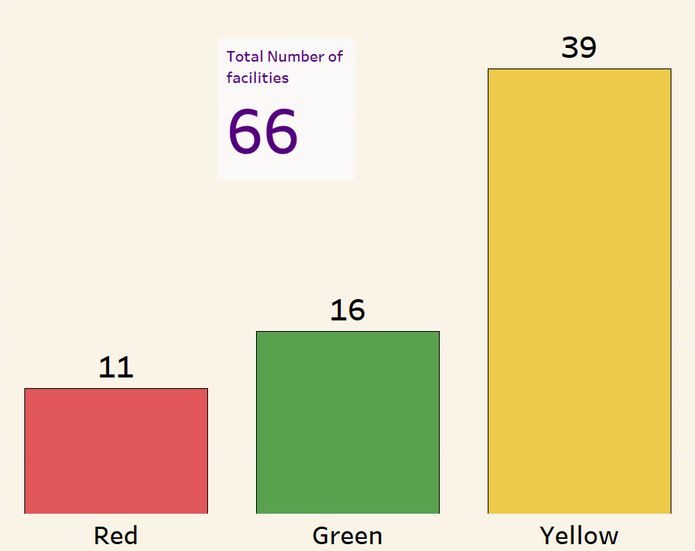
Overall Performance by Facility
Indicators assessed – 25
3 Thematic components
  Policy & Governance
  Standard Precautions
  Environmental Mgt

Slide 15
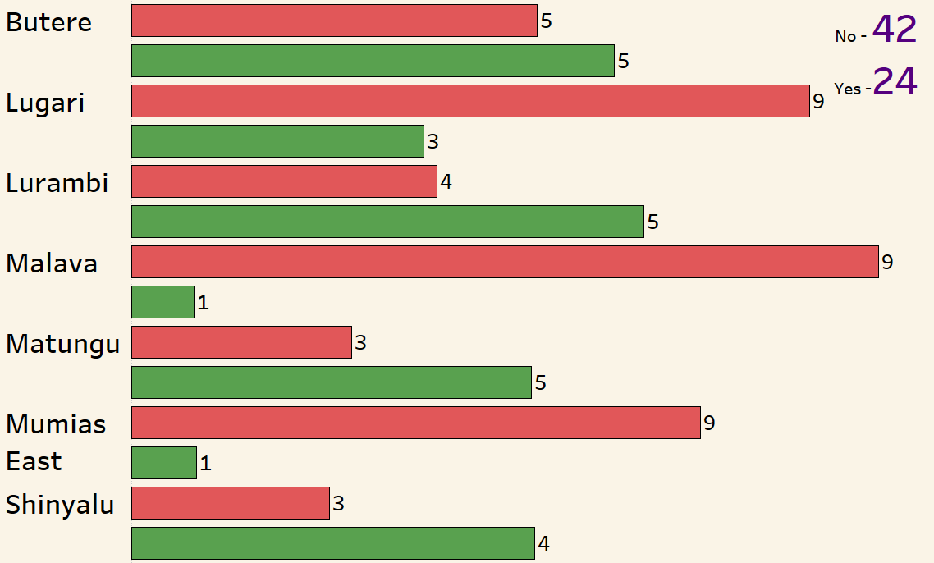
Results - Policy & Governance by sub county

Slide 16
Results -Standard precautions

Slide 17
Results: Environmental management
APHIAplus Western Kenya | TOGETHER FOR BETTER HEALTH IN WESTERN KENYA

Slide 18
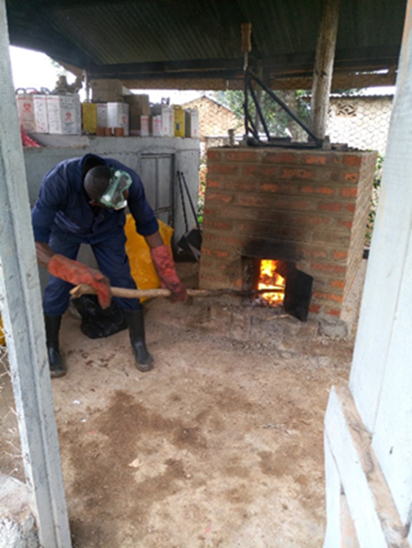
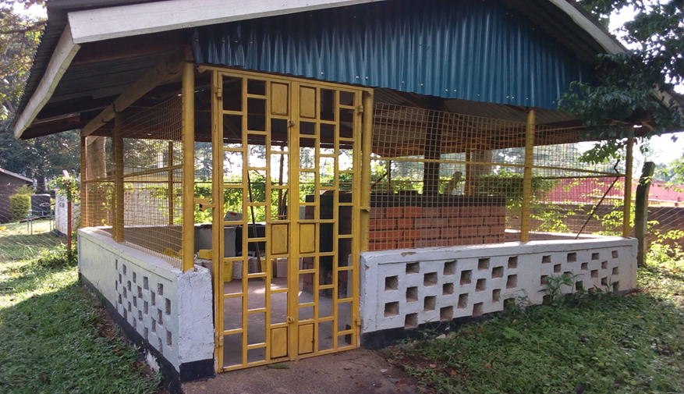
Results: Environmental management
Waste Pooling: Sub county hospitals used to incinerate sharps from peripheral
APHIAplus Western Kenya | TOGETHER FOR BETTER HEALTH IN WESTERN KENYA

Slide 19
Challenges
Inadequate and broken down waste treatment and disposal equipment
Very little investment in the HCWM value chain
Waste generators lack capacity on safe handling and disposal of hazardous waste
Lack of correct and dedicated transport vehicles to support waste networking
APHIAplus Western Kenya | TOGETHER FOR BETTER HEALTH IN WESTERN KENYA

Slide 20
Conclusion& Recommendations
Kakamega County has a framework for HCWM in most health facilities
However, a more investment by stakeholders is required to develop a robust HCWM system in the entire county.
Health care waste management is a shared responsibility and requires partnerships with public and private sector
Integration of HCWM into all health programs at all level of health care delivery.
APHIAplus Western Kenya | TOGETHER FOR BETTER HEALTH IN WESTERN KENYA

Slide 21
Acknowledgements
Kakamega county: Department of health, CHMTs & SCHMts and health facilities
USAID and PEPFAR for the funding
PATH – APHIAPLUS project
IPNET-Kenya
APHIAplus Western Kenya | TOGETHER FOR BETTER HEALTH IN WESTERN KENYA

Slide 22
Disclaimer
This presentation was made possible by the generous contribution of the American People through the US Agency for International Development (USAID).
The views expressed in this presentation do not necessarily reflect the views of the USAID or the United States Government.
APHIAplus Western Kenya | TOGETHER FOR BETTER HEALTH IN WESTERN KENYA

