Slide 1


7th INFECTION PREVENTION AND CONTROL SCIENTIFIC CONFERENCE
27TH – 30TH NOVEMBER 2018
GREEN HILLS HOTEL, NYERI
Strengthening Biosafety and Biosecurity Awareness in Kenya and Beyond
Patrick Okanya
Secretary General, Biorisk Management Association of Kenya (BMAK)
Lecturer, The Technical University of Kenya

Slide 2
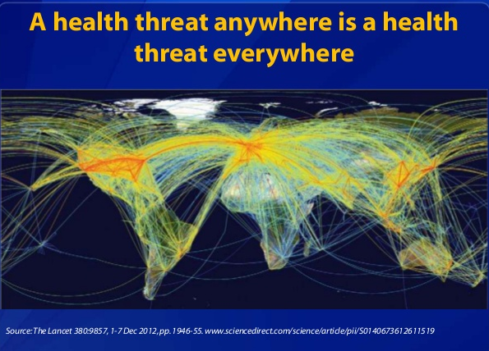
Outline

Slide 3

What is BMAK?
BMAK is a non-profit professional association aimed at bringing together professionals involved in the fields of biosafety and biosecurity in Kenya
BMAK is a member state of the International Federation of Biosafety Associations (IFBA) – (44 members)

Slide 4

BMAK OBJECTIVES
To enhance the knowledge and understanding of biosafety and biosecurity issues in Kenya
To advocate for the implementation of sound biorisk management practices
To encourage local, regional and international dialogue on biological risk management

Slide 5


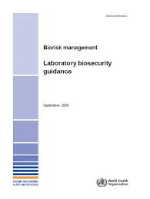
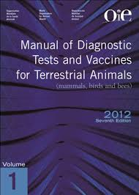
Biorisk Management
Emphasis on good laboratory practice as provided for in the Kenya Laboratory Biosafety & Biosecurity Policy Guidelines , WHO Laboratory Biosafety Manual ,WHO Laboratory Biosecurity Guidance, Biosafety manuals for animal health etc

Slide 6


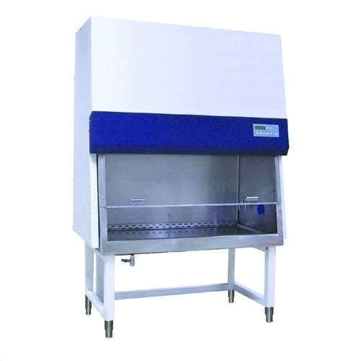
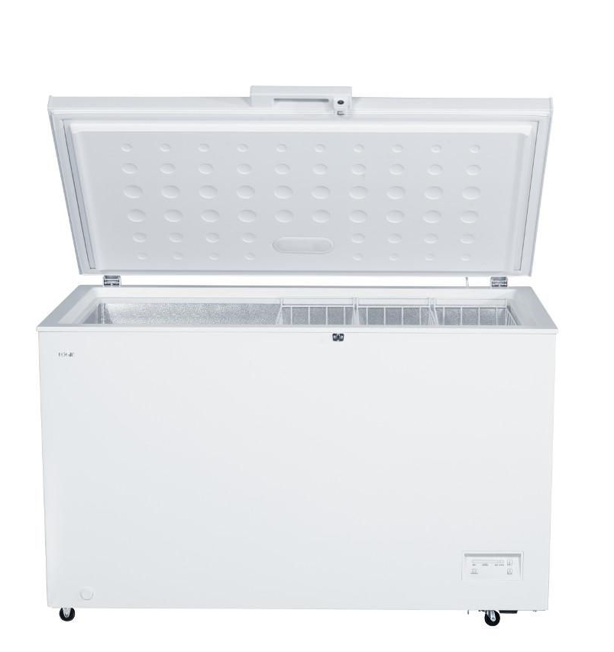

Biosafety and Biosecurity Gaps
Biological material Inventory

Slide 7
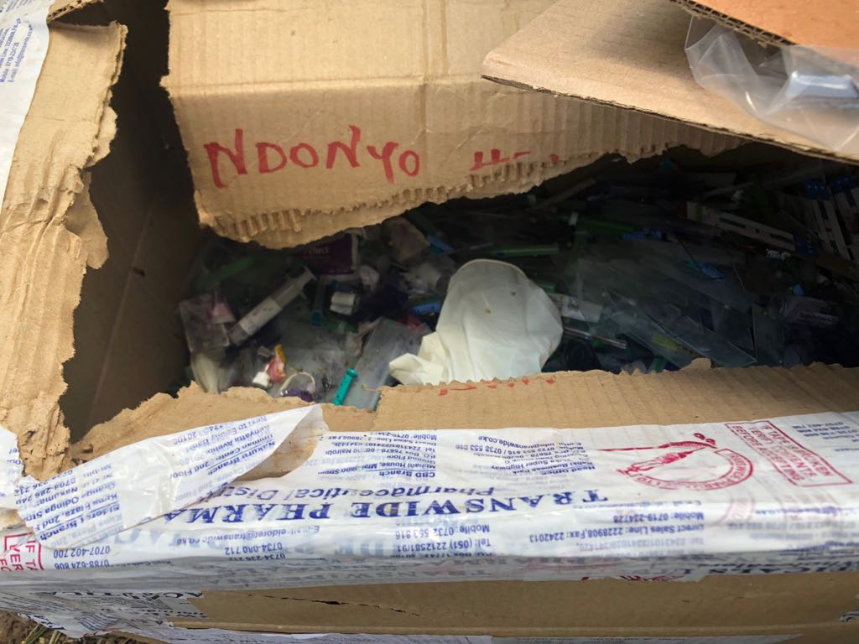
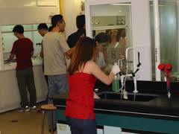
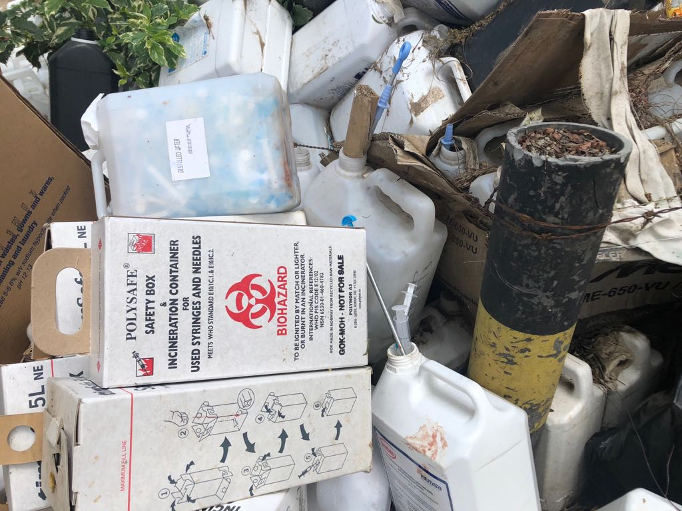

Knowledge, Attitude and Practice Gaps

Slide 8
BMAK’s Achievements
BMAK members have actively been involved in:
Conducting training for biosafety and good microbiology laboratory Practices in private and public institutions in Kenya
Participating in National and International Conferences with themes on biosafety and biosecurity
Stakeholder participation in curricula development/review in biosafety and biosecurity
Coordinating Regional Biorisk workshops and IFBA Professional examination certification -

Slide 9
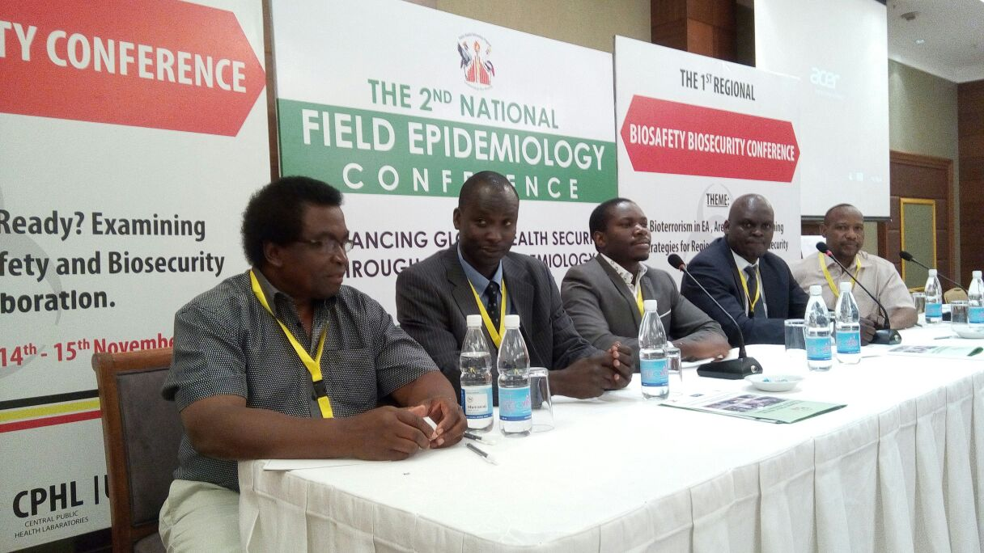
Regional Biosafety Biosecurity Conference, Kampala
BMAK Delegates representation in the conference held on 14th -15th November 2016, Uganda.
Theme:
Bioterrorism in EA
Are We ready? Examining
Strategies for Regional
Biosafety and Biosecurity
Multi Sectoral Collaboration

Slide 10

BMAK’s Achievement - Continued
Recipient of funds from the Global Affairs Canada - 2017/2018 through IFBA
  Developed a biosafety and biosecurity strategic plan
  Coordinated trainings for IFBA exam certifications in Biorisk management and Biosecurity – 54 participants
  Participating countries – Kenya, Uganda, Tanzania, South Sudan, Rwanda, Ethiopia

Slide 11
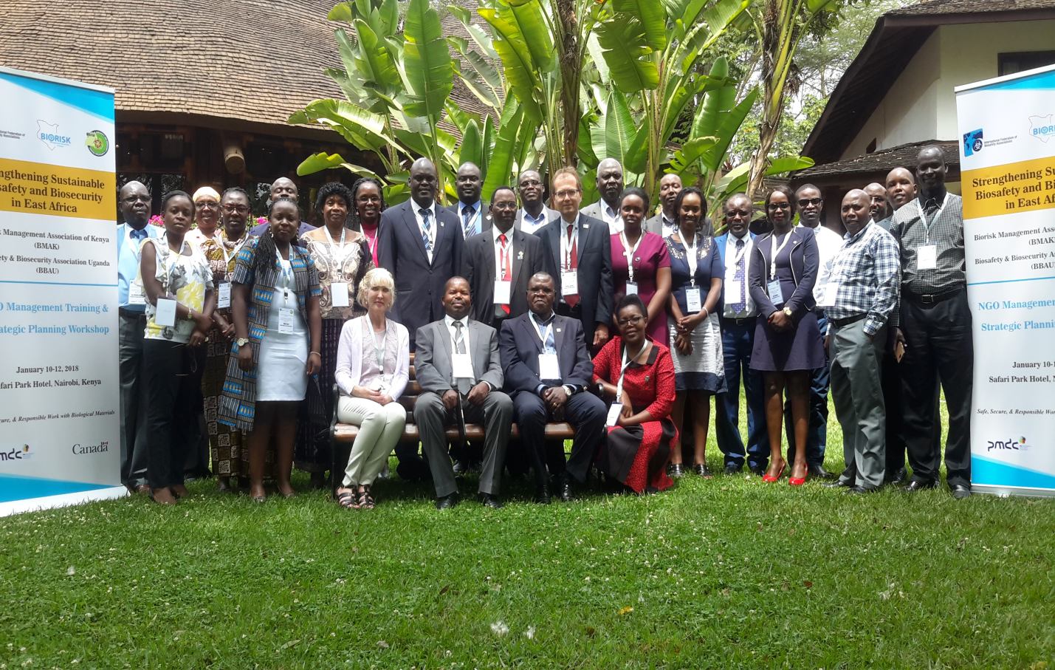
Stakeholders meeting for Sustainable Biosafety and Biosecurity in East Africa Region- Safari Park Hotel, Jan 2018
BMAK
BBAU
MOH
IFBA
CDC K & Uganda
DTRA
Representatives from African Union, South Sudan and Rwanda

Slide 12
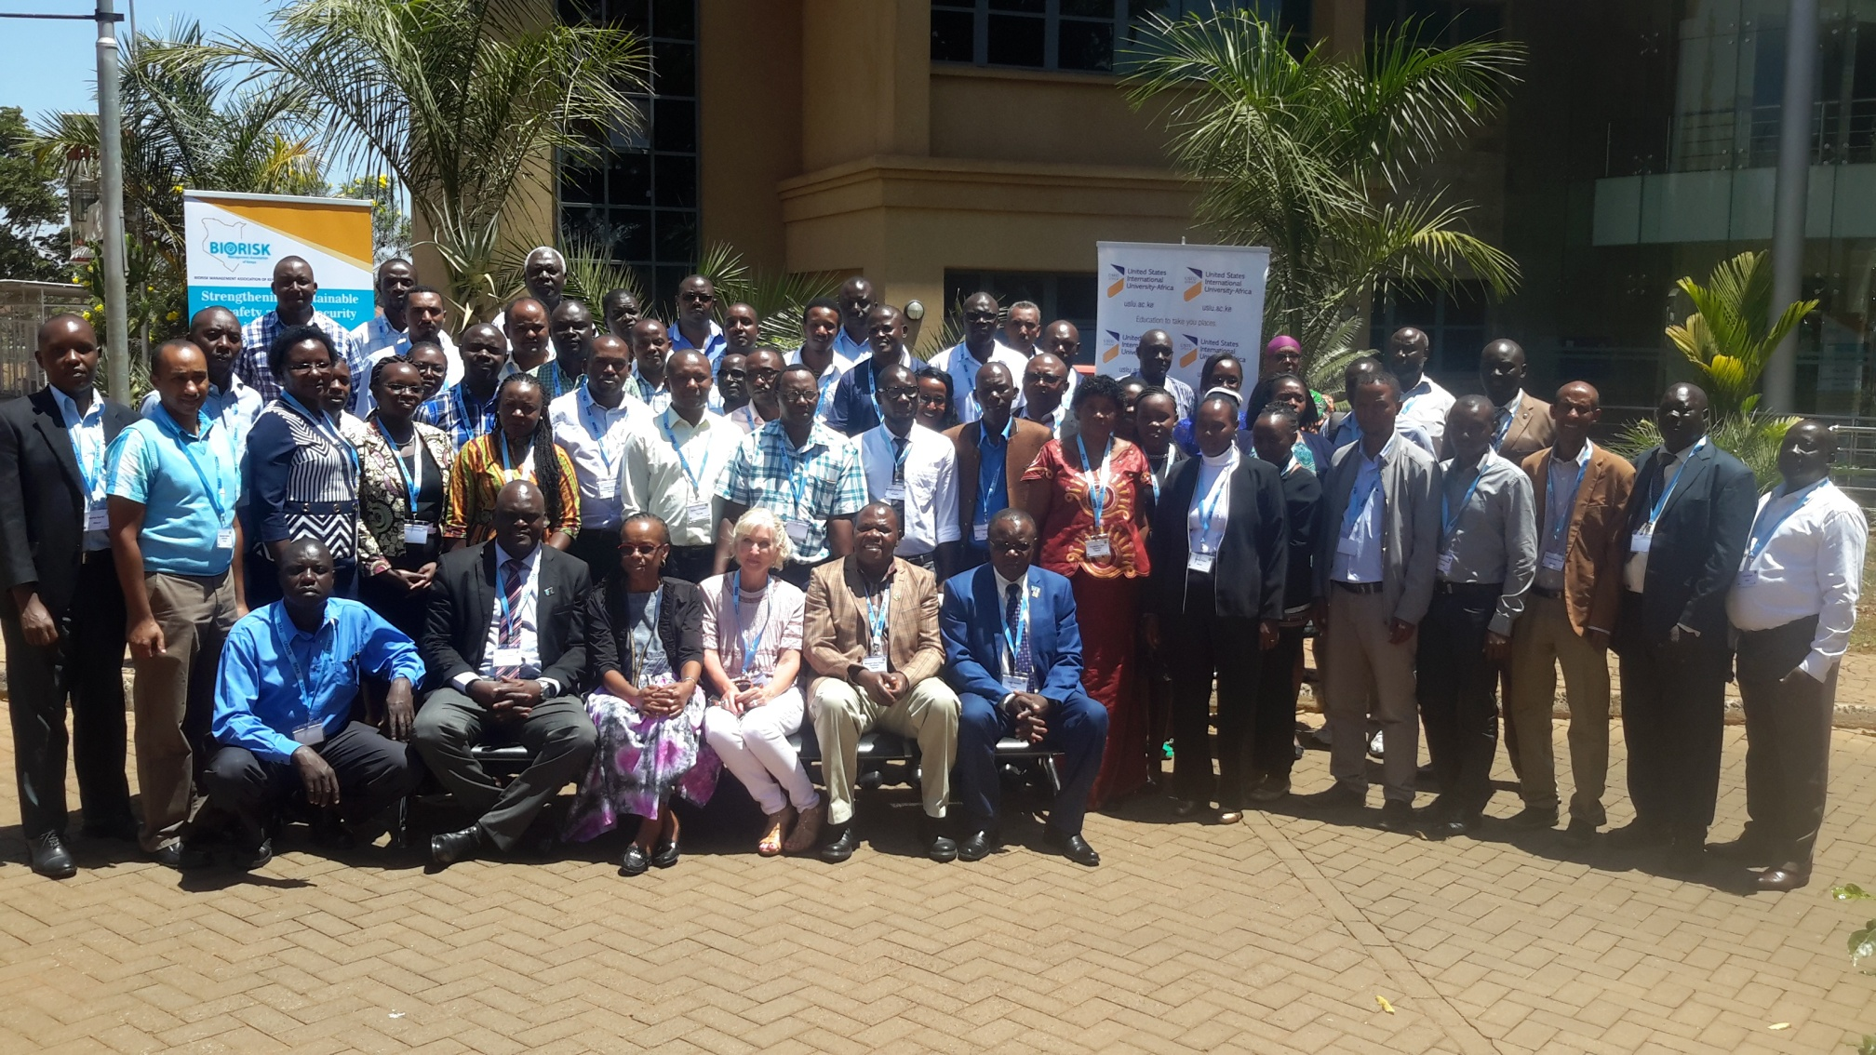
Regional Participants in a Biorisk Workshop Feb 2018

Slide 13
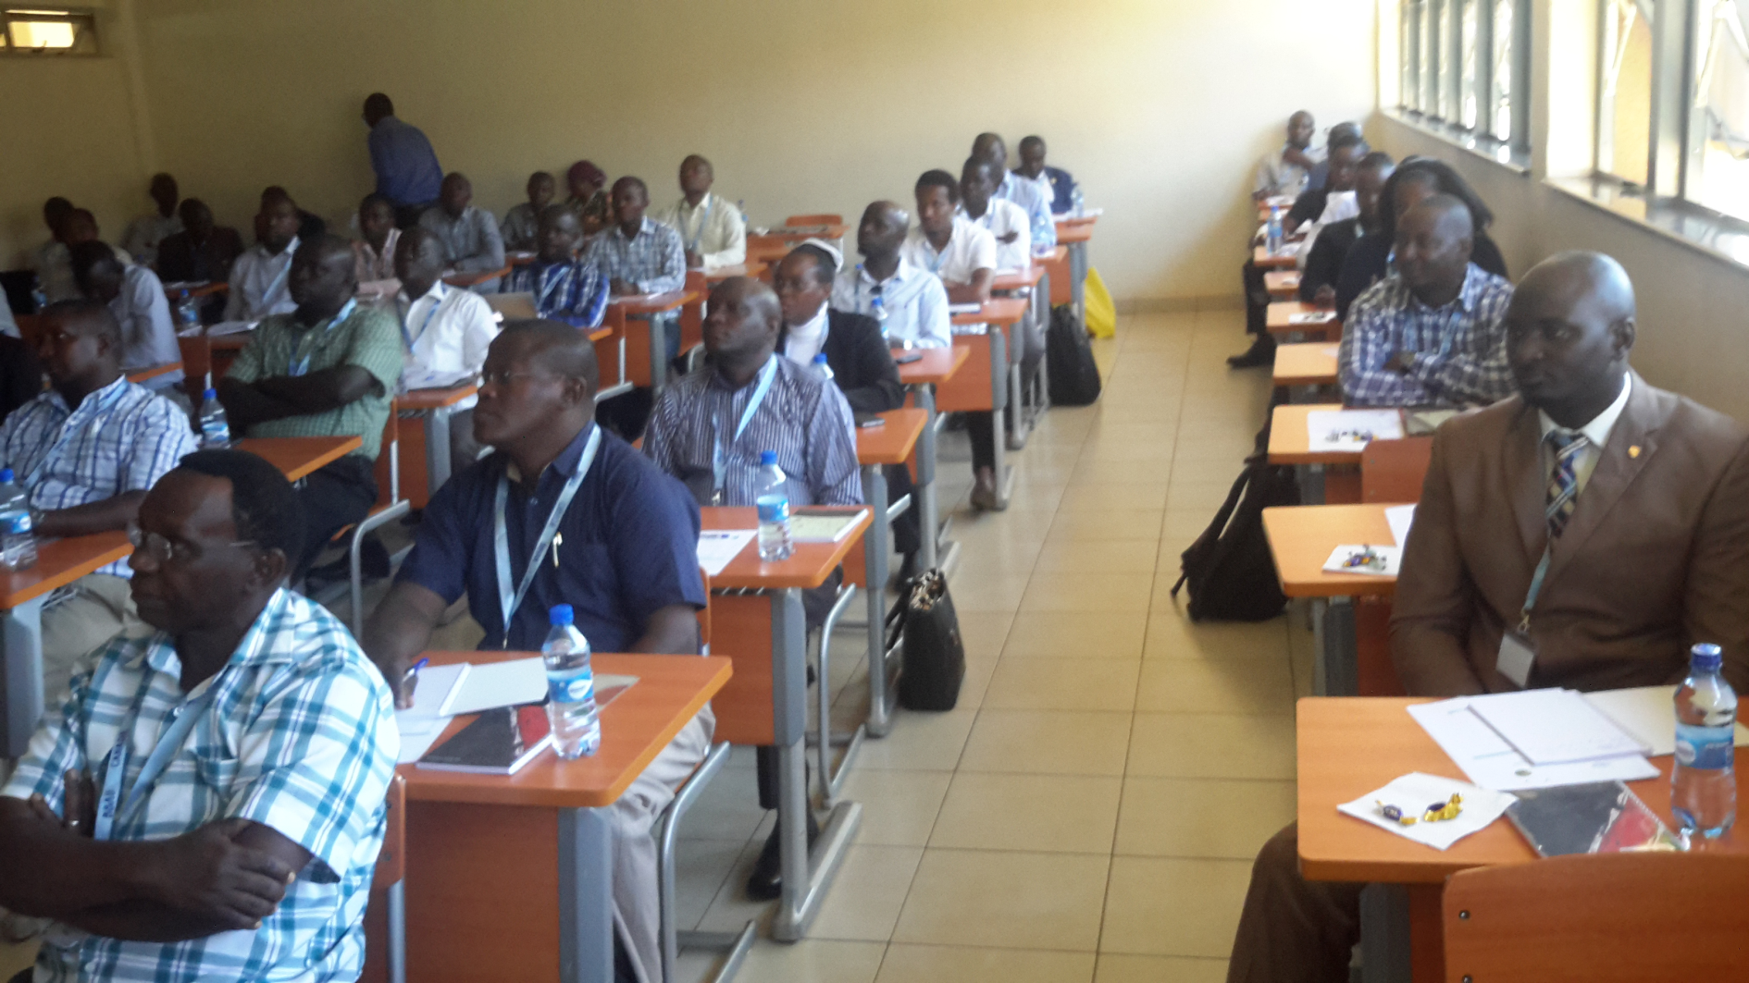
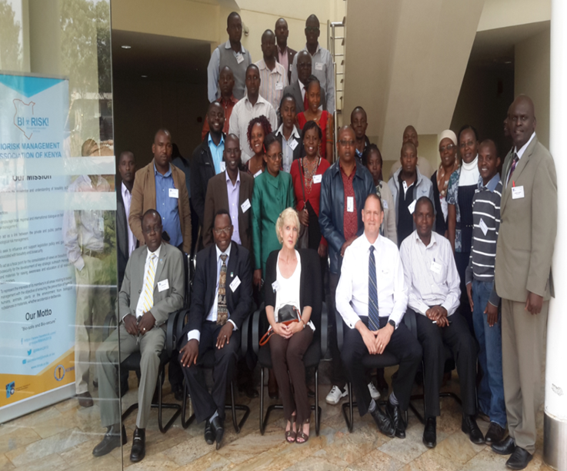
EA Regional Workshop and IFBA Competence Exams USIU- Africa, 28th Feb 2018

Slide 14
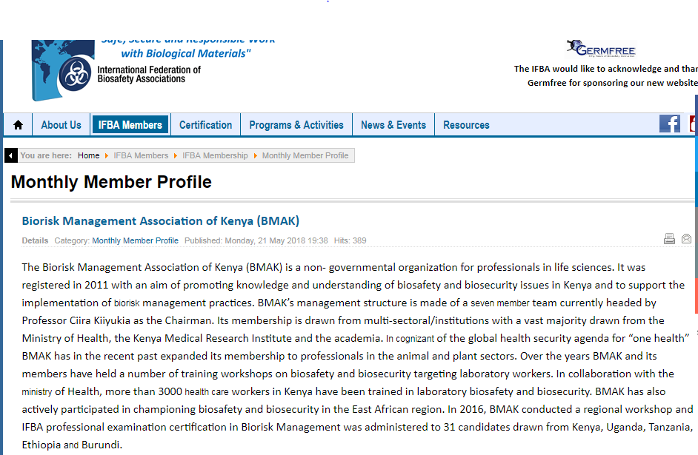
BMAK – June 2018 Monthly Profile on IFBA Website

Slide 15

BMAK AT IFBLS 33rd World Congress -22-26th Sept 2018
Strengthening Global Biosafety Session
IFBLS 2018
FLORENCE ITALY

Slide 16
Professional IFBA Exams Co-ordinated by BMAK
Professional Certification (PC) in “ Biorisk Management”
Professional Certification (PC) in “Biosecurity”
Professional Certification (PC) in “Biocontainment Facility Design, Operations & Maintenance”
Professional Certification (PC) in “Biosafety Cabinet Selection, Installation & Safe Use”

Slide 17
Way Forward
Increase biosafety and biosecurity awareness through trainings and workshops to both private and public sectors
Advocate for the legislation of biosafety and biosecurity bill
Continuous discussion of biorisk issues with all the key stakeholders – multi-sectoral collaboration

Slide 18
Joining BMAK
Students to professionals from public health, veterinary, agriculture, academia, emergency response agencies, pharmaceutical/biotech industries and government stakeholders involved in policy making
Individual annual subscription fee is Ksh. 5000/- and Kshs. 1000 for students.
Corporate membership from Kshs. 50,000/-

Slide 19
Summary
There is need to protect employees, the community and the environment from risks associated with biological agents handled in the laboratory and the greater health care setting

Slide 20

ACKNOWLEDGEMENT

