Slide 1
Role of Laboratory in AMS:
Quality Samples for Quality Testing
Abubakar Abdillah
Clinical Pathology
Aga Khan University Hospital Nairobi
IPNET
27.11.2018

Slide 2
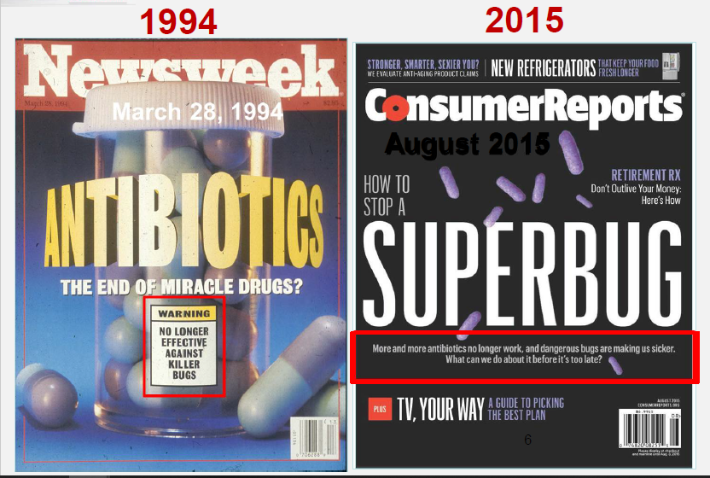

Slide 3
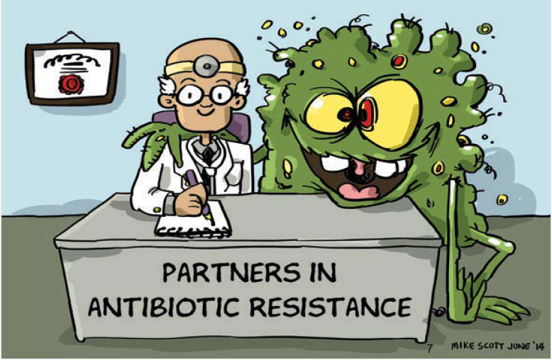

Slide 4
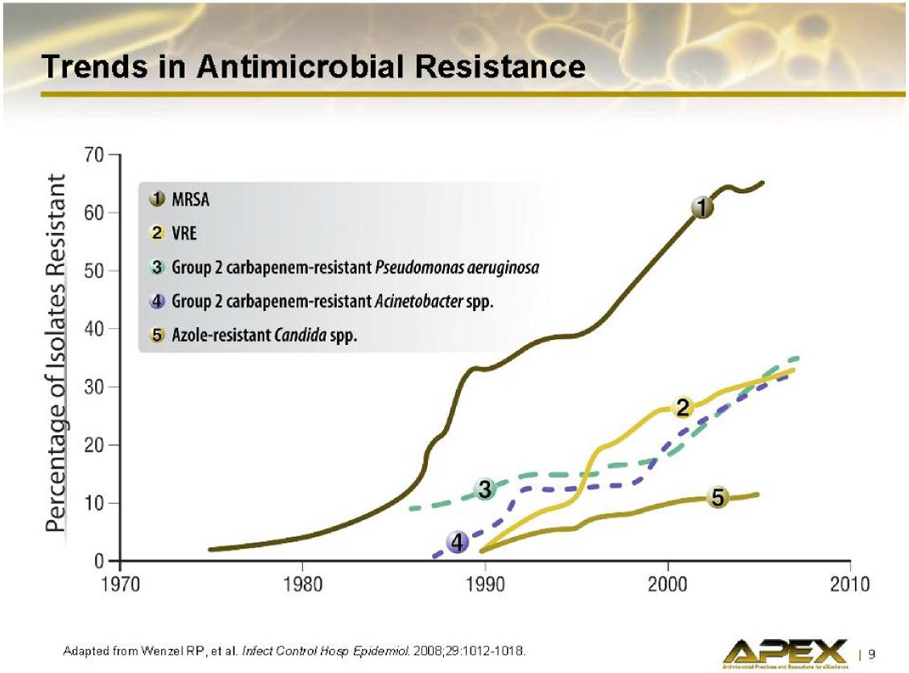

Slide 5
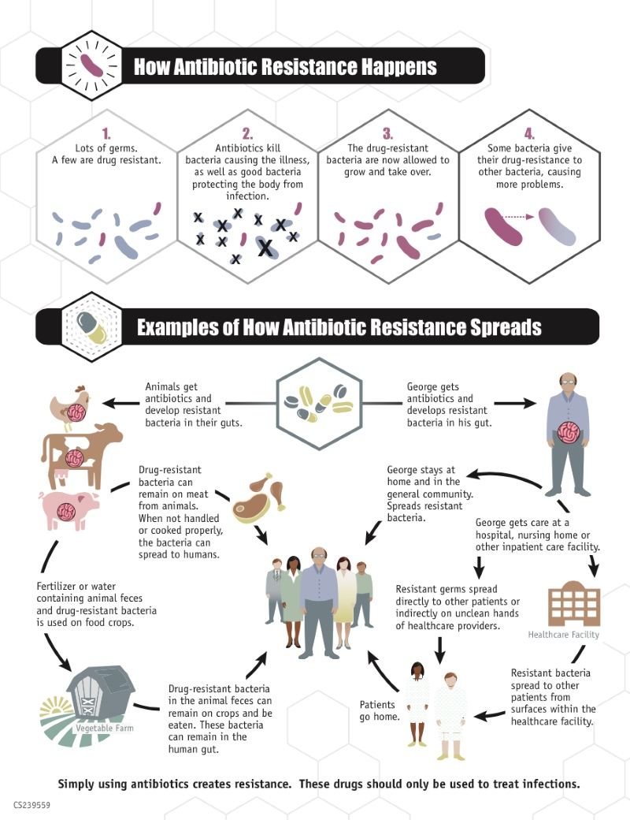
Notes:
Antibiotics are misused across the continuum of care Studies indicate that up to 50% of antibiotic use is either unnecessary or inappropriate across all type of health care settings 1
•Use of antibiotics in animals-~80% of antibiotics sold in US are used in animals primarily to promote growth and prevent infection 2 Molecular methods have confirmed that resistant bacteria in animals are consumed by humans resulting in infection
Up to 90% of antibiotics used in animals are excreted in urine and stools and can disperse in fertilizer, groundwater, and surface runoff
•Antibiotic misuse adversely impacts patients and society ↑Antimicrobial resistance(AR) and C difficile infections

Slide 6
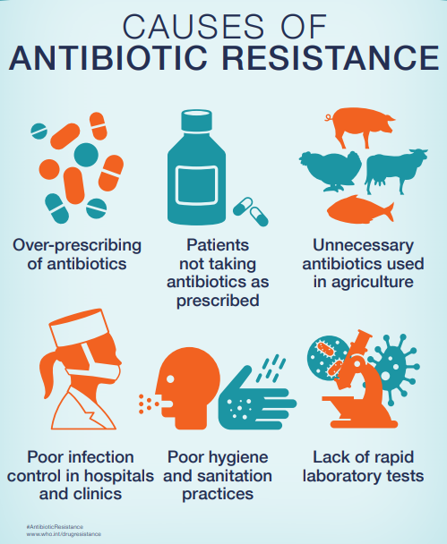
Notes:
Emergence of antimicrobial resistance
confer resistance to most or all available antimicrobials
Return of serious untreatable infections
Much of this is attributable to suboptimal—usually excessive—use of antimicrobials in and out of hospital settings,
estimated to occur in 30 to 50% of all prescriptions

Slide 7
Suboptimal antimicrobial usage often stems from
  inappropriate interpretation or use of microbiological test results
  lack of a microbiologically confirmed diagnosis,
  laboratory test errors,
  failure to submit appropriate specimens for culture,
  misuse of microbiology resources, and
  a general overreliance on empirical antimicrobial therapy with attendant disregard of microbiological results.

Slide 8


Slide 9
AMS
A bundle of interventions to promote and ensure the optimal use of antimicrobial treatment “that results in the best clinical outcome for the treatment or prevention of infection, with minimal toxicity to the patient and minimal impact on subsequent resistance”
Antimicrobial stewardship programs (ASPs) aid physicians in
  providing optimal antimicrobial therapy to their patients,
  prescribing the right antimicrobial regimen to the right patient for the right period of time
  avoiding unnecessary antimicrobial use.
Notes:
Ultimately, ASPs aim to
improve patient outcomes
limit adverse drug events and antimicrobial resistance.
Save resources and money.

Slide 10
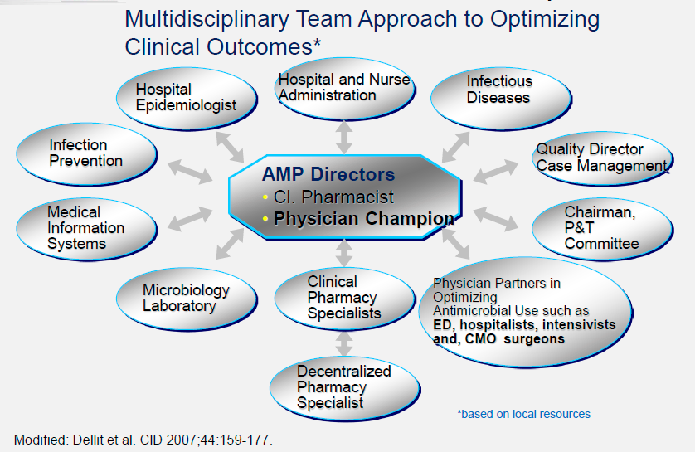
AMS TEAM

Slide 11
Microbiology laboratories
Laboratory vital to patient care and the success of ASPs.
Reports provide the primary basis for determining the incidence of antimicrobial-resistant infections
  longitudinal assessments of the problem's severity
Determining the prevalence of resistance among clinical isolates of common bacterial species
  informs empirical antimicrobial therapy strategies
Notes:
Microbiology laboratories and the physicians or scientists who lead them must avoid a potentially paradoxical role in this dynamic.

Slide 12
Effective antimicrobial stewardship is closely linked with the ability to make correct diagnoses.
  Many types of viral respiratory infections, for example, are clinically indistinguishable from bacterial respiratory infections.
  And fungal infections, such as pulmonary aspergillosis or Candida-associated sepsis, can mimic the clinical presentation of bacterial infections.
Incorrect diagnoses can lead
  to overuse or misuse of antibiotics, particularly the critical broad-spectrum antibiotics
  to poor outcomes for patients resulting from failure to treat the actual disease present.

Slide 13
Diagnostic Stewardship
“coordinated guidance and interventions to improve appropriate use of microbiological diagnostics to guide therapeutic decisions. It should promote appropriate, timely diagnostic testing, including specimen collection, and pathogen identification and accurate, timely reporting of results to guide patient treatment” (WHO 2016).
It is aimed at
  reducing false-positive testing results, which can lead to overuse of antibiotics, and
  enhancing the detection of true-positive cases of infection for appropriate treatment.
Notes:
As part of a broader antibiotic stewardship program, diagnostic stewardship is aimed at
reducing false-positive testing results, which can lead to overuse of antibiotics, and
enhancing the detection of true-positive cases of infection for appropriate treatment.

Slide 14
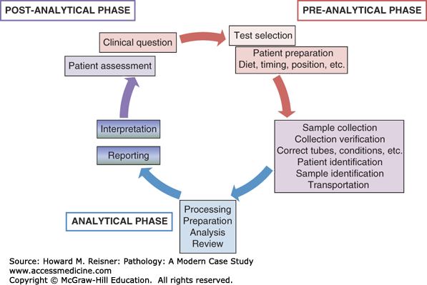
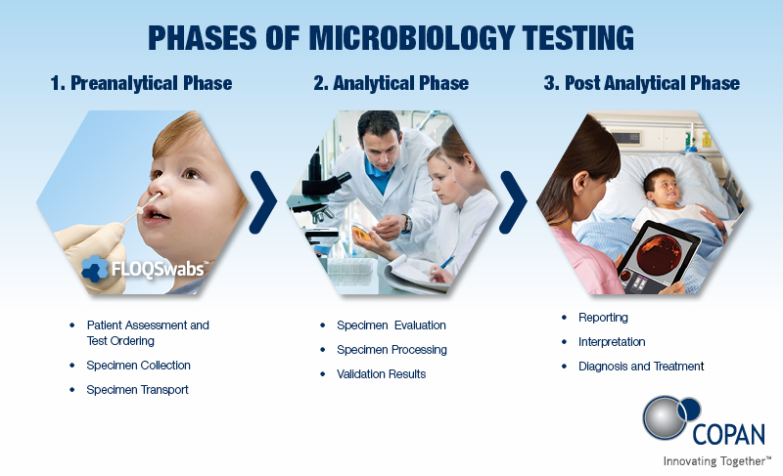

Slide 15
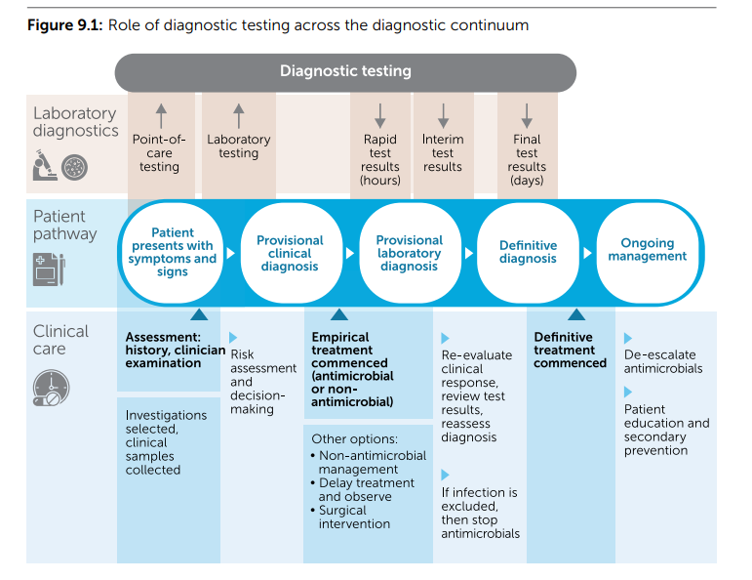
Notes:
diagnosis and management are dynamic processes that are complemented by an understanding of the time course of the disease and testing.7
When there is a strong clinical indication to start treatment early, empirical treatment is started based on a provisional diagnosis and immediately after collecting appropriate specimens.
Treatment is later modified depending on the patient’s progress and the results of investigations.
This can occur, for example, in patients with suspected sepsis who may not necessarily present as being acutely unwell but need urgent management.6
If the clinical problem is subacute or chronic, treatment can be deferred until after a microbiological diagnosis has been established, although it is usually not.
This is especially important for conditions that may require prolonged therapy, such as chronic osteomyelitis, septic arthritis or infected prosthetic material.

Slide 16
Guidance in the Pre-analytic Phase
Support practices that ensure that the right tests are performed on appropriately collected clinical samples.
Help to ensure that communication with, and delivery to, the laboratory is optimised to influence clinical care.
This role also includes efforts to avoid testing when it is not clinically appropriate.
Notes:
Interpreting microbiology test results
Being able to make the right diagnosis is usually a prerequisite to providing effective therapy.
Recommendations for drug choice, dosing, or duration may be useless if the diagnosis is wrong.
Selecting the appropriate test or culture according to the patient's syndrome,
Obtaining optimal collection of clinical specimens, and

Slide 17
Choice of Tests
Culture-based tests are the principal investigations used to diagnose and guide treatment for most bacterial infections that are treated with antimicrobials.
Non-culture-based tests using molecular and immunology methods make up the remaining suite of microbiology tests used in clinical care

Slide 18
Irrespective of the test method, if samples were optimally collected and transported;
A positive microbiology diagnostic test is used to
  confirm a provisional clinical diagnosis,
  and the antimicrobial susceptibility results guide targeted antimicrobial management.
Negative tests,
  may suggest that a diagnosis can be excluded
  and provide evidence that antimicrobial therapy is not indicated.

Slide 19
Biomarkers
Tests for acute-phase reactants (for example, C-reactive protein and procalcitonin) may be used in a complementary role.
They can indicate the possibility of an infectious aetiology in acute clinical syndromes.
It should be appreciated that these tests are non-specific, and their value is limited in guiding decision-making.
Despite widespread use, the published evidence for their effectiveness has been limited to a range of specific scenarios.
  They have been demonstrated to be useful in suggesting a bacterial aetiology in adults with acute respiratory disease presenting to emergency departments
Notes:
They can indicate the possibility of an infectious aetiology in acute clinical syndromes before microbiological results are available or when culture-based tests are not feasible.

Slide 20
Quest to find a highly sensitive and specific and readily available and interpretable ID biomarker has spanned decades
Accurate biomarkers could be a boon to antimicrobial stewardship programs by
  providing more accurate infection diagnosis,
  suggesting the class of infectious agent (bacterial, fungal, viral, etc.),
  monitoring clinical responses, and
  guiding the duration of treatment
For now, In essence, tests for acute-phase reactants should be used sparingly and interpreted with caution when managing infectious diseases

Slide 21
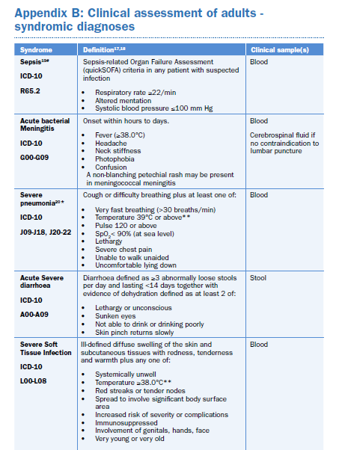
Optimal selection of diagnostic microbiology tests is critical to providing reliable guidance to clinicians who are managing patients with possible infection.
The type of test selected depends on the timing of presentation and the type of organisms suspected to be causing the infection.
The decision to order a diagnostic test should be based on the pre-test probability of suspected infection, taking into consideration that potential pathogens may be present as part of the normal flora.
Syndrome-specific diagnostic algorithms and integrated clinical pathways may be useful for guiding test selection

Slide 22
Specimen Collection And Transport
Optimal specimen collection and transport are critical elements of the testing process
Samples from non-sterile sites such as wounds and sputum are easily contaminated during collection.
  It is important that efforts are made during the collection process to increase the chance that test results reflect the organisms that are present at the site of infection.
Collection of the sample after antimicrobial therapy has started may lead to false negative culture results.

Slide 23
Test results may also be adversely affected by
  suboptimal specimen labelling,
  an inadequate volume of material provided,
  incorrect specimen containers, and
  delays between specimen collection and performing the test

Slide 24
The following general principles apply to optimal sample collection and transport:
Set up best-practice systems for sample collection to avoid contamination and maximise diagnostic accuracy - SOPs
Follow clinical guidelines on microbiology specimen collection that incorporate laboratory requirements, and are current and readily accessible - SOPs
Collect clinical samples for culture before antibiotics are commenced, whenever possible
Provide consumer guides for self-collected samples
Label clinical samples correctly and include relevant clinical information in the request order
Minimise transport time to the laboratory; especially when testing is performed at a distant location.

Slide 25
Sputum
May be obtained at any time during the clinical course, but ideally prior to initiation of antimicrobial therapy
Prior to collection, label the specimen container with the appropriate identifying label; including patient ID, visit, and date and time of collection.
Educate the patient about the difference between sputum and oral secretions.
Notes:
Inform the patient that saliva and upper respiratory/nasal secretions are not sputum and are not acceptable specimens.

Slide 26
Breathe deeply a number of times and then cough from deep down within the lungs.
Lean forward, breathe in and out slowly twice, hold breath for 2-3 seconds each time, and on third time forcefully cough to bring up the sputum.
Collect the sputum in the sterile container provided and avoid touching the inside or edge of the specimen container or lid with their fingers.
A minimum volume of 1 mL of sputum must be collected.
Notes:
however, the target volumes for time intervals (e.g. 5 mL sputum at TB screening, baseline, and at all other visits through week 4; 3 mL at all subsequent visits thereafter) should be collected if possible

Slide 27
Sputum specimens must be delivered to the laboratory as soon as possible and within 24 h of collection;
  however, delays up to 3 days in transport from clinic to laboratory may be allowable
If the transport distance is long, the sample is chilled in TB in estigation, this limits overgrowth of normal flora
  Refrigeration will kill Strep. Pnuemoniae, Influenza; deliver to lab within 1-2 hrs for best results
  Room temperature storage for up to 24hrs.
In suspected cases of TB,3 samples should be taken preferably on waking.
Notes:
The request form should be marked “acid – fast bacilli (AFB) and a Danger of infection label affixed to form and container

Slide 28
Oropharyngeal (OP) and Nasopharyngeal (NP) Swabs
Optimal timing:
Specimens should be collected within 3 days of symptom onset and no later than 7 days from all patients meeting the case definition
Ideally prior to the initiation of antimicrobial chemoprophylaxis or therapy.
Swab types.
Use only sterile cotton, dacron or rayon swabs with plastic shafts or if available, flocked swabs.
DO NOT use calcium alginate swabs or swabs with wooden sticks, as they may contain substances that inactivate some viruses and inhibit some molecular assays.

Slide 29
Collecting the OP swab.
Insert swab into the posterior pharynx and tonsillar areas.
Rub swab over both tonsillar pillars and posterior oropharynx
Avoid touching the tongue, teeth, and gums.
Collecting the NP swab.
Insert flexible wire shaft swab through the nares parallel to the palate (not upwards) until resistance is encountered or the distance is equivalent to that from the ear to the nostril of the patient.
Gently, rub and roll the swab.
Leave the swab in place for several seconds to absorb secretions before removing.
Notes:
indicating contact with the nasopharnyx

Slide 30
Place NP and OP swabs immediately into a sterile vial containing 2 ml of viral transport media without antibiotics.
Notes:
If specimens will be examined within 48 hours after collection, keep specimen at 4ºC and ship on wet ice or refrigerant gel-packs, otherwise store frozen at ≤-70ºC and ship on dry ice

Slide 31
Commenting on specimen quality
Rejection criteria?
The Lab should have in place systems to manage poor-quality specimens submitted for testing.
Macroscopic and microscopic analyses are used to determine whether the sample submitted is unlikely to yield useful clinical information.
Poor samples should be rejected or re-collected, or,
  at a minimum, a comment should be added to the laboratory report.

Slide 32
Assessing Sputum Quality
Macroscopic appearance
Microscopic appearance
  Q score

Slide 33
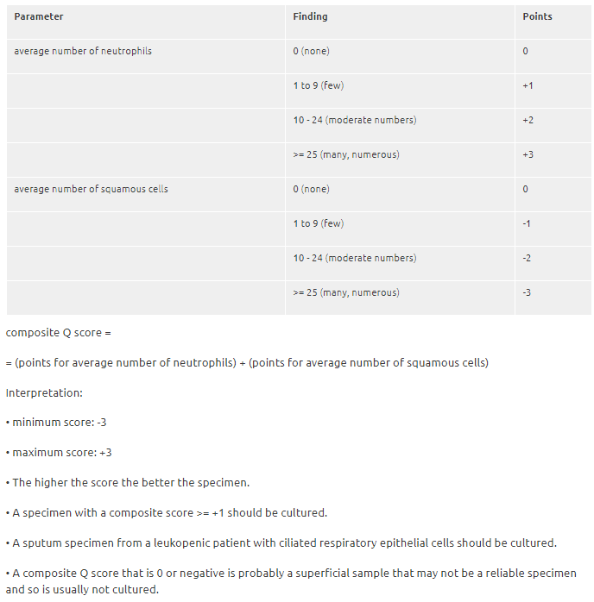
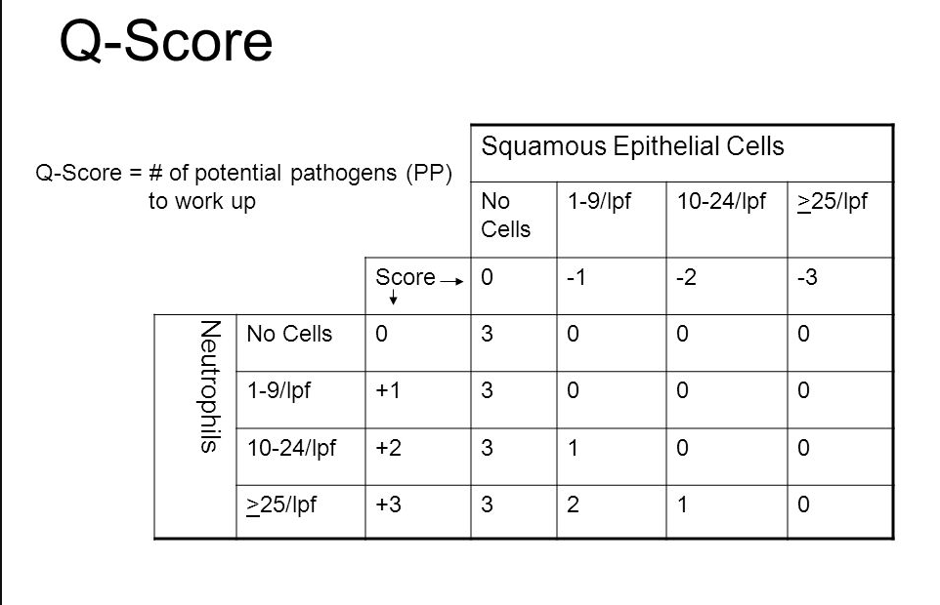
Notes:
Grading system for sputum does not apply for lower respiratory tract infections by Legionella species, Mycobacterium tuberculosis, fungi and viruses.

Slide 34
Analytical Phase
Fluid or Tissue Sample
Gram Stain - Bacteria present? If so, Gram - or +
  Results in minutes
Sample incubated in culture media - Usually 24-72 hours for growth
Biochemical testing to determine the organism - Minutes to 24 hours
Susceptibility testing - Another 24-48 hours
Notes:
The analytical phase of diagnostic testing, from specimen processing to final result, is often complex. It can involve a range of methods, from traditional Gram-stain microscopy to wholegenome sequencing. Some elements of testing are predominantly manual, whereas others are automated. Diagnostic testing technology is rapidly evolving, with the goal of optimising negative and positive predictive values, and reducing the time to produce results

Slide 35
Traditional Culture Methods
PROBLEMS
Usually takes ~ 48 - 72 hours
  Requires a sufficient number of bacteria; Often not possible if antibiotics given prior
May be difficult in mixed infections
Fastidious organisms won’t grow or require specialized media
  Viral, Fungal, and Mycobacterial cultures technically more difficult
  take longer (up to 6 weeks)

Slide 36
Rapid diagnostics and testing
Speed of diagnostic testing is a key factor in effective antimicrobial stewardship.
Typical turnaround time using traditional microbiological testing methods is 72 to 120 hours
Key goals of antimicrobial stewardship can be achieved through faster and more accurate diagnostic testing—
  reducing time to appropriate antibiotics,
  reducing unnecessary use of antibiotics, and
  informing decisions regarding antibiotic de-escalation or discontinuation
Speeding up diagnostic testing is a central theme in recent policy initiatives to combat AMR.

Slide 37
Expanding to a global One Health perspective, the World Health Organization (WHO) 2015 Global Action Plan on Antimicrobial Resistance (WHO 2015) highlighted the need for “effective, rapid, low-cost diagnostic tools...for guiding optimal use of antibiotics in human and animal medicine.”
The WHO plan calls for rapid diagnostics to be “easily integrated into clinical, pharmacy and veterinary practices” and for “affordable, point-of-care diagnostic tools to inform health practitioners and veterinarians of the susceptibility of the pathogens to available antibiotics.”

Slide 38
Rapid Antigen Tests
Group A Streptococcus
  Sensitivity/Specificity 86%/92% in children, 91%/93% in adults1
Influenza EIA
  Sensitivity/Specificity 50-70%/90-95%2
Serology
Measurement of host antibodies to a suspected pathogen
Lack sensitivity & specificity
Requires 1 - 2 weeks to get results, 8-10 weeks for diagnosis
1PLoS One 9(11):e111727, 2014
2www.cdc.gov/flu/professionals/diagnosis/rapidclin
Notes:
Point-of-care tests include the detection of influenza antigens from respiratory samples55, the use of immunochromographic or latex agglutination tests for meningitis56, and rapid tests for pneunomoccal urinary antigen to predict pneumococcal infection

Slide 39
Molecular/Proteomics
Various newer tests/technologies available
Urinary Antigens
  Legionella, S pneumoniae
Influenza A/B, RSV antigens
Polymerase chain reaction (PCR)
Multiplex PCR
Nanoparticle Probe Technology
Peptide Nucleic Acid Fluorescent In Situ Hybridization (PNA FISH)
Matrix-Assisted Laser Desorption/Ionization Time-of-Flight Mass Spectrometry (MALDI-TOF MS)
Notes:
Point-of-care tests include the detection of influenza antigens from respiratory samples55, the use of immunochromographic or latex agglutination tests for meningitis56, and rapid tests for pneunomoccal urinary antigen to predict pneumococcal infection

Slide 40
Increasingly, results of molecular and advanced phenotypic methods (for example, MALDI-TOF) can be provided within hours, which significantly improves early treatment decisions.
Direct susceptibility testing may be performed on positive blood culture samples, providing preliminary information to guide management 24–48 hours earlier than the final result
All of the laboratory processes, from specimen transport and analytical workflow to result reporting, should be optimised to reduce the time taken for the information to be available to influence clinical care.
Notes:
for example, MALDI-TOF for the detection of pathogens and specific antimicrobial-resistant organisms direct from clinical samples

Slide 41
Antimicrobial Susceptibility Reporting
Final step of reporting results is crucial in the process of susceptibility testing
Necessary so that empiric antimicrobial therapy can be narrowed appropriately
Patient-specific information that confirms the absence of pathogens enables physicians to discontinue antimicrobials entirely
Notes:
Directed therapy typically carries less risk for developing antimicrobial resistance and adverse drug events, and often is more effective and less expensive
The time that it takes a laboratory to report this information directly impacts the duration of empiric antimicrobial therapy, the time to directed therapy, or discontinuation of unnecessary therapy.

Slide 42
Cascade or selective reporting can be used to promote the judicious use of antimicrobials
Algorithm-driven reports that provide only a limited number of tested antimicrobial susceptibilities based on
  formulary availability,
  local cumulative susceptibilities, and
  cost for isolates with no or low levels of resistance and
  reporting of susceptibility to broader-spectrum drugs only when isolates are resistant to drugs in the first “cascade.”
Clear and concise messages on patient reports may be useful to guide therapy
Notes:
and the use of selective reporting and provision of instructions for how to interpret results
The method by which the microbiology laboratory communicates results can have a profound impact on prescribing habits.

Slide 43
Communication Is Key
Effective communication between the clinical microbiology laboratory and prescribing physicians is essential for optimizing antimicrobial regimens and delivering safe patient care
Several forms, including verbal and written test results reporting
It is imperative that reporting be timely, clear, understandable, and accessible to prescribing physicians.
Laboratories should have procedures in place to ensure effective communication, and these procedures should be reviewed and updated regularly.

Slide 44
Cumulative Antimicrobial Susceptibility Report
Antibiograms
Empiric therapy
  should be broad enough to cover the pathogens that are most likely to be involved.
Especially important for certain infections such as bacteremia,
  clear data that patients have a greater chance of survival if their empiric antimicrobial regimen covers their infecting pathogen.
Unnecessarily broad empiric therapy also carries risks
  increase in the incidence of adverse drug events,
  acquisition of Clostridium difficile infection,
  development of antimicrobial resistance, and
  increased healthcare costs

Slide 45
Cumulative Antimicrobial Susceptibility Report
Antibiograms
helping prescribers select effective therapy when culture results are pending,
informing local guidelines for empirical treatment
updating perioperative prophylaxis recommendations,
providing a rationale for antimicrobial formulary selection,
surveying local resistance and benchmarking,
identifying targets for stewardship interventions and best practices
providing the context for new drug susceptibility testing results.
Notes:
The collection, organization, and communication of resistance data culminates in the creation of an antibiogram. Antibiograms provide critical information to ASPs and prescribing physicians on institutional susceptibility patterns.
Many ASPs use antibiograms to develop institution-specific guidelines for prescribing physicians. ASPs can also use their local antibiograms to make decisions about which antimicrobials should or should not be on their institution’s drug formulary.

Slide 46
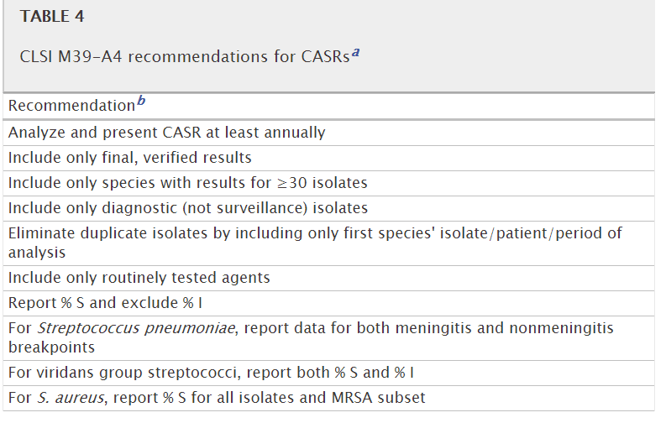

Slide 47
