Slide 1
Overview of the National Policy and Action Plan on Antimicrobial Resistance in Kenya
7th Infection Prevention and Control Scientific Conference
Green Hills Hotel Nyeri
27TH November 2018

Slide 2
Outline
Background
Process of Policy formulation
Objectives and Scope of the Policy and NAP
Roles and Responsibilities for Implementation
Coordination of Stakeholders
Monitoring and Evaluation
Notes:
Use this slide to introduce the content of the

Slide 3
Objectives
By the end of this module participants will be able to
Describe the objectives and scope of the
  National Policy on prevention and containment of AMR in Kenya
  National Action Plan on prevention and containment of AMR in Kenya
Describe roles and responsibilities of the stakeholders
Describe monitoring and evaluation plans

Slide 4
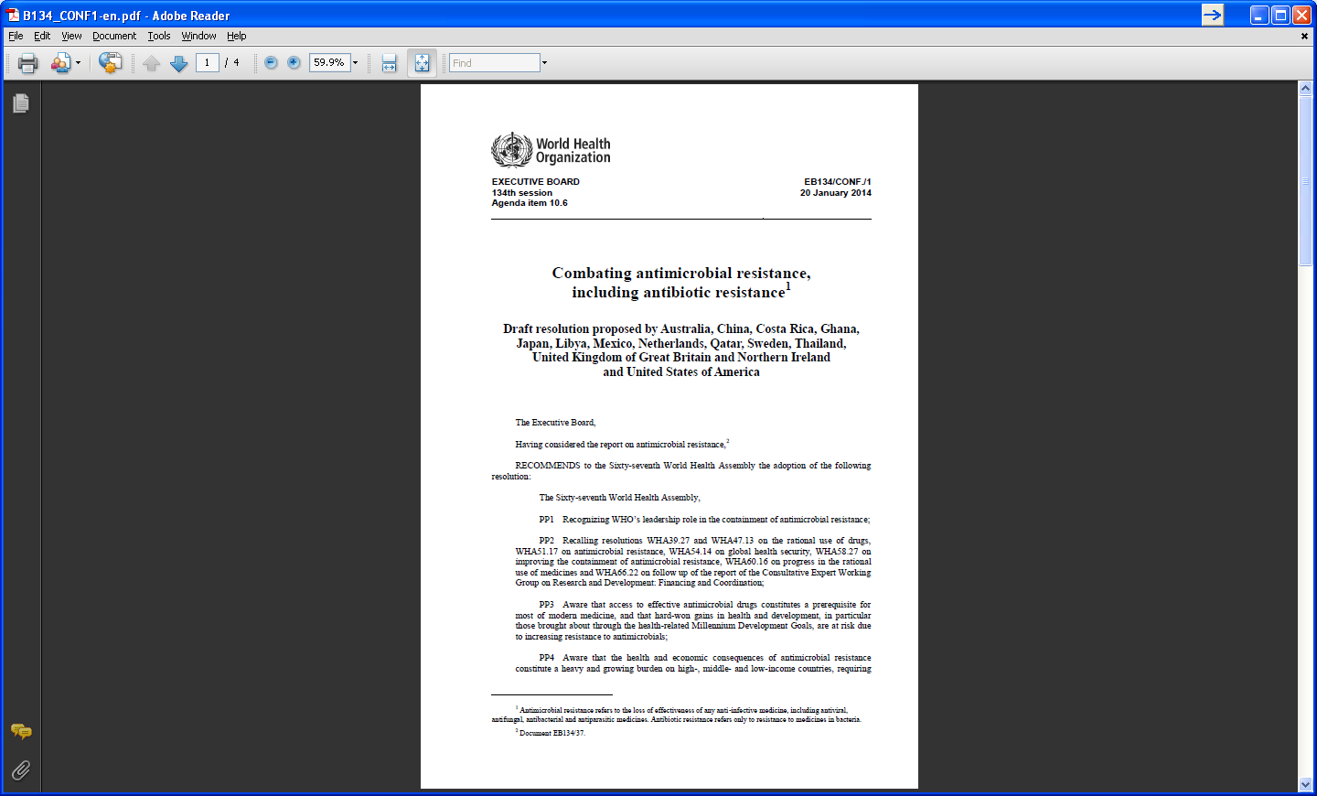
Background
World Health Assembly May 2014 resolution:
  To develop a draft global action plan to combat AMR
  to ensure that all countries have the capacity to combat AMR
Takes into account existing action plans and
all available evidence and best practice
To apply a multisectoral approach
Notes:
The World Health Assembly at its 67th session adopted resolution WHA67.25 on combating antimicrobial resistance. Through this resolution, the Health Assembly has requested that the Director-General develops a draft global action plan to combat antimicrobial resistance, including antibiotic resistance, and submits a draft of that plan to the Sixty-eighth World Health Assembly in 2015.
WHO will lead the development of a draft global action plan that reflects the commitment, perspectives and roles of all relevant stakeholders, and in which everyone has clear and shared ownership and responsibilities.
The Health Assembly, through the resolution, has specifically requested that WHO consult Member States as well as other relevant stakeholders, especially other multilateral stakeholders such as FAO and OIE, in developing the global action plan. Such consultation is a major component of the work plan for the next 12 months.

Slide 5

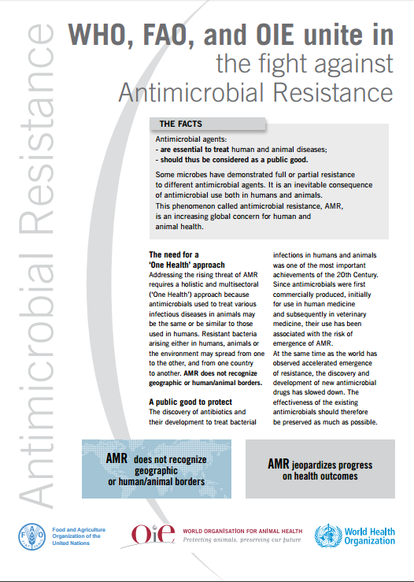
Addressing AMR is a Shared Responsibility
Notes:
This slide illustrates the shared responsibility at the global level where the tripartite engagement between the WHO, FAO and OIE to combat AMR. Point out that the Global Action Plan on AMR was developed in a collaborative approach. Emphasize that the same approach was adopted to facilitate the development of the National Action Plan, the solutions are local as much as the AMR challenge is global

Slide 6
Why We Should Care About AMR in Kenya?
AMR threatens to reverse the gains made in the fight against
  HIV/AIDS,
  TB and
  malaria
The impact of AMR on the agricultural sector will have enormous negative effects on the economy
Kenya has ratified the resolutions by the WHA, OIE and FAO on combating AMR globally
Notes:
Use this slide to describe the rational of developing a specific policy for AMR. Highlighting the gains made in TB, HIV and Malaria, and the possible effects on Agricultural exports. Mention that as a Member state of the WHO, we are bound to fulfilling commitments that the country has made at the international level.

Slide 7
Process of AMR Policy Formulation
Based on National priorities:
The Constitution of Kenya 2010
Sector policies
  Health Policy
  Veterinary Policy
  Agricultural Policy
Notes:
Use this session to underscore the role played by leveraging on the existing priorities across sectors. The Constitution of Kenya 2010 re-affirms the fact that every Kenyan citizen has a right to the highest attainable standards of healthcare. The AMR policy finds relevance into the other sector specific policies

Slide 8
Process of AMR Policy Formulation (continued)
Situational Analysis
  Antimicrobial use studies, data management, legislation, KAP, lab capacity, etc.
Recognition of AMR as an issue national importance
  Identify the key ministries responsible
  Other MDA that are important in addressing AMR
  Private sector organizations
  Development partners-WHO/FAO/OIE/CDC/…
AMR is not limited to one sector and requires a multi-sectoral approach
Notes:
Use this slide to describe the steps undertaken during the development of the Policy and National Action Plan. Emphasize on the importance of the Situation analysis which provided a platform to prioritize AMR across sectors within the government set up.

Slide 9
Process of AMR Policy formulation (continued)
Government protocols that guide policy and strategy formulation
  Formally Constitute committee/taskforces or TWGs
  Develop work plan and discussion paper (zero draft)
  Consultative workshops internally and externally with various stakeholder (Industry, counties among others)
  Brief to Departmental heads (Principal Secretaries)
  Brief to Ministerial heads (Cabinet Secretaries)
Notes:
This slide continues to highlight the process of engaging the whole of society in developing the policy and action plan to ensure ownership of the final documents and ease of implementation.

Slide 10
National AMR Policy

Slide 11
AMR Policy Goal
To reduce the burden of AMR
To ensure successful treatment and prevention of infectious diseases with
  effective,
  quality-assured and
  safe
  accessible
  antimicrobials to all who need them
Notes:
This slide highlights the Goal of the AMR policy

Slide 12
Scope of the AMR Policy
Antimicrobial resistance arising from antimicrobial treatment of infectious diseases of
  bacterial,
  viral,
  protozoal and
  fungal origin.
The initial implementation of this Policy will focus on antibacterial resistance.
Notes:
Emphasize that the scope of this policy focuses on Antibacterial resistance

Slide 13
AMR Policy Objectives
Objective 1: Improve awareness and understanding of antimicrobial resistance through effective communication, education and training
Objective 2: Strengthen the knowledge and evidence base of the AMR through surveillance and research
Objective 3: Reduce the incidence of infection through effective sanitation, hygiene and infection prevention and control
Objective 4: Optimize the use of antimicrobials in human, animal and plant health.
Objective 5: To support sustainable investment in R&D
Notes:
Mention that these objectives were drawn from the Global Action Plan

Slide 14
OBJECTIVE 1.
Improve awareness and understanding of AMR
Comm. Strategy
Training Institutions
CPD
AMR Campaigns
Media
School Curricula
Risk Communication
Notes:
This slide illustrates the importance of a communication strategy for AMR in ensuring that messages are targeted to different audiences to ensure risk is well communicated.

Slide 15
OBJECTIVE 2.
Strengthen the Knowledge and Evidence Base of Antimicrobial resistance: Surveillance and research
National AMR Surveillance system
Build Laboratory Capacity- Skills, Standards, Quality AST
Laboratory Network
National Reference Center
National Consumption of AMAs
NPHLS
CVIL
RESEARCH & TRAINING INSTITUTIONS
DATA SHARING PLATFORMS
Notes:
Use this slide to illustrate the interconnected nature of the surveillance system and the different stakeholders. Note that the network is not limited to hospital laboratories but also covers Research and Training Institutions. Emphasize that the National Surveillance system will serve as an important source of data sharing.

Slide 16
OBJECTIVE 3.
Reduce the incidence of infection through effective sanitation, hygiene and IPC
Vision
A health care system committed to reducing the high incidence of HAIs
Mission Statement
To promote high standards of IPC in order to reduce the risks of HAIs and improve the safety of patients, clients, HCWs, and the general public

Slide 17
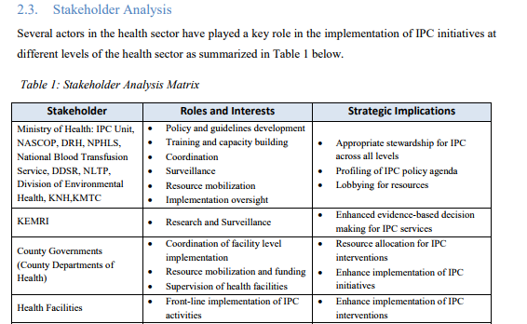
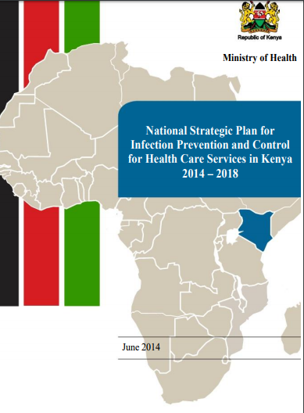
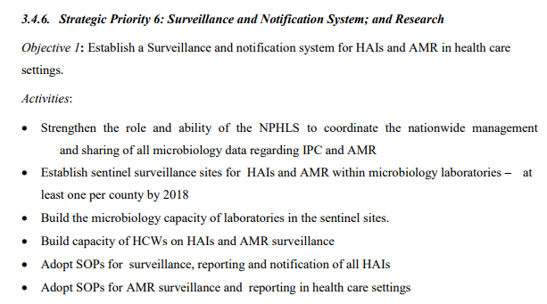

Slide 18
OBJECTIVE 4.
Reduction of antimicrobial use through adoption of preventive measures
  Review and develop guidelines for
    infection prevention and control (IPC);
    hygiene & sanitation;
    good agricultural and animal husbandry practices;
    preventive vaccinations;
    farm biosecurity;
    food and water safety; &
    prudent antimicrobial use.
  Develop and/or review existing legislation to support compliance to IPC guidelines.
  Provide incentives for utilization of disease preventive measures and vaccines as alternatives to prophylactic antimicrobial use
Notes:
Use this slide to emphasize infection prevention nd control as a key intervention to reduce consumption of antimicrobial agents and prevention of transmission of multi- drug resistant organisms as a result of poor infection control and lack hygiene.

Slide 19
OBJECTIVE 4.
Prudent (optimal) use of antimicrobials
Develop and review policies, guidelines and strategies
Review, develop and enforce legislation on prudent use of antimicrobial agents
Collaborate with professional regulatory bodies
Support health care provider compliance to antimicrobial use guidelines
Ensure appropriate human resourcing
Notes:
The slide describes the importance of introducing guidelines and strategies that will promote better use of antimicrobial agents. Some of these strategies are implementing antimicrobial stewardship programs in hospitals, enforcing legislation that will enhance compliance to set standards, increase awareness through involving professional and regulatory bodies in disseminating information and improving human resource capacity to ensure appropriate use of antimicrobial agents

Slide 20
OBJECTIVE 5.
Research, development and investment in new antimicrobials and diagnostic tools
Increase investment in research for
  new and existing antimicrobials
  diagnostic tools
  alternative medicine
  vaccines and other interventions
Provide an enabling environment for private sector to undertake research and development of
  new antimicrobials
  vaccines
  alternative medicine
  diagnostics
Collaborate with local and international research organizations to support research in AMR
Notes:
This slide describes the need for increased investment in research and development as advocated for in the Policy and the NAP outlines the priority areas for investment.

Slide 21
Policy Implementation

Slide 22
Policy Implementation Framework
Legal Framework
  Guided by various acts governing practice relevant to AMR
Institutional Framework
  Role of Public Sector
    The AMR policy builds on the existing structures and policies in the country that are directly or indirectly related to AMR.
  Role of Private sector
  Role of International Agencies
Notes:
Mention that the policy clearly outlines the roles of the different stakeholders in supporting its implementation. Point out that implementation will be guided by existing institutional and legal framework for sustainability where possible.

Slide 23
Implementation of the AMR Policy
National Action Plan
National Action Plan (NAP) has been developed to effectively implement the AMR policy
Financing
The National and County Governments in collaboration with development partners will ensure that adequate funding
Notes:
This slide describes the financing mechanisms and the National Action Plan as a detailed tool for implementing the policy. Mention that the AMR policy and NAP should be referred to side by side.

Slide 24
NAP Objectives and Activities
NAP lists interventions and activities for each AMR policy objective

Slide 25
Roles and Responsibilities

Slide 26
      Role of the National Government
The Ministry responsible for Health
  Provide leadership in the Implementation of this Policy and
  Host the multi-sectoral Secretariat for the AMR agenda.
The Ministry responsible for Agriculture, Livestock and Fisheries.
  Provide leadership in the implementation of the AMR agenda in sub sectors
  Be part of the AMR secretariat
The Ministry responsible for Environment
  Support implementation of the AMR agenda with respect to the environment
Other Government Ministries, Departments and Agencies (MDAs)
  Support specified roles in the AMR agenda.
Notes:
The next set of slides highlights the roles of each sector and level of government in implementing the AMR Policy.

Slide 27
Role of County Governments
The Department responsible for Health
  provide leadership in implementation of this policy at the county
  implement AMR agenda within the health sector
The Department responsible for Veterinary Services
  provide leadership in the implementation of the AMR agenda in sub sectors
The Department responsible for Environment
  support implementation of the AMR agenda with respect to the environment
Other Departments and Agencies
  Support specified roles in the AMR agenda

Slide 28
Role of Other Sectors
Role of Private Sector
Collaborate with the government to implement this Policy
Role of International Agencies
Resource mobilization
Technical assistance
Notes:
This slide highlights the supportive roles of the other sectors in implementing the AMR policy.
Private sector includes: CBOs; NGOs; cooperative societies; pharmaceutical industries; input suppliers such as feed manufacturers; food processors; development partners, professional regulatory bodies and associations
These include but are not limited to: WHO, FAO, OIE, EAC, IGAD, COMESA, AU-IBAR and WTO.

Slide 29
How will the Stakeholder Coordinate their activities?

Slide 30
AMR Coordination Mechanism
The Ministries responsible for Health and Livestock, Fisheries & Crops
  jointly establish the multisectoral AMR Secretariat
Ministry responsible for Health
  host to coordinate the AMR agenda
The Intergovernmental structures
  agree on implementation of the National Action Plan

Slide 31
AMR Coordination Mechanism
National Antimicrobial Stewardship Advisory Committee (NASIC)
Technical and Management Com
Intergovernmental Relations
County Antimicrobial Stewardship Advisory Committee (CASIC)
AMR Secretariat
National- Technical Working Groups
County- Technical Working Groups
Notes:
The figure in the slides illustrates the coordination mechanisms from the National to county levels.
NASIC Steering Committee (NASIC-SC)
The NASIC-SC will comprise of Principal Secretaries of relevant ministries and two representatives of the Council of Governors. The NASIC-SC will be responsible for policy direction, resource mobilization, budget and work plan approvals.
Co-Chairs: Ministry of Health (MOH) and Ministry of Agriculture Livestock, Fisheries & Blue Economy (MALF)
Members: Ministry of Education Science and Technology (MOEST) Ministry of Environment and Natural Resources (MENR), the National Treasury & the Ministry of Industry, Trade and Cooperatives
The Committee may co-opt any department, bureau, office, agency, or instruments of the government, and request the county governments and private sector for assistance as the circumstances may require.
Terms of Reference for the Steering Committee:
Policy direction
Approval of budgets
Approval of work plans
Resource mobilization
NASIC Technical Committee (NASIC-TC)
The NASIC-TC will comprise of Technical Directors of relevant ministries and experts. The NASIC-TC will be responsible for technical oversight, overseeing the implementation of the National Policy for AMR. It shall also ensure close coordination with other relevant stakeholders.
AMR Secretariat
The NASIC will be supported by an appropriately resourced secretariat based at the MOH, responsible for the logistics of meetings; minute-taking; preparation and circulation of documents (e.g. background papers, reports and advisory notes to ministers); and storage and archiving. The head of the secretariat will be the national AMR focal point.
Roles and Responsibilities of the AMR Secretariat:
Link the two levels of the NASIC at the National and County levels.
Coordinate policy implementation at the National and County Governments
Ensure continuous national, county and international stakeholder engagement
Representing the national AMR in meetings, conferences, stakeholder meetings and other relevant national and international forums.
Engage technical advisors and support the functions of TWGs.
Composition of the Secretariat:
The AMR Secretariat should be composed of members representing the relevant sectors, notably human health, animal health and production and the food and environment sectors. Representatives should be given sufficient authority by their institutions to make decisions.
COUNTY GOVERNMENT COORDINATION MECHANISMS
At the County Government, the lead Departments (Health and Agriculture) will establish a County Antimicrobial Stewardship Interagency Committee (CASIC). CASIC will comprise of County Executive Committee members, County Chief Officers of relevant Departments Technical County Directors and experts. The CASIC will be responsible for approving budgets and work plans, resource mobilization and implementation of the NAP at the county level.
Terms of Reference for the CASIC:
Monitor and evaluate the implementation of the national action plan at the county level for the prevention and containment of AMR;
Mobilize human and financial resources to support the plan through regular budget allocations, mainstreaming of activities within core programmatic areas.
Enforce guidelines, rules and regulations in accordance with existing laws, as may be necessary, related, incidental, or consistent with the purpose, intent, and objective of this National Action Plan.
Submit to the CASIC regular status reports, budgets, policy proposals on the implementation of the national plan
Collaborate and coordinate with the county and national government and non-state actors

Slide 32
Role of Public sector-
Oversight, Management & Coordination
National Antimicrobial Stewardship Interagency Committee (NASIC)
Management Committee- Technical Directors &Experts
County Antimicrobial Stewardship Interagency Committee (CASIC)
Principal Secretaries of relevant ministries and a management committee comprising of Technical Directors and experts
approving budgets and work plans, resource mobilization and policy
County Executive Committee members, County Chief Officers of relevant Departments and Technical County Directors.
approving budgets and work plans, resource mobilization and implementation of Policy
Notes:
This figure is a summary of the functions of the NASIC and CASIC.

Slide 33
Kenya’s implementation status

Slide 34
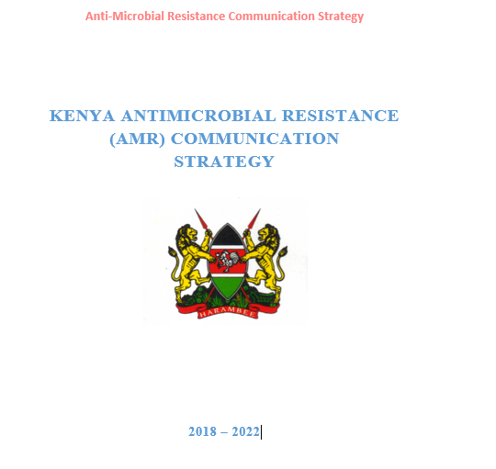
1. Advocacy, Awareness and Education
Provide relevant and accurate information to persons handling antimicrobials.

Slide 35

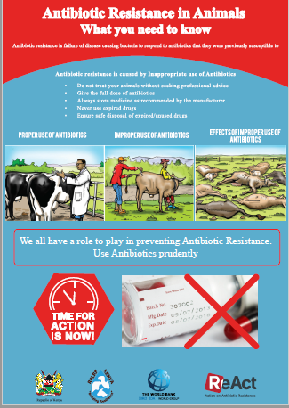
Information Education and Communication Materials

Slide 36


Advocacy, Awareness and Education

Slide 37

Marking the World Antibiotic Resistance Awareness Week 2017

Slide 38
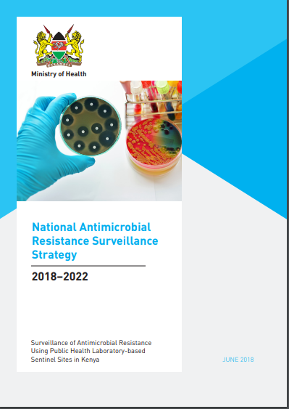

Understanding the Scope of AMR- Surveillance
Implementation is in progress
2 pilot sites to test the system
Scaling up to 4 sites in 2018
Goal to have at least 20 sites by 2022
Surveillance strategy finalized

Slide 39
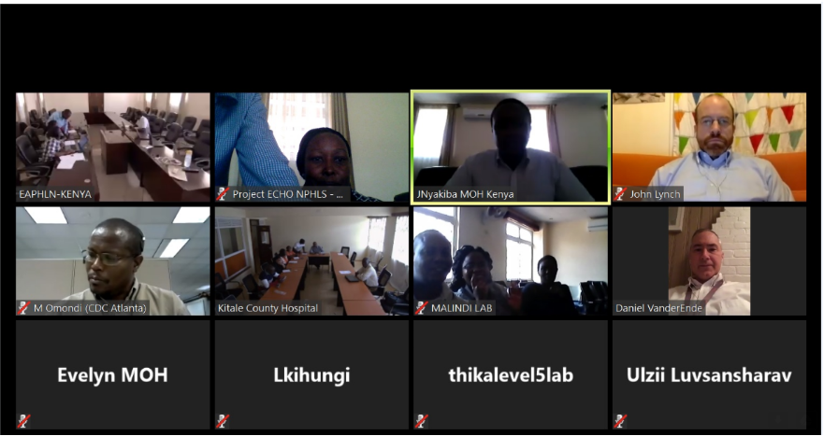

Participants and trainers from different regions during the on line training

Slide 40


AMR Data- Site Weekly Summaries to the National AMR Database at the National Public Health Laboratory

Slide 41
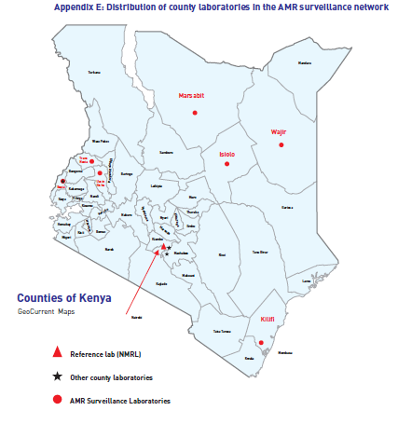
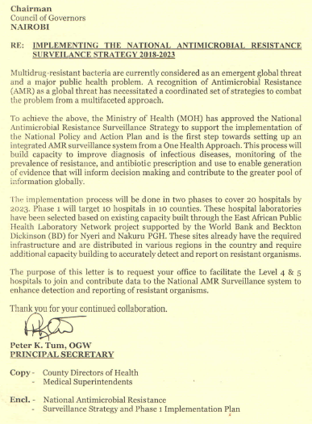
Scale Up of Surveillance to major regions in the country

Slide 42
Specific Challenges to Surveillance
Inconsistent Supply of Laboratory Supplies
Inadequate capacity to perform AST
Under- utilization of hospital laboratory
Mistrust between the laboratory staff and the clinical staff

Slide 43
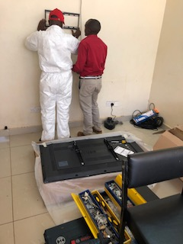
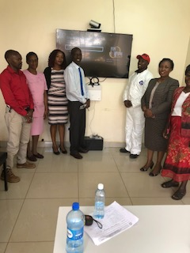
Improving Connectivity to enhance Participation through Partner support-Thika L5 Hospital

Slide 44

Infection Prevention and Control- Implementing the National Strategy
Incorporation of IPC/AMS standards into the Kenya Quality for Health 2018 (Minimum standards that healthcare facilities must attain)
Sector guides for various value chains in the animal health sector;
  Good husbandry practices
  Good hygienic practices along the value chain (HACCP)
  Biosecurity measures at the farms
  Good Agriculture Practices
  Good Veterinary Practices

Slide 45

Building Capacity for IPC
National Basic Training Course for IPC- Trained TOTs in 30/47 Counties
Established IPC programs in facilities
Adopted a Continuous Quality Improvement Approach to implementation
Online and on site mentorship platform

Slide 46
Optimizing Use of antimicrobial agents
Completed a point prevalence survey on antibiotic use in 3 major hospitals (An additional 3 covered by students)
Development of Antimicrobial Stewardship Guidelines is on going
  Establishment of Stewardship Programs in hospitals
Development of Guidelines on rational use of antibiotics in Animals completed
Review of antibiotics import data is on going/ mapping of medicines the veterinary supply chain complete

Slide 47
1. Antibiotic Use Prevalence by Ward Types Hospital 1
6th IPNET-Kenya 1 December 2017, Eldoret, Kenya, University of Nairobi, Washington State University, Ministry of Health, and CDC

Slide 48
2. Prescribing Patterns by Antibiotics Hospital 1
6th IPNET-Kenya 1 December 2017, Eldoret, Kenya, University of Nairobi, Washington State University, Ministry of Health, and CDC

Slide 49


Slide 50












Slide 51
Monitoring and Evaluation

Slide 52
Monitoring and Evaluation (M&E)
Objective:
  To ensure prudent antimicrobial use
  Reduction of AMR against set targets and
  Document useful lessons for planning purposes.
Notes:
A Monitoring and Evaluation framework for the AMR national action plan is critical in measuring the impact of proposed interventions. This Framework will be developed for each activity bearing a monitoring indicator to be measured in the process of its implementation. The framework will incorporate both objective and outcome indicators. Responsible Ministries/ Departments/Agencies will monitor and evaluate interventions identified in the NAP. A mid-term review will be done after two years to monitor the implementation of the NAP. End of term evaluation will be conducted in 2021.

Slide 53
Policy Review and NAP Monitoring
AMR policy will be reviewed as frequently as necessary
NAP mid-term review will be done after 2 years of implementation (2019)
NAP End-term evaluation will be conducted in 2021
Notes:
Highlight that the AMR policy is a living document and will be reviewed as and when is necessary.

Slide 54


