Slide 1
NEEDLE STICK INJURIES AMONG HEALTH CARE WORKERS AT NYERI COUNTY REFERRAL HOSPITAL BETWEEN 2014 AND 2017
7 TH INFECTION PREVENTION NETWORK CONFERENCE
DATES: 27 TH – 30 TH NOVEMBER 2018
VENUE: GREEN HILLS HOTEL, NYERI KENYA
RACHEL CHEGE
NOVEMBER, 2018

Slide 2
Background
Health care workers (HCWs) are at increased risk of exposure to Needle stick injury (NSIs) in the course of their duty.
This puts them at risk of Acquiring blood-borne pathogens.
With proper intervention measures put in place, the risk can be minimized
  Training on infection prevention and control (IPC)
  Hepatitis B vaccination (HBV)
  Post exposure prophylaxis (PEP) uptake

Slide 3
Objectives
Broad objective
To determine the prevalence of needle stick injuries among healthcare workers at Nyeri County Referral Hospital, 2014-2017
Specific objectives
To determine the demographic characteristics of HCWs reporting NSIs, 2014-2017
To identify the effect of IPC training on preventing NSIs.
To analyze PEP uptake among HCWs with NSIs, 2014-2017

Slide 4
Methods
Study design – A prospective descriptive study
Study population – all healthcare workers working at NCRH.
Sampling- purposive sampling was used.
400 HCWs were sampled in the four years period.
Data collection-Anonymous self administered questionnaires used to collect data.

Slide 5
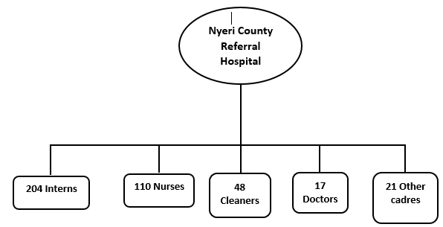
Results
400 healthcare workers in different cadres participated.

Slide 6
Results
103/400 (26%) reported needle-stick injury
Healthcare workers in the age group of 21 – 30 reported the highest number of cases; 53/103 (51.5%)

Slide 7
Distribution of exposures among respondents 2014-1017
Notes:
High numbers of interns, their chastics least trained in ipc, not vaccinated, poor documentation practices

Slide 8
Distribution of the needle-stick injuries by age 2014-2017
Notes:
Newly employed, unlikely to be trained, interns, less experienced

Slide 9
Work experience of HCW reporting NSIs, NCRH 2014-2017
Notes:
The chart shows that HCWS with less than 3 years of experience reported more nsis in comparison to those with more than 3 years of experience.

Slide 10
Distribution of needle stick injuries by departments, NCRH, 2014-2017
Notes:
The graph shows that most cases were reported from medical department followed by surgical while casualty , lab and vct had the lowest.

Slide 11
Effects of IPC training on HCWs exposure to NSIs, 2014-2017
Notes:
The figures shows that nsis were high among untrained in comparison with only 11 percent of the trained who had nsis.

Slide 12
Hepatitis B Vaccination status among interviewed HCW, NCRH 2014-2017
Notes:
The figure shows that of the 103 with nsis only 18 were fully vaccinated with the 3 jabs while 55 were not immunized.

Slide 13
PEP uptake and completion among HCW exposed to NSI, NCRH, 2014-2017
Notes:
The graph shows that out of the 103 only 43 reported to their supervisor and out of this only 38 started PEP while only 21 completed.

Slide 14
Conclusion
NSI are common amongst Nyeri County Referral hospital HCWs.
There was no statistical significance variation on exposures among cadres.
Most of the exposures were from medical ward.
High incidence were recorded by HCWs in the age group between 21 – 30 years.
Highest exposure was among HCWs without IPC training as compared to HCWs trained on IPC.
A Fifth of HCWs had completed the full vaccination against HBV.
Only 21 HCWs completed the full course of PEP.

Slide 15
Recommendations
Interventions such as occupational safety training, orientation of new interns, provision of job aids and on job trainings need to be implemented.
All healthcare workers should be fully vaccinated against HBV
Reporting of NSIs and completing PEP are important infection risk-reduction measures.

Slide 16
References
Sumati M, Kumar S, Mesenakshi M, Manju B (2013) Needle sticks injuries among health care worker in tertiary care hospital of India; Global journal of Medical research 13: 41-50
Mbaisi, etal "Prevalence and factors associated with percutaneous injuries and splash exposures among health-care workers in a provincial hospital, Kenya, 2010." Pan African Medical Journal 14.1 (2013).

Slide 17
Acknowledgement
Co-Authors: Muthee J. N., Gitonga R. F., Michira J. K., Gituku J. G., Watahi P., Saidi S.
Nyeri County Referral Hospital
Notes:
I acknowledge the following people for their support

Slide 18


.
THANK YOU

