Slide 1

Overview of the Kenya National Surveillance Strategy

Slide 2
Scope:
Background
Goal
Objectives
Overview

Slide 3
TWG Members
Prof. Lilly Bebora - University of Nairobi Veterinary Dept
Susan Githii - National Public Health Labs
Dr. Nyawira Kamau - Medical Adviser, GlaxoSmithKline (GSK)
Prof. Revathi - Aga Khan University Hospital
Dr. Margaret Mbuchi - Kenya Medical Research Institute
Dr. Lillian Musila (lead) - Walter Reed Project/KEMRI

Slide 4
Introduction
Antimicrobial resistance (AMR) is emerging as a global health security threat
Alarming rapid global spread of multi-resistant bacteria that resist treatment with existing antimicrobial medicines has been reported.
Routine identification and testing for AMR is not performed by most hospitals hence majority of patients are treated syndromically

Slide 5
Cont.
Surveillance and research on AMR is dependent on local research, training institutions and private hospitals, with limited systematic and nationwide surveillance
All this available data is not readily available for public health consumption and application for policy decisions.

Slide 6
Cont.
Thus information on the magnitude of the AMR problem, trends and incidence are limited.
Establishing a national surveillance system will benefit in understanding the major bacterial pathogens and drug-resistant bacteria affecting patients in health facilities
It is also important to guide national policies and treatment guidelines according to the National AMR patterns.

Slide 7
GOAL :
The primary goal of the surveillance system is to describe the national burden of antimicrobial resistance among WHO priority pathogens isolated in Kenyan health facilities

Slide 8
Objectives
  To establish a national database for AMR bacterial pathogens in the existing public health framework.
  To evaluate the resistance and susceptibility of bacterial pathogens to drugs used in current treatment guidelines
  To determine transmission patterns of antibiotic resistant bacteria within and between different hospitals and regions

Slide 9
Objectives cont.
To build capacity within national and county laboratories to conduct AMR surveillance
To conduct routine and standardized identification and AST on target clinical specimens.
To establish a national repository of bacterial isolates.
To guide research questions on AMR

Slide 10
OVERVIEW OF STRATEGY
AMR surveillance will engage hospitals and public health microbiology laboratories at different levels throughout the public health system
Clinical specimens will be routinely collected at the participating hospitals and submitted to the diagnostic laboratory for organism identification and AST.
Samples targeted are wound swabs, blood, cerebrospinal fluid (CSF), urine, and stool.
Notes:
To allow for more inclusive, local regional and nationally relevant data for informed decision making.

Slide 11
OVERVIEW OF STRATEGY cont.
Results will be returned to clinicians, hospital teams including AMR and IPC teams and stored in the laboratory databases.
Isolates and ID/AST data will be transmitted to the NMRL for quality checks
The AMR Secretariat will generate reports, guide national policy and report aggregated data to hospitals and WHO completing the global component of the surveillance system

Slide 12
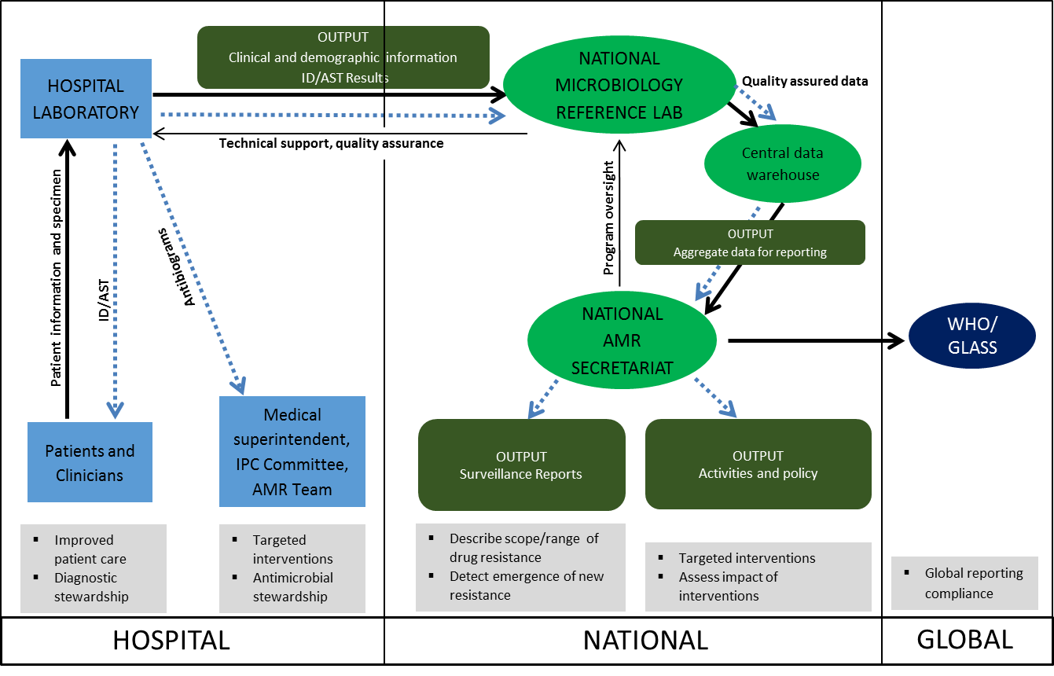
Data sharing and isolate transmission
Notes:
Specimens are submitted to the diagnostic laboratory for organism ID and AST. The diagnostic laboratory returns results to clinicians and hospital AMR stakeholders. ID/AST data is transmitted to the NMRL for quality checks. The NMRL transmits the data to the central data warehouse and together with the National AMR Secretariat, generates reports, guides national policy and reports aggregated data to WHO

Slide 13
Priority Organisms and Antibiotic Sensitivity Testing
Based on the WHO Global Antimicrobial Resistance Surveillance System (GLASS) and national priorities.
Clinical significance of the pathogen, public health impact, amount of data available /gaps and ease of testing
Antibiotics recommended for testing for each organism are listed

Slide 14
Cont.
Other antibiotics that are commonly prescribed or available for treating infections may be tested
AST will be conducted according to (SOPs) that have been reviewed and harmonized through the NMRL.
Current Clinical and Laboratory Standard Institute (CLSI) guidelines will be used to interpret resistance

Slide 15
Target organisms
Organism | Significance
E.coli | both zoonotic, easy to test for in both humans and animals, good indicator organisms, clinically significant and predominant pathogens, both gram positive and negative bacteria
S. aureus
Salmonella | important diarrhoea and blood pathogen
Shigella | important diarrhoeal pathogens)
Streptococcus pneumoniae | Significant cause of morbidity/mortality in children <5yrs, under-studied
Pseudomonas aeruginosa | nosocomial infection , cause of mortality in HDU/ ICUs morbidity/mortality, high MDR
Acinetobacter spp | nosocomial infection , cause of mortality in HDU/ ICUs morbidity/mortality, high MDR
Klebsiella spp | high MDR organism, a predominant cause of infections particularly sepsis and UTI
Notes:
Based on the clinical significance of the pathogen, public health impact, ability to cause disease and WHO priority pathogens

Slide 16
Implementation strategy
Baseline survey will be conducted in all potential laboratories using a standard assessment checklist to assess the following:
• Willingness to participate
• Adequate physical infrastructure and equipment
• Existing laboratory / human capacity
• Microbiology expertise among laboratory staff

Slide 17
Cont.
Patient populations (i.e. in-patient admissions and out-patient attendance)
Minimum system requirements for the Laboratory Information Management System
Capacity will be built in the laboratory based on the outcomes of the assessments
Notes:
Roles and responsibilities, Antimicrobial stewardship well outlined in the strategy

Slide 18
Data management
AMR surveillance data will be managed, analyzed and reports generated under the guidance of the ANCC.
Data summaries and trends will be prepared bi-annually or annually and made accessible to county and national level
Data will also be configured to feed into the WHONET/GLASS network for global reports
Notes:
ANCC – Antimicrobial data coordinating center
To inform them of the status of AMR in their respective regions/hospitals.

Slide 19
Monitoring and evaluation
M & E tools will be developed to regularly assess the entire surveillance system
AMR reports will be generated based on the set of priority indicators
Quality assurance checks within the facility to ensure completeness of AMR data collection

Slide 20

THANKYOU
Questions?

