Slide 1
LABORATORY SAFETY AUDITS A GAME CHANGER IN INFECTION PREVENTION AND CONTROL
Authors: Edward Oula A¹., Caren Sigei A².
¹Ahero County Hospital Laboratory, ²Ahero County Hospital Laboratory Safety Office.
A¹ Laboratory Quality Manager; 0726705475; edgaredwards85@gmail.com
A² Laboratory Safety Officer; 0724381574; carensigei@gmail.com
Green Hills Hotel-Nyeri
DATE: 29th November 2018

Slide 2
Background
Facility and biosafety is one of the quality system essentials envisaged in the Kenya Quality Manual for medical laboratories.
Safety audit is a fundamental requirement of ISO 15190 standard clause 7.3.1 and section 12 of WHO SLIPTA checklist clause 12.0
    The standard stipulates that a safety program shall be audited at least annually.

Slide 3
Background cont’d
ISO 15189 Clause 4.14 further stipulate that a lab shall conduct internal audits at planned intervals to identify nonconforming activities and institute CAPAs.
Requirements of National policy guideline on IPC can effectively be assessed using Section 12 of WHO SLIPTA checklist for clinical and public health laboratories.

Slide 4
Problem Statement
Baseline safety audit indicated low scores in this section.
The lab embarked on this study to ensure compliance with this section requirement with the ultimate goal of improving safety, infection prevention and control.

Slide 5
Objective
To improve facility and safety section scores of WHO SLIPTA assessment checklist to 95% and improve general laboratory’s safety.

Slide 6
Methodology
The study was based on the DMAIC(Define, Measure, Analyse, Improve, Control) model of quality improvement.
The lab conducted baseline safety audit using section 12 of the WHO SLIPTA assessment checklist.
Action plan with strict timelines were developed with the primary goal being closing the gaps identified during the audit.

Slide 7
Methodology cont’d
Lab management appointed a safety focal person whose primary role was to spearhead closure of the nonconformities.
Three follow up audits were conducted at an interval of one, three and four months respectively.

Slide 8
Gaps at Baseline
No MSDS for all chemicals used in the laboratory
First aid kit, spill kit and eye wash stations are not available.
No evidence of staff having been vaccinated against hepatitis.

Slide 9
Cont’d
No evidence of support staff(sample riders and cleaners) being trained on biosafety
Improper waste segregation
Absence of fire fighting equipment and fire drills
Servicing and certification of biosafety cabinet not prompt

Slide 10
Results

Slide 11
Results

Slide 12
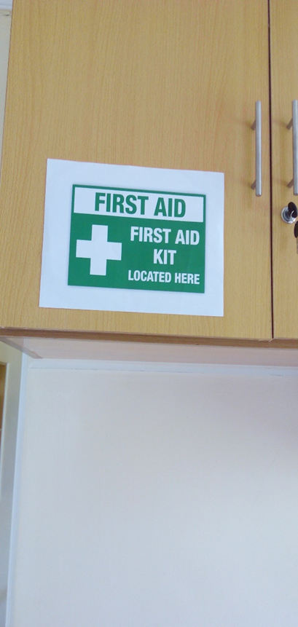
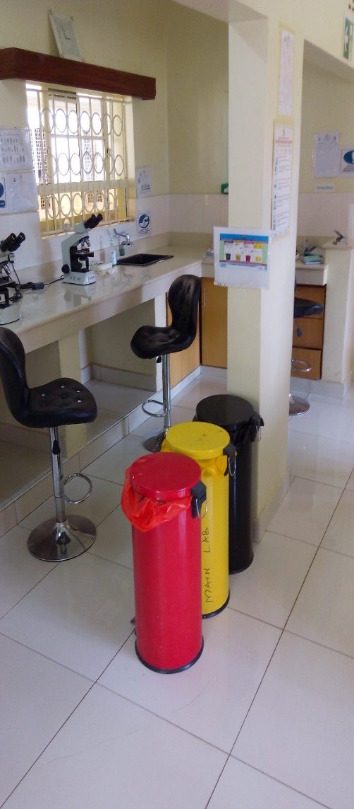
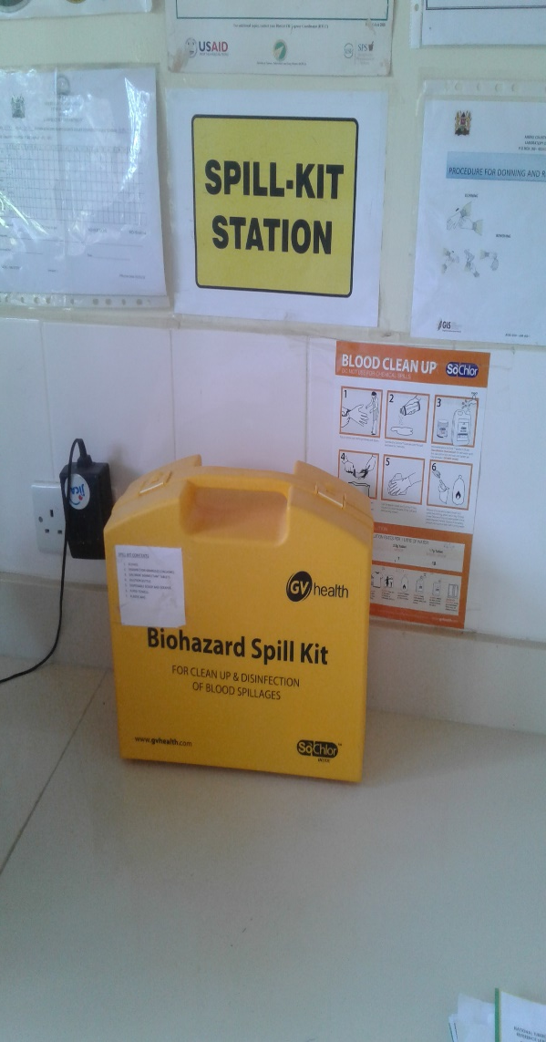
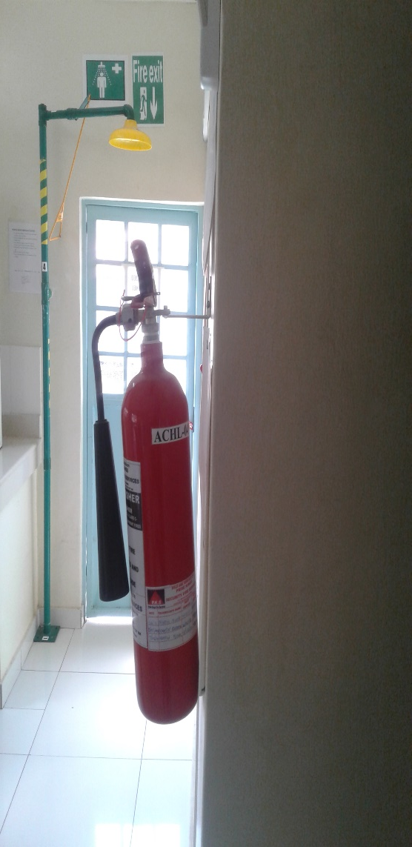
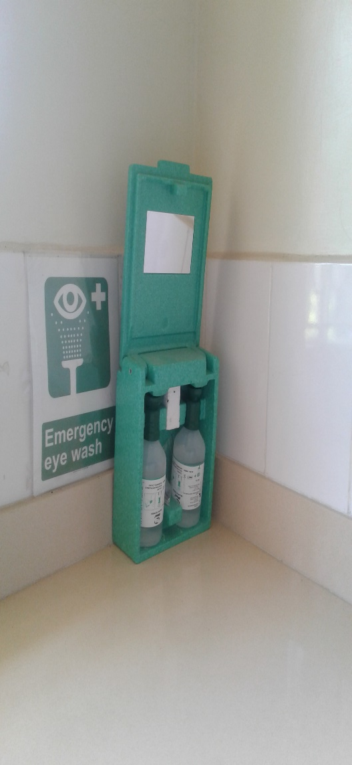
Pictorials

Slide 13
Conclusion
Properly conducted safety audits helps in identification of NCs resulting into improvement of laboratory’s IPC
Safety audits impacts positively on performance of other assessments i.e. SIMS,KENAS
Periodic safety audits should be cascaded and embraced by other hospital departments.
“An ounce of prevention is worth a pound of cure.” ― Benjamin Franklin

Slide 14
Acknowledgement
Ahero County Hospital Management
Ahero County Hospital Lab staff
GIS QMS Mentors

