Slide 1
Infection Prevention and Control in Machakos Level 5 Hospital Renal Unit
BY
David Maundu

Slide 2
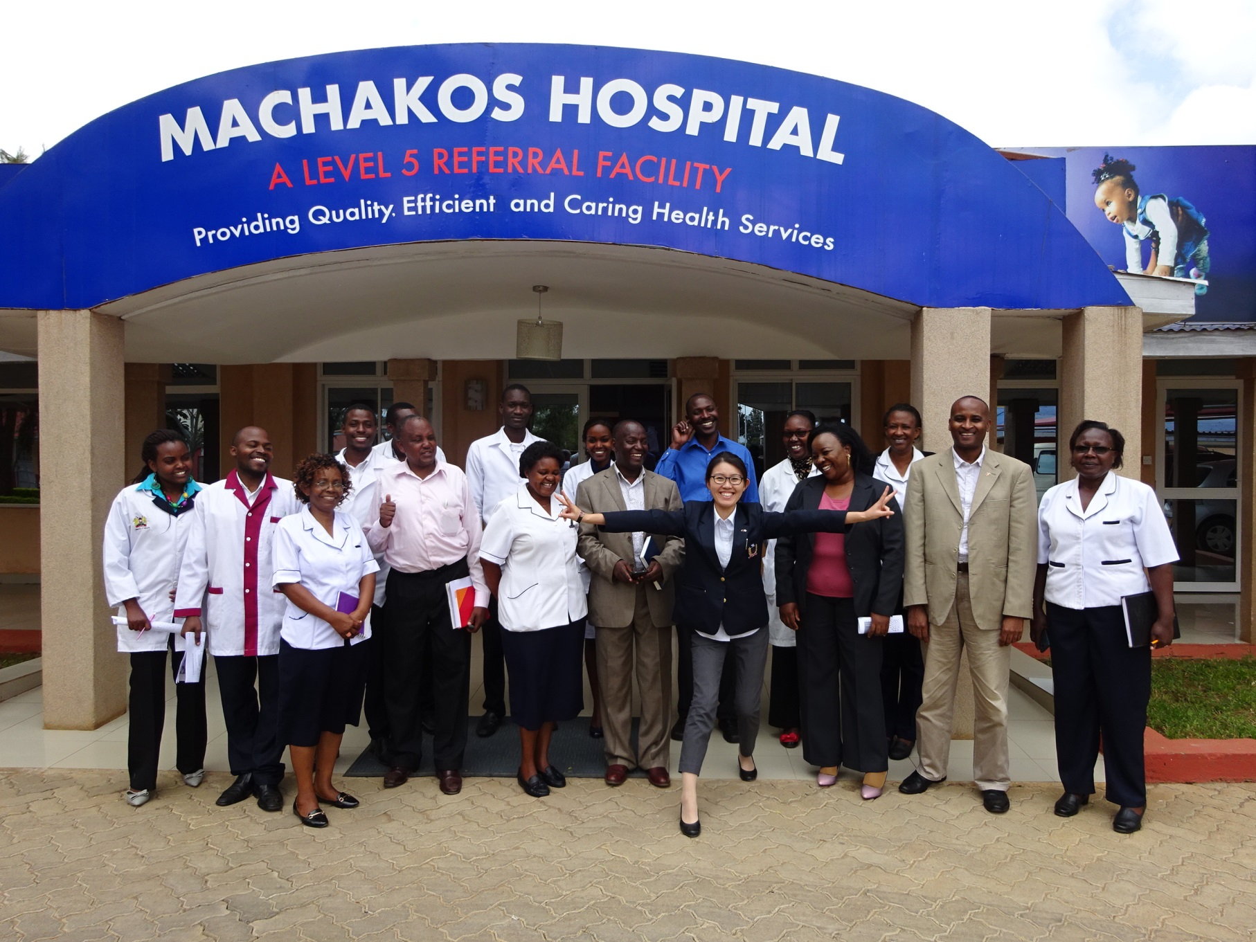
THE TEAM BEHIND THE SUCCESS

Slide 3
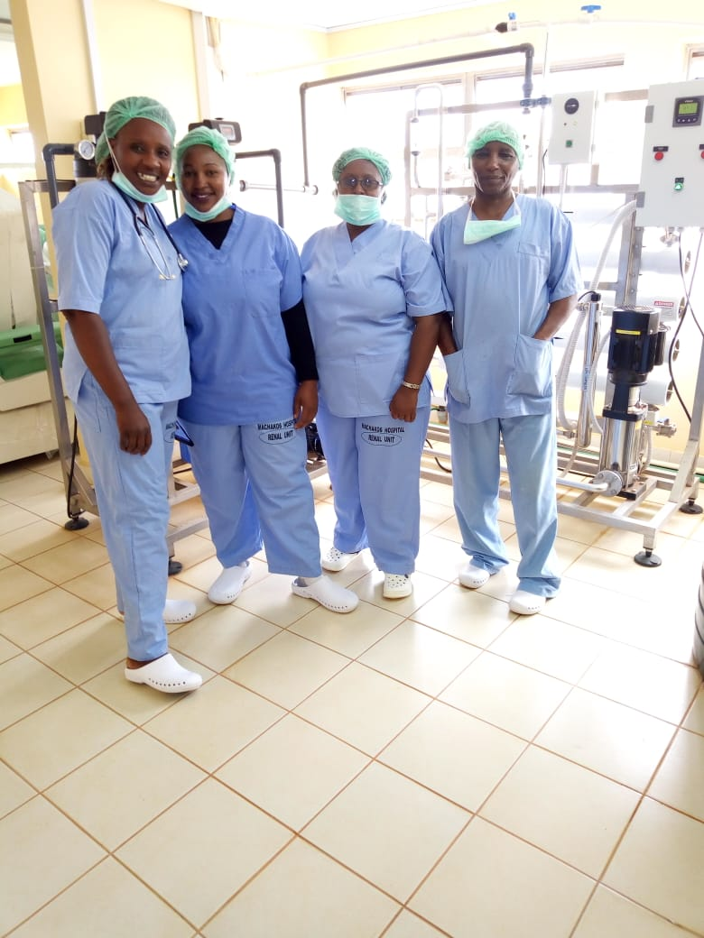
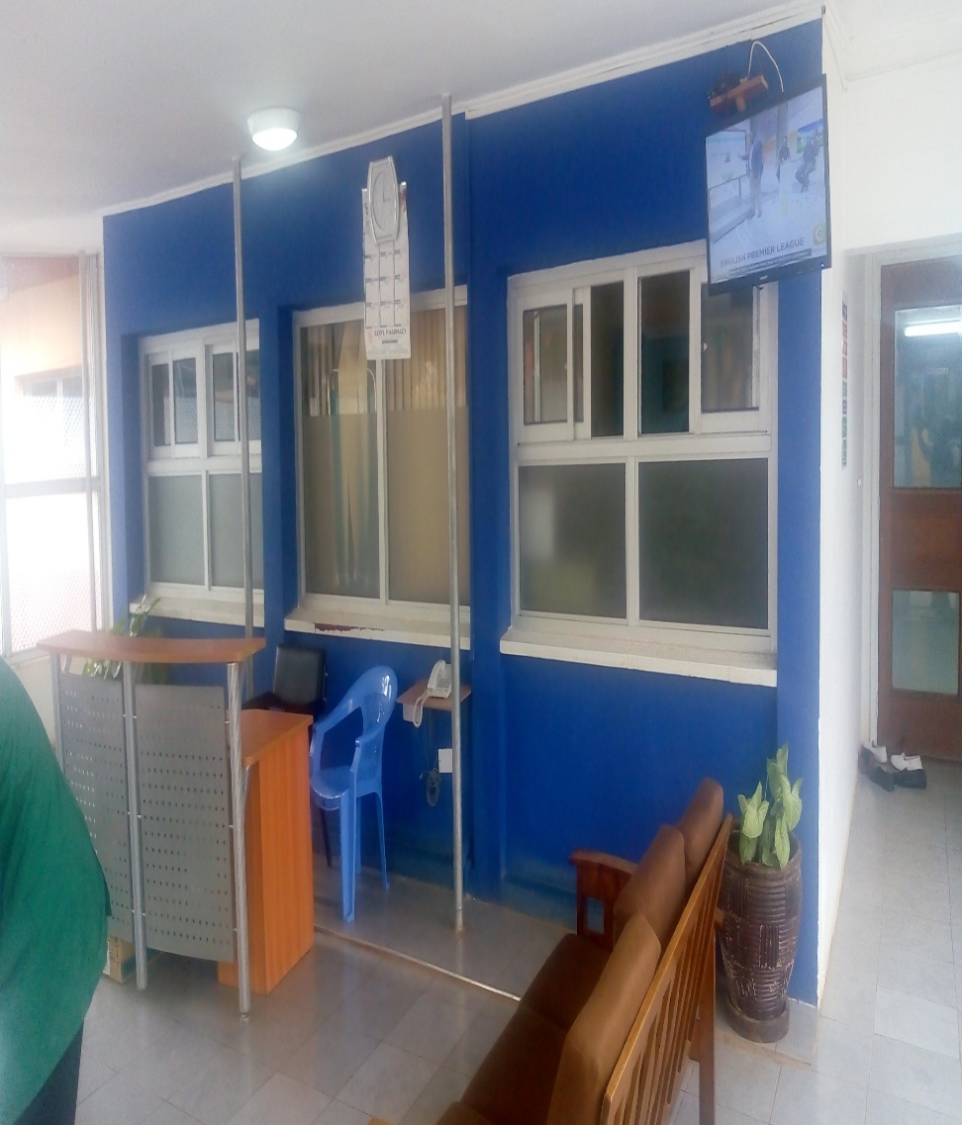
STAFF IN RENAL UNIT

Slide 4
Machakos level 5 Hospital Renal unit
Established in June 2015 as the first in the lower eastern region of Kenya
Manned by 4 doctors, 10 nurses and 2 biomedical technicians
Patient capacity – 9
Only one nurse is trained on IPC
Notes:
4 doctors (2 medical officers and 2 physicians)
Patients – 6 were referrals from Kitui and Makueni counties, 4 inpatients and 17 outpatients

Slide 5
Vulnerable cases managed at the unit
Cases handled at the center have high vulnerability to HAI. The ailments handled at the unit include:
End Stage Renal Disease (12)
Diabetes (6)
Acute renal failure (3)
Hypertension (4)
Abortion (1)
Road traffic accidents (1).

Slide 6
Methodology
For the implementation of IPC at the Renal unit, we initiated
4 staff went bench marking at KNH
Weekly meetings - discuss IPC implementation progress, challenges and action points.
Assessment of the unit conducted
  Gaps identified
          Missing Standard Operating Procedures (SOPs),
          Improper hand washing
          One color coded bin used
          Staffs not immunization on Hepatitis B virus and none trained on IPC
Notes:
4 staff (1 doctor, 2 nurses and 1 biomedical engineer)

Slide 7
Intervention based on identified gaps
          Trained all staffs on how to prepare Standard Operating Procedures
          Trained staff on hand washing techniques
          Staff trained on Types and importance of color coded bins
          Medsup provided Hepatitis B virus vaccine

Slide 8
RESULTS

Slide 9
Conclusion
Implementation of IPC standards is critical in eliminating or mitigating infection risk for both patients and healthcare workers in the renal unit

Slide 10
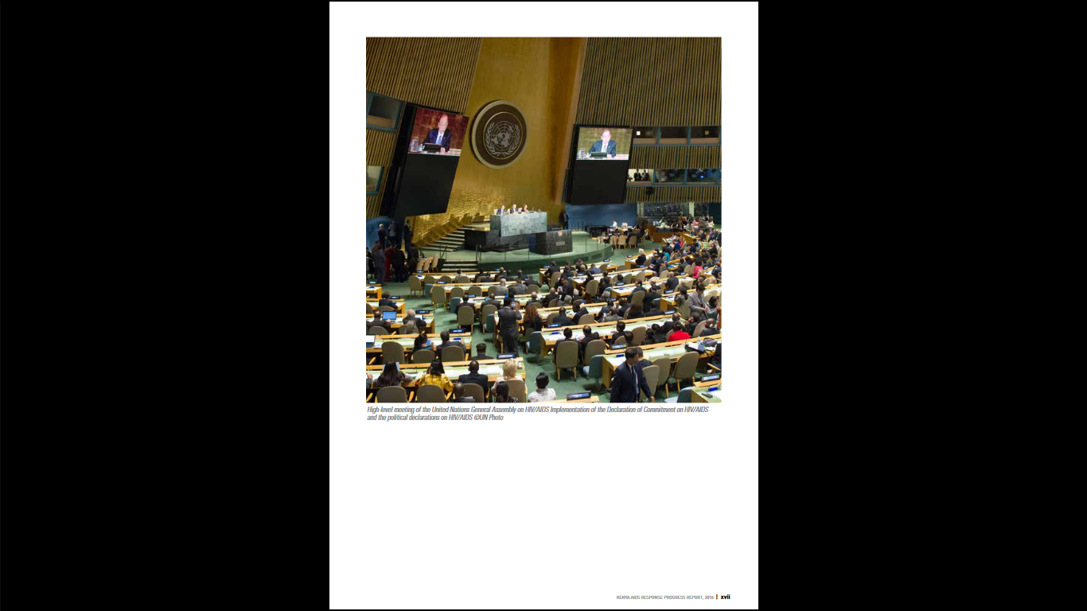
Team work

Slide 11
AKNOWLEGEMENT
COUNTY GOVERNMENT
HMT-MEDSUP
PARTNERS-AMREF; EPHLP
ML5H STAFF

Slide 12
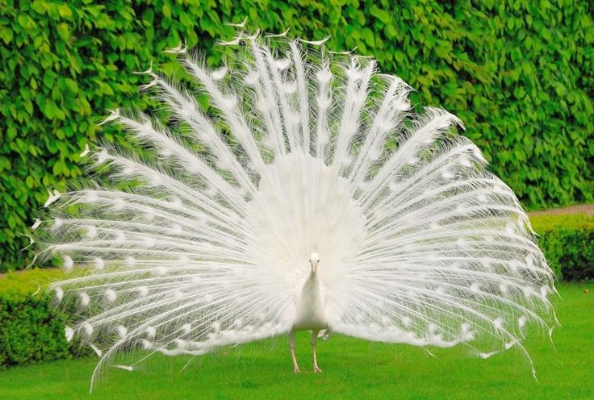
LADIES AND GENTLEMEN
NIMUVEA

