Slide 1
IMPROVING HAND HYGIENE COMPLIANCE AMONG HEALTH CARE WORKERS AT KITALE COUNTY HOSPITAL
Julia Ambeyi
Kitale County Hospital

Slide 2
HOSPITAL JOURNEY
Model site by MOH 2016
Identification of 4 quality improvement projects;
Hand hygiene
Health care waste management
Surgical site infections
Injection safety

Slide 3
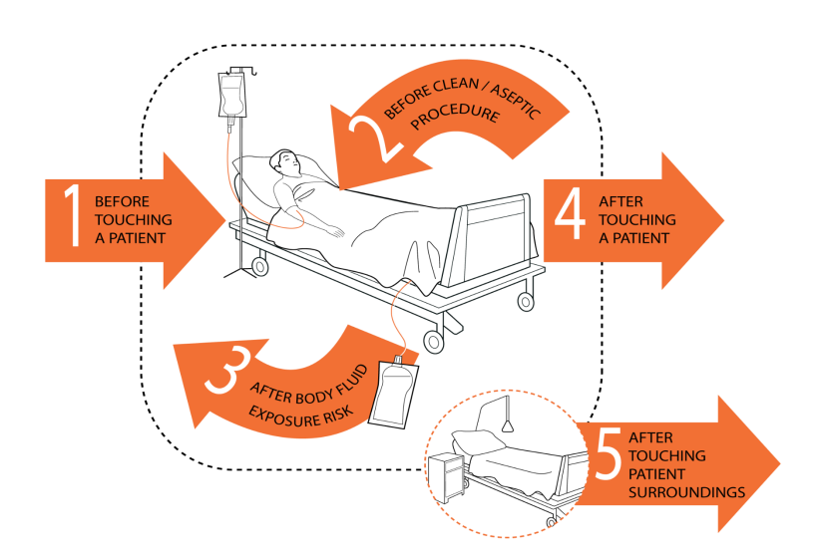
Hand Hygiene QI Project
Started in April 2018
Monthly data collection by the IPCC team
Use of WHO tool:
Assessment of 5 moments of Hand hygiene
Assessment of hand hygiene infrastructure

Slide 4

Increased hand hygiene =
Lack of hand hygiene
+
Patient care =
Increased risk of hand contamination
Increased risk to patient safety
Reduced numbers of patients acquiring HAIs
Decreased waste of resources
Saved lives
Notes:
SAY: Health care workers’ hands become colonized with microorganisms and potential pathogens during patient care. A lack of hand hygiene during patient care increases the risk of contamination and the spread of infection. The longer the duration of care , the higher the risk of hand contamination and potential risks to patient safety. Something as simple as good hand hygiene can reduce the number of patients acquiring HAIs. Fewer HAIs means fewer resources spent on combatting infections that could have been prevented, and ultimately, less morbidity and death. Hand hygiene is a critical component of patient safety and that is why it appears as one of the international patient safety goals.

Slide 5
Hand Hygiene Compliance per Unit-1

Slide 6
Hand Hygiene Compliance per Unit-2

Slide 7
Facility HH Compliance

Slide 8
What Worked
Increased knowledge among health care workers
Action plan to avert water shortage
Supply of ABHR by program partners
Supply of wall mount dispensers
Notes:
2 rounds done with maintenance on hand washing points, report complied, an a budget proposal for repairs submitted to the Med Sup
Problem of water valve tampering found , biomed to monitor the status daily

Slide 9
CHALLENGES
Only few IPCC members are available to collect data
Lack/ Inconsistent supply of hand hygiene supplies.
Non functional sinks
Unmet proposals
Notes:
Staffing shortage, minimum commitment on data collection
Awaiting release of funds for production of ABHR
Valve had been tampered with, also leaking tank not repaired. Facility bought clean water

Slide 10
Acknowledgement
IPC Focal person
IPCC team
ITECH, FHI360
CDC Kenya and Atlanta
MOH
Kitale Hospital Staff

Slide 11
Thank You

