Slide 1
Challenges and opportunities for Antimicrobial Stewardship in our setting- The Pharmacist’s role
Dr. Nath Arwa- Clinical Pharmacist
Aga Khan University Hospital, Nairobi
27th November 2018, Nyeri

Slide 2
Outline
Background information
Pharmacist’s role
AMS activities
Accomplishments
Challenges
Future activities

Slide 3
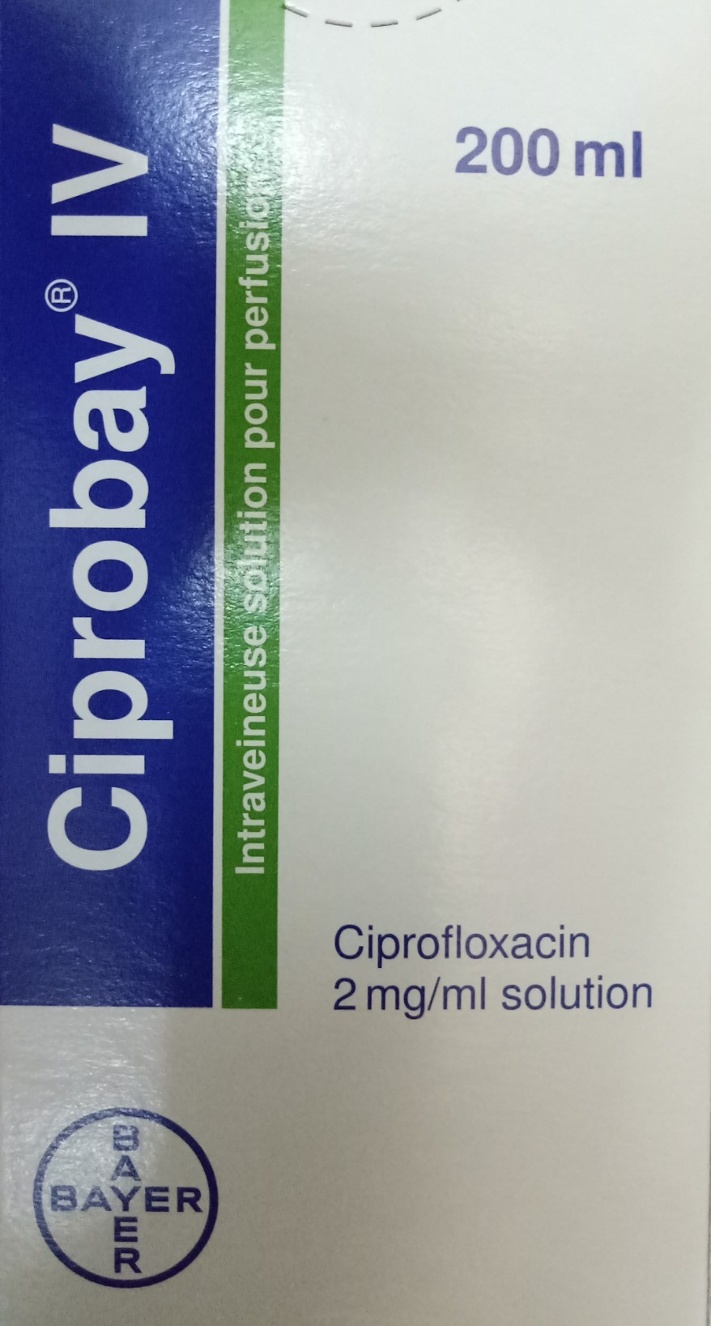
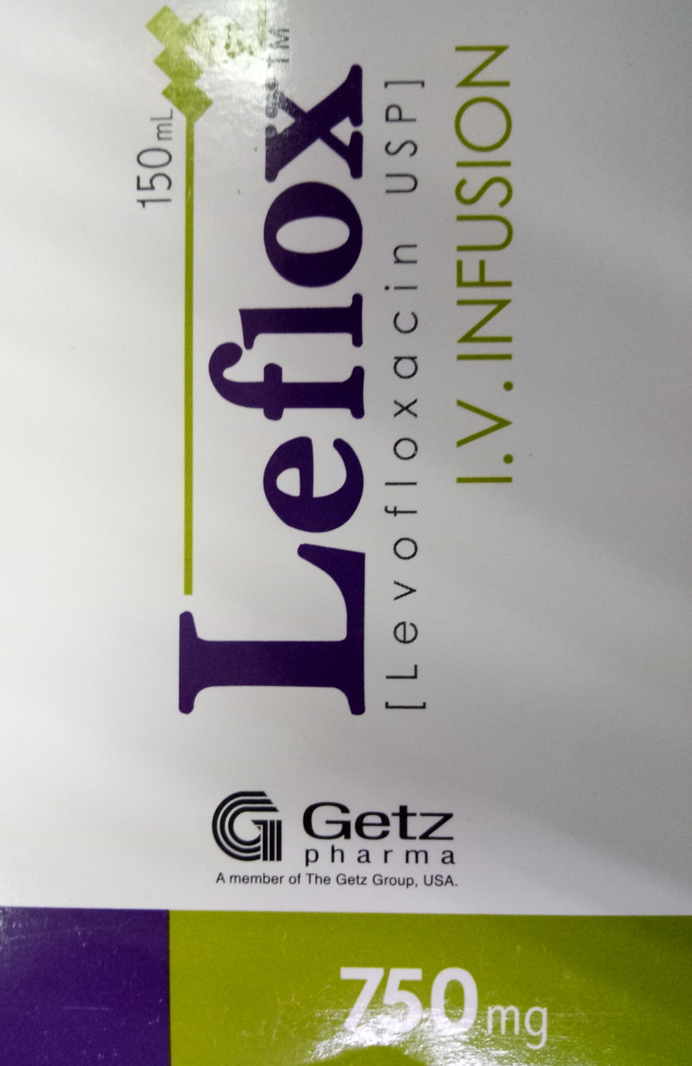
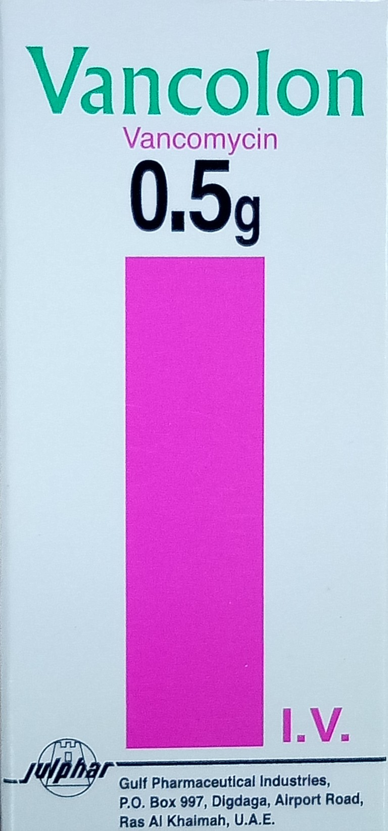

Slide 4
Background information
Suboptimal antimicrobial use common
Threatening patient safety
  the risks of antimicrobial-related complications
  lengths of stay and mortality rates
  increasing frequency of difficult to treat antimicrobial resistant infections
  paucity of new antimicrobials to combat drug-resistant organisms

Slide 5
What is Antimicrobial Stewardship?
It is a multidisciplinary program of activities that optimize antimicrobial use in order to improve clinical outcomes and minimize unintended consequences of antimicrobial use
  Toxicity
  C.difficile infections
  Development of resistance

Slide 6
Composition of an Antimicrobial Stewardship Team
ID Specialist
Hospital Administration
Infection Prevention & Control
Antimicrobial
Stewardship
Program
Microbiology(ist)
Pharmacy
Clinicians
Information Systems
Patient safety & Quality
Nursing

Slide 7
Pharmacist’s Roles
Ensure that each antimicrobial order has an indication
Ensure correct antimicrobial orders based on infection site, facility resistance patterns and guidelines
Restriction criteria and preferred formulary status
Optimize antimicrobial doses
  age, weight and organ function, causative pathogens and severity of infection

Slide 8
Pharmacist’s Roles contd
Follow up on microbiologic culture results
  de-escalate/ escalate or stop therapy
Recommend IV to PO conversion
Monitor for adverse drug reactions and drug-drug interactions
Assist in the development and implementation of antimicrobial use policies and educational material
Provide aggregated reports on antimicrobial use

Slide 9
Our initial AMS journey….
Joint commission made AMS mandatory by 1st January 2017
Multidisciplinary AST formed
Guidelines and policies
Daily OP AMB Rx review since Sept 2017
Feedback to prescribers & Pharmacy Management
Feedback to colleagues – WhatsApp forum
Feedback at divisional meetings
Hospital antibiogram (Prof. Revathi, Prof. Adam, Dr. Riunga)
OPAT
Monitoring AMBs in the ‘Sepsis protocol’ at A&E

Slide 10
Currently….
Daily OPD antimicrobial prescription audits
Patient education through leaflets designed by the AST
Pharmacy Staff education through the WhatsApp forum
Antibiotic prophylaxis policy and guidelines
  Drug Use Evaluation (DUE) on going
Antimicrobial Stewardship policy
Education through the PIL Newsletter
  AMS Policy flow chart, ABx surgical prophylaxis
Review of hospital antimicrobial guidelines
Off-hour phone ID consultations

Slide 11
Restricted AMBs
Decision to restrict use of 14 AMBs
IP interventions postponed till mid May 2018
Monitoring from 15th May 2018
CPs monitor use of category 1 Restricted AMBs
Category 2 to be monitored later

Slide 12
List of Category 1 & 2 AMBs
Category 1:
  Teicoplanin
  Tigecycline
  Linezolid
  Caspofungin
  Colistin (Polymixin E)
  Polymixin B
Category 2:
  Meropenem
  Imipenem/ cilastatin
  Ertapenem
  Doripenem
  Ceftazidime
  Cefepime
  Piperacillin/ tazobactam
  IV Vancomycin

Slide 13
Handling of Category 1 AMBs
Rationale for prescribing mandatory -notes & T-sheet
CPs discuss rationale with ID Physician on-call
ID on-call may choose to call prescriber directly to discuss case
Prescriber can alternatively directly call ID on-call to discuss AMB options at the time of prescribing
On-call ID Physician shall advise accordingly
Dispensing for 48 hrs after sampling for C&S/PCR
Rx lapses after 48 hrs- mandatory review with labs
Will allow room the opportunity to make a conscious decision to continue/ escalate/ de-escalate Tx
ID Physician’s decision is final!

Slide 14
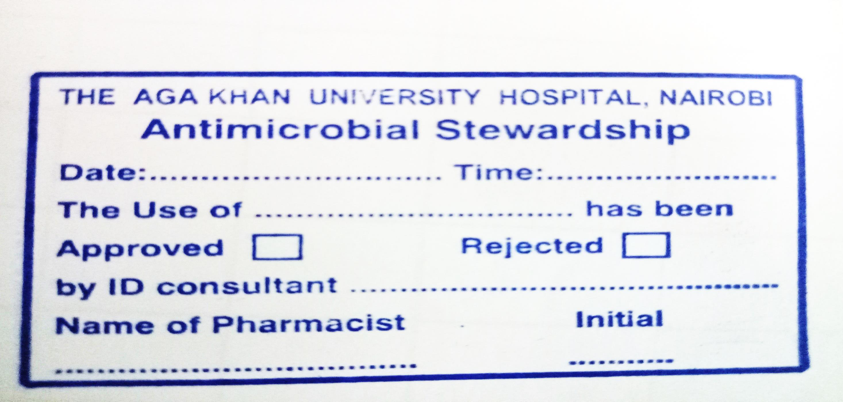
CP’s STAMP

Slide 15
Accomplishments
Hospital antibiogram available (soft and hard copies)
Policies completed forwarded to Chief of staff
Policy on AMS partially implemented from 15th May 2018
  decrease in the prescribing of category 1 AMBs
Antibiotic prophylaxis guideline -from 9th July 2018
  Duration- a challenge
Antimicrobial guidelines, AMS policy and the antibiotic prophylaxis policy & guidelines completed due for launching
Sepsis protocol

Slide 16
Accomplishments contd
4 ID Physicians
  3 actively involved
Chief of staff has approved guidelines & policies
  memos
Sensitized A&E prescribers on rational prescribing and common drug-drug interactions
  Fewer incidences of FQ- Antacid/ haematinic co-prescribing

Slide 17
Challenges
Unlike prescribers we don’t see the big picture
  Lack of access to imaging results etc.
  No bacteremia/ different focus other than blood
Belief in “hitting hard” instead of basing on labs
CPs Lack formal ID training
Challenge of covering off CP working hours
Rampant testing/ Tx of asymptomatic bacteriuria
Reluctance to De-escalate
Low uptake of “IV to PO conversion”
Prescriber arrogance/ intimidation

Slide 18
Challenges contd
ID consults will be a challenge
Certain divisions delayed in giving feedback during drafting of AMB guidelines
Passive nursing approach
Lack of Beta-D glucan test
Rampant Caspofungin use in critical care areas
Prolonged prophylactic ABX use (OBS/ GYNE)
Rampant Levofloxacin use in OP (Drug-resistant H. Pylori)
OP Data collection laborious/ time consuming
OP AMB Rx reviews -retrospective
High turnover at A&E- locum prescribers
Room for uptake of faster diagnostics (T2Candida/ T2Bacteria)

Slide 19
Future plans
ID pharmacy training for the 2 CPs in the AST
Prospective audits with feedback ( Category 1 & eventually 2 Restricted AMBs)
AMB guidelines to be launched and distributed
Regular DUEs of Surgical Prophylactic Antibiotics
Education
Point prevalence surveys for other ABXs

Slide 20
Colistin injection
Month | Total DDDs of Colistin dispensed
Jan-17 | 0
Feb-17 | 0
Mar-17 | 115.33
Apr-17 | 29
May-17 | 16.67
Jun-17 | 23
Jul-17 | 32
Aug-17 | 14.33
Sep-17 | 89.67
Oct-17 | 8
Nov-17 | 17.33
Dec-17 | 41
Jan-18 | 0
Feb-18 | 10
Mar-18 | 9
Apr-18 | 0
May-18 | 30
Jun-18 | 0
Jul-18 | 0
Aug-18 | 0
Sep-18 | 13
Oct-18 | 0

Slide 21
Linezolid
Month | Total DDDs of Linezolid dispensed
Jan-17 | 9.5
Feb-17 | 57.5
Mar-17 | 6
Apr-17 | 6.5
May-17 | 58.5
Jun-17 | 15.5
Jul-17 | 20.5
Aug-17 | 60
Sep-17 | 21.5
Oct-17 | 39
Nov-17 | 28
Dec-17 | 34
Jan-18 | 31.5
Feb-18 | 20.5
Mar-18 | 84
Apr-18 | 98.5
May-18 | 74
Jun-18 | 10.5
Jul-18 | 14.5
Aug-18 | 11.5
Sep-18 | 0
Oct-18 | 4

Slide 22
Teicoplanin injection
Month | Total DDDs of Teicoplanin dispensed
Jan-17 | 9
Feb-17 | 1
Mar-17 | 24.5
Apr-17 | 28.5
May-17 | 9
Jun-17 | 11
Jul-17 | 36
Aug-17 | 29.5
Sep-17 | 29.5
Oct-17 | 18.5
Nov-17 | 0.5
Dec-17 | 11
Jan-18 | 4
Feb-18 | 19.5
Mar-18 | 10
Apr-18 | 4
May-18 | 6
Jun-18 | 0
Jul-18 | 0
Aug-18 | 0
Sep-18 | 0
Oct-18 | 0

Slide 23
Tygecycline injection
Month | Total DDDs of Tygecycline dispensed
Jan-17 | 0
Feb-17 | 16
Mar-17 | 17
Apr-17 | 4
May-17 | 25.5
Jun-17 | 8
Jul-17 | 29
Aug-17 | 47
Sep-17 | 5
Oct-17 | 0
Nov-17 | 23.5
Dec-17 | 6
Jan-18 | 12.5
Feb-18 | 17
Mar-18 | 0
Apr-18 | 15
May-18 | 0
Jun-18 | 0
Jul-18 | 2
Aug-18 | 0
Sep-18 | 0
Oct-18 | 10

Slide 24
Caspofungin injection
Month | Total DDDs of Caspofungin dispensed
Jan-17 | 45.8
Feb-17 | 58.4
Mar-17 | 29.4
Apr-17 | 69.6
May-17 | 42.8
Jun-17 | 33.8
Jul-17 | 82
Aug-17 | 88
Sep-17 | 91.6
Oct-17 | 71.2
Nov-17 | 12.8
Dec-17 | 4.2
Jan-18 | 37
Feb-18 | 56.6
Mar-18 | 72.6
Apr-18 | 36.8
May-18 | 29
Jun-18 | 48.6
Jul-18 | 19
Aug-18 | 55.6
Sep-18 | 30.4
Oct-18 | 55.4

Slide 25
Vancomycin injection
Month | Total DDDs of Vancomycin Dispensed
Jan-17 | 85
Feb-17 | 135.75
Mar-17 | 120.25
Apr-17 | 115.75
May-17 | 107.75
Jun-17 | 98.75
Jul-17 | 162
Aug-17 | 64.25
Sep-17 | 60.75
Oct-17 | 72.5
Nov-17 | 77
Dec-17 | 54.5
Jan-18 | 73
Feb-18 | 64.75
Mar-18 | 51.75
Apr-18 | 58.25
May-18 | 96
Jun-18 | 64.75
Jul-18 | 73
Aug-18 | 76.5
Sep-18 | 63.25
Oct-18 | 105

Slide 26
Doripenem injection
Month | Total DDDs of Doripenem Dispensed
Jan-17 | 0
Feb-17 | 0
Mar-17 | 0
Apr-17 | 0
May-17 | 0
Jun-17 | 0
Jul-17 | 0
Aug-17 | 0
Sep-17 | 0
Oct-17 | 0
Nov-17 | 0
Dec-17 | 0
Jan-18 | 0
Feb-18 | 0
Mar-18 | 0
Apr-18 | 13.33
May-18 | 15.33
Jun-18 | 3.67
Jul-18 | 3.33
Aug-18 | 0
Sep-18 | 0
Oct-18 | 0

Slide 27
Ertapenem injection
Month | Total DDDs of Ertapenem Dispensed
Jan-17 | 35
Feb-17 | 13
Mar-17 | 51
Apr-17 | 43
May-17 | 74
Jun-17 | 9
Jul-17 | 23
Aug-17 | 46
Sep-17 | 2
Oct-17 | 18
Nov-17 | 34
Dec-17 | 71
Jan-18 | 49
Feb-18 | 12
Mar-18 | 59
Apr-18 | 47
May-18 | 58
Jun-18 | 25
Jul-18 | 50
Aug-18 | 51
Sep-18 | 109
Oct-18 | 31

Slide 28
Imipenem-Cilastatin injection
Month | Total DDDs of Imipenem Dispensed
Jan-17 | 90.25
Feb-17 | 51
Mar-17 | 99.75
Apr-17 | 47.25
May-17 | 75
Jun-17 | 29.5
Jul-17 | 92.75
Aug-17 | 46.5
Sep-17 | 56.25
Oct-17 | 85.5
Nov-17 | 73.75
Dec-17 | 46
Jan-18 | 32.25
Feb-18 | 56.25
Mar-18 | 55.75
Apr-18 | 74.5
May-18 | 29.25
Jun-18 | 34.5
Jul-18 | 44
Aug-18 | 15.75
Sep-18 | 27.75
Oct-18 | 44

Slide 29
Piperacillin-Tazobactam injection
Month | Total DDDs of Piperacillin Dispensed
Jan-17 | 140.142857
Feb-17 | 234
Mar-17 | 144.96
Apr-17 | 169.71
May-17 | 156.54
Jun-17 | 132.11
Jul-17 | 287.04
Aug-17 | 234.32
Sep-17 | 131.14
Oct-17 | 197.36
Nov-17 | 173.89
Dec-17 | 156.21
Jan-18 | 253.93
Feb-18 | 305.04
Mar-18 | 159.43
Apr-18 | 315
May-18 | 245.25
Jun-18 | 213.75
Jul-18 | 581.14
Aug-18 | 320.14
Sep-18 | 245.57
Oct-18 | 207.32

Slide 30
Meropenem injection
Month | Total DDDs of Meropenem Dispensed
Jan-17 | 672.25
Feb-17 | 642.25
Mar-17 | 794.75
Apr-17 | 649.25
May-17 | 608.75
Jun-17 | 637.25
Jul-17 | 724
Aug-17 | 460.25
Sep-17 | 360.5
Oct-17 | 747
Nov-17 | 455.75
Dec-17 | 481
Jan-18 | 715.25
Feb-18 | 454
Mar-18 | 479.75
Apr-18 | 658.5
May-18 | 725.5
Jun-18 | 456.75
Jul-18 | 558.75
Aug-18 | 391.5
Sep-18 | 491.25
Oct-18 | 629.25

Slide 31
Cefepime injection
Month | Total DDDs of Cefepime Dispensed
Jan-17 | 20
Feb-17 | 54
Mar-17 | 133.5
Apr-17 | 104.5
May-17 | 12
Jun-17 | 137
Jul-17 | 55
Aug-17 | 49
Sep-17 | 28
Oct-17 | 35
Nov-17 | 17
Dec-17 | 14
Jan-18 | 181
Feb-18 | 93
Mar-18 | 39
Apr-18 | 58
May-18 | 39
Jun-18 | 58
Jul-18 | 13.5
Aug-18 | 10.5
Sep-18 | 48.5
Oct-18 | 22.5

Slide 32
Ceftazidime injection
Month | Total DDDs of Ceftazidime Dispensed
Jan-17 | 47.75
Feb-17 | 16.25
Mar-17 | 25.25
Apr-17 | 11.25
May-17 | 57.75
Jun-17 | 1
Jul-17 | 12.5
Aug-17 | 15.5
Sep-17 | 28.5
Oct-17 | 16
Nov-17 | 21.75
Dec-17 | 15
Jan-18 | 35.25
Feb-18 | 4.75
Mar-18 | 30.75
Apr-18 | 9.25
May-18 | 10
Jun-18 | 4.25
Jul-18 | 14.5
Aug-18 | 9.25
Sep-18 | 4
Oct-18 | 10.5

Slide 33
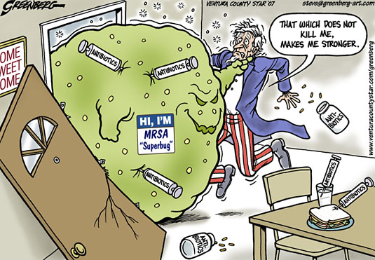

Slide 34
Thank You!

