Slide 1

AIC KIJABE-NAIVASHA MEDICAL CENTER
IPC -a pillar for quality of care in universal health coverage
Mary Njeri Njuguna
29th Nov 2018

Slide 2
A study on IPC education and provision of Hand hygiene products in improving compliance of Hand Hygiene in AIC Kijabe Naivasha Medical Center

Slide 3
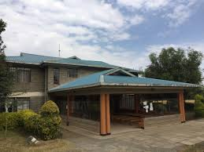
AIC Kijabe Naivasha Medical Center
Nakuru County- Kenya

Slide 4
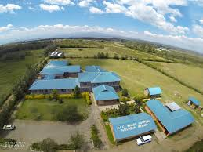
NAIVASHA MEDICAL CENTER

Slide 5
BACKGROUND
According to WHO, hands are the main pathways of germ transmission during health care while thousands of people die every day around the world from infections acquired while receiving health care.

Slide 6
BACKGROUND CONT……
Contaminated hands are the foremost source of spreading infection in health care workers. Practicing hand hygiene is a simple and effective way to prevent infection.
On average, healthcare providers clean their hands less than half of the times they should(CDC)

Slide 7
BACKGROUND CONT….
Safety of patient and health care workers can be achieved by promoting best practices in infection control through education on effective hand hygiene and provision of various measures of hand hygiene.

Slide 8
METHOD
A 6 days’ training on IPC was conducted in Nakuru.
It was followed by a Survey at the facility on hand hygiene.
A structured questionnaire was used during the survey for evaluating the compliance of hand hygiene among Health Care Workers (HCW) .
Observations were made on how, when and where they do their hand hygiene.

Slide 9
QUESTIONNAIRE
NO. | QUESTION | YES | NO | IF YES, EXPLAIN
1 | Do you know when to perform hand hygiene?
2 | Do you know where you can perform hand hygiene?
3 | Do you know the methods of hand hygiene?

Slide 10
OBSERVATION CHECKLIST
NO | OBSERVED PRACTICE | TICK AS APPROPRIATE
1 | WETTING HANDS
2 | APPLY SOAP AND SCRUBBING ALL AREAS OF THE HAND
3 | RINSING UNDER RUNNING WATER
4 | DRY USING PAPER TOWEL
5 | PROPERLY DISPOSING THE PAPER TOWEL

Slide 11
RESULTS
Among the staff evaluated , only 3% could clearly demonstrate hand washing procedure.
33% of the evaluated could explain when and where the hand hygiene needs to be done.
In the facility which has various departments, only 5 areas had hand sanitizers and 3 with running water

Slide 12
RESULTS CONT…..
Following the survey and the training, the IPC team conducted CMEs in the facility to most of the staff on the need for proper hand hygiene
Introduction of alcohol hand rubs equipments on the pathways of the hospitals.
Running water, soap, hand sanitizers and paper towels were introduced to each department and corridors improving accessibility and compliance on hand hygiene

Slide 13
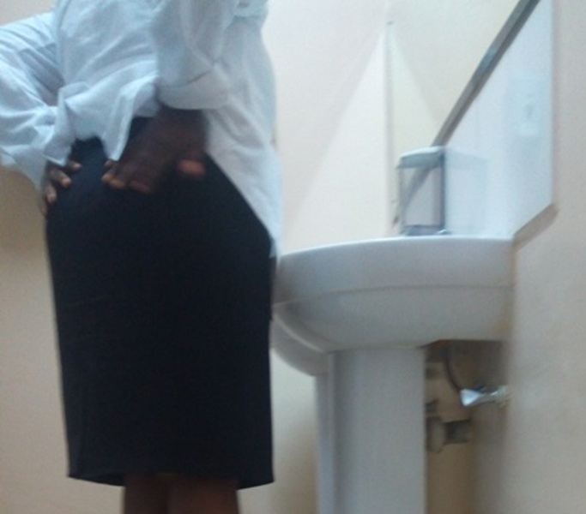
Poor hand drying practices

Slide 14
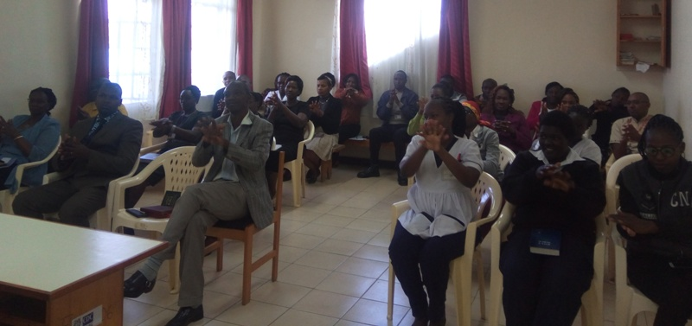
CME ON HAND HYGIENE

Slide 15
Results following the CME and IPC training
A survey was conducted using the same tools after 3 months.
98% percent of staff have knowledge of when and where to do hand hygiene.
80% can now demonstrate proper procedure for hand hygiene

Slide 16
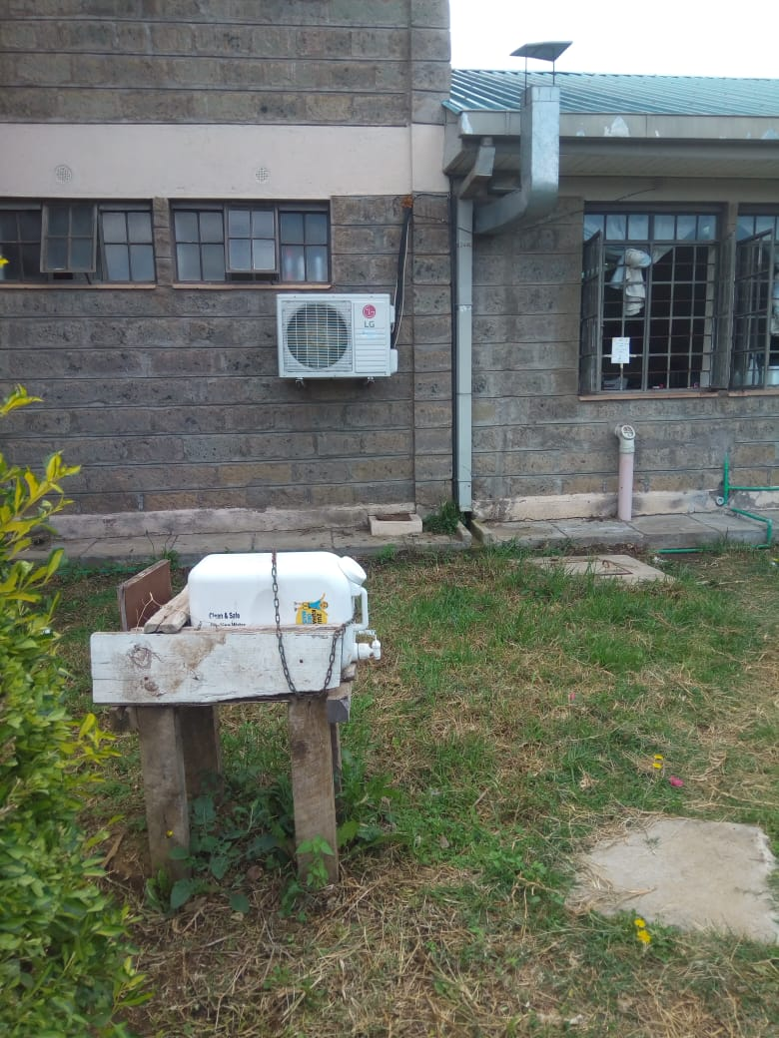
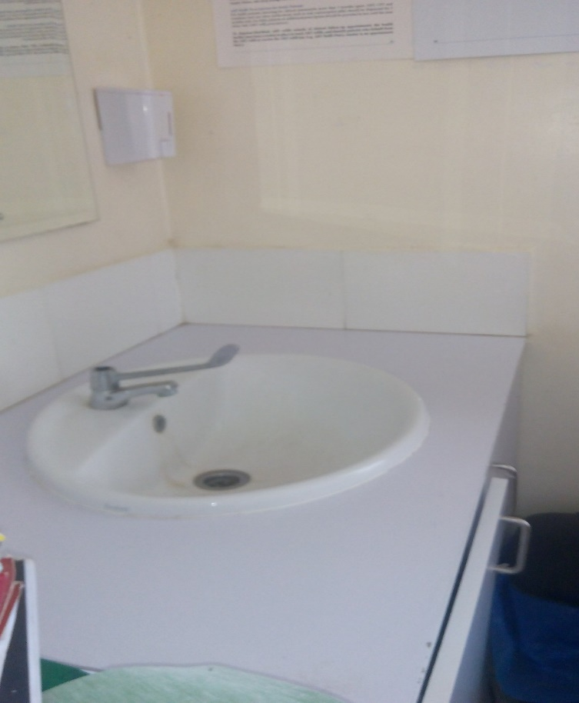
Hand hygiene before
Hand hygiene After

Slide 17
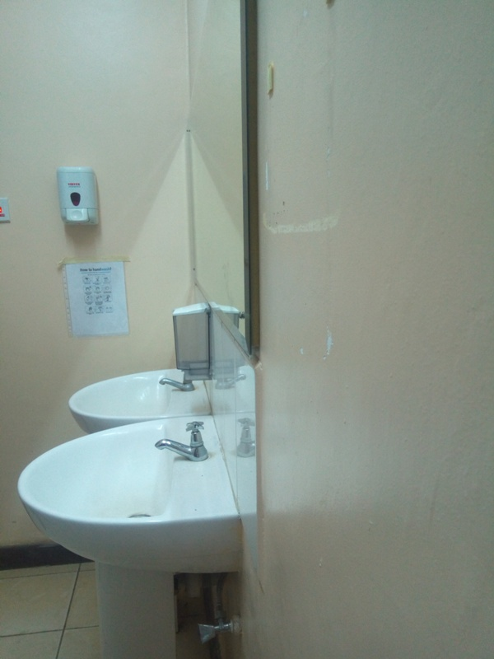
Availability of soap,towel and instructions

Slide 18
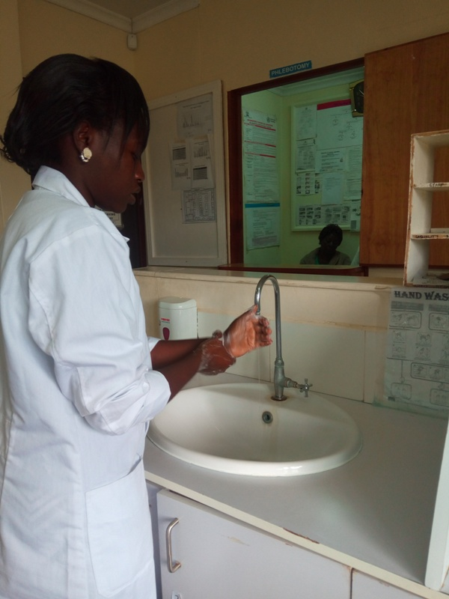

Slide 19
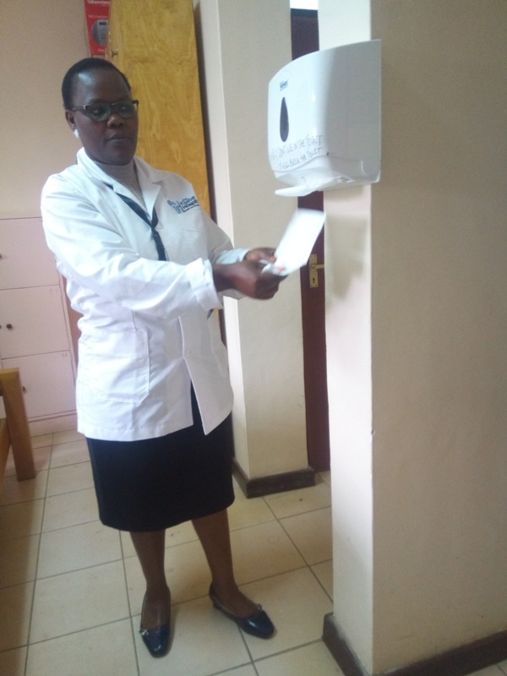

Slide 20
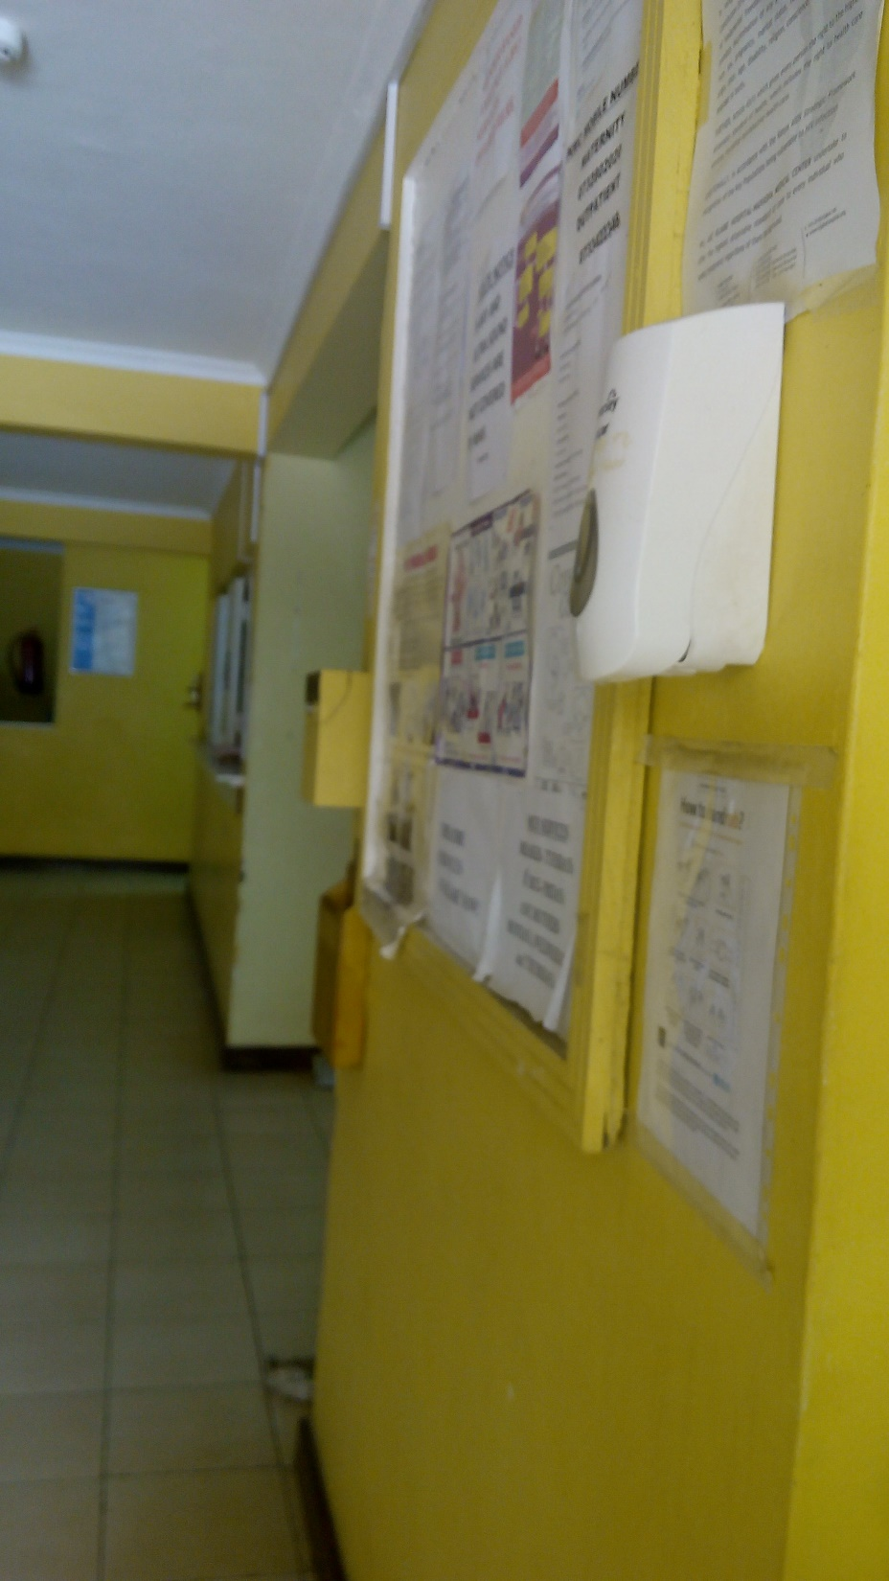

Slide 21
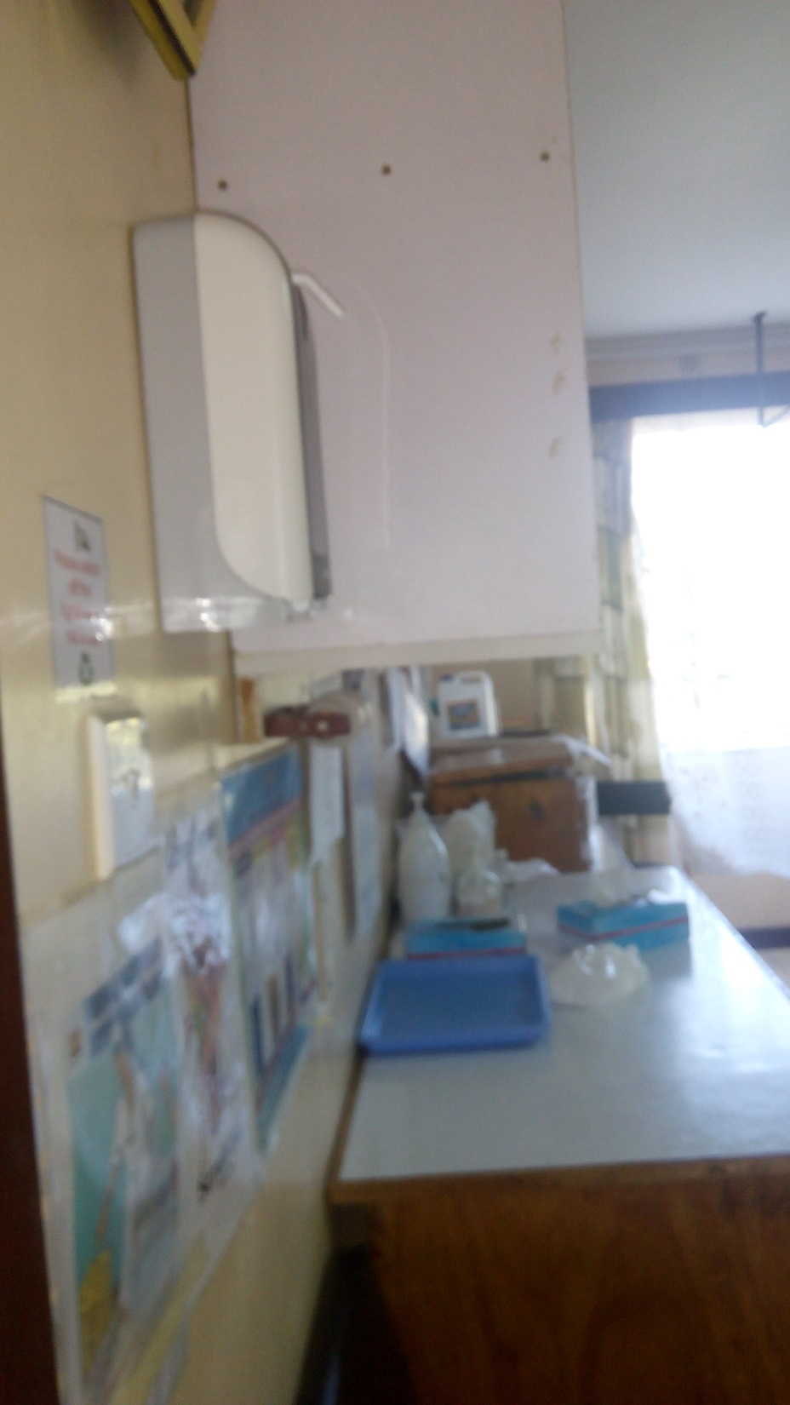

Slide 22
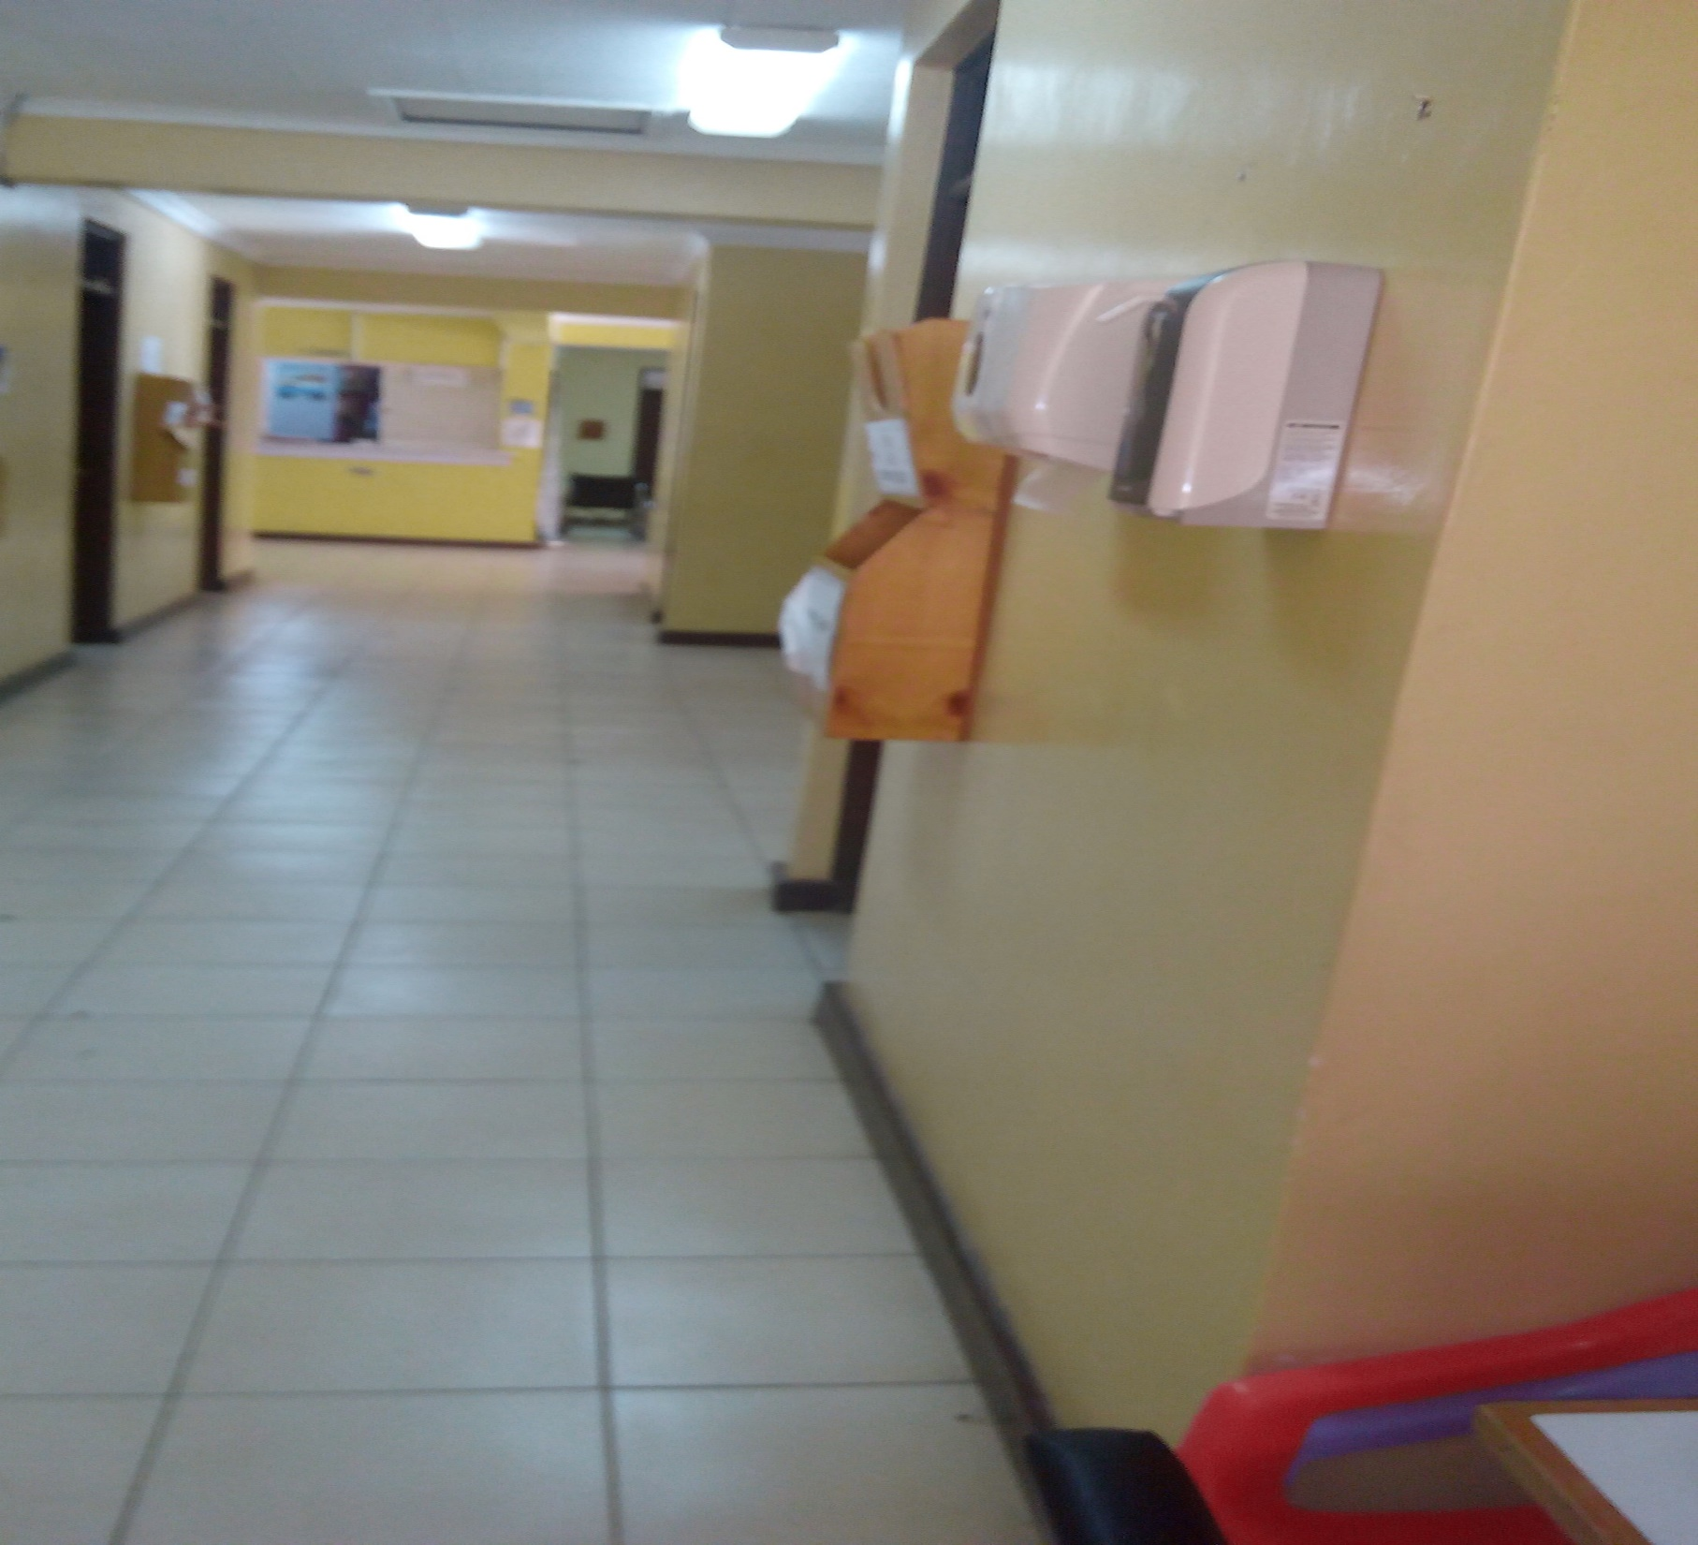

Slide 23
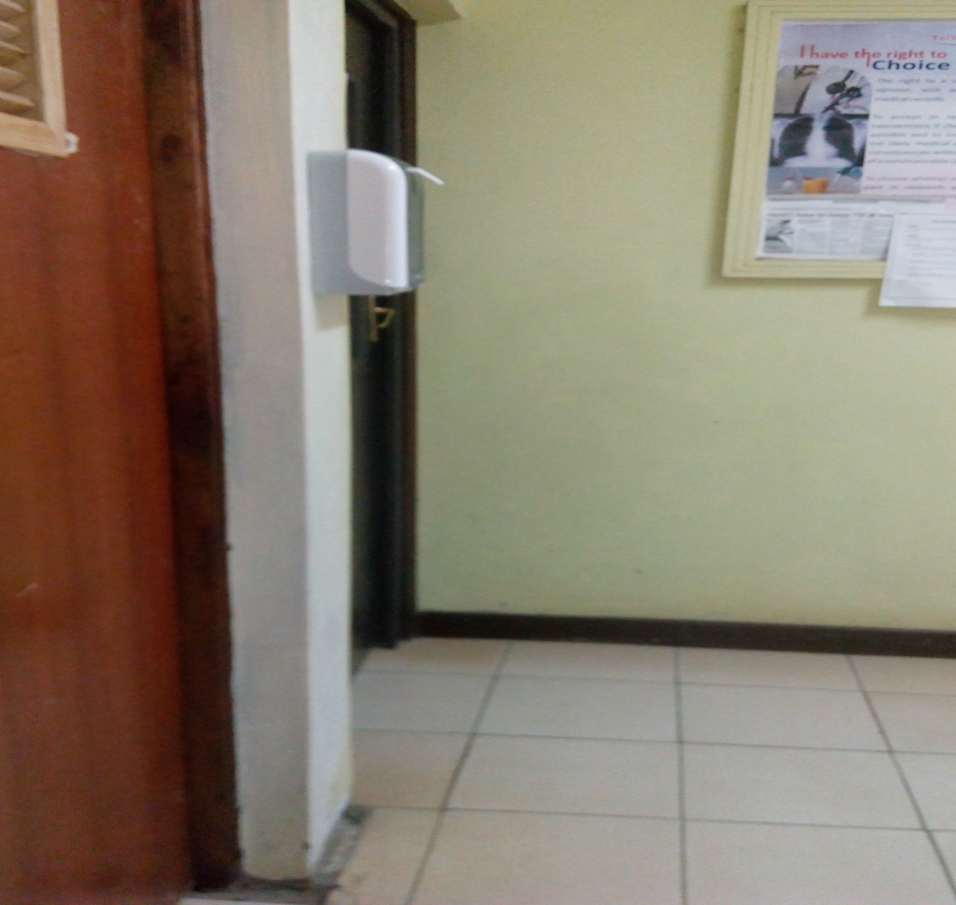

Slide 24
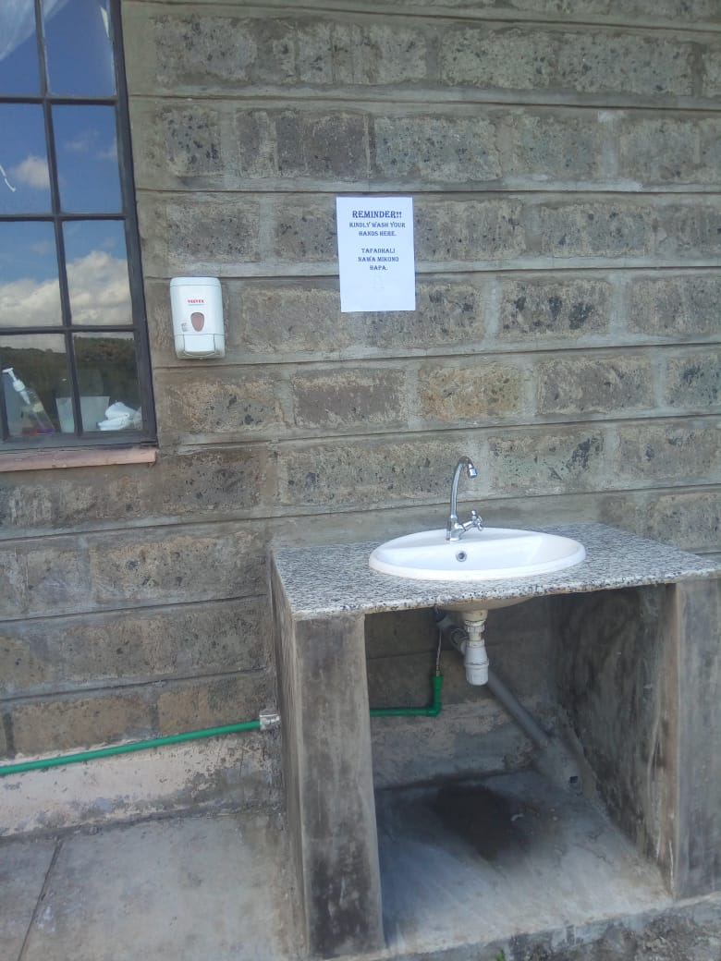

Slide 25
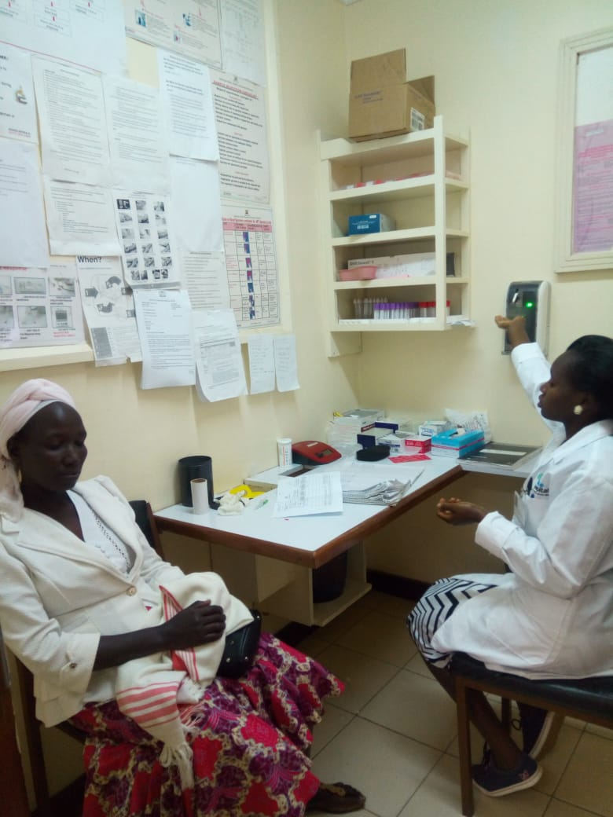

Slide 26
CONCLUSION
Training of staffs on Hand hygiene is key to any hand hygiene compliance
Management and staff sensitization on IPC is key for support and availing needed hand hygiene equipment
Provision of various hand hygiene products has promoted hand hygiene resulting to effective ways of preventing infection amongst HCW and patients.

Slide 27
ACKNOWLDGEMENT
Helina Maina
IPC Committee
FHI 360/CDC Laboratory Project

Slide 28
THANK YOU

