Slide 1
Title
Assess Health Care Waste Management (HCWM) in context of environmental safeguards in Universal Health Coverage.
A case of Nyeri County
Author;- Kenneth K.Njuki –Public Health Officer kenkjuki@yahoo.com

Slide 2
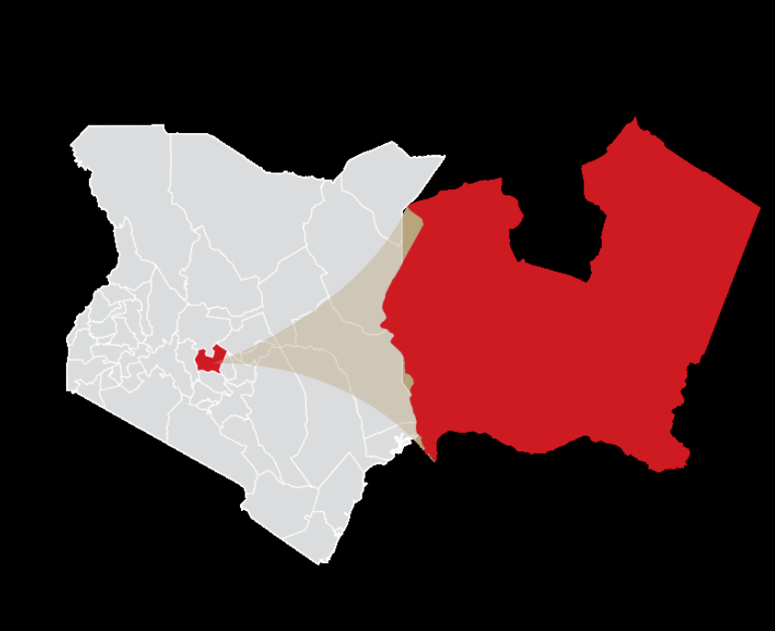
Nyeri County
(number 19)
County vision; A prosperous people in a secure, healthy environment, with a high quality of life.

Slide 3
Introduction
Government of Kenya has prioritized Universal health coverage (UHC) in its big 4 agenda.
Nyeri is among the first four piloting counties in UHC others being Kisumu, Isiolo and Machakos.
Without effective environmental safeguards, health care waste is known to expose health workers and the public to infections/ hazards.
Since environmental safeguards are key to UHC implementation, we assessed and analyzed some of the adopted practices in waste management by health facilities in the County.

Slide 4
Methodology
Between July and September 2018 a cross sectional study was done to assess in public, faith based and private health facility settings availability of;-
Functional incinerators,
Burning chambers
Well protected placenta pits
Protected ash pits and
Having colour coded bins and
Waste segregation practices

Slide 5
Methodology cont-
Seven hospitals, twelve health centers and seven dispensaries were surveyed by collecting data through an expert standardized national self-administered questionnaire/observation check list.
Data was collected on a Microsoft Excel spreadsheet, analyzed and summarized in frequencies and percentages.

Slide 6
Findings
Of the facilities assessed
5(71%) of the hospitals had a functional incinerator
3(28%) of health centers and 1(14%) of dispensary had burning chamber.
Facilities with colour coded bins,
5(64%) of hospitals
4(33%) of health centers
100% dispensaries

Slide 7
Findings conti -
On waste segregation
Only hospitals were segregating waste and only in 3 out 7 (38%) assessed.
Availability of protected ash pits was fairly well distributed;-
Hospitals (64%),
Health centers (32%)
Dispensaries (33%).

Slide 8
On well protected placenta pits
Hospitals (71%)
Health centers (41%)

Slide 9
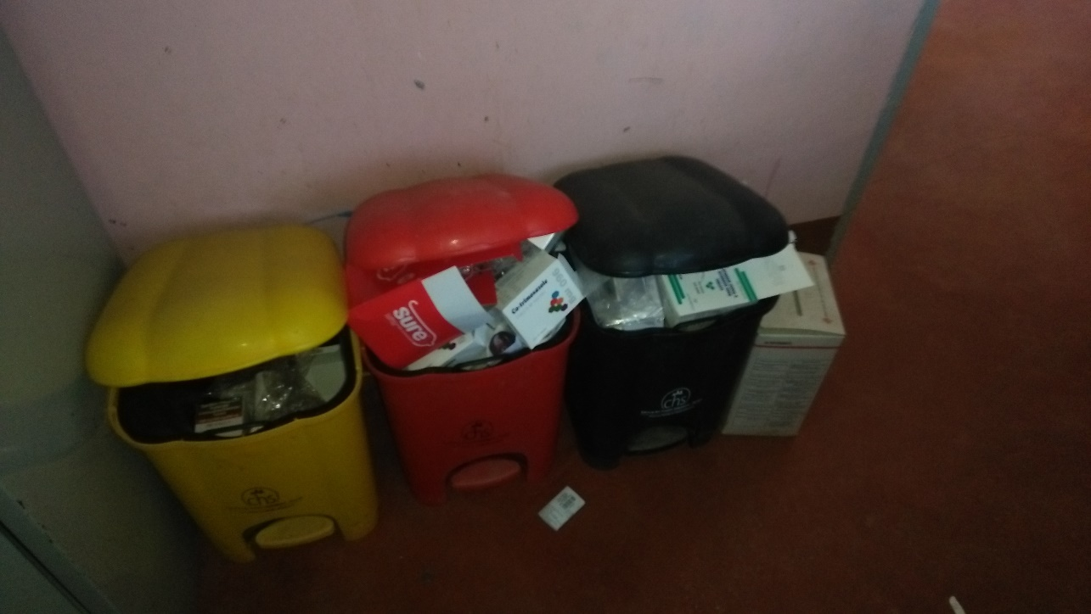
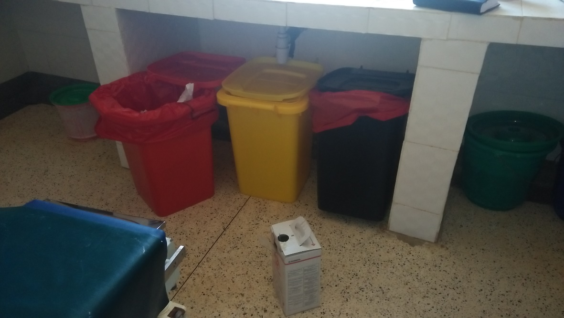
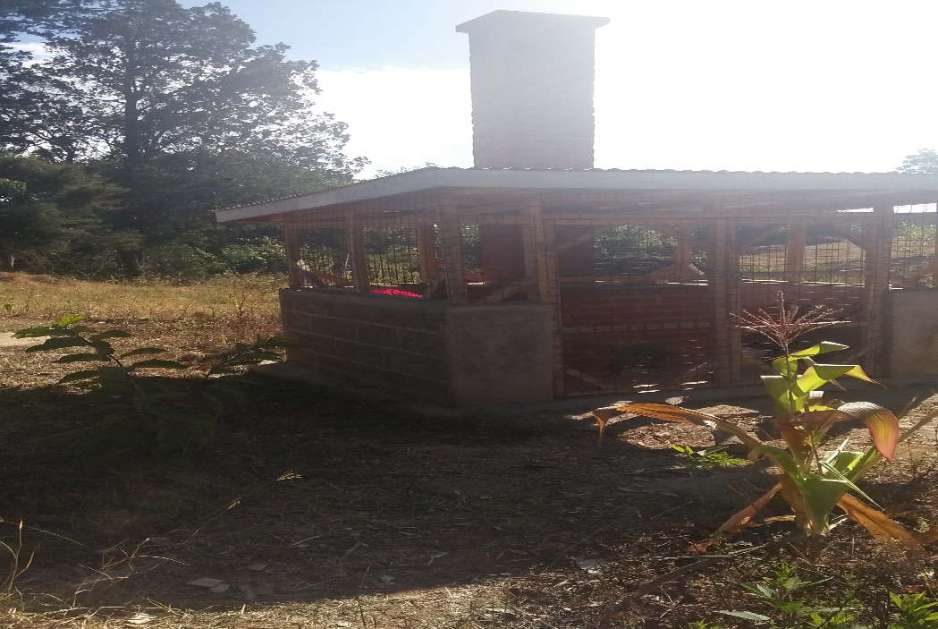
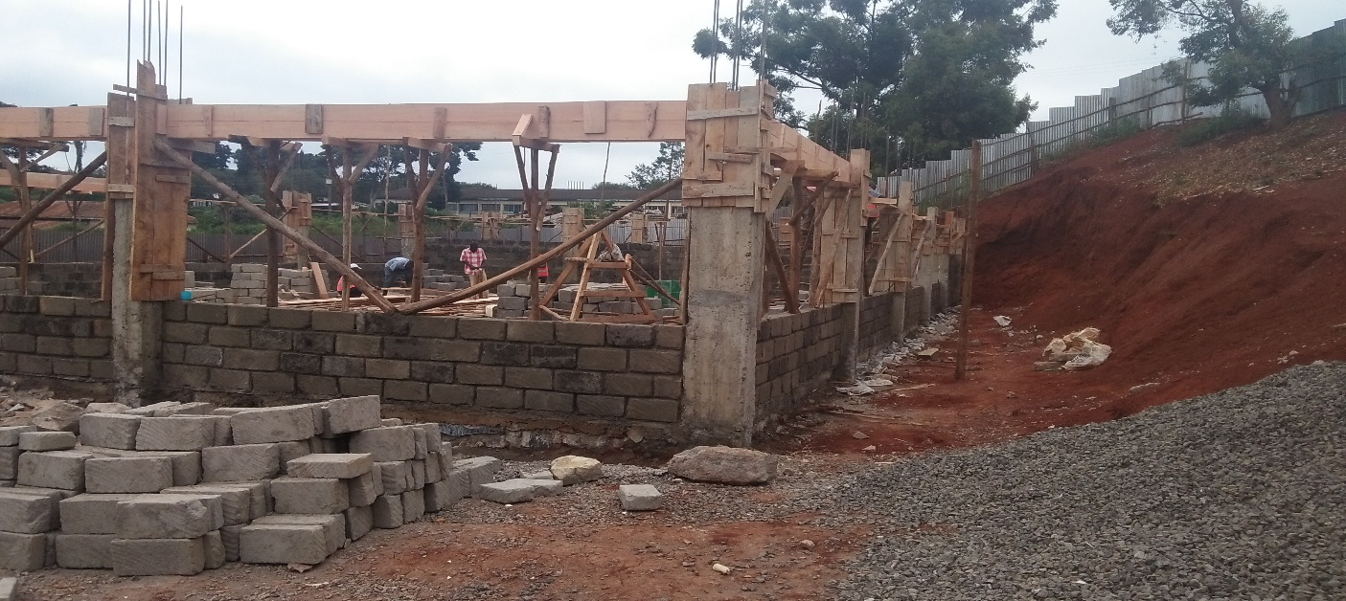

Slide 10
Conclusion
More resources need to be allocated by the County Government/Partners to be spent on provision of basic commodities/amenities and training of staff on proper health care waste management practices

