Slide 1
Mathematical Tools for Understanding Healthcare Associated Infections
Samuel Mwalili, PhD
Senior Statistician, Surveillance and Epidemiology
Division of Global HIV and TB, CDC
5th IPNET-Kenya Infection Prevention and Control Conference
18 November 2016
Machakos, Kenya

Slide 2
What is HAI?
Healthcare-associated infections (HAIs)–infections that patients acquire during the course of receiving treatment for other conditions or that healthcare workers acquire while performing their duties within a healthcare setting.

Slide 3
Health-care-associated infections
Health-care-associated infections (HAIs) are characterized by pathology related to the presence of infectious agents or their products
Transmissible agents – fungi, viruses, parasites, prions, etc.)
HAIs are often caused by bacteria, which frequently acquires resistance to one or more antimicrobial agents
Bacteria have the ability to colonize human beings for prolonged period of time

Slide 4
Need for mathematical tools in unpacking HAI

Slide 5
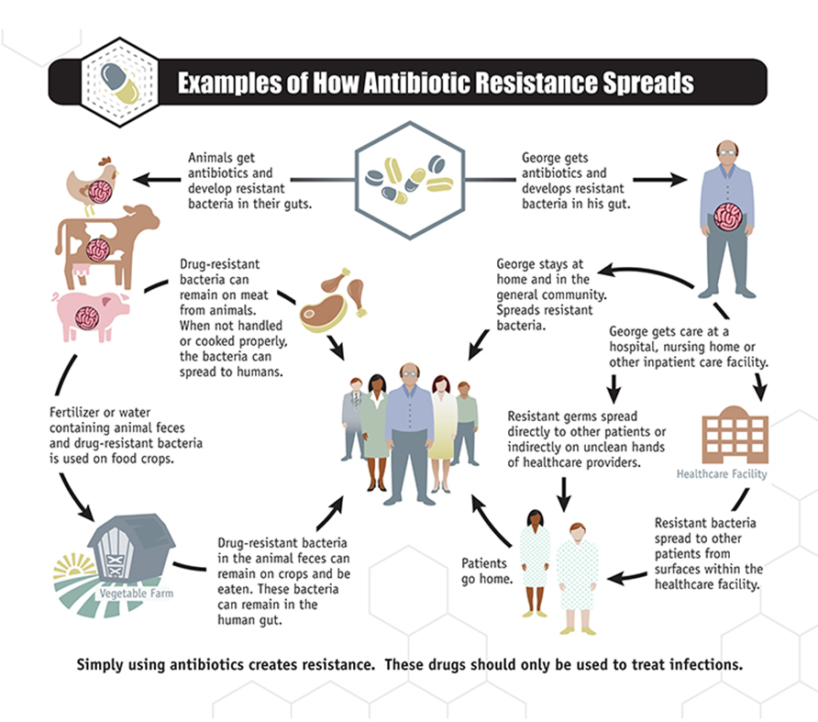
Where Mathematical Models are required

Slide 6
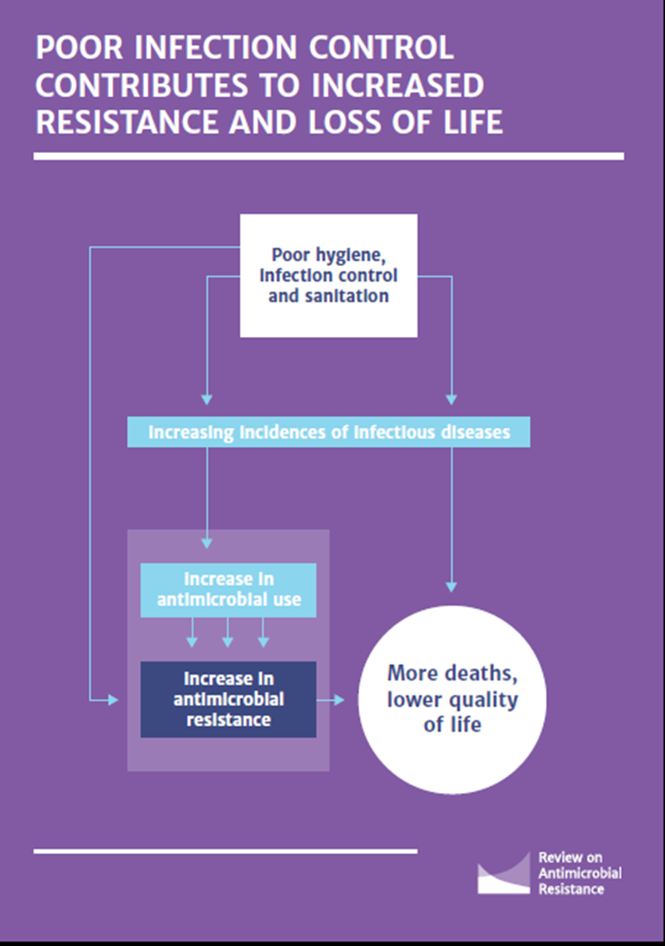
What are the dynamics (e.g “force of infection”) underlying the healthcare-patient infection?

Slide 7
Understanding of the underlying dynamics
Control of HAIs DEMAND thorough understanding of the underlying dynamics of HAIs w.r.t their ecology, epidemiology and economic ramifications

Slide 8
Mathematical models provide evidence-based and cost-effective methods
Mathematical models identify factors responsible for the observed patterns of occurrence and provide a theoretical guidelines for the design of efficient countermeasures
Mathematical models aim improve the understanding of the pathogen transmissions by estimating the transmission rate of contagions and predicting the impact of interventions

Slide 9
SIR model

Slide 10
SIR model for epidemics (compartmental model)
N: number of individuals in the population
S: number of Susceptible individuals
I: number of Infective individuals
R: number of Removed (recovered/dead) individuals
homogeneous mixing:
S → I with rate β (infection rate)
I→ R with rate μ (recovery rate)

Slide 11
SIR model for epidemics
s: susceptible
i: infected
r: recovered
s → i β (infection rate)
i → r μ (recovery rate)

Slide 12
SIR model for epidemics: numerical integration
condition for outbreak:

Slide 13
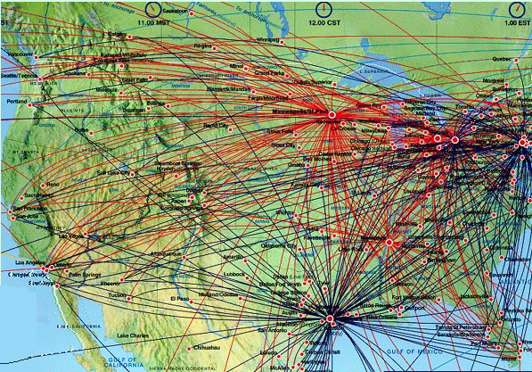
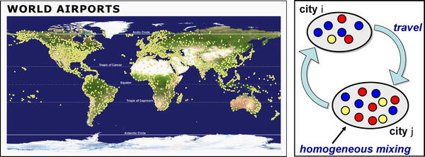
The effect of the airline transportation network
Main modeling features (SARS, H1N1, etc.):
SIR model with empirical population
and airline traffic/network data
homogeneous mixing within cites
network connections and stochastic
transport between cities
Colizza et al. (2007) PLoS Medicine 4, 0095

Slide 14
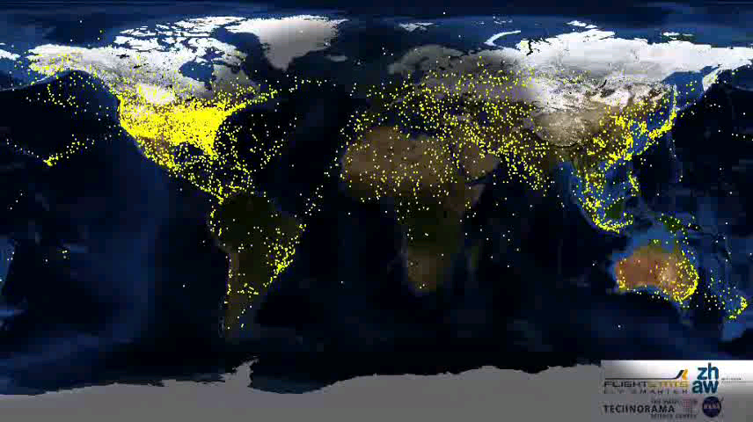

Slide 15
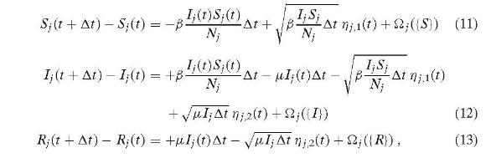
Stochastic SIR on global networks
Main modeling features:
SIR model with empirical population
and airline traffic/network data
homogeneous mixing within cites
network connections and stochastic
transport between cities
Gaussian noise
stochastic travel operator
Colizza (2006) Bulletin of Math. Biol. 68, 1893-1921

Slide 16
Methicillin-resistant Staphylococcus aureus (MRSA) transmission at intensive care unit

Slide 17
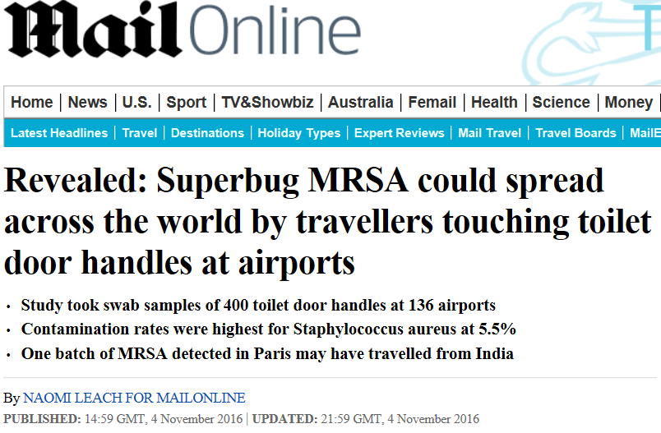

Slide 18
MRSA transmission at intensive care unit
Staphylococcus aureus is a major cause of healthcare associated bacteraemia and post-operative wound infection
Methicillin-resistant S. aureus (MRSA) emerged in Europe in 1960s but now is found throughout the world
IPC strategies today are not frequently supported by rigorous scientific evidence

Slide 19
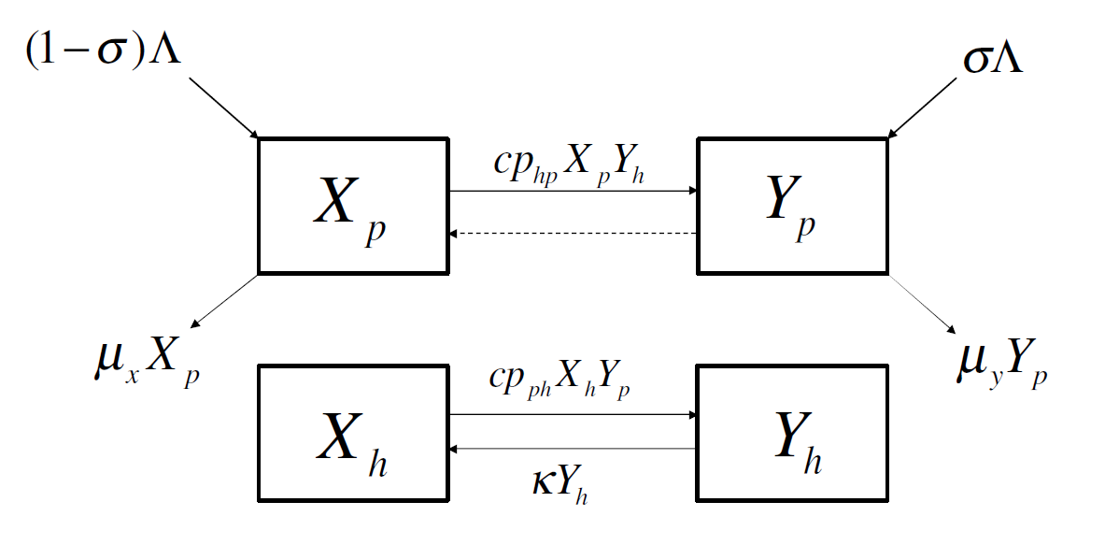
… Susceptible patient (p) and healthcare worker (h)

Slide 20
…. Infectious patient and healthcare worker

Slide 21
… a proportion of patients may be colonized on arrival

Slide 22
… allow for natural death of patients

Slide 23

… Contact rate c and Transmission probability p

Slide 24
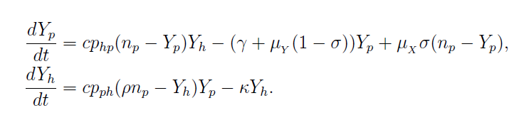
…. Simplified mathematical equation

Slide 25
