Slide 1
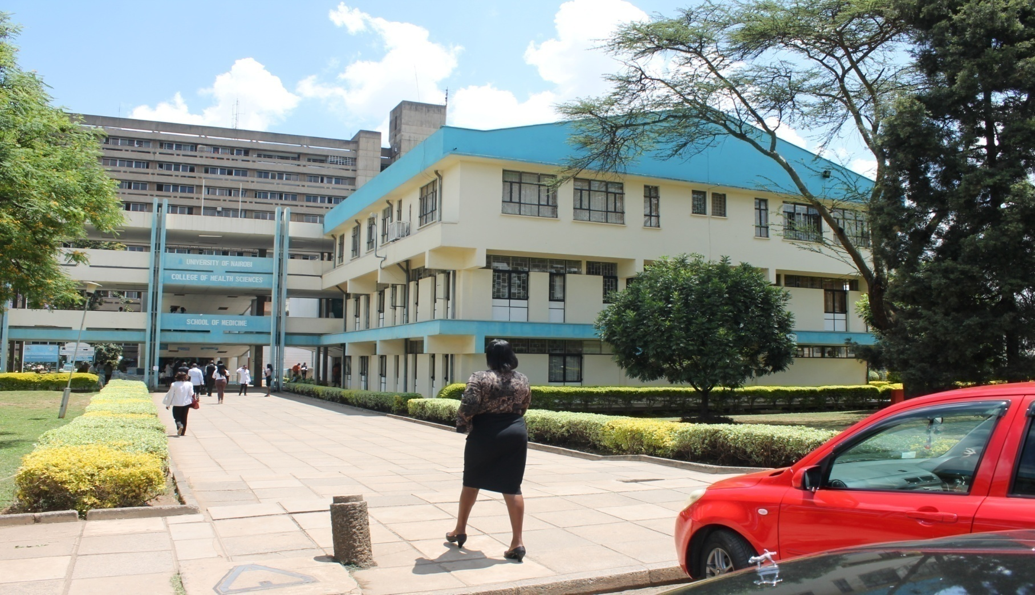
University of Nairobi
College of Health Sciences

Slide 2
IPC IN SPECIALIZED UNITS FOCUSING IN ICUs
Introduction
Hospital acquired infections is a major safety concern for both healthcare providers and patients.
Considering morbidity, mortality, increased length of stay and cost, efforts should be made to make the hospital as safe as possible by preventing such infections.

Slide 3
RISK OF INFECTIONS IN ICU
Patients hospitalized in ICUs have 5-10
times risk to acquire nosocomial
infections than other hospital patients.
Frequency of infections at different anatomic sites and risk of infections vary with the type of ICU, frequency of specific pathogens varies by infection site.

Slide 4
RISK OF INFECTIONS IN ICU cont.
Contributing to Seriousness of nosocomial infections especially in ICUs is the increasing incidence of infections caused by antibiotic resistant pathogens.
Why do patients need ICU Care?
Ventilatory Support – Respiratory Failure, Pneumonia
Heamodynamic Support – Shock
Renal Replacement Therapy – Renal failure, severe Acidosis
Monitoring, Neurologic dysfuntion, Hematologic

Slide 5
Factors that increase Cross infection
Lack of Hand washing facilities.
Patients close together
Understaffing – nurse/patient ratio
Preparation of IVs on the unit
Lack of isolation facilities
No separation of clean and dirty areas
Excessive Antibiotic use
Inadequate decontamination of items & Equipment
Inadequate cleaning of environment

Slide 6
Some Health-care Associated Infections
UTI associated with Foley catheter
Lower respiratory Tract Infection-post_op and ventilator depedent
Skin necrosis (skin breakdown)
Bloodstream infection and line associated
Surgical site infection
Nutritional related and malnutrition

Slide 7
FEVER IN THE ICU
ICU patients have several underlying Medical/
surgical conditions
Undergo many invasive diagnostic/therapeutic procedures.
Fever in ICU must be thoroughly & promptly evaluated to discriminate infections from non infectious aetiologies.

Slide 8
Infectious Causes of Fever in ICU
Ventilator associated Pneumonia
Catheter related blood stream infections
Urosepsis
Intra-abdominal infections
Sinus Infections
Diarrhoea
Surgical site infections
Intravenous line infections
Drug fever
Post operative fever
Neurosurgical causes

Slide 9
Why pay attention to ICU Patients
Sickest Patients – Multiple diagnosis, multiple organ failure, immuno- compromised, sepsis, trauma
Move less
Malnourished
More obtunded (Glasgow Coma Scale)
Diabetes and Heart failure

Slide 10
Risk Factors of Infection
Operative Surgery
Intravascular & Urinary Catheterization
Mechanical ventilation
Other factors – multiple injuries, burns, age (elderly or neonates), immuno-suppression, existing disease.

Slide 11
Inanimate Environment
Is a reservoir of pathogens.
Equipment, tables, files, sinks, Floor, Curtains, Linen
High-quality cleaning and disinfection of all patient areas is important, especially surfaces close to the patient.
Some pathogens can survive for long periods in the environment, particularly MRSA, VRE.

Slide 12
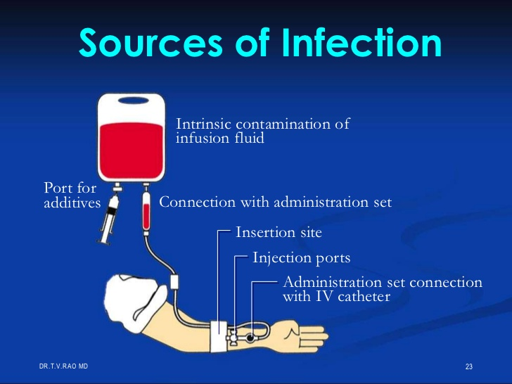
Intrinsic contamination of Infusion Fluid

Slide 13
Strategy for Prevention
Hand washing
Use gloves to prevent contamination of the hands when handling respiratory secretions.
Wear gloves and gowns(contact precautions) during all contact with patients and items potentially contaminated with respiratory secretions.
Use aseptic technique.

Slide 14
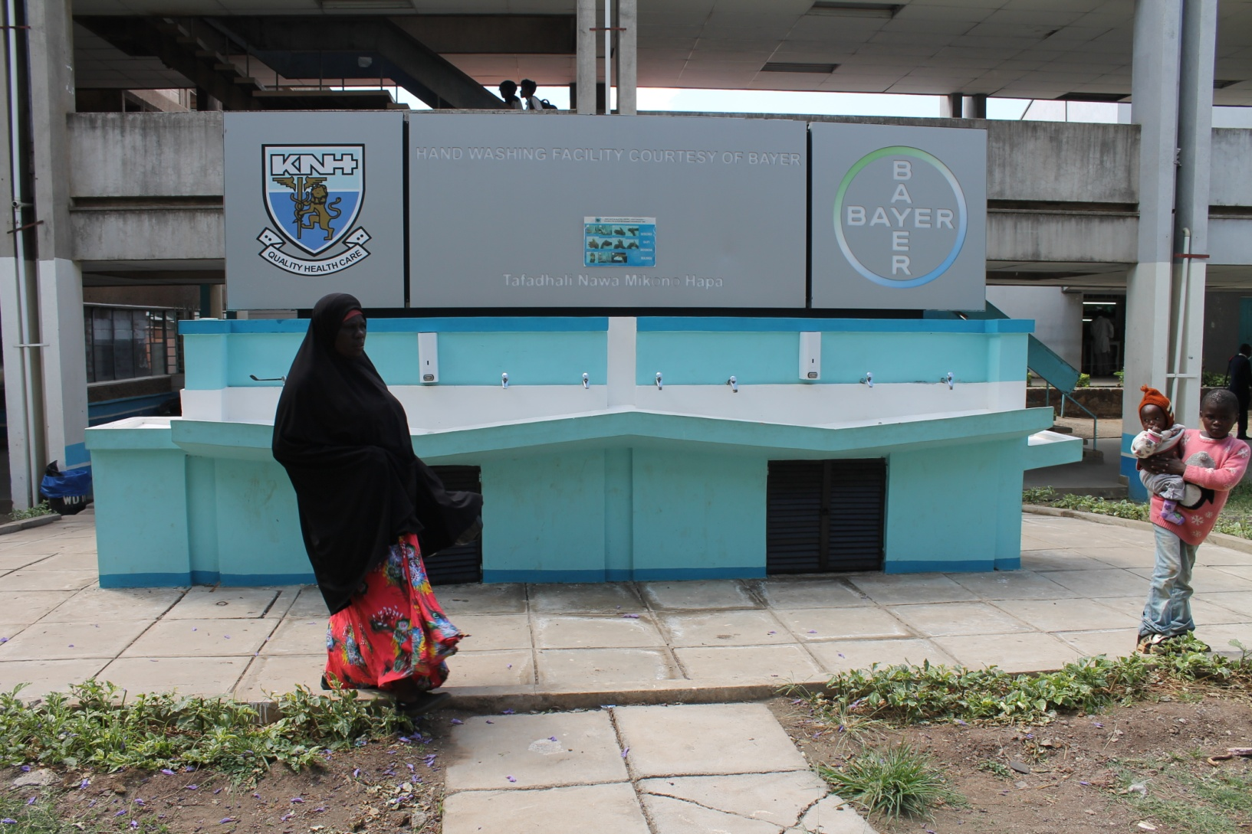
Hand Washing

Slide 15
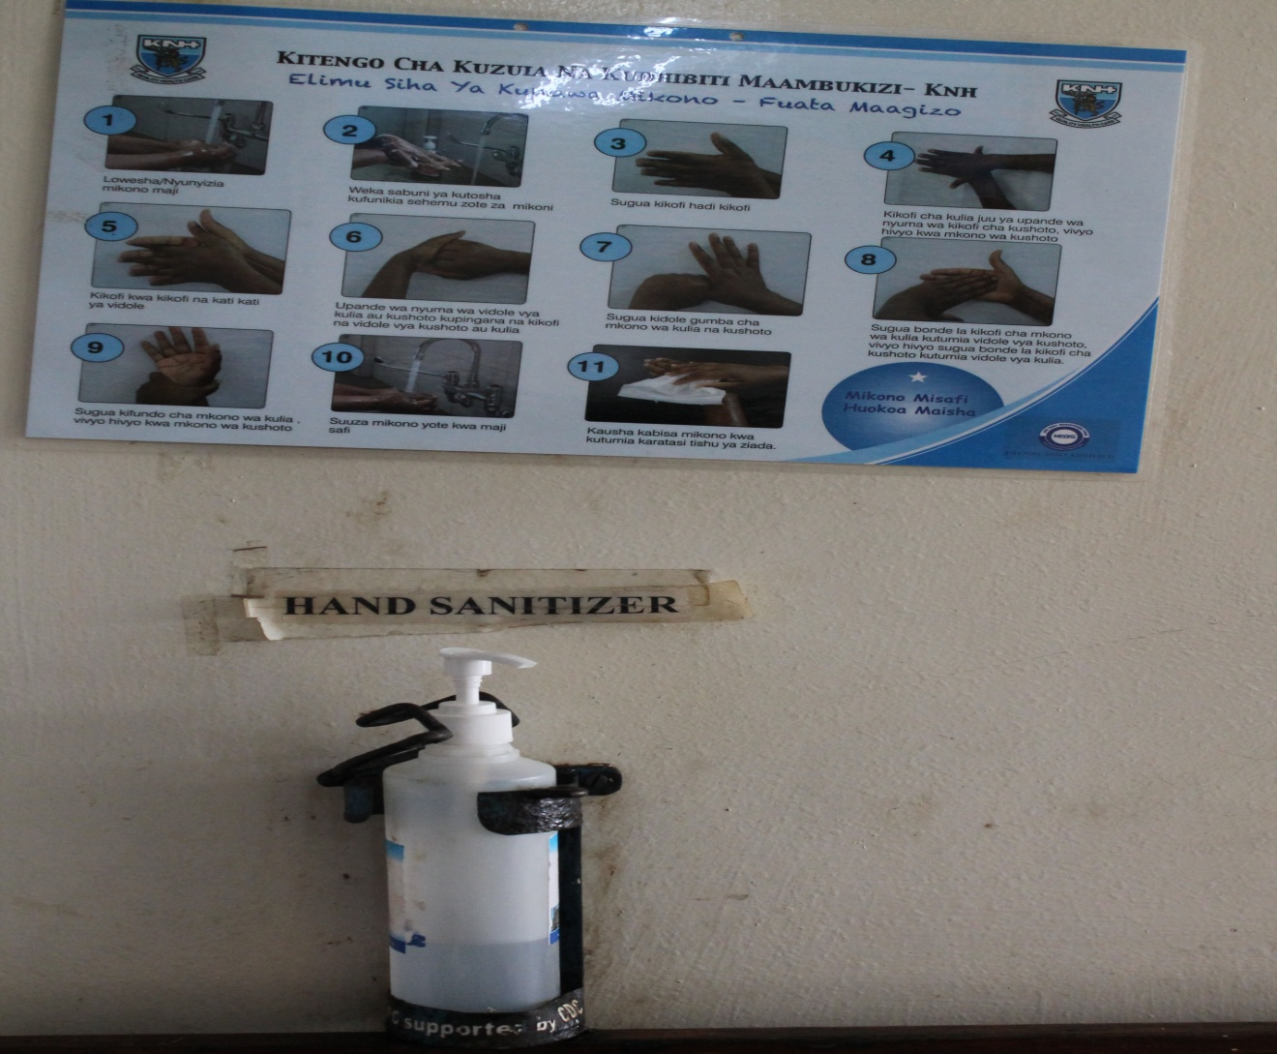
Hand Sanitizer

Slide 16
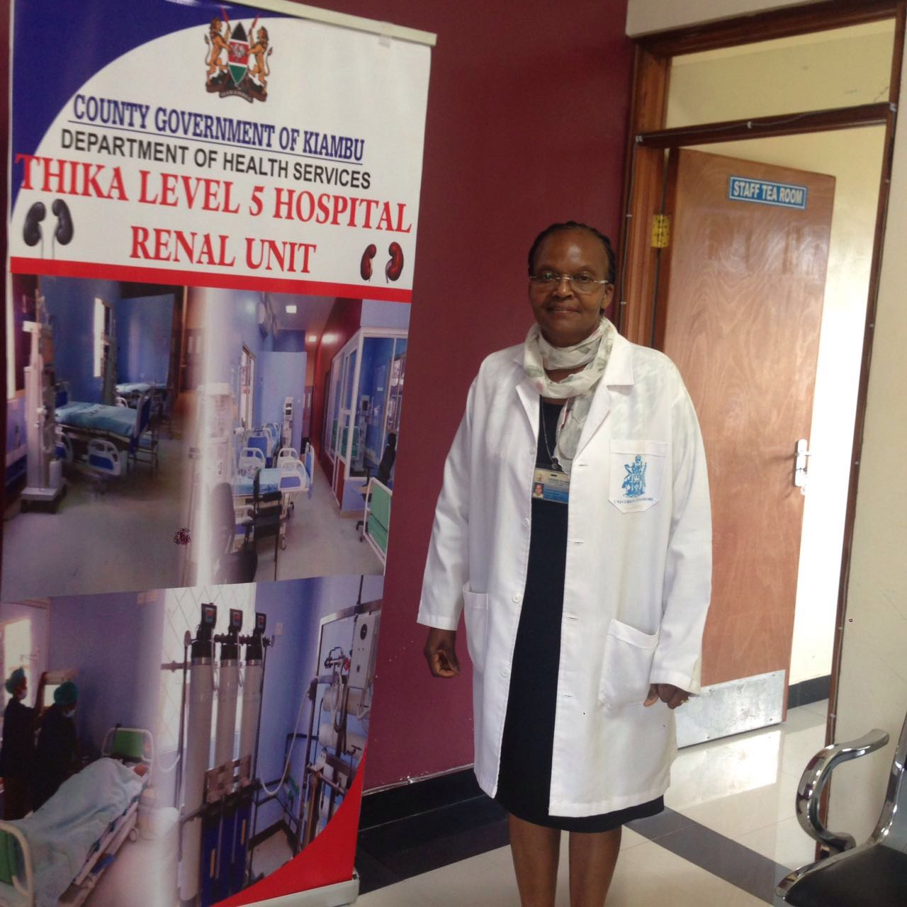
Thika Level V – New ICU

Slide 17
Strategy for Prevention
Clean and decontaminate all equipment after use.
Sterilize or use high-level disinfectant for all items that come into direct or indirect contact with mucous membranes.
Rinse and dry items that have been chemically disinfected.
Package and store items to prevent contamination before use.
Keep environment clean and dry and dust free.

Slide 18
INFECTION CONTROL MEASURES
Identify Reservoir colonized and infected patients, Environmental contamination, common sources.
Halt transmission among patients. Improve hand washing and asepsis. Barrier precautions (gloves, gown) for colonized and infected patients eliminate any common sources.
Disinfect environment.
4. Separate susceptible patients
5. Close unit to new admissions if necessary.

Slide 19


Slide 20
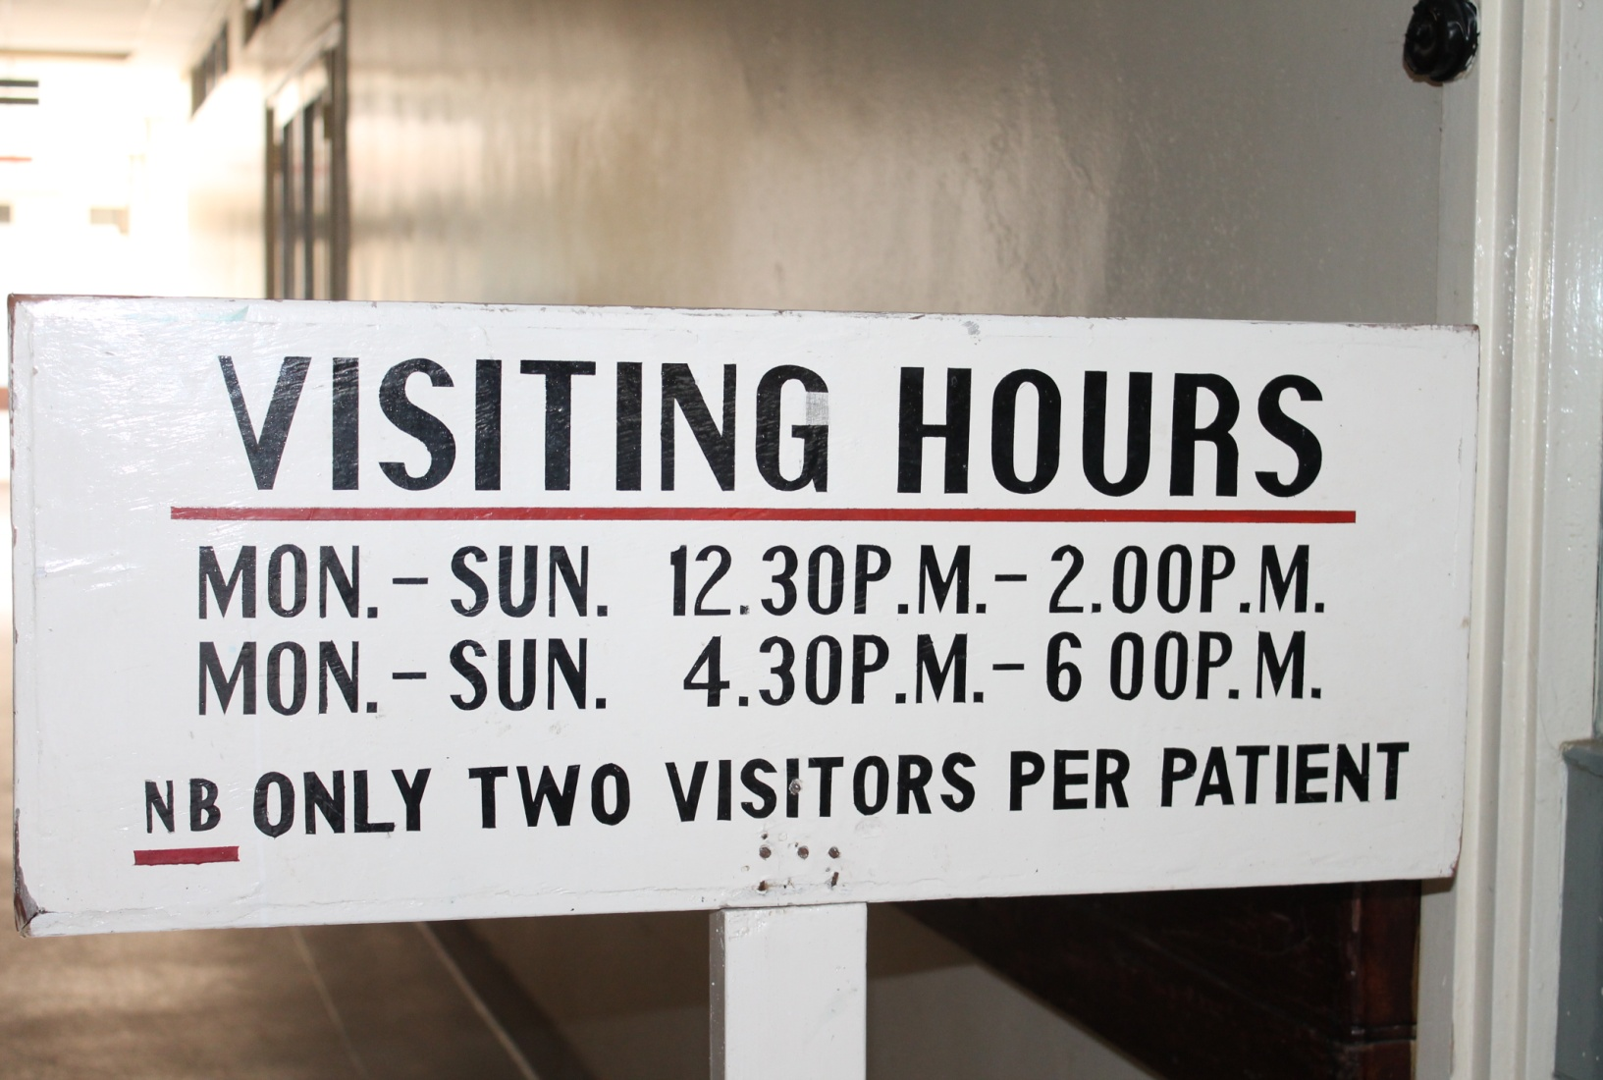

Slide 21
Infection Control Measures
6. Halt progression from Colonization to infection.
Discontinue compromising factors when possible e.g. – extubate, remove nasogatric tube, bladder catheters, rotate IV Catheter sites, proper ventilation and pulmonary care.
7. Modify host factors. Treat underlying disease and complications.
Control antibiotic use (rotate, restrict, stop use)

Slide 22
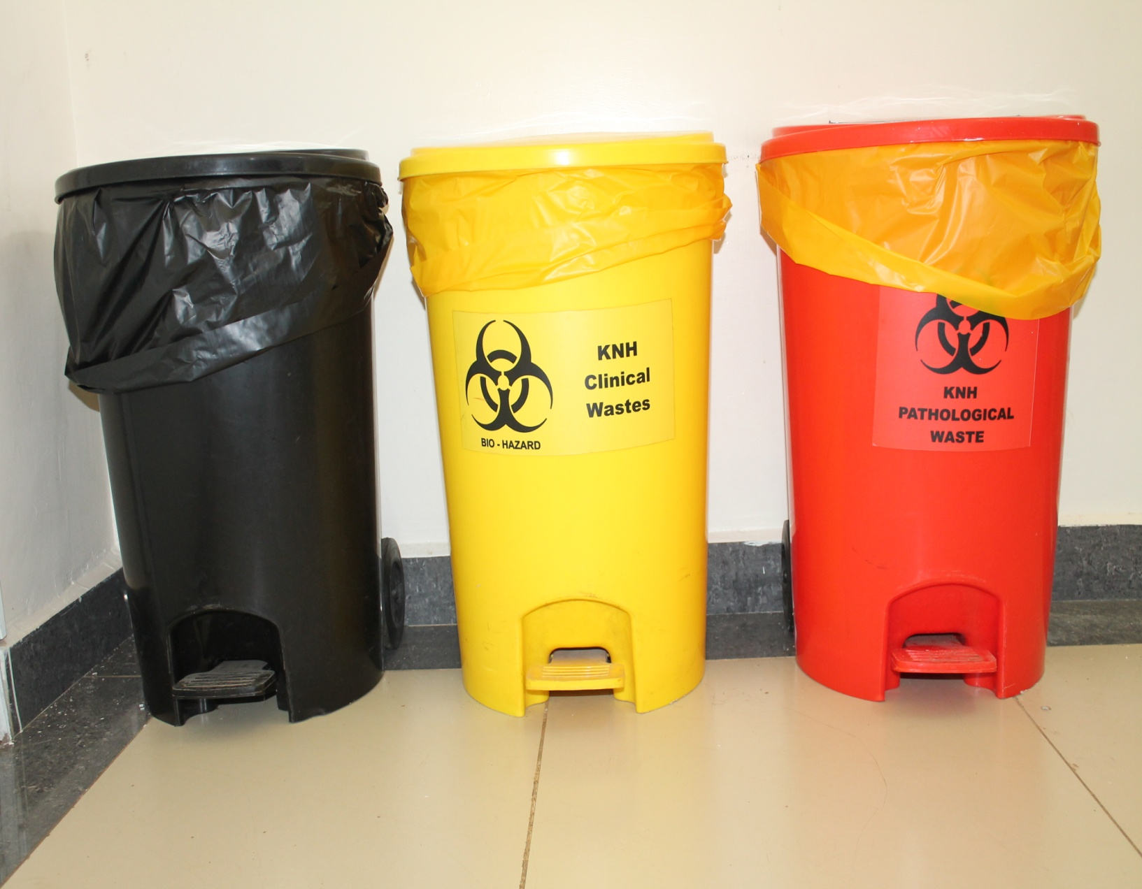

Slide 23
CONCLUSION
Strategy of infection prevention
Strict attention to hand hygiene\
Prudent antibiotic use
Aseptic technique
Disinfection/sterilization of items and equipments
Education of staff on infection control awareness and practice
Keep environment clean , dry and dust free
Surveilance of nosoconial infection to identify problem areas and set priorities

Slide 24
CAN WE CONTROL ICU INFECTION
The key to control antibiotics resistant pathogens in ICU is rigorous adherence to infection control guidelines and prevention of antibiotic misuse
Increase of infection control resources are a win-win-win investment.
- Reduce patient morbidity and
mortality
- Net cost saving to institution, society
and patient
- Improve patient satifaction

Slide 25
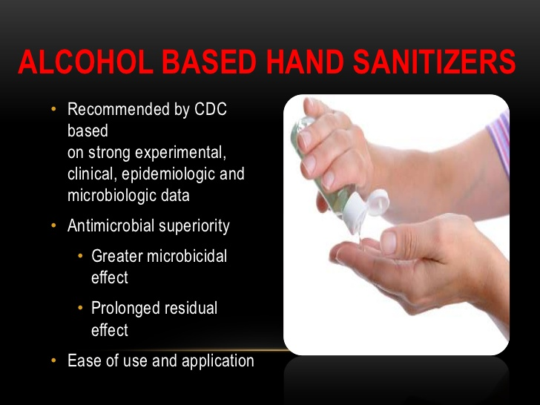

Slide 26
An intervention to decrease catheter related bloodstream infections in the ICU
Hand washing
Use of full barrier precaution during placement of catheters
Cleansing the skin with chlorhexidine
Use of sites other than femoral vein when possible
Removal of catheters that were no longer needed
(Analysis included almost 2,000 ICU months and 375,750 catheter days of data)
(NEngl J MED PRONOVOST P., ET AL, 355(26)2725-2732 2006

Slide 27
ICU care is more invasive
More invasive life lines and procedures including surgeries
Longer length of stay
More IV and parenteral drugs
More tube feeding and parenteral nutrition
More ventilation

Slide 28
HAVE YOU WASHED YOUR HANDS?
THANK YOU

