Slide 1
IPC in relation to infectious diseases - a practical experience
Dr. Loice Achieng

Slide 2
Basics
Recognise the risk
Take necessary precaution to protect yourself and others
Provide timely information
Identify when the risk ends

Slide 3
Case 1
Young female patient from DRC flying to Dubai via Nairobi
Found in a pool of blood at the airport toilet
Quickly transferred to KNH in an airport ambulance
In Kenyatta, transferred to the gynaecology ward for management of PV bleeding - assumption at this point was that she had a spontaneous abortion

Slide 4
Case 1
Had PDT done
Pelvic exam
Transferred to the ward and settled on a bed on IVFs, grouping and cross match done, patient noted to be unstable
Found unresponsive on the bed, with on-going bleeding, no further tests available at this point

Slide 5
Thoughts?
How would you handle this case from this point?
Did infection control have any role in this?

Slide 6
We are only as strong as our weakest link

Slide 7
Case 2
18 year male from Mukuru Kwa Njenga slum
Brought to KNH with confusion and seizures
At casualty patient is quickly wheeled to emergency room, suctioned and airway secured
Patient stabilised and admitted to the ward
Lumbar puncture done the next day - very cloudy CSF
Culture the next day - Neisseria meningitidis

Slide 8
Thoughts
When do we give consideration to droplet vs airborne precaution?
How do we manage exposure?

Slide 9
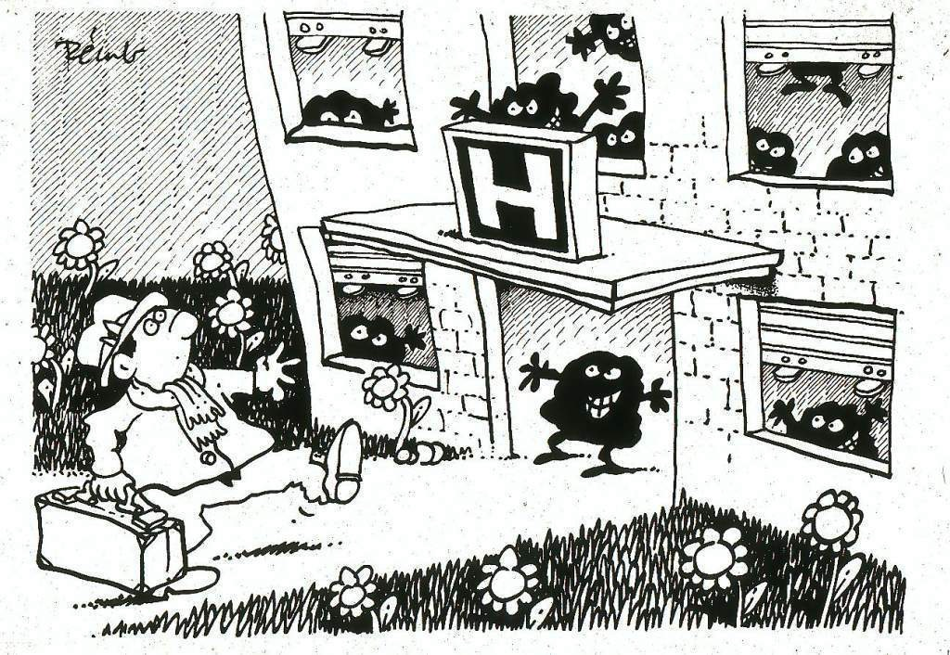

Slide 10
Case 3
32 year old female
Admitted with TEN after reaction to ciprofloxacin
Had lost significant skin cover
Admitted to the dermatology ward, received standard care
Developed sepsis in the course of care

Slide 11
Microbiology
Various samples taken for culture
Urine - MDR Pseudomonas aeruginosa
Skin - Staphylococcal sp reported at methicillin resistant and later vancomycin intermediate
Skin - MDR Acinetobacter baumanii
Blood - Staph epidermis

Slide 12
Case 3
Risks
    Central line due to difficulty with getting lines
    Urethral foley
    Exposed skin
    Multiple antibiotic courses

Slide 13
1st principle of infection prevention
at least 35-50% of all healthcare-associated infections are associated with only 5 patient care practices:
Use and care of urinary catheters
Use and care of vascular access lines
Therapy and support of pulmonary functions
Surveillance of surgical procedures
Hand hygiene and standard precautions

Slide 14
What next
Where do we nurse this patient?
What IPC experience is available to contain the infections?
Further antibiotic use?
How to decontaminate the spaces and ensure a clean environment for the other patients?
How do we train all health care workers in IPC?

Slide 15
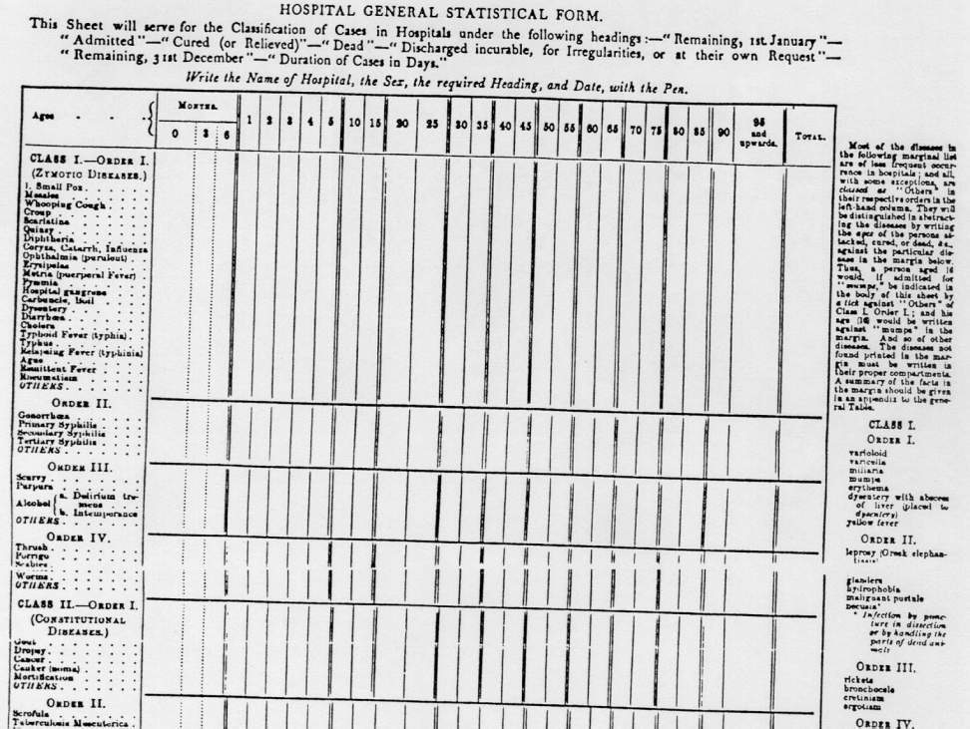
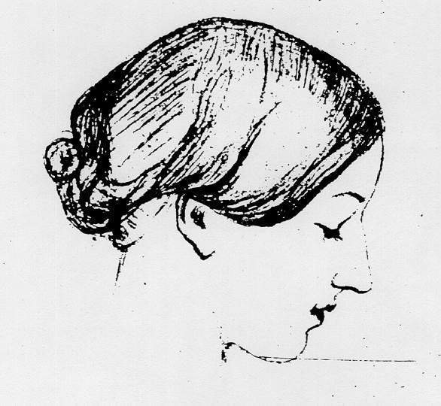
The very first requirement in a hospital is that it should do the sick no harm

