Slide 1

Healthcare associated infections and antimicrobial resistance surveillance in Kenya
Linus Ndegwa, MPHE, HCS
Infection Prevention and Control Manager
DGHP
Centers for Disease Control and Prevention- Kenya
5th Infection Prevention Network –Kenya Congress 2016, Machakos, Kenya
Nov 17, 2016
Center for Global Health
Place Descriptor Here

Slide 2
Introduction
Healthcare associated infections (HAIs)
  New infection in hospitalized patient
    ≥48 hours after admission
    ≤10 days post-discharge
    ≤48 hours after insertion of indwelling device (e.g. urinary catheter)
  Includes occupational infections among facility staff¹
HAI frequent patient safety issue worldwide²
Frequency in low/middle-income countries higher than in high-income countries
JP Burke, Infection control—a problem for patient safety;N Engl J Med, 348 (2003), pp. 651–656
Prevention of hospital-acquired infections: a practical guide. Geneva: World Health Organization; 2002

Slide 3
HAI in Africa
Systematic review of HAIs
  Prevalence rate 15.5% in low and middle income countries Vs 7.1% in European union
  220 articles published from 1995 to 2008
  Only 14 (6%) from Africa
  12 of them on Surgical sites and general HAIs
Extent the threat not well addressed in Africa
B Allegranzi, SB Nejad, C Combescure, et al. Burden of endemic health care-associated infection in developing countries: systematic review and meta-analysis Lancet, 377 (2011), pp. 228–241

Slide 4
HAI data from Kenya
Respiratory HAI surveillance in 3 hospitals 2010-2012¹
  Overall incidence 9.2/10000 patient days
  ICU 33.0/10,000 patient days
Paediatric hospital acquired bacteraemia in coast²
  Risk of hospital acquired bacteraemia 5.9/100 admission
  40 times higher than community acquired bacteraemia
Surveillance in ICU of KNH ( 3 months in 2010) ³
  Prevalence of CAUTI was 18%
  Common organisms: Escherichia coli (27%); Klebsiella pneumoniae (18%); Pseudomonas aeruginosa (13.6%)
  The organism were resistant to common antibiotics- gentamycin, nitrofurantoin, co-amoxiclav
1. Ndegwa,et al. Surveillance for respiratory health careeassociated infections among inpatients in 3 Kenyan hospitals, 2010-2012.AJIC, 42 (2014), pp. 985–990
2. Alex,et al. Risk and causes of paediatric hospital-acquired bacteraemia in Kilifi District Hospital, Kenya: a prospective cohort study. Lancet, 378 (2011), pp. 2021–2027
3. Inyama,et al. THE INCIDENCE OF NOSOCOMIAL URINARY TRACT INFECTIONS: KENYATTA NATIONAL HOSPITAL - INTENSIVE CARE UNIT, Baraton Interdisciplinary Research Journal (2011) 1 (2), 12 - 21

Slide 5
Antimicrobial resistance (AMR) overview
Post antibiotic era in which common infections kill again
Resistance to last line therapies
Common infections difficult to treat
Few new antibiotics in the pipeline
http://www.who.int/mediacentre/commentaries/antibiotic-resistant-bacteria/en/ accessed 31st Oct 2016

Slide 6
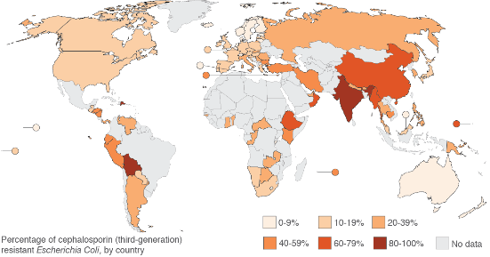
AMR data from Africa – extended-spectrum beta-lactamase producers
Extended-spectrum beta-lactamase producers
No data in most of Africa
previous travel in LMIC risk factor-UTI
  India: OR =145.6
  Africa: OR =7.7
Kelvin,et al. Community –onset extended spectrum β-lactamase (ESBL) producing Escherichia coli: importance of international travel . Journal of infection, 37 (2008), pp. 441–448

Slide 7
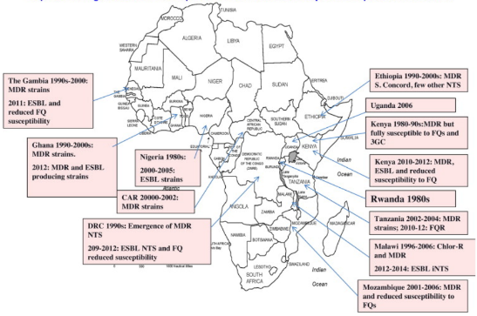
AMR in Africa: resistant non Typhi salmonella
Kariuki,et al. Antimicrobial resistance and management of invasive Salmonella disease Vaccine, 33 (2015), pp. S21–29

Slide 8
AMR in Kenya: Salmonella Enterica Serovar Typhi
Typhoid in Kenya associated with dominant multidrug resistant salmonella¹
Characterized 323 S.Typhi isolates from outbreaks 1988 to 2008
  22.9 % resistant to one drug
  60.4% resistant to 2 or more drugs
1. Kariuki,S. , Gunturu,R , Kiiru,J et al. Typhoid in Kenya is associated with a dominant multidrug-resistant Salmonella enterica serovar Typhi haplotype that is also widespread in Southeast Asia. Journal of clinical microbiology, 48 (2010), pp. 2171–2176

Slide 9
AMR in Kenya: Gonorrhea
In Rural Western Kenya, STIs in men from 2002-2009²
  65% of 168 gonorrhea isolates resistant to Penicillin
  11% resistant to ciprofloxacin
  Quinolone resistant appeared in 2007 , and was 9.5%
    Increased to 50% in 2009
2. Kariuki,S. and Gordon. Antibacterial resistance in sub-Saharan Africa: an underestimated emergency. Ann N Y Acad Sci., 1323(2014), pp. 43-55

Slide 10
AMR in Kenya: Streptococcus pneumoniae
Pneumococcal carriage in Western Kenya¹
  80.4% oropharyngeal /nasopharyngeal swabs cultured for pneumococcus penicillin resistant
Invasive pneumococcal disease in Western Kenya²
  Bacteremia incidence 129/100,000 person years
  >95% resistant to trimethoprim-sulfamethoxazole
  <5% resistant to beta-lactam antibiotics
1.Conklin, L , et al. High Streptococcus pneumoniae colonization prevalence among HIV-infected Kenyan parents in the year before pneumococcal conjugate vaccine introduction. BMC infect Dis., 16 (2015), pp. 2171–2176
2. Feikin D , et al. esiegarchh arrtaictlee of pneumococcal bacteremia in a prospective cohort of older children and adults in an area of high HIV prevalence in rural western
Kenya. BMC Infectious Diseases 2010, 10:186

Slide 11
AMR in Kenya: Shigella
Shigella-associated diarrhea in Kibera
  Incidence 408/10000 person years²
  >90% shigella isolates resistant to trimethoprim-sulfamethoxazole
  1% resistant to ciprofloxacin
1bacteremia in a prospective cohort of older children and adults in an area of high HIV prevalence in rural western
Kenya. BMC Infectious Diseases 2010, 10:186
3. Njuguna, H , et al. Use of Population-based Surveillance to Define the High Incidence of Shigellosis in an Urban Slum in Nairobi, Kenya. PLoS ONE 8(3): e58437. doi:10.1371/journal.pone.0058437

Slide 12
World Health Assembly resolution on AMR
Adhere to a comprehensive, financed national plan with accountability and civil society engagement
Strengthen surveillance and laboratory capacity
Ensure uninterrupted access to essential medicines of assured quality
Regulate and promote rational use of medicines, and ensure proper patient care
Enhance infection prevention and control
Foster innovation, research and new tools
Notes:
WHA51.17. resolution, listed the following activities for combatting antimicrobial resistance:
Adhere to a comprehensive, financed national plan with accountability and civil society engagement.
Strengthen surveillance and laboratory capacity.
Ensure uninterrupted access to essential medicines of assured quality.
Regulate and promote rational use of medicines, and ensure proper patient care.
Enhance infection prevention and control.
Poor infection control in any setting can greatly increase the spread of drug-resistant infections, especially during outbreaks of disease.
Foster innovation, research and new tools.

Slide 13
MOH structure for IPC/AMR
MOH
Department of standards and Quality assurance and Regulations (DHSQAR)
Division of quality assurance (QA)
Unit of Patient safety-PS
IPC & AMR
Activities
  Training of health care workers on IPC/AMR
  Setting up IPC and antimicrobial stewardship(AMS) program
  Model sites for IPC and AMR

Slide 14
Global Health Security Agenda (GHSA) overview
Launched in 2014
Goals: prevent, detect, respond to infectious disease threat and promote global health security as security priority
Half of the investment for Africa
Partnership: WHO, IHR (2005), FAO, OIE
“…we must come together to prevent, and detect, and fight every kind of biological danger — whether it’s a pandemic like H1N1, or a terrorist threat, or a treatable disease”.” —President Barack Obama, 2011
Notes:
This effort will support existing agreements under the World Health Organization (WHO) International Health Regulations 2005 (IHR), the World Organization for Animal Health (OIE) Animal Health Codes, and the Codex Alimentarius International Food Standards and will complement existing multilateral efforts in this area, including under the G8, G20, Global Partnership Against the Spread of Weapons and Materials of Mass Destruction, Global Health Security Initiative, and regional forums.

Slide 15











Action Packages to Achieve Targets
Antimicrobial Resistance
National Laboratory Systems
Emergency Operations Centers
Zoonotic Diseases
Surveillance
Linking Public Health with Law Enforcement and Multisectoral Rapid Response
Biosafety/Biosecurity
Reporting
Medical Countermeasures and Personnel Deployment
Immunization
Workforce Development
Notes:
There are eleven action packages, or targets, that comprise GHSA.
While they may seem like discrete activities, these lanes are overlapping and inter-related.
As an example, the Antimicrobial Resistance technical area aims to prevent the emergence and spread of antimicrobial-resistant organisms, increase the surveillance and early detection of antimicrobial-resistant organisms, and enhancing antimicrobial stewardship to include promoting the appropriate and responsible use of antibiotics in all settings.
To meet the objectives for AMR, public health officials and SMEs will have to combine efforts with surveillance programs, laboratory programs and systems, information systems and other sectors to achieve these goals

Slide 16
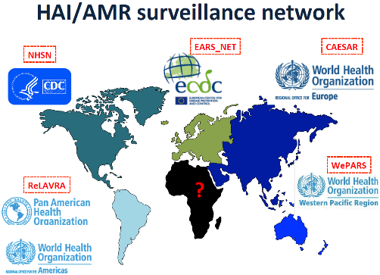

Slide 17
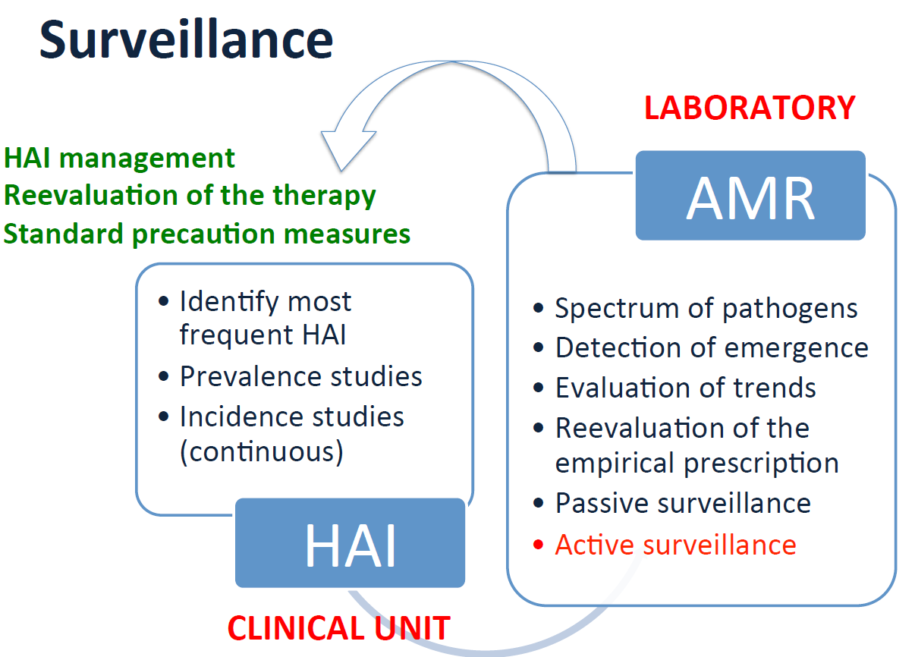
Importance of surveillance

Slide 18
Challenges for AMR and HAI surveillance in Kenya
Data on AMR and HAI in Kenya from focused studies, but no national-level surveillance
  Standard case definitions for HAIs
  Knowledge of HAIs by the clinicians and IPC teams
Laboratory capacity
  Limited use of microbiology by clinicians
  Laboratory quality
Resources to set up and sustain surveillance

Slide 19
Conclusions
Paucity of data on AMR and HAI surveillance in Kenya and Africa in general
Intervention programs like AMS, mobilization of resources and policy guidelines, requires data

Slide 20

Are there any questions?
Lndegwa@.cdc.gov
The findings and conclusions in this report are those of the authors and do not necessarily represent the official position of the Centers for Disease Control and Prevention.
Protect your patients. Protect yourself. Protect your family.
Center for Global Health
Place Descriptor Here

