Slide 1
Current Threats to Biosecurity
By
Bunyasi Albert
IFBA Certified Profesional
IFBA Heros Award 2015

Slide 2
A lot has happened in a year!
Attacks in Europe - ISIS
Male murdered in Philippines – Abu Sayyaf
Mass migration from Syria – ISIS, AQ, Assad Regime etc.
Attacks on civil aviation
Anthrax plot in Kenya
Mogadishu Suicide Bomb
What’s next??

Slide 3
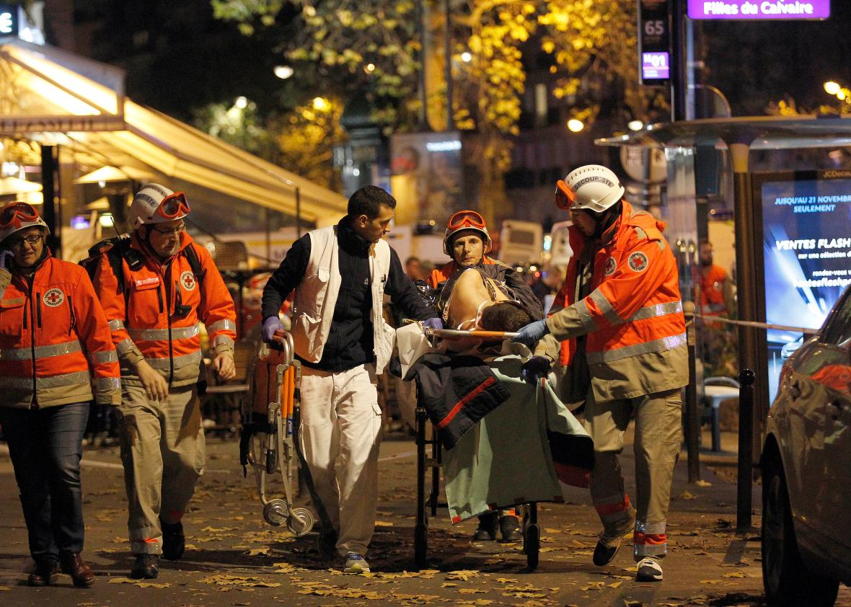
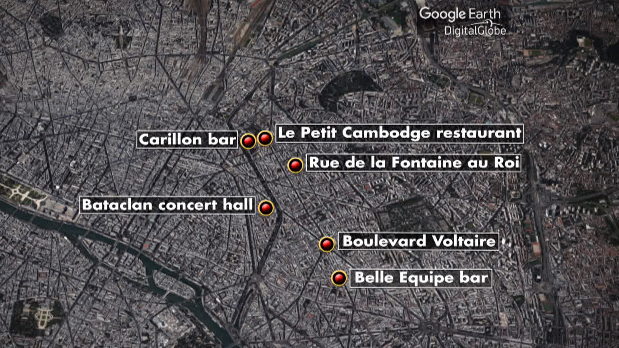
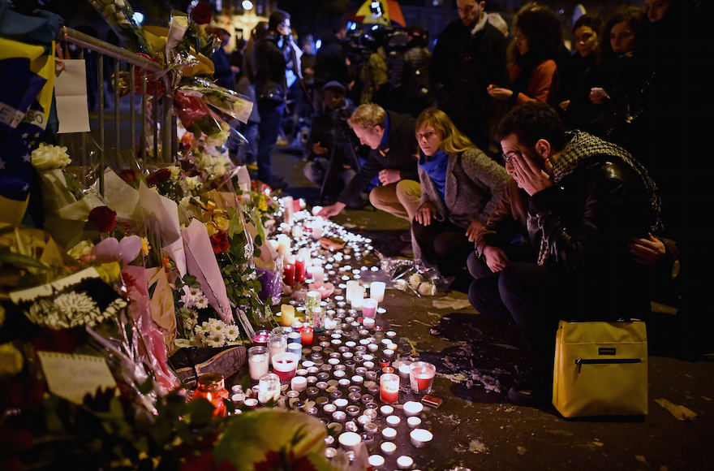
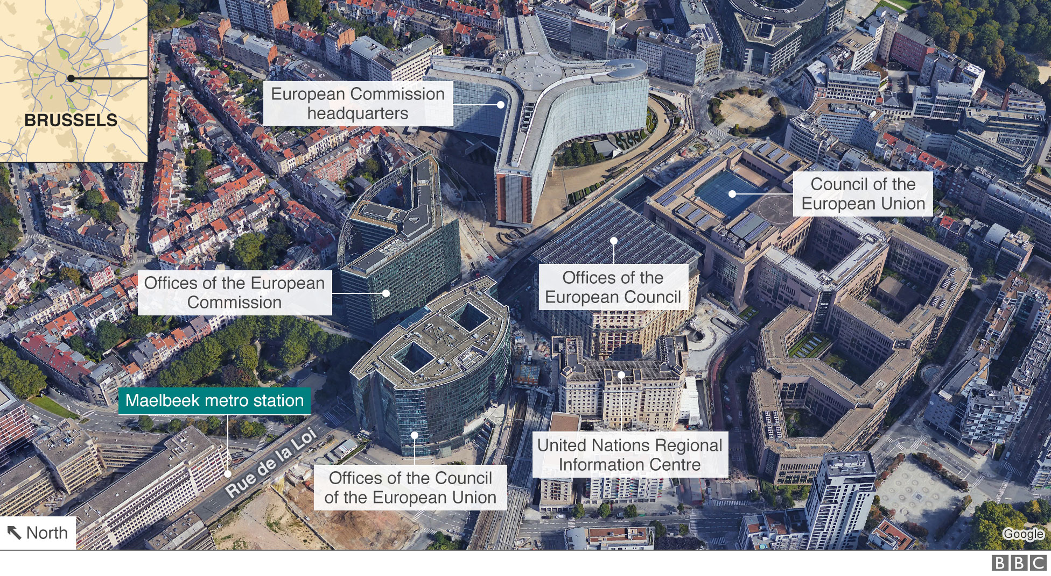
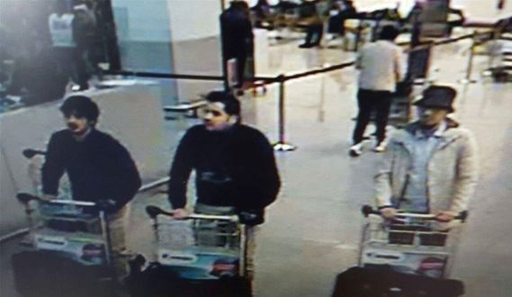
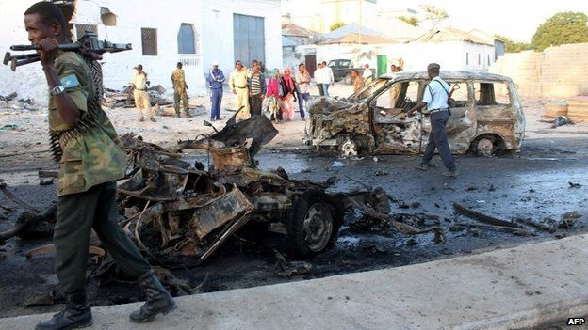

Slide 4
Paris – Theft of PPE
Nov 22 French police are investigating the recent theft of medical protective clothing from a hospital in Paris, the Paris public hospital administrator AP-HP has said.
The motive for the theft is unclear but it comes amid heightened fears in France over the risk of biological or chemical terrorism following the deadly Nov. 13 attacks in Paris.
The disappearance of a "limited number" of "protective clothing elements" from the Necker hospital was discovered on Nov. 18, the Assistance Publique-Hopitaux de Paris (AP-HP) said in a statement on Saturday. A report was filed the day after at the local police station, it added.
Source: Reuters

Slide 5
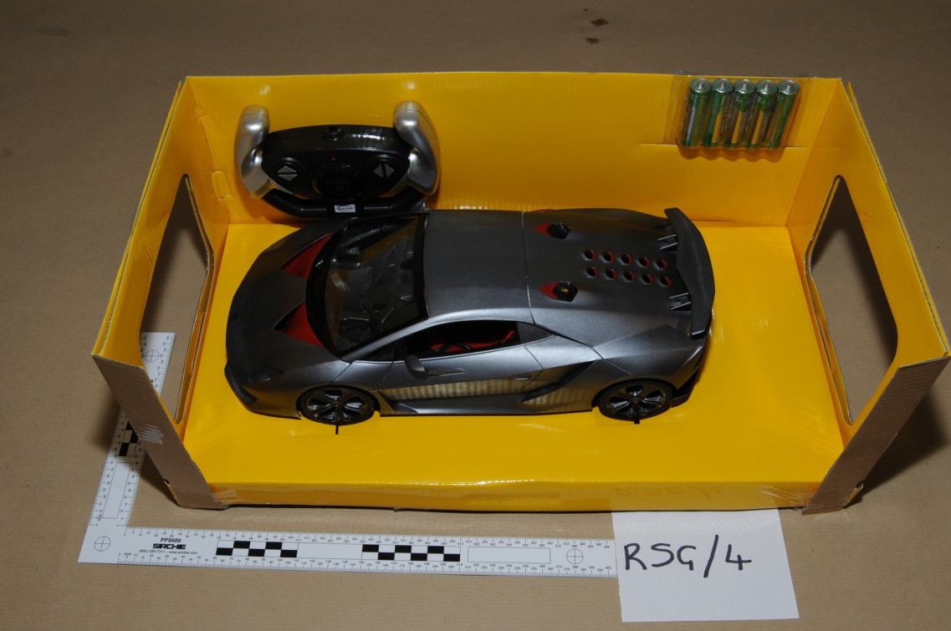
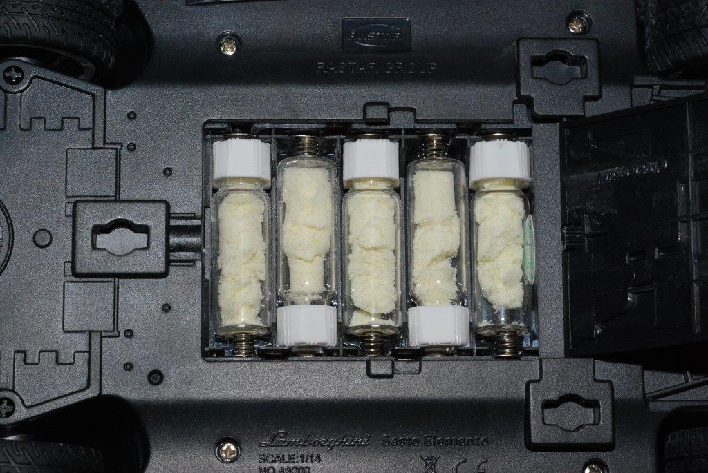
UK Ricin Plot 2015

Slide 6
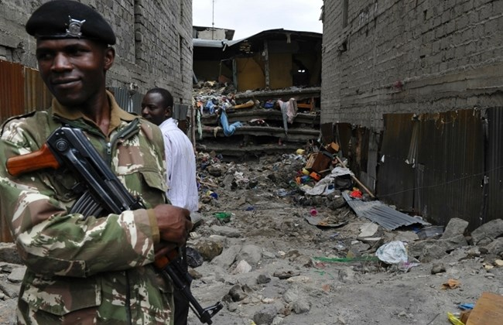
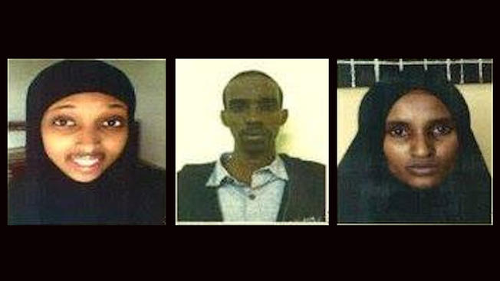
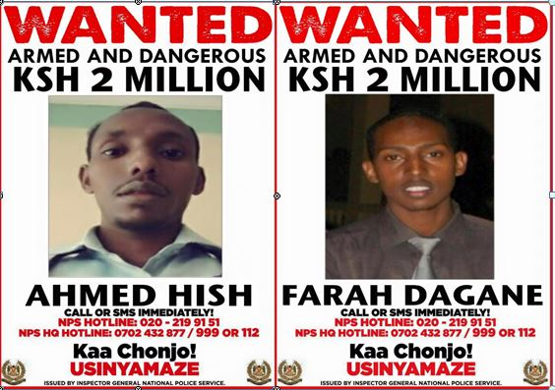
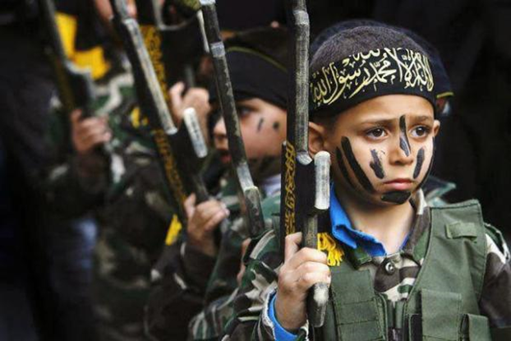
Kenyan Anthrax plot

Slide 7
Terrorism in the Asia Pacific Region
Jermiah Islamiah – South East Asia
Laskar Jihad – Indonesian (close links with Pakistan and Afghanistan)
Islamic Defence Front - Indonesia
Abu Sayyaf Group - Philippines
The Moro Islamic Liberation Front - Philippines
ISIS – South East Asia

Slide 8
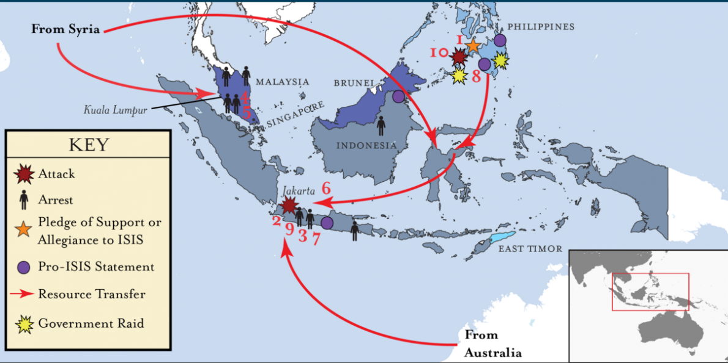
Regional threats

Slide 9
Emerging threats
Advances in the life sciences
Increase in research due to MRP and outbreaks
Knowledge is more common
Changes to the internet
Social media
Long-term effort by ‘the enemy’

Slide 10
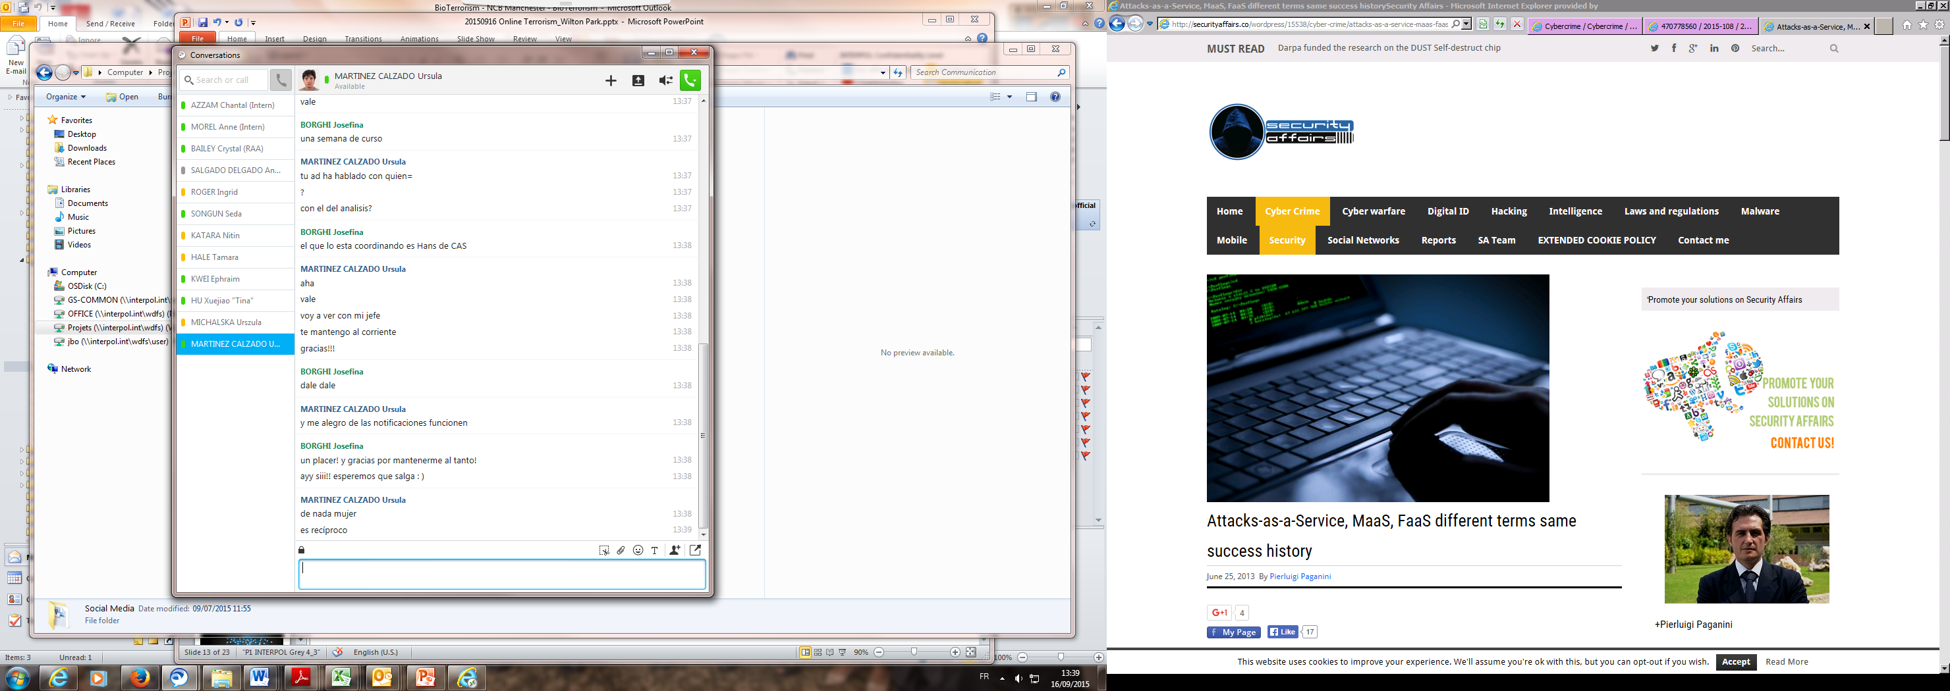
SOCIAL MEDIA
Notes:
The speed, global reach and relative anonymity with which terrorists can use the Internet to promote their causes or facilitate terrorist acts, together with complexities related to the location, retention, seizure and production of Internet-related data, makes international cooperation between law enforcement and intelligence agencies an increasingly critical factor in the successful investigation and prosecution of terrorism cases.
respect fundamental human rights, such as freedom of expression, respect for private life, home and correspondence, and the right to data protection.

Slide 11
Twitter
316 million monthly active users
500 million tweets sent per day
YouTube
48 hours of user-generated videos are uploaded every minute,
8 years of content being uploaded every day
300 million photos uploaded everyday
Notes:
Twitter stats: June 30, 2015
Youtube 2012: 48 hours of user-generated videos are uploaded every minute, resulting in the equivalent of almost eight years of content being uploaded every day.

Slide 12
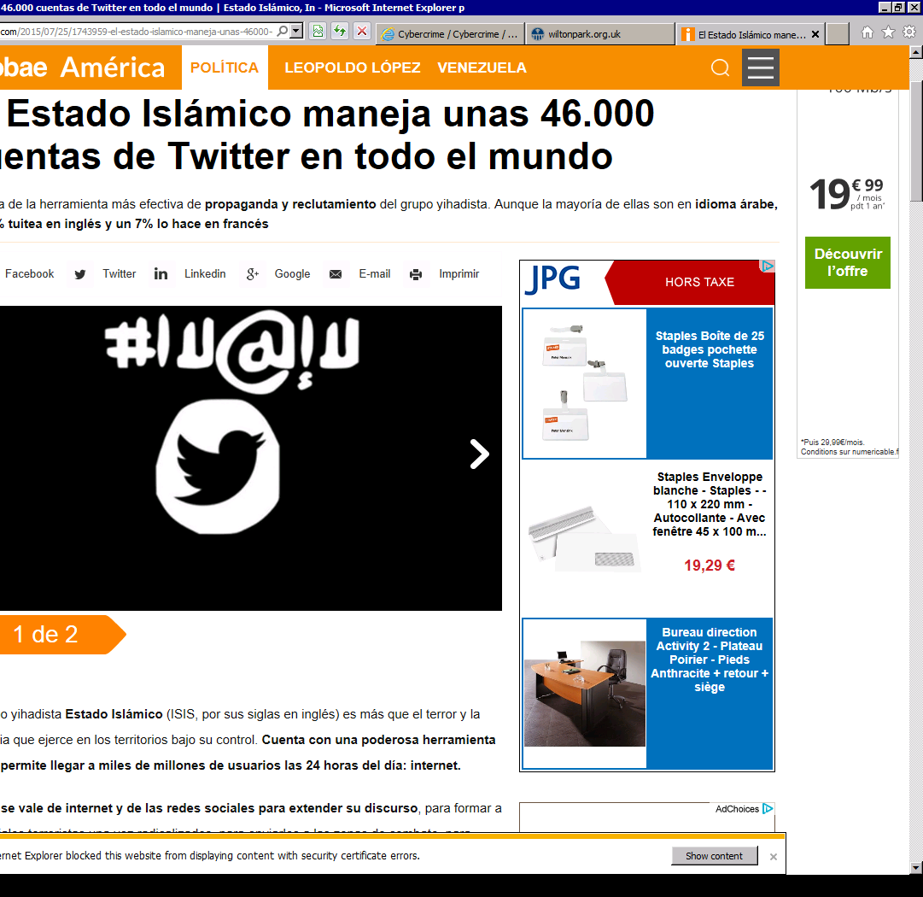
ISIS Twitter Accounts
46.000 accounts
  30.000 controlled by people
  16.000 controlled by computer
Notes:
Arabic 75%
English 18%
French 7%
According to the Spanish Secretary of Security

Slide 13
Why and how is it useful?
Propaganda: recruitment, radicalization and incitement to terrorism
Training
Financing
Cyberattacks
Planning and coordination of attacks
Mask the Internet Protocol (IP) address
“dead dropping” of communications
Notes:
Propaganda: eg: displays of weaponry and power, intimidation tactics. Propaganda generally takes the form of multimedia communications providing ideological or practical instruction, explanations, justifications or promotion of terrorist activities. These may include virtual messages, presentations, magazines, treatises, audio and video files and video games developed by terrorist organizations or sympathizers
Recruitment:develop relationships with, and solicit support from, those most responsive to targeted propaganda. Terrorist organizations increasingly use propaganda distributed via platforms such as password-protected websites and restricted access Internet chat groups as a means of clandestine recruitment The use of technological barriers to entry to recruitment platforms also increases the complexity of tracking terrorism-related activity by intelligence and law enforcement personnel.
Financing: The manner in which terrorists use the Internet to raise and collect funds and resources classified into: direct solicitation, e-
commerce, the exploitation of online payment tools and through charitable organizations. Direct solicitation refers to the use of websites, chat groups, mass mailings and targeted communications to request donations from supporters. Websites may also be used as online stores, offering books, audio and video recordings and other items to supporters. Online payment facilities offered through dedicated websites or communications platforms make it easy to transfer funds electronically between parties. Funds transfers are often made by electronic wire transfer, credit card or alternate payment facilities available via services such as PayPal or Skype. Online payment facilities may also be exploited through fraudulent means such as identity theft, credit card theft, wire fraud, stock fraud, intellectual property crimes and auction fraud.
Training: practical guides in the form of online manuals, audio and video clips, information and advice. How to join terrorist organizations; how to construct explosives, firearms or other weapons or hazardous materials; and how to plan and execute terrorist attacks. The platforms act as a virtual training camp. They are also used to share specific methods, techniques or operational knowledge. Instructional material available online includes tools to facilitate counter-intelligence and hacking activities and to improve the security of illicit communications and online activity through the use of available encryption tools and anonymizing techniques.
Planning and coordination of attacks: A simple online e-mail account may be used by terrorists for electronic, or virtual, “dead dropping” of communications. This refers to the creation of a draft message, which remains unsent, and therefore leaves minimal electronic traces, but which may be accessed from any Internet terminal worldwide by multiple individuals with the relevant password. mask the unique Internet Protocol (IP) address, reroute Internet communications via one or more servers to jurisdictions with lower levels of enforcement against terrorist activity and/or encrypt traffic data relating to websites accessed. Steganography, the hiding of messages in images, may also be used.
Cyberattacks: hacking, advanced persistent threat techniques, computer viruses, malware, phlooding or other means of unauthorized or malicious access

Slide 14
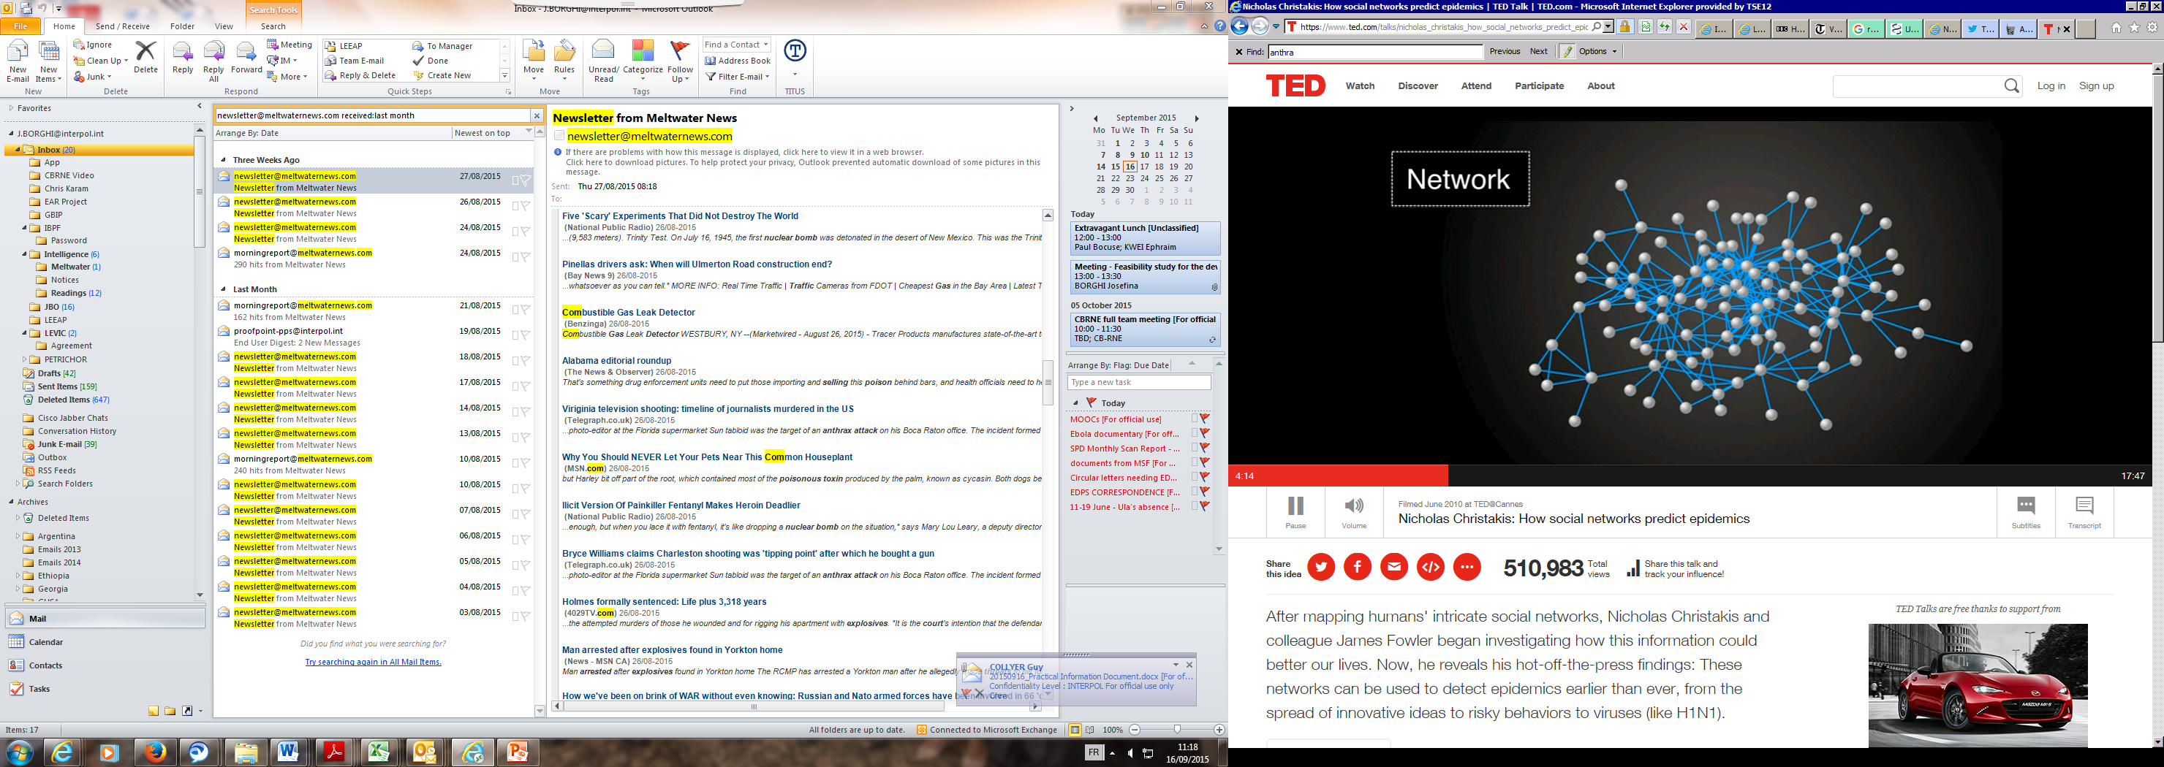
Notes:
We live our lives in Networks. The dots are the people and the lines are the relationship between each people. Within each network, people have different roles. Not all positions are the same. Some people have more connections than others, this is called the « degree node » : number of nodes that a person has.
105 people and friendships relationships

Slide 15
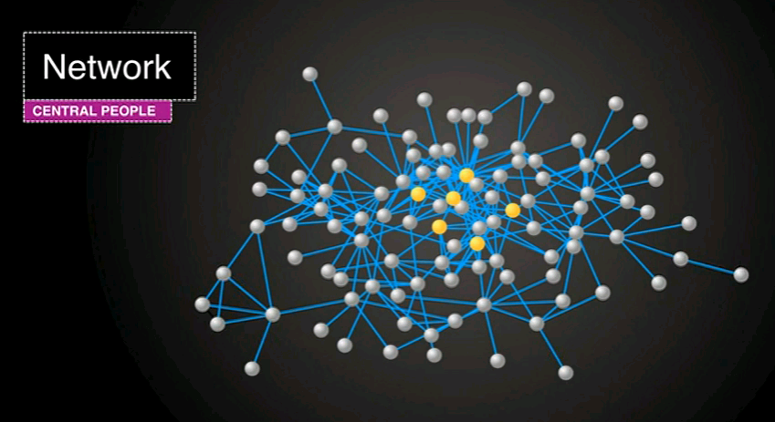
Notes:
If you wanna track sth that is spreading, set up sensors. Monitor people that are the center of the network. If they are to have a piece of information or a germ the you know that this will get spread. This is a more effective way to monitor people rather than monitoring people randomly.

Slide 16
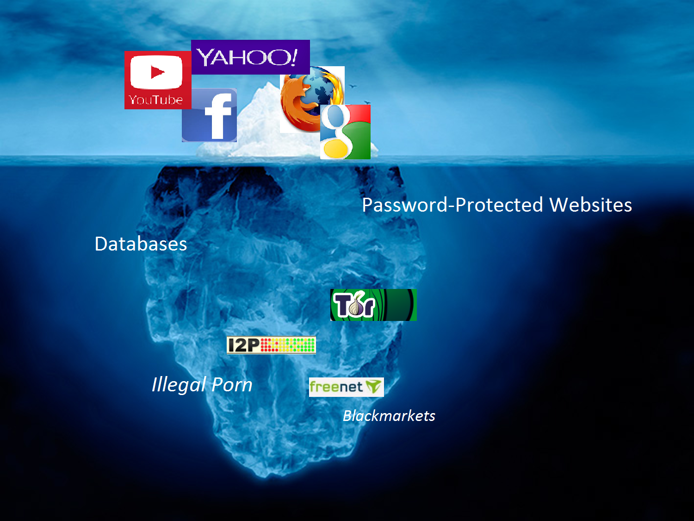
DARKNET
Notes:
Darknets are fast emerging as the preferred trading venue for organized crime networks and individuals to carry out illicit activities, with cryptocurrencies the preferred medium for paying for these criminal services.

Slide 17
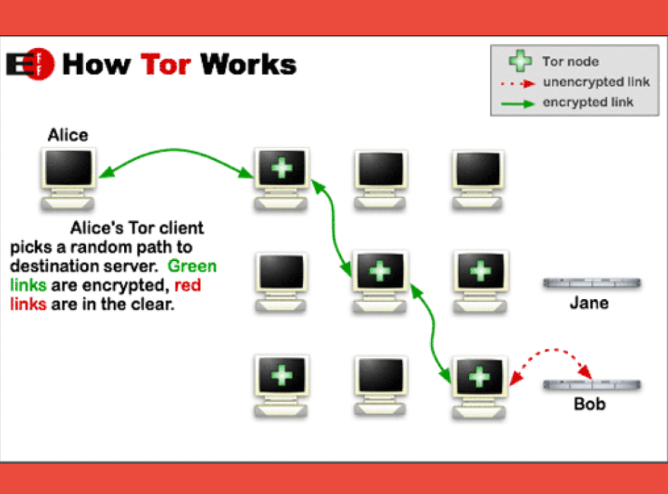
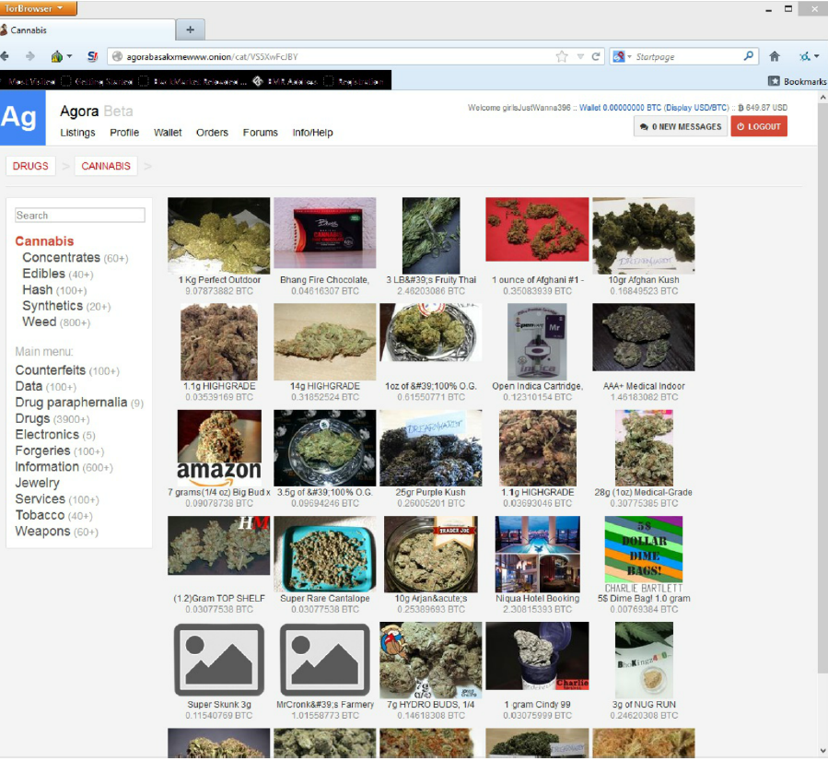
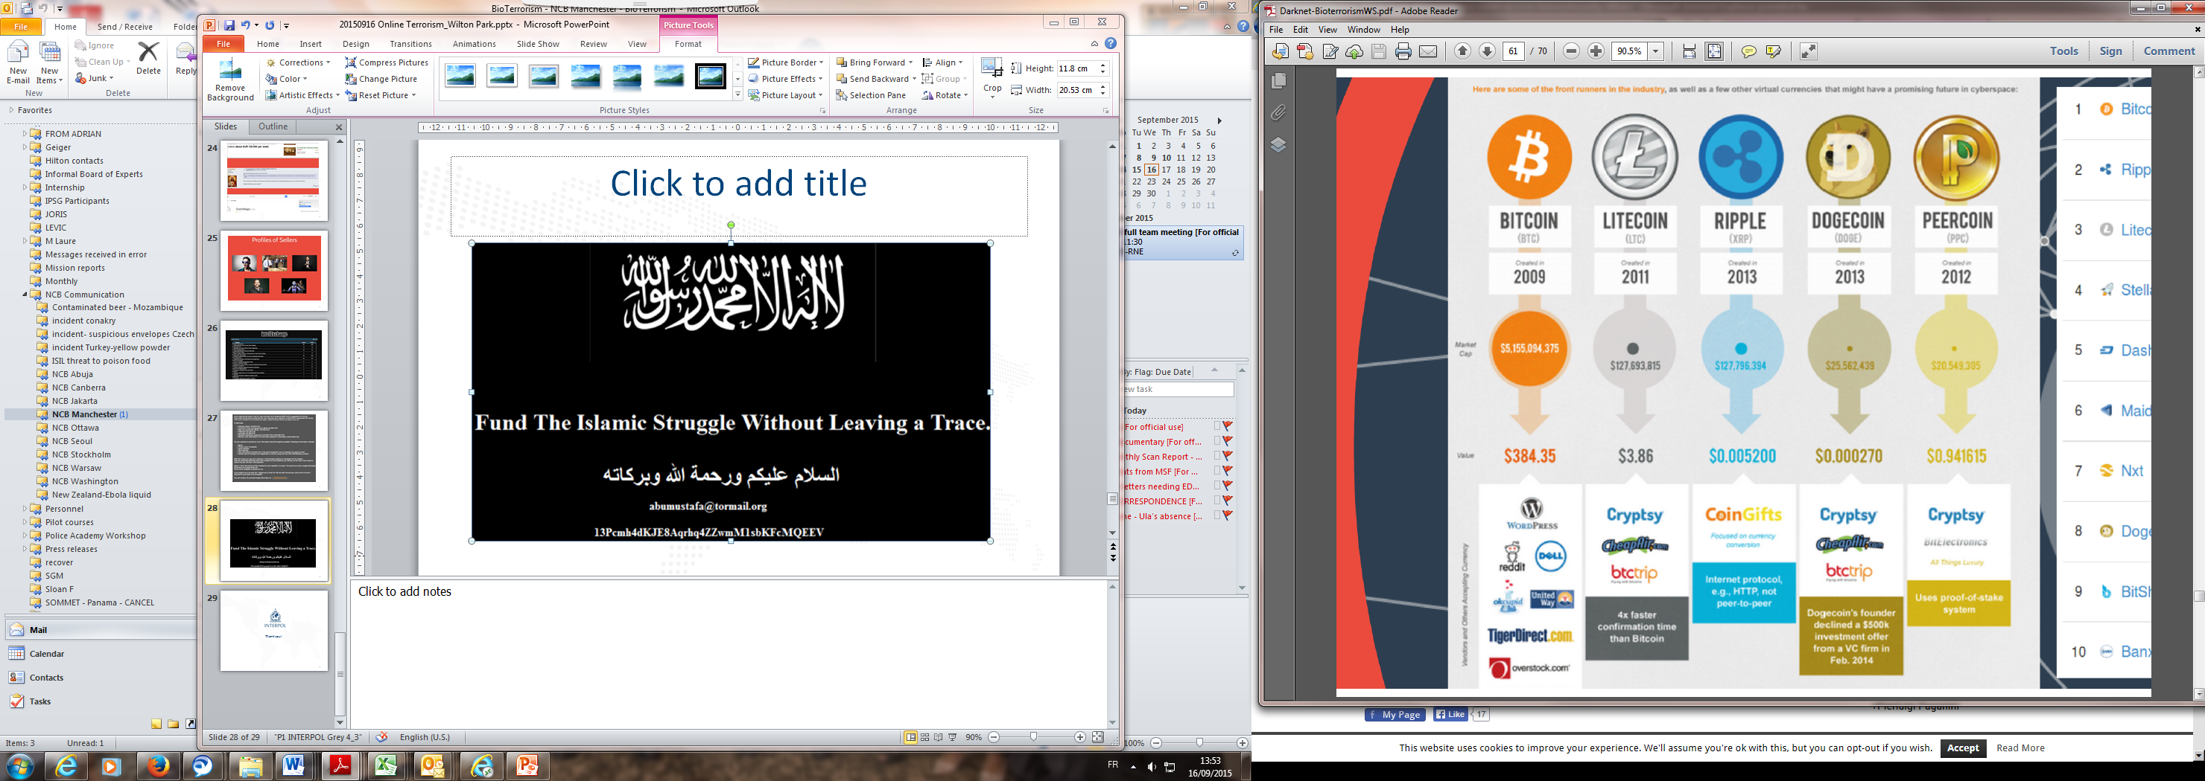
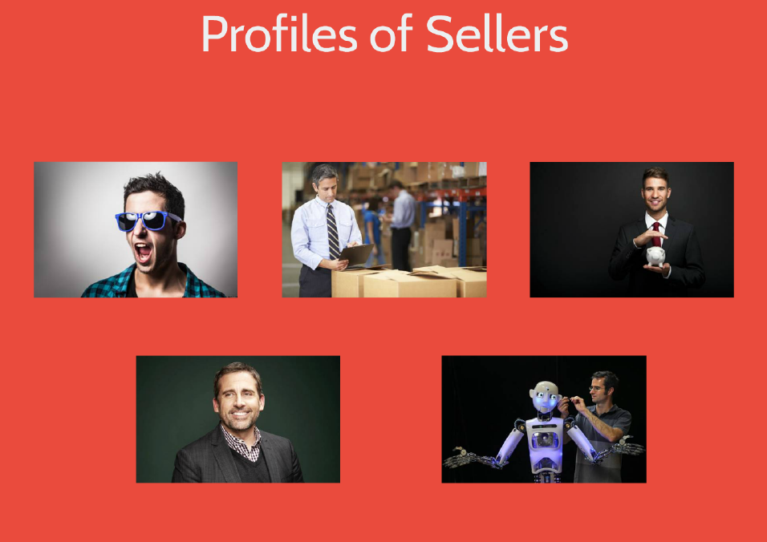
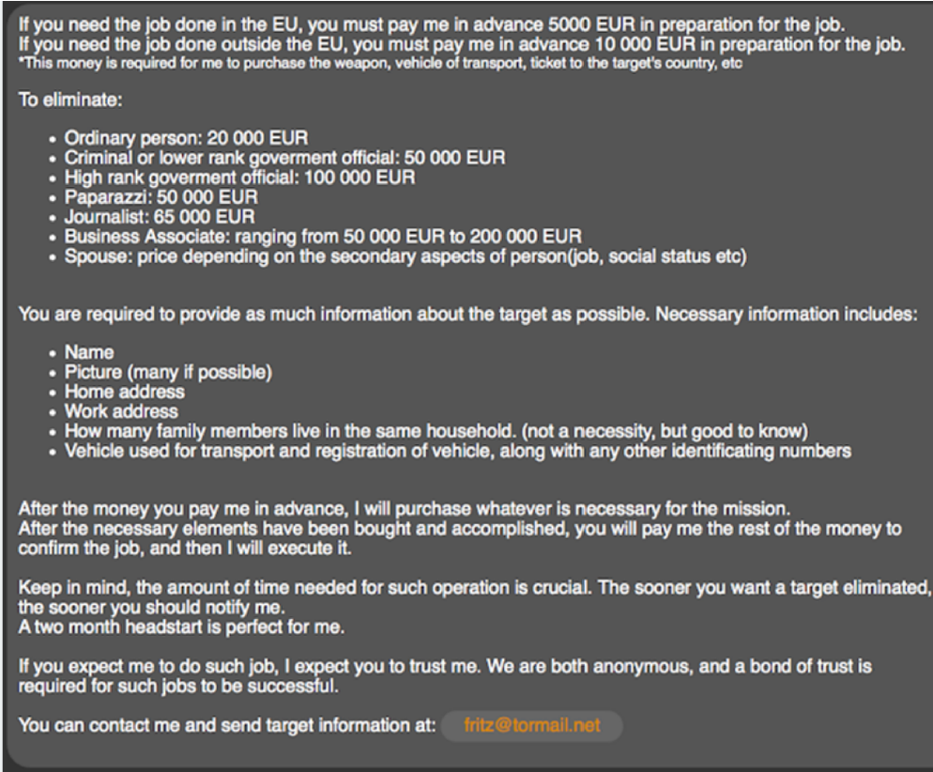
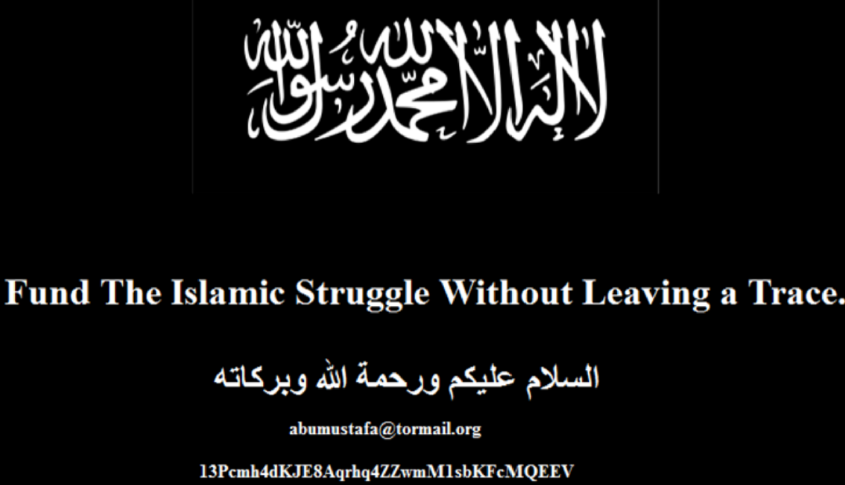
DARKNET

Slide 18
The QISS Report
Chemical and Biological incidents
Reporting on current best practice and procedures
Human, animal, plant and food health security
In support of the Global Heath Security Agenda
April reporting available NOW!!
First issue is free as we NEED your feedback
Future editions require funding

Slide 19
Challenges
Police and scientists
Support to Biosecurity
Surveillance in Biosecurity

Slide 20

IPNET COMMITTEE

Slide 21
Thanks.

