Slide 1
CONDUCTING EFFECTIVE BIOSAFETY TRAININGS USING MINIMAL RESOURCES IN NAIROBI COUNTY:
AT THE 5TH IPNET KENYA CONFRENCE MACHAKOS
ON 17TH NOV 2016
BY EMMA NYAGA

Slide 2
Introduction:
Increased risk of Laboratory acquired infections in clinical Laboratories has led to harnessed efforts by the MOH in collaboration with development partners to increase awareness of better safety practices
One of the ways applied to achieve this is through biosafety trainings.

Slide 3
Continuation…
This study describes how it has been possible to make an impact in improving primary health care practices through biosafety trainings .
In Nairobi, we have embraced both the basic 5 day trainings and the CME’S approach in order to achieve the goal of Biosafety.

Slide 4
Method: CME approach
This was done following a request from the CMLC’S office Nairobi.
A one day CME was conducted in St Marys War Memorial Hospital Nairobi.
This was done in two days to two different groups on the 23rd and 24th March 2016 consecutively.

Slide 5
Continuation…
Five topics were chosen from the Biosafety curriculum as follows;
Emergency and incidence response,
Infection prevention and control,
Quality management systems and safety,
Spill management and
Waste management programmes
A ten questions pre and post-test was also given in the beginning and at the end of each class.

Slide 6
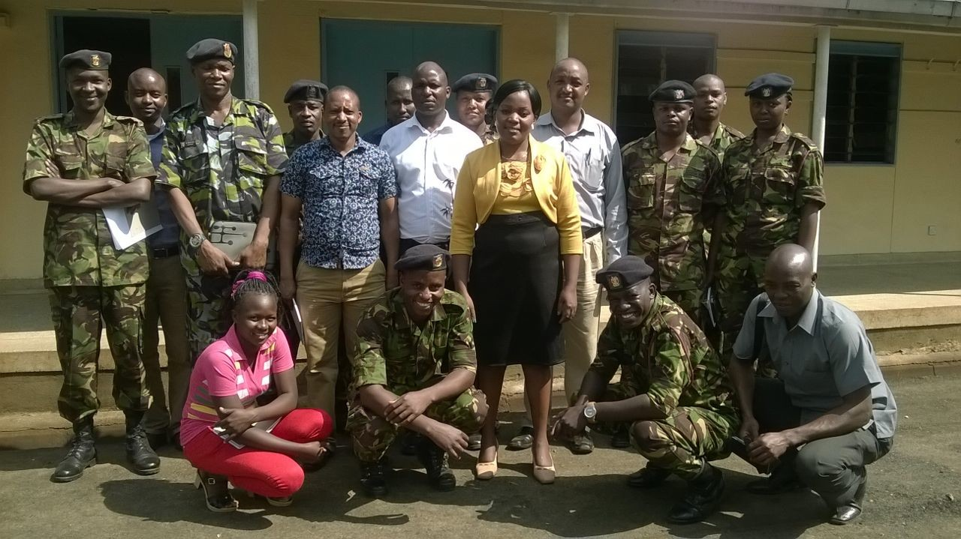
Some of the group 1 members:

Slide 7
Method: The 5 day training approach
While the CME ‘s were done by one facilitator, the 5 days trainings were done by 5 facilitators.
One such training was done in STC CASINO H/C, on 2nd to 6th February 2015. The main reason why this was picked among many trainings happening in Nairobi is because it was facility based and not hotel based.
It also started with a pre-test and ended with a post-test but this time there were 20 questions.

Slide 8
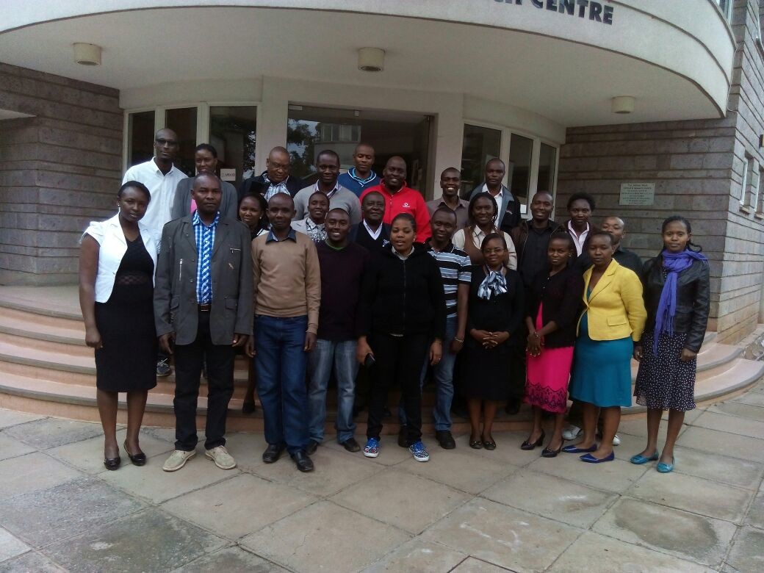
One of the trainings done in NRB

Slide 9
Results: CME.
The first group made up of 20 participants undertook the CME and proved to have learnt by improving the pre-test mean grade from 40% to 85% in the post-test.
The second group proved to have learnt by improving the pre-test mean grade from 45% to 80% in the post-test.

Slide 10
Results: 5 day Training
The 5 day Training conducted at STC Casino H/C was successful with a 95% attendance recorded.
Learning took place as evidenced by the tests’ results as shown below.
Pre-test mean grade-40%
Highest score-70%
Post-test mean grade-90%
Highest score -100%
The participants were also able to make SMART work plans.

Slide 11
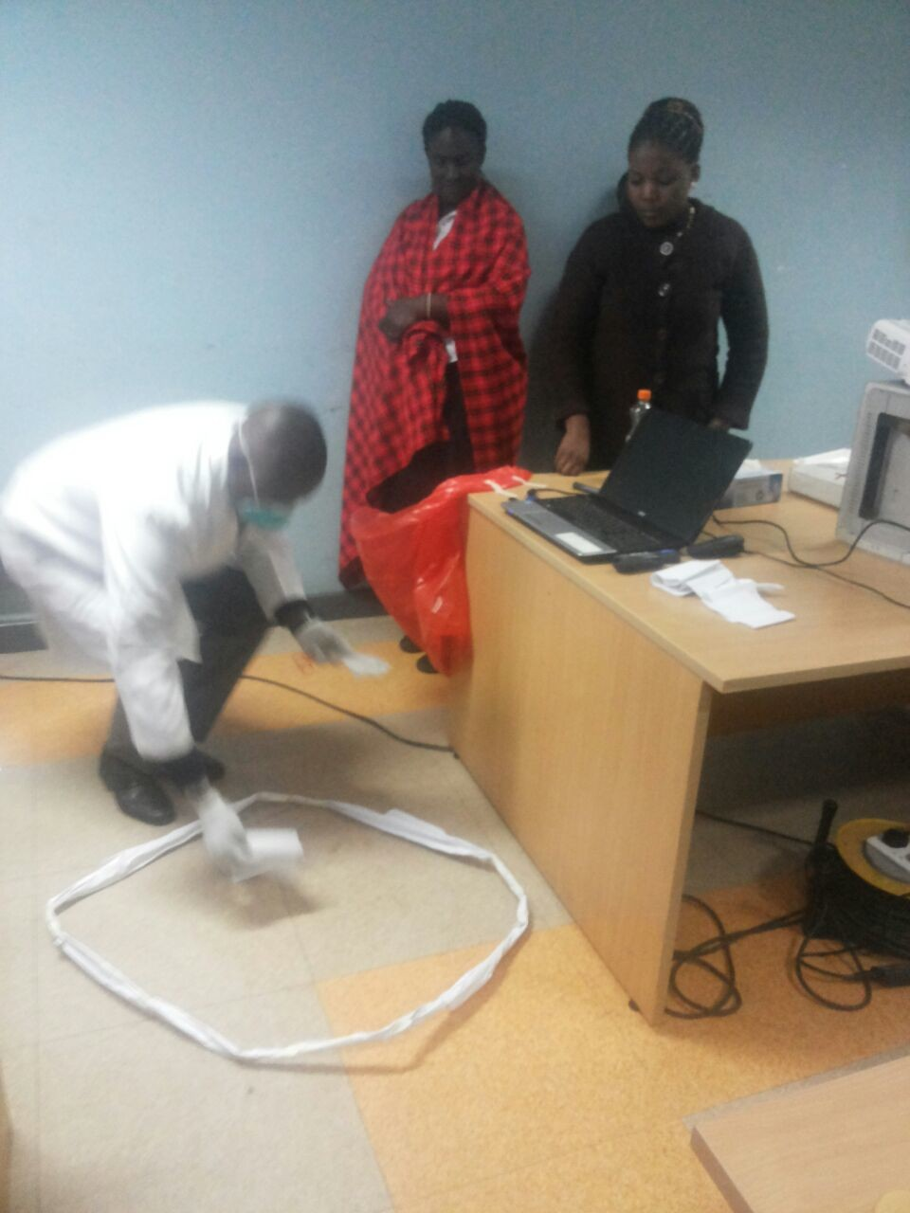
Spill management:

Slide 12
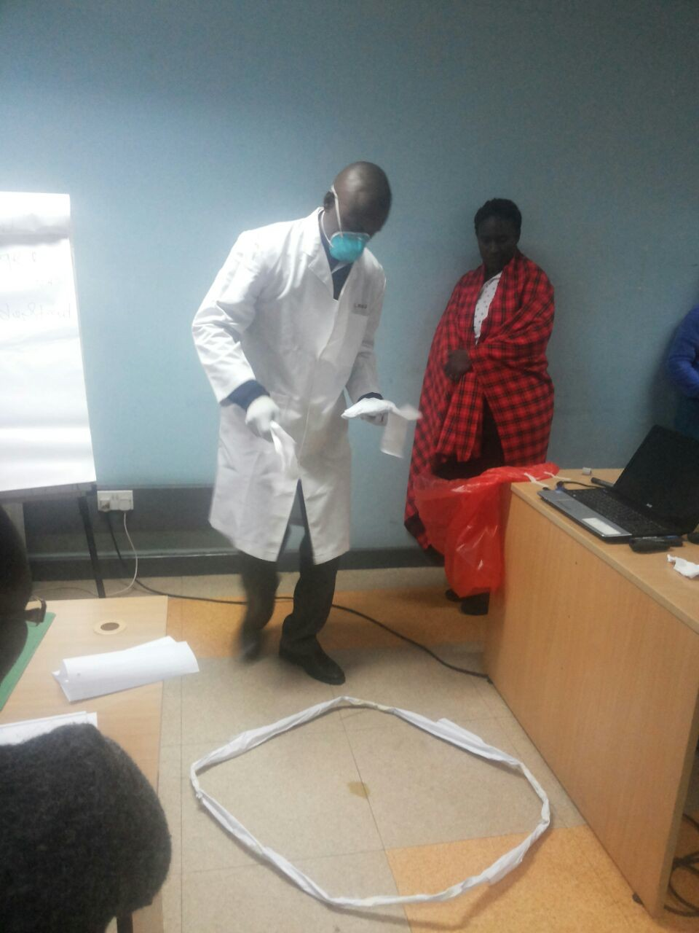
Spill management continued:

Slide 13
Challenges:
The facility based training was done without water while the tea was unreliably available.
There was also no ready lunch but some lunch allowance ,thanks to the former MSH.
The daily commuting affected the programme a great deal since we had to start late and finish late due to heavy traffic in the city during pick hours.
The 5% deficit in attendance was a result of interruptions from home and work places.

Slide 14
Conclusion:
For effective biosafety CMEs and basic 5 day trainings, commitment by both participants and facilitators is required.
The participants understood the biosafety principles and were ready to apply them in the improvement projects outlined in the work plans in their respective facilities as shown by pre and post-tests performance.
The best setting for effective biosafety training is residential, away from home. However, if worse goes to worse like it some times happens in Nairobi, its still possible.

Slide 15
Acknowledgements:
Doris Bota –University of Maryland NRB
N. Marebe-CMLC NRB.
My Lab Team in WHC.

Slide 16
THANK YOU

