Slide 1
Ipnet K Conference
The value of infection prevention and control for communicable diseases in community and health care settings
Gelian Hotel, Machakos Kenya, 15–18th Novemeber 2016
BIORISK MANAGEMENT IN KENYA
Patrick Okanya, PhD
Biorisk Management Association of Kenya (BMAK)

Slide 2
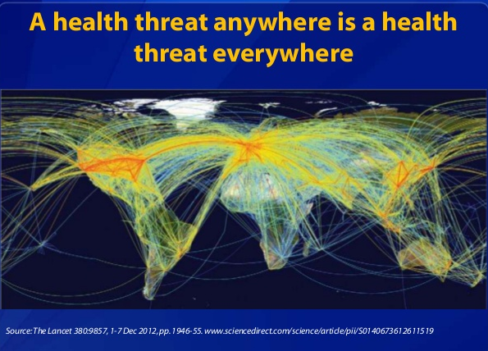
Outline

Slide 3
Outline
Biorisk Management Association of Kenya (BMAK)
Objectives of BMAK
Recent Activities of BMAK
Models for Biorisk Management
Biosafety and Biosecurity in Kenya/ What has been done
Biosecurity Survey in Kenya
Way forward
Key Stakeholders in Biosafety and Biosecurity issues in Kenya

Slide 4

BMAK
BMAK was registered in 2011 as a non-profit professional association aimed at bringing together professionals involved in biosafety and the emerging area of national Biosecurity in Kenya
Membership: Students to senior professionals in the fields of public health, veterinary, agriculture, academia, emergency response agencies, pharmaceutical/biotech industries, policy makers
BMAK is a member state of the International Federation of Biosafety Associations (IFBA)

Slide 5
BMAK Objectives
To enhance the knowledge and understanding of biosafety and biosecurity issues in Kenya
To encourage local, regional and international dialogue on biological risk management
To act as a link between the private and public sector partnership on biological risk management (Multi-sectoral approach)
To seek to influence and support legislation policy and guidelines associated with biosafety and biosecurity
To act as a focal point for the consolidation of views on biosafety and biosecurity for the development of key strategic outreach messages and materials for raising awareness and education of all relevant stakeholders.

Slide 6
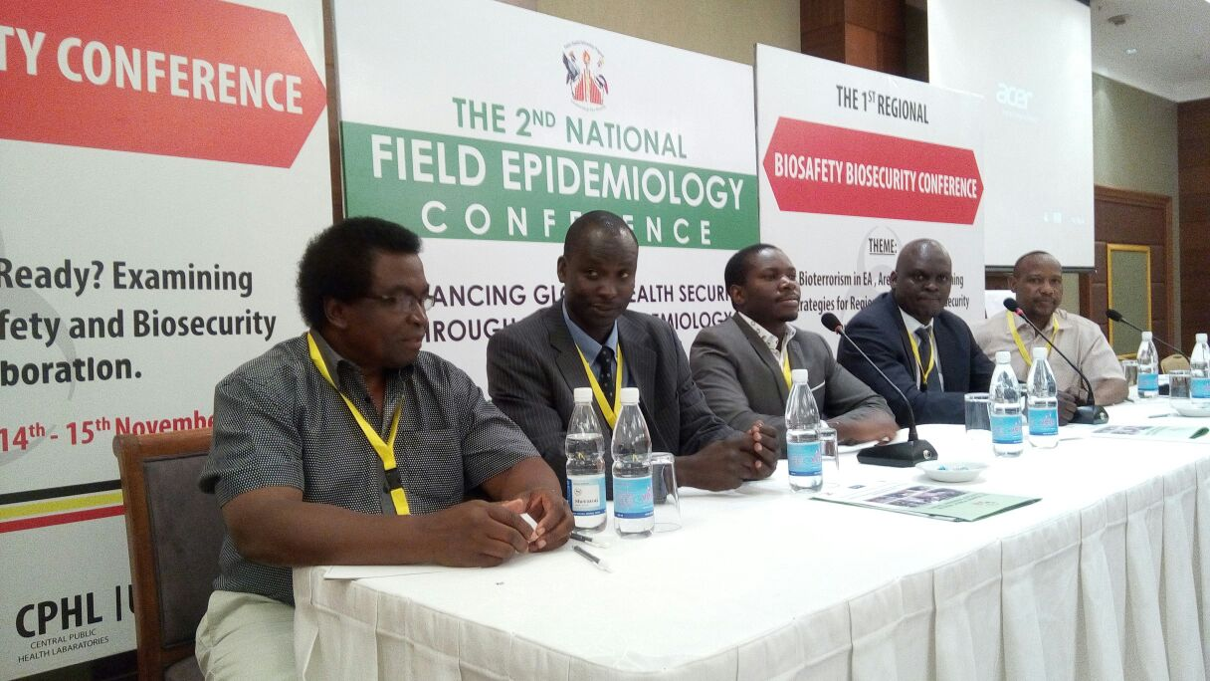
Recent BMAK Activities
Delegates representation in the 1st Regional Biosafety Biosecurity Conference, Kampala Ethiopia14th -15th November 2016, Uganda.
Bioterrorism in EA
Are We ready? Examining
Strategies for Regional
Biosafety and Biosecurity
Multi Sectoral Collaboration

Slide 7
Regional Workshop for Africa
Preparing for the Eighth Review Conference of the Biological Weapons Conference
Addis Ababa, Ethiopia, 13–14 September 2016
Strengthening national Implementation
Austin Ochieng Aluoch, PhD
Biorisk Management Association of Kenya (BMAK)

Slide 8
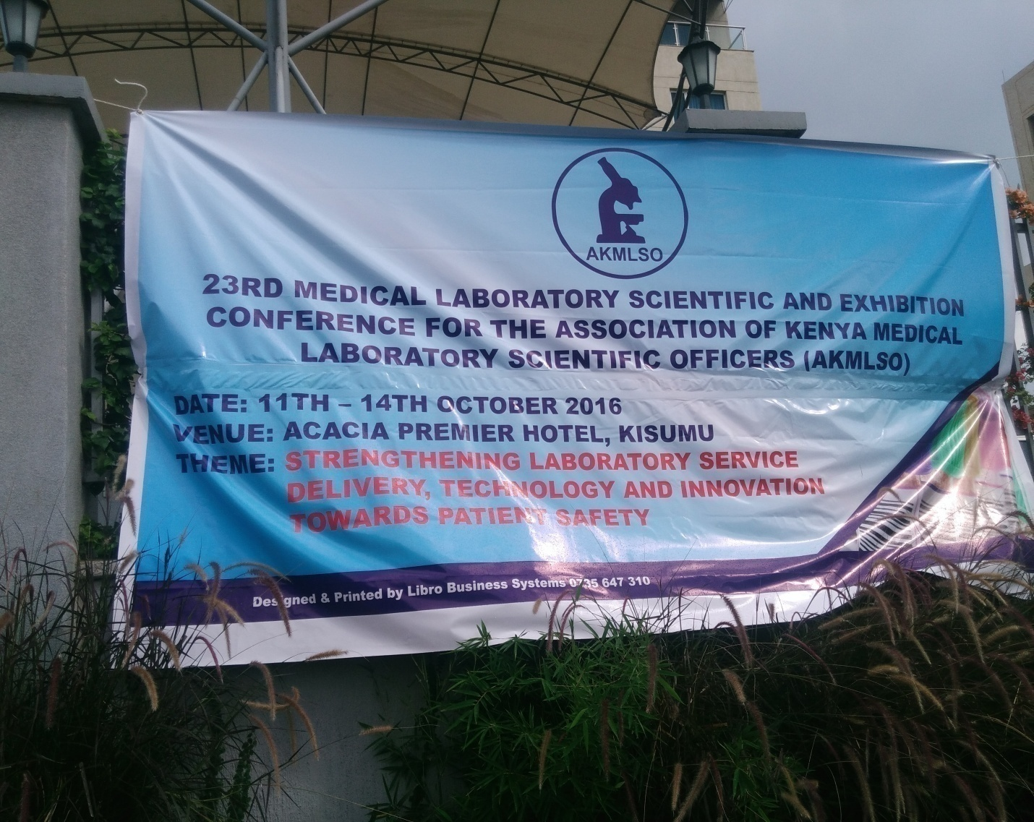
Participation in the 23rd AKMLSO Conference

Slide 9
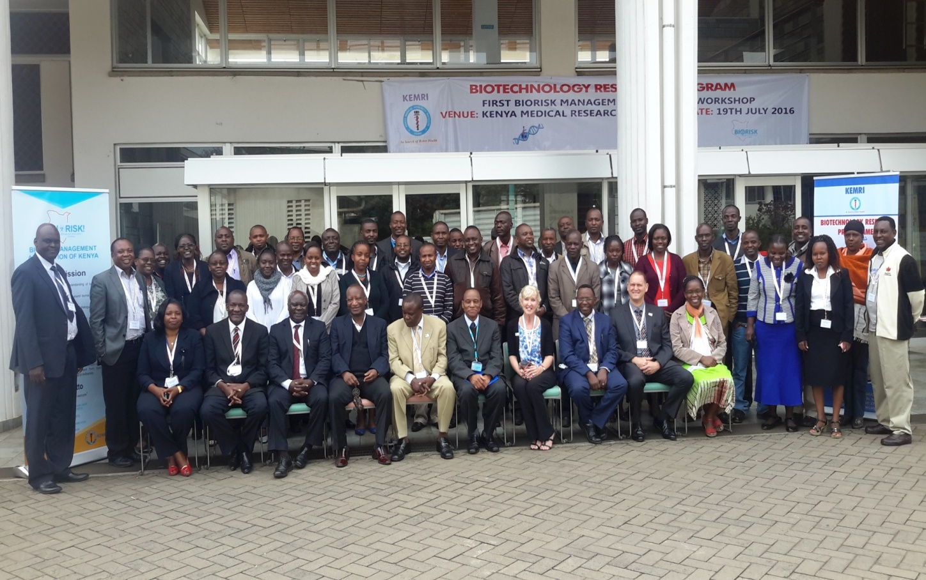
BMAK Workshop at KEMRI – 19th July 2016
50 participants trained on Biorisk Management

Slide 10
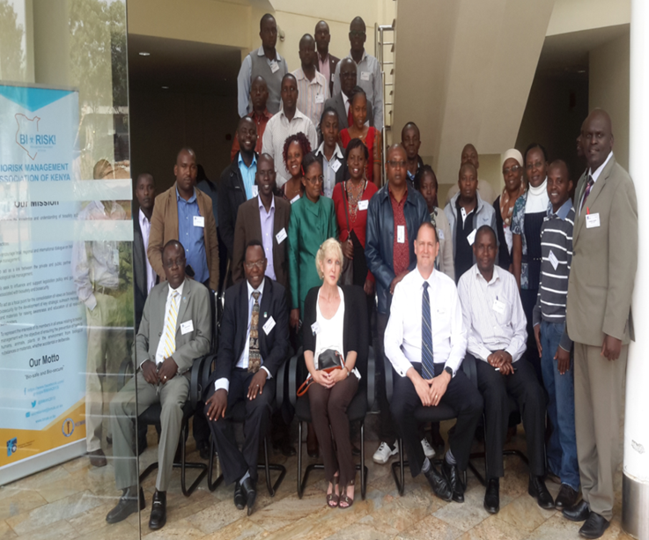
Regional Workshop and IFBA Competence Exam in Biorisk Management – USIU- Africa, 22nd July 2016

Slide 11
Biosafety, Biosecurity and Biorisk
Biosafety – keeping bad bugs away from people (protection from unintentional release)
Biosecurity – Keeping bad people from bugs (protection from intentional release)
Biorisk – Probability (likelihood) and severity (consequences) of harm from biological agents
  The risk associated with biological materials has both a safety and security component hence biorisk

Slide 12
Biological and Weapons Convention (BWC)
The Biological and Toxic Weapons Convention entered into force on 26th March 1975
Kenya acceded and ratified the convention on the 7th of January 1976
Kenya has been a consistent participant of the BWC intersessional process
Kenya is also a signatory to the WHO’s International Health Regulations (IHR) Since 2005 and the “Global one health approach”

Slide 13
BWTC – 15 Articles
The key provision is contained in Article 1
Each State Party to this Convention undertakes never in any circumstances to develop, produce, stockpile or otherwise acquire or retain
  microbial or other biological agents or toxins whatever the origin or method of production, of types, and in quantities that have no justification for prophylactic, protective or other peaceful purposes
  weapons equipment or means of delivery designed to use such agents or toxins for hostile purposes or in armed conflict

Slide 14
Need for Biorisk Management System (BMS)
To protect employees, the community and the environment from risks associated with biological agents handled in the laboratory
The system provides a framework for
  assessing and controlling biological hazards & risks in the laboratory
  continually improving the management of biological risks

Slide 15
Biorisk Management Approach
Starts with identifying all hazards and risks in the laboratory
Conduct a “biorisk assessment” which is key to managing these hazards & risks
Risk assessments should involve all employees (biorisk management advisor, scientists, lab techs, supervisors, security officials)
  Should be conducted before work with new biological agents, before new laboratory activities are carried out, regularly on an ongoing basis

Slide 16
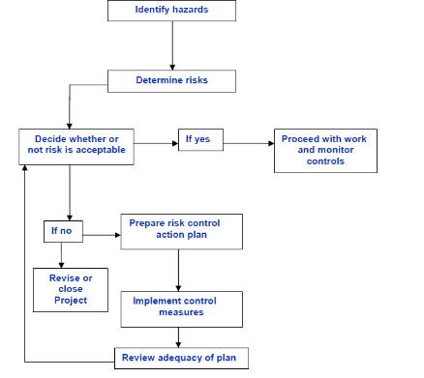
Biorisk Assesment Flow chart

Slide 17
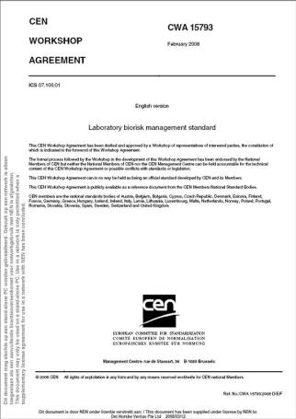
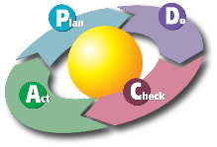
Models of Biorisk Management
PDCA - CEN Workshop Agreement (CWA) 15793 model
International consensus document developed in 2007 by participants from 24 countries

Slide 18
PDCA
An effective approach is built on the concept of “continual improvement” through a cycle of planning, implementing, reviewing and improving the processes
This is known as the PDCA (Plan-Do-Check-Act) principle:
  Plan:, identification of hazard, risk analysis and establishing/ development of new goals
  Do: Testing and optimization of new concepts
  Check: Careful checking of process and results obtained,
  Act: Taking corrective action e.g full implementation as a standard if the process is successful and periodically audited.

Slide 19
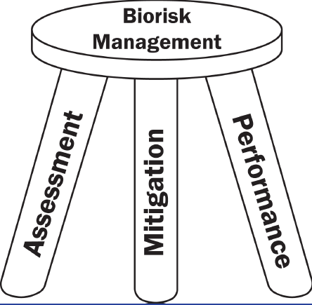
Assessment, Mitigation and Performance
Introduced in the WHO Biorisk Management Train-the-Trainer Program (follows PDCA approach)
Assessment
  Identification hazards and assessment of risks (Plan)
Mitigation
  Application of controls using the hierarchy of controls (Do)
Performance
  Monitoring of the controls through audits, incident investigations and identification of non-conformities (Check and Act to address any non-conformities)

Slide 20
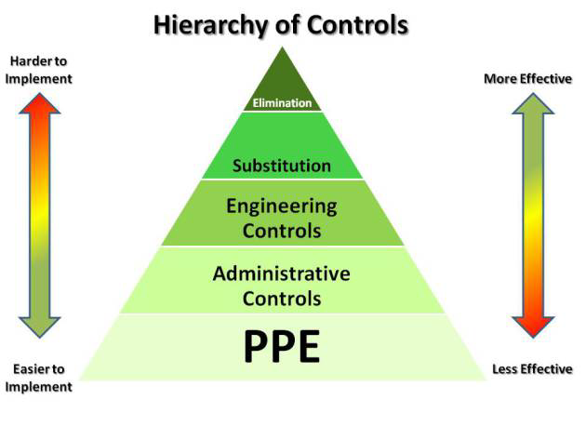
Hierarchy of Controls

Slide 21
Biosecurity Survey in Kenya, Nov 2014 to February 2015
A research project of NACOSTI , Kenya and the Centre for Biosafety and Biopreparedness, Denmark surveyed 86 laboratory facilities in kenya.

Slide 22
Sample questions in the questionnaire
Which pathogens and toxins are used or stored in the institution?
Are you aware of laboratory biosecurity?
Are the personnel in the laboratory trained in biosecurity?
Does your laboratory have a procedure for waste mangement
What kind of pathogen containment is used (freezer, reefrigerator, storage room, cabinets etc)
Does their personal identification restrict access to the facility?
Are there security guards at the laboratory?
Are harzadous biological material storage rooms locked?

Slide 23
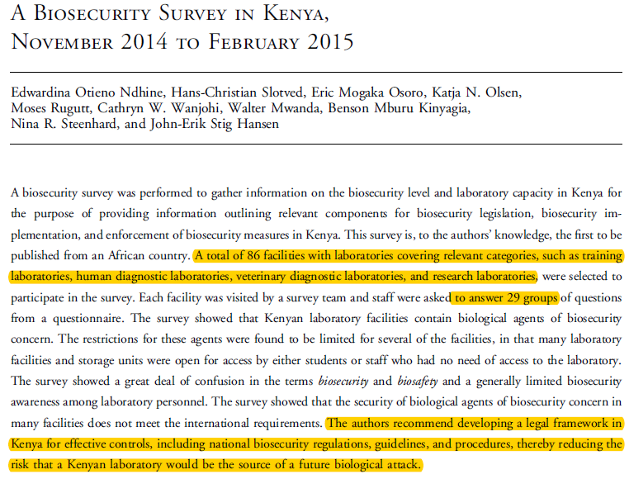
Health Security, 14, 4, 2016, DOI :10.1089/HS.2016.009

Slide 24
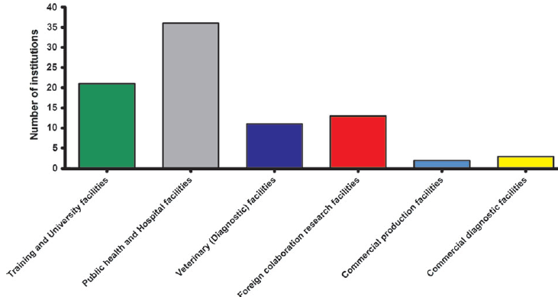
Type and Number of Facilities Surveyed

Slide 25
Survey Outcomes
Kenyan laboratories contain biological agents of biosecurity concern
Restrictions to these agents was wanting! i.e storage units were open to access without stringent restrictions
Limited awareness of biosafety and biosecurity among personnel
Lack of inventory
Security of the VBM did not meet international requirements

Slide 26
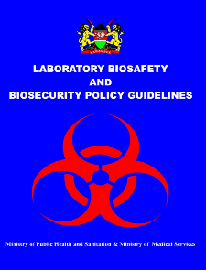
Biorisk Management Achievements in Kenya
Laboratory Biosafety and Biosecurity policy guidelines
Biosafety and Biosecurity curriculum manual- NPHLS
Over 3000 health care workers have been trained in BSS
Active engagement/discussions of BSS issues by government, private institutions, non governmental organizations, law enforcers
A foiled bioterrorism attack in May 2016
A draft of a Bioscience policy

Slide 27
Most health care laboratories have adopted the AMP model of the Biorisk Management

Slide 28
Way Forward
Continuous discussion of biosecurity issues with all the Key stakeholders – multisectoral collaboration
Biosafety and Biosecurity trainings using government approved curriculum
Reviewing of the BSS curriculum from time to time
Inventory of all valuable biological material in the country
Legislation- legal framework for biosafety and biosecurity regulations

Slide 29
Key Stakeholders in Biosafety and Biosecurity issues in Kenya
Ministry of Health- NPHLS, OSH
Centre for Disease Control (CDC-Atlanta & Kenya)
Kenya Medical Research Institute (KEMRI)
NACOSTI, NBA
Global Health Security Agenda (GHSA)
World Health Organisation
AfBSA
AMREF
University of Maryland
International Health Research (IHR)
Denmark Government
IFBA
Defense Threat Reduction Agency (DTRA)
BMAK

