Slide 1

PPE COMPLIANCE AMONG LODWAR COUNTY & REFERRAL HOSPITAL LABORATORY STAFF
IPNET CONFERENCE 2016
AT GELIAN HOTEL-MACHAKOS
PRESENTED BY
LETING SIMON

Slide 2
Background Information
PPE ONE Of the best lines of protection against hazardous exposures.
Use of PPE to reduce employee exposure(OSH).
Bureau of Labor statistics data, 78% of survey respondents attribute
Accidents and workplace injuries, top concern
compliance to safety protocols is key.

Slide 3
Problem statement
100% PPE compliance translates to minimal incidents and accidents
Compliance at LCRH was low;
Gloves(58%), labcoats (40%), closed shoes(18%)
Documented cases of incidents/accidents at 27.8%
Strategies for compliance is necessary to solve this problem.

Slide 4
OBJECTIVE(S)
To determine the possible causes of non compliance to personal protective equipment among Laboratory staff
Strategies to put in place for improved PPE compliance.

Slide 5
Methodology
Study area-
Lodwar county Referral Hospital
Located in North western part of Kenya
Bordering 3 international Boundaries- Uganda, Sudan & Ethiopia
Borders Elgeyomarakwet, westpokot & Baringo counties

Slide 6
Cont’
Improvement plan done between sept 2014 and March 2015
Data collected, through a questionnaire
18 participants were involved- 15 staff and 3 volunteers
Every participant given a questionnaire to fill
Baseline PPE compliance was determined
Final data was collected in Jan to march 2016

Slide 7
Cont’
Feedback meeting was convene for all staff
Suggestions for improvements received
Recommendation for Biosafety/IPC training was forwarded to the management
CMEs and OJT were organized
All untrained staff underwent the five day training

Slide 8
Results
Significant reduction in documented cases of incidents/accidents to 5.5%
Major factors noted for non compliance
Unavailable/inadequate supplies
Too hot
information gap
Other factors
Poor fit
Allergy

Slide 9
Data on factors contributing to non-compliance
Unavailability of supplies | Too hot | information gap | Poor fit | Allergy
5 | 3 | 7 | 2 | 1
27.8% | 16.7% | 38.9% | 11% | 5.5%

Slide 10
Factors contributing to non-compliance

Slide 11
Data
 | Gloves | Lab coats | Closed shoes
Initial | 58 | 40 | 18
Final | 75 | 88 | 95

Slide 13
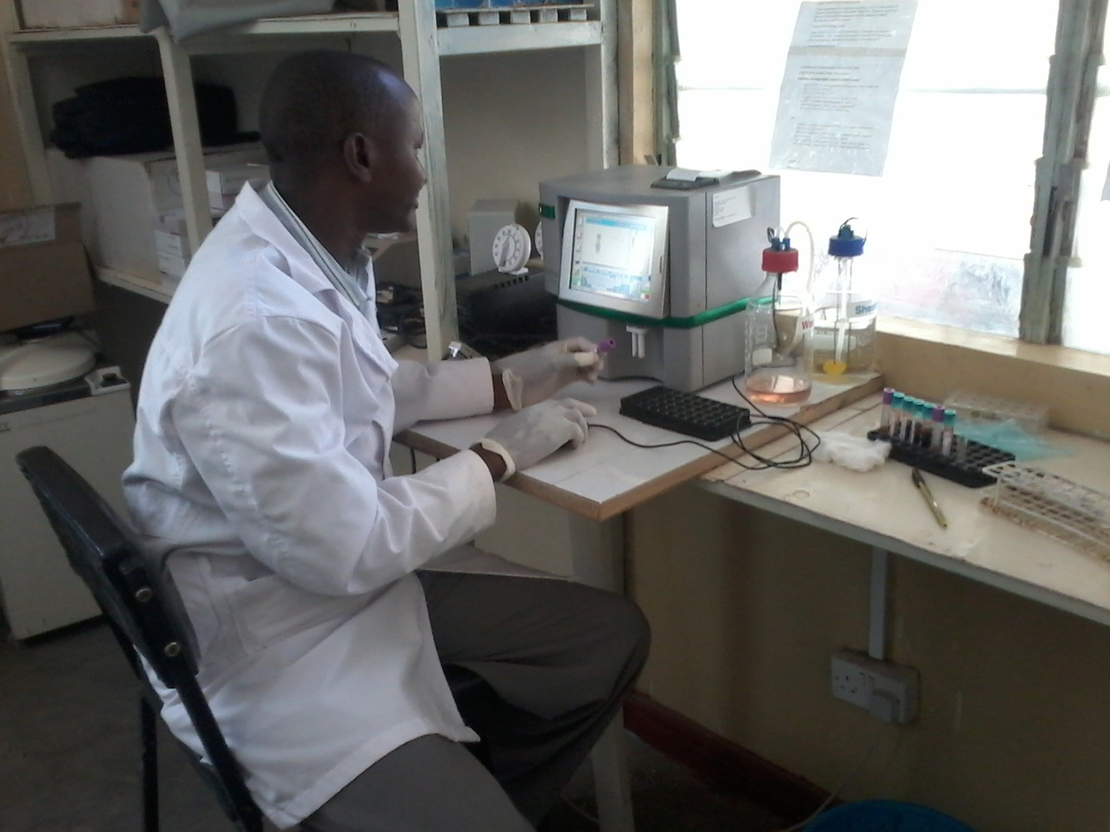
Staff in ppe

Slide 14
Conclusions
Management support is key
Training, CMEs and OJT leads to greater PPE compliance.
Regular reminders with new posters keep compliance top of mind.
Continued commitment from managers to ensure availability & access to equipment
A strong safety culture in an organization is important.

Slide 15
Recommendations
Ensure timely orders to avoid stock-outs
Procure all sizes of gloves
Procure powder free gloves for the allergic group.

Slide 16
Acknowledgements
County govt
LCRH Management
LCRHL staff
IPNET
Audience

Slide 17
THANK YOU

Slide 18
