Slide 1
Implementing OSH in Healthcare settings in Kenya
fifth IPNET conference,
15th -18th November 2016,
Gelian Hotel Machakos Kenya.
By Isaac Mugo- IPC/injection safety/ biosafety officer -GIS

Slide 2
Background.
The World Health Assembly 2007 endorsed the Global Plan of action on workers’ health 2008 – 2017 to provide a political framework for development of policies, infrastructure, technologies and partnerships for achieving basic level of health protection in all workplaces throughout the world.

Slide 3
Background…….
Kenya enacted the Occupational Safety & Health Act(OSHA), 2007 to provide minimum standards for establishing and maintaining a positive work environment for all workers

Slide 4
Interventions at MOH
A situation analysis to find out the baseline on Occupational Safety and Health in 95 Health facilities was conducted from October, 2011 to May, 2012.

Slide 5
Policies and guidelines
A workshop for OSH Guidelines development was held September, 2013- Naivasha

Slide 6

National OSH Guidelines
Launched on Aug 26th, 2014
dissemination to the 47 counties each county received 50 copies of the guidelines

Slide 7
Intervention on training…..
Training package developed
  OSH curriculum
  OSH training participants manual
  OSH Trainers manual
72 Healthcare workers from 9 facilities trained on OSH
18 OSH TOT trained

Slide 8
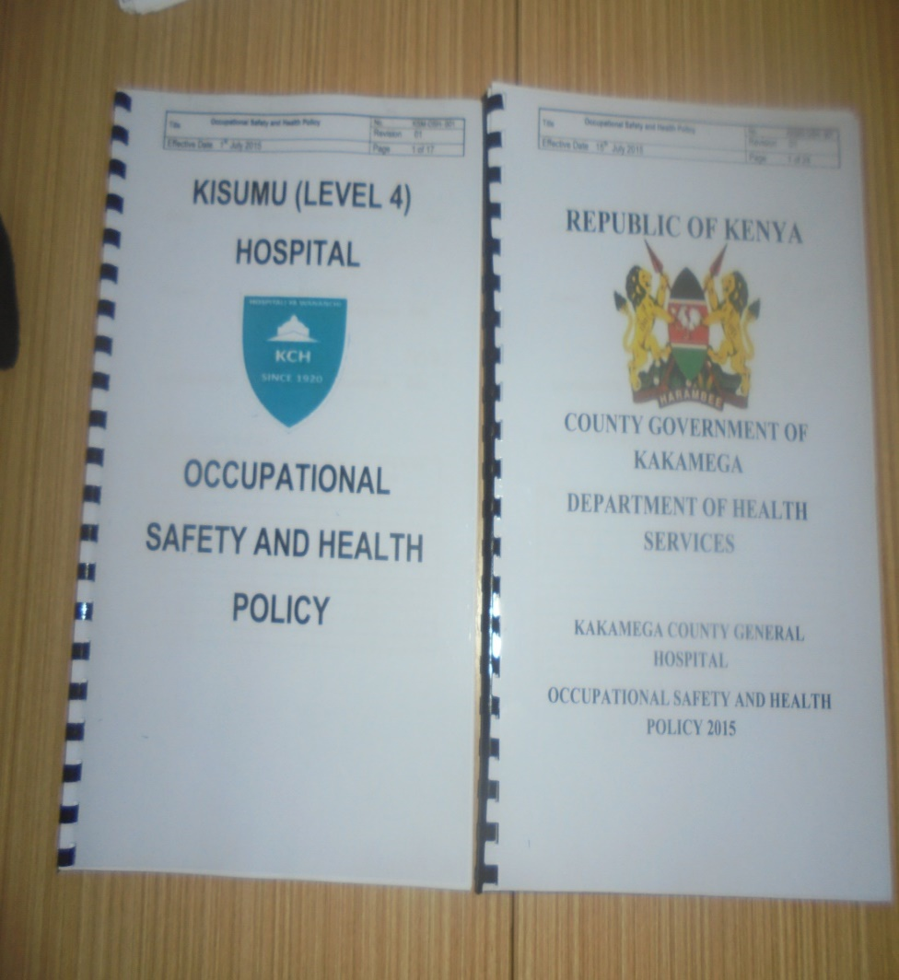
Intervention on facility OSH policy
Nine facilities developed their specific OSH policies
Nine facilities constituted their OSH committees
Some of the Nine facilities in Started trainings and registration with DOSHS

Slide 9
Continuing activities
One facility held trainings for all its staff and registered with DOSHS
One facility has planned to launch the policy and invited the county leadership.
Several DOSHS forms are completed but not yet processed
One of the trained TOTs has introduced the OSH training in a university using the materials developed

Slide 10
Challenges
Lack of awareness
Not budgeted for at the county or facility level

Slide 11
THANK YOU

