Slide 1
Contribution of IPC in quality management systems(QMS) and Accreditation
Ernest Makokha
5th Infection Prevention and Control (IPC), Scientific Conference
GELIAN HOTEL, MACHAKOS
NOVEMBER 15-19, 2016

Slide 2
Presentation Topics
Defining terms
  IPC
  QMS
  Accreditation
Benefits of IPC, QMS and Accreditation
Implementing of IPC, QMS and accreditation programs
Using IPC to monitor QMS and Accreditation programs
IPC- a game changer on-going lab QMS improvement and accreditation in Kenya

Slide 3
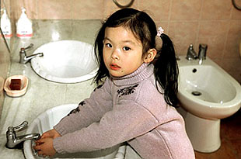
Defining IPC
Measures taken to ensure the protection of those who might be vulnerable to acquiring an infection while receiving care due to health problems, in a range of settings
The basic principle of infection prevention and control is hygiene

Slide 4
Key Routine IPC practices
POC risk assessment
Hand hygiene
Aseptic techniques
PPE
Cleaning and disinfection of physical environment
Handling of Health Care waste

Slide 5
How do we evaluate the impact of IPC practices?
Well-designed IPC programs are cost-effective as they:
  Reduce health-care associated infections
  Shorten length of hospital stays
  Decrease cost of treating health care-associated infections
  Reduce total patient complications
  Reduce tension and conflict among health care givers
  Reduce staff turnovers
  Reduce clinical error rates
Problem: how do we measure impact?

Slide 6
Defining: Quality Management System
A collection of policies, procedures, plans, resources, processes, practices, and the specification of responsibilities and authority of an organization designed to achieve product and service quality levels, customer satisfaction and company objectives
QMS Principles
Customer focus
Leadership
Involvement of people
Process approach
System approach to management
Continuous improvement
Factual approach to decision making
Mutually beneficial supplier relationship

Slide 7
QMS Model
1. Quality planning
2. Quality Assurance
1. Quality Control
Do the right things
Do things Right
Do the right things right
Focus on setting quality objectives & process to ensure achievement
Apply planned systematic activities to ensure process used will meet requirements and objectives
Monitoring specific results to determine compliance with relevant quality standards and identify ways to avoid failure

Slide 8
Defining Accreditation--1
Hospital accreditation:
  Validation by an external authority of patient safety, clinical quality improvement process and valuable ideas for improving critical process in accordance with set standards
  In other words, confirmation that the hospital promotes capacity building, ensures staff satisfaction and improves health outcomes of patients
Laboratory accreditation:

Slide 9
Laboratory Accreditation
Confirmation and recognition by an external/independent/objective party (accreditation body)that the lab is conducting testing and reporting results in accordance with known standards of testing, inspection, calibration, and other related activities
  In other words, the laboratory has competent staff who are able to use appropriate technology to provide services as per set standards
  Note: Accreditation is not about who the best is; but who has a system of standard procedures

Slide 10
Synergistic benefits of IPC, QMS, Accreditation
These 3 can be used as a catalyst for collaboration:
  Look beyond silos
  Make each team feel like they can make a meaningful contribution to the team and speak up
  Engage in quality improvement, safety and process improvement projects
  Team members learn new language, skills and expertise together
  Understand the role, value and contribution of each team
  Act as a processes for continuous learning, improvement, & measuring of progress

Slide 11
12 Lab Quality System Essentials(QSE)
A set of coordinated activities that function as building blocks for
quality management
Organization
Personnel
Equipment
Process Control
Purchasing
&
Inventory
Information Management
Assessment
Documents
&
Records
Occurrence Management
Process Improvement
Customer Service
Facilities
&
Safety

Slide 12

Laboratory Accreditation Checklist
For Clinical and Public Health Laboratories
12 QSE adopted by SLIPTA
QSE | Total Scores | % Weight
Documents and Records | 28 | 10
Management Review | 14 | 5
Organization and personnel | 22 | 8
Client management | 10 | 4
Equipment | 35 | 13
Internal audit | 13 | 5
Purchasing and inventory | 26 | 9
Information management | 21 | 8
Process control | 32 | 12
Corrective action | 19 | 7
Occurrence/incident management | 12 | 4
Facility and safety | 43 | 16
TOTAL | 275 | 100

Slide 13
Laboratory Accreditation Checklist
For Clinical and Public Health Laboratories
12 QSE adopted by SLIPTA
QSE | Total Scores | Observed score
Documents and Records | 28 | 16
Management Review | 14 | 8
Organization and personnel | 22 | 15
Client management | 10 | 3
Equipment | 35 | 19
Internal audit | 13 | 8
Purchasing and inventory | 26 | 11
Information management | 21 | 14
Process control | 32 | 14
Corrective action | 19 | 9
Occurrence/incident management | 12 | 5
Facility and safety | 43 | 26
TOTAL | 275 | 148

Slide 14
Xxxx Laboratory: SLMTA 2010-2014 progress

Slide 15
WHO AFRO Stepwise Laboratory Quality Improvement Towards Accreditation
End Point
National, Regional, or International Accreditation Body
5
Star
4
Star
3
Star
>95%
2
Star
85-94%
> 95 %
1
Star
75-84%
% score on external evaluation using a check-list
65-74%
0
Star
55-64%
Step-wise progression towards accreditation readiness
Incremental Process
Audited against SLIPTA Checklist and recognized as operating at a level of performance demonstrated by star rating
Notes:
15

Slide 16
Difficult spots

Slide 17

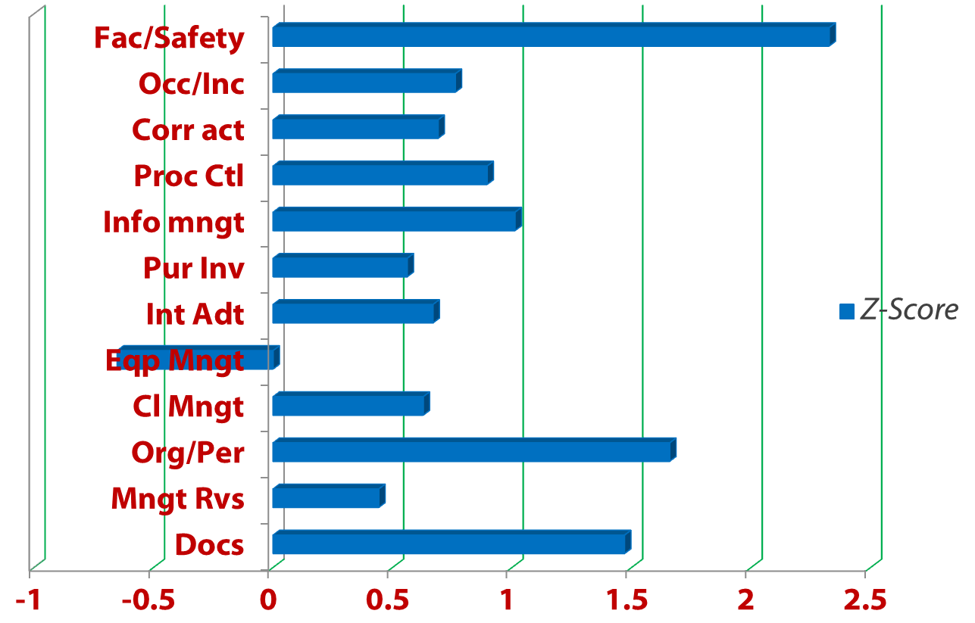
Game changers for Lab Accreditation

Slide 18
Predictors of stagnation
Identifying Factor X

Slide 19
12.0 FACILITIES & SAFETY(43 Points)
Physical work environment
Space for optimal workflow
Controlled access
Storage
Biosafety
  Waste management
  Handling of sharps
  Fire safety
  Safety audits
  PPE
  Staff vaccinations
  PEP
  Trainings
Organization
Personnel
Equipment
Process Control
Purchasing
&
Inventory
Information Management
Documents
&
Records
Occurrence Management
Assessment
Process Improvement
Customer Service
Facilities
&
Safety

Slide 20
Light Lifting support
A one-off support to address non-conformances detected during SLMTA process:
  Biosafety/Biosecurity
  Documentation support
  Minor renovations
  Minor essential lab supplies

Slide 21


Global Status
Notes:
Kenya is the largest SLMTA country
# labs enrolled in SLMTA: 1091
# people who completed 3 workshop series: 2632
# cohorts: 54
# SLMTA labs in Kenya: 141
# SLMTA labs in Ethiopia: 138
# SLMTA labs in Uganda: 109

Slide 22
Laboratories # 141
8 SMLTA Cohorts

Slide 23
Lab Cohorts and Ownership
Who owns these labs?
COHORT #1 | High volume national and county labs | 12 |  | Ownership | # Labs
COHORT #2 | High volume sub-county labs | 8 |  | National | 21
COHORT #3 | FBO and other labs | 7 |  | County | 33
COHORT #4 | EAPHN & DOD-supported labs | 14 |  | S/County | 65
COHORT #5 | Nairobi City County and other labs | 15 |  | Nairobi CC | 14
COHORT #6 | Blood Banks and others | 19 |  | FBO | 21
COHORT #7 | Public Private Partnership(PPP) labs | 10 |  | NGO | 3
COHORT # 8 | Viral Load testing and sub-county labs | 56 |  | DOD | 4

Slide 24
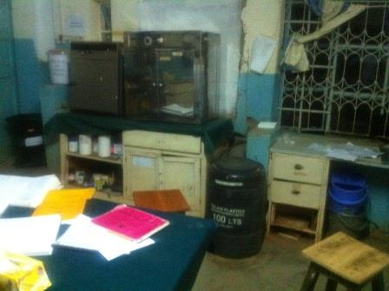
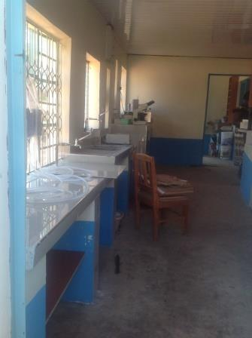
Lab XXYY
Before After

Slide 25
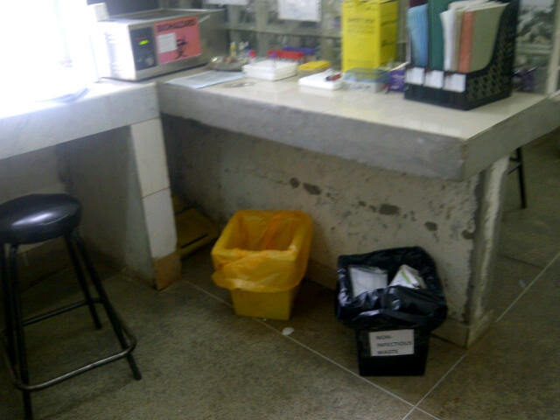
Biosafety in practice

Slide 26
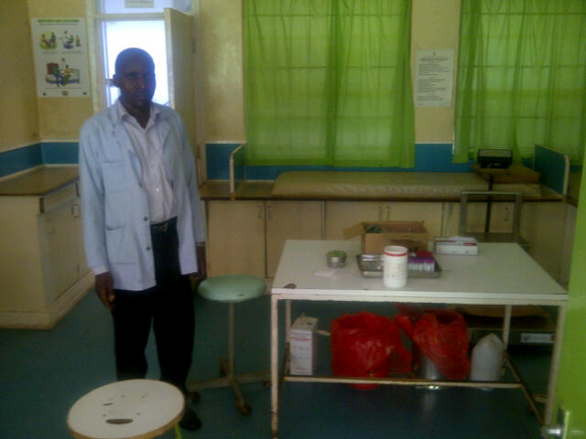
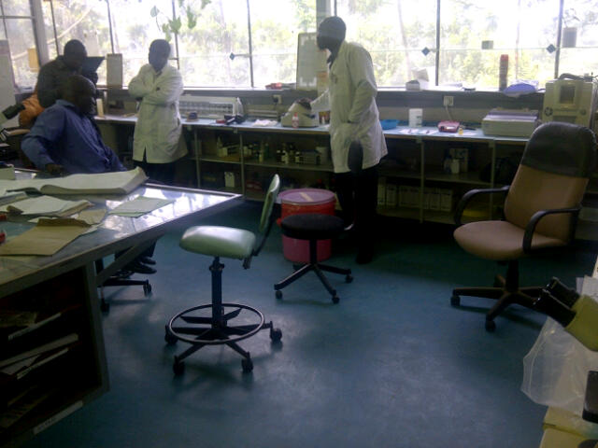
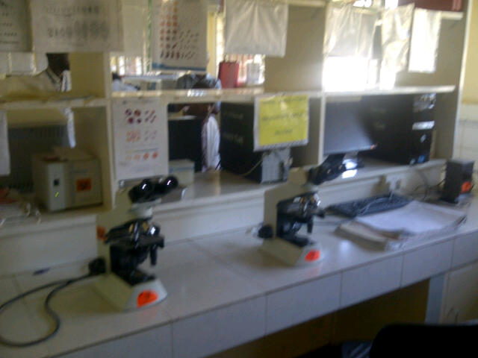
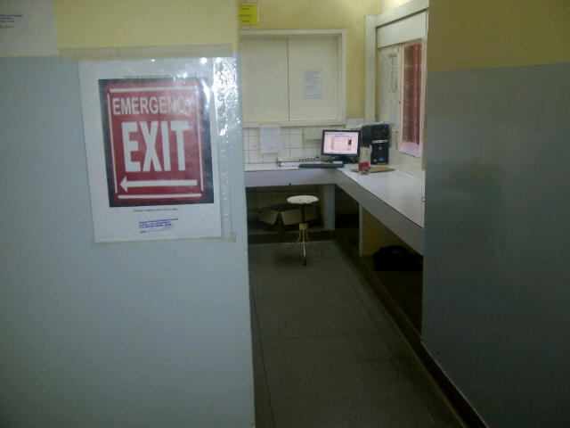
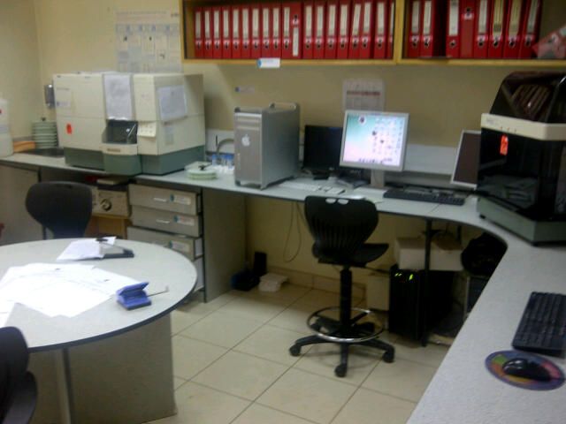
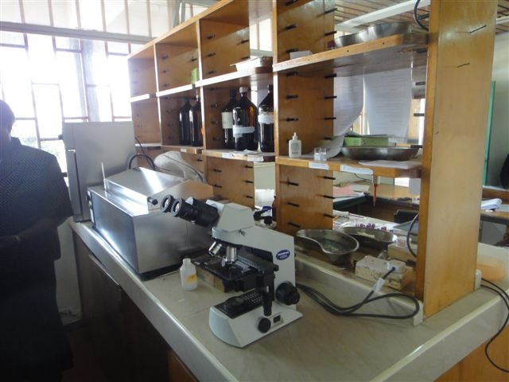
Across Kenya

Slide 27














