Slide 1


Improvement of safety practices prudent to infection prevention at
Vihiga county hospital laboratory.
BY:
BECKY SABUL……… AUTHOR
BRIGID SOITA………. CO-AUTHOR
Email: brigidsoita@gmail.com
beckychepkemboi@gmail.com

Slide 2
Introduction:
The laboratory environment can be a very hazardous place to work in. Laboratory workers are exposed to numerous potential hazards including chemical, biological and physical hazards.
Laboratory safety is of paramount importance so there is need to adhere to the safety guidelines to avoid transmissions of infections.

Slide 3
Introduction Cont.’:
Non adherence to the safety guidelines poses greater risks to the community, patients and staffs. Also, such practices compromise the quality of laboratory services.
Infection prevention in the laboratory largely depends on safe practices

Slide 4
Introduction Cont.’:
This study was conducted to describe the improvement of safety practices and interventions put in to improve infection prevention at Vihiga county referral Hospital laboratory.

Slide 5
Method
Laboratory practices were observed and the following gaps were identified:
    -No controlled access in to the laboratory
    Most staff used open shoes
    Gloves were not consistently used
    Proper waste segregation not observed
    Spills poorly handled
    Laboratory staff not vaccinated
    Eating and chewing in the laboratory was a common practice

Slide 6
Method cont.’
Interventions included :
Development of safety policies and procedures
Trainings
Placement of safety signages
Improvisation of safety emergency tools(first aid kit ,eye wash station spill kit)
Monitoring of the safety practices were put in place.

Slide 7
Results
By July 2016 the laboratory had realized:
    minimized access to the laboratory
    Proper waste segregation
    Proper use of gloves
    Minimized use of laboratory coats outside the laboratory environment
    PEP protocol displayed and followed
    safety policies and procedures in place and followed
    Hand washing technique improved
    Plans to vaccinate staff underway

Slide 8
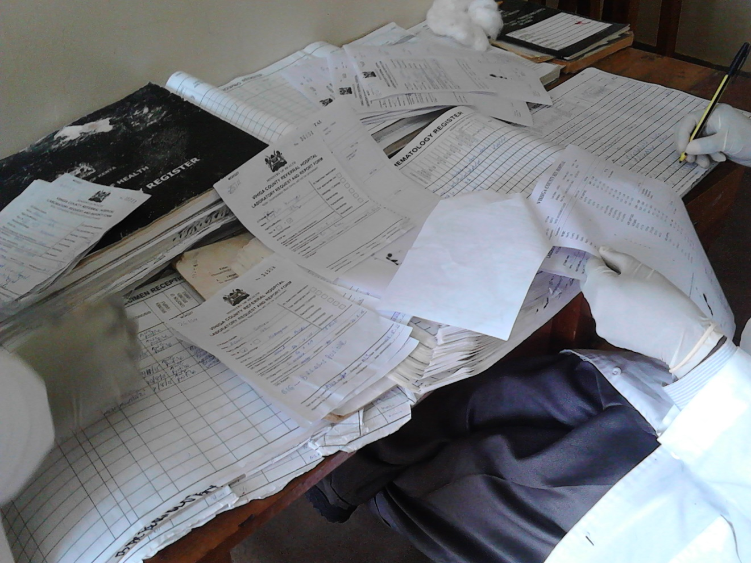
Use of gloves while recording results- which may lead to transfer of infection to clients.

Slide 9
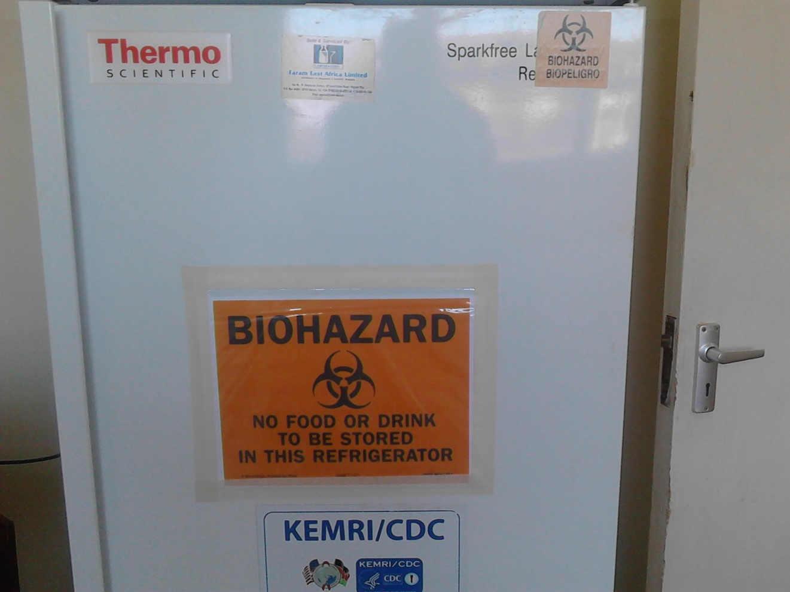
A fridge with signage

Slide 10
DISCUSSION
Vihiga County Referral Hospital Laboratory saw improvement in its safety practices, it recognized that integrating regular training of its staff on safety and regular monitoring into its operations would ensure rapid improvement and sustainability.
The lab undertook a process of ensuring all staff practice safe practices – to a mission of ensuring continual improvement of infection prevention.

Slide 11
Conclusion
Significant improvement in the safety practices was realized due to regular trainings and supervisions.
By all means, lets improve our laboratory safety practices.
Safety is everyone's responsibility.

Slide 12
Acknowledgement
GOD
MSH /APHIA PLUS
IPC COMMITTEE
GIS
COLLEAGUES

Slide 13
THANK YOU!!!

