Slide 1

Structures of IPC in Kenya
Dr. Rachel kamau
Ipnet conference

Slide 2
Outline
Describe how Kenya infection prevention and control programme in organised.
Outline the roles and responsibilities of the various IPC management and coordination organs

Slide 3
Introduction
Healthcare associated infections are a major concern for MOH
Infection Prevention and Control Programs at all levels require an appropriate, clear, and firm organisational structure
National Infection and Control Policy outlines the IPC structures that should be established at all levels of healthcare
It recommends establishment of IPC advisory and management structures at national, county and hospital levels
The establishment of the recommended structures are at different levels across the counties

Slide 4
Organization of the Ministry of Health-IPC Program
Ministry of Health
Department of Standards Quality Assurance &Regulation
Division of Quality Assurance
Patient and Health Worker Safety Unit
Infection Prevention and Control
Antimicrobial Resistance
Notes:
This slide shows the organization of the MOH departments where the AMR program is embedded.

Slide 5
The Process – Establishing the National IPC Program
2010
Development of the National IPC Policy and Guidelines for Healthcare setting in Kenya
2011
Creation of an IPC secretariat – representatives from MOH divisions meeting once a month.
2013
Appointment of a full time staff at the secretariat- one staff
2014
2015
2016
Establishment IPC unit with 2 full time staff
Establishment of the Patient Safety Unit – IPC and AMR programs, 4 staff
Establishment of the National infection prevention and control committee
Development of the National IPC strategic plan 2014-2018
Assessment of IPC practices in 2 pilot sites
Development of IPC work-plan for support by CDC
Training of TOTs on basic IPC in 15 counties
Dissemination to IPC policy, guidelines and strategic plans to county health teams
Inclusion of IPC activities into the AMR GHSA proposal
Revision of the national IPC policy, guidelines and development of training modules
Notes:
This slide illustrates the process which facilitated the inclusion and prioritization of the AMR agenda within the ministry of health. GARP’s Consistent engagement with the Ministry of Health at various forums provided for an opportunity to raise the AMR agenda. GARP membership was diverse spanning from Agriculture, Livestock, Human health including Academia and representation from MOH.
International Health Regulations and the proposal under the Global Health Security Agenda also aim at strengthening AMR surveillance

Slide 6
Organization of the National IPC Program
National /Policy Level
National IPC advisory Committee
National IPC Technical Working Group
MoH IPC Unit
County / Frontline Level
County / Sub-County IPC Committee
Hospital IPC Committee
Facility Level IPC Coordinator / Focal Person

Slide 7
National IPC Advisory Committee
Chaired by the DMS
Members are heads of programs with activities on IPC, Partners supporting the national IPC program, and key persons with expertise on IPC
Head of the IPC program is the secretary of the committee.
It is charged with the responsibility of overall policy and strategy development for IPC in health care settings
Notes:
The National IPC structures are functional. The committees meet quarterly.

Slide 8
The National IPC Technical Working Group
Chaired by head of IPC program
Program officers carrying out IPC activities, partners supporting national and county IPC programs, the IPC coordinator from KNH
It is responsible for planning and ensures implementation of recommendations from NIPCAC
Coordinating programs with IPC activities
The NASCOP IPC program is the secretariat for this TWG

Slide 9
The MOH IPC Program
Has a multi-disciplinary team
It is charged with the responsibility of evidence gathering and synthesis to inform national IPC policy and strategy.
Developing/reviewing policy, guidelines and training materials on IPC
Training of county TOTs
Mentoring of counties on IPC

Slide 10
County IPC Advisory Committee
Similar activities as NIPCAC but at the county level
Responsible for the overall coordination of IPC programs within the county (sub-county).
The County Department of Health appoints an IPC coordinator/focal person who acts as coordinator and secretary of this committee

Slide 11
Other Committees at County Levels
Sub-county IPC Committee
Hospital IPC Committee
Focal persons at facility level

Slide 12

Hospital Infection Prevention and Control Committee (HIPC)
Provides a forum for multidisciplinary input, cooperation, and information sharing on IPC
Is responsible for the planning, implementation, prioritisation, and resource allocation of all matters relating to IPC
Acts as a liaison between departments responsible for patient care and support services
Notes:
The ICC must report directly to either administration or the medical staff to promote program visibility and effectiveness.
An effective IP&C Program should collaborate and consult with internal (e.g., patient safety, quality assurance, reprocessing, occupational health) and external partners (e.g., other facilities and local, provincial/territorial and national health agencies) to ensure appropriate communication and sharing of information. An ICC can help foster this collaboration.
The ICC provides administrative power to the IP&C program. The ICC is generally the official route for informing administration of IP&C problems and accomplishments, such as outbreak investigations, new regulations, policy and procedures compliance, and routine data monitoring.

Slide 13
Hospital Infection Control Program
Activities
Surveillance of HAIs
Outbreak investigation
Implementation of guidelines for IPC
Cooperation with occupational health
Cooperation with quality improvement program
Cooperation with MTC
Education of hospital staff on infection control
Monitoring of antibiotic resistant organisms
Eliminating wasteful or unnecessary practices

Slide 14
Structure of IPC program at Health Facility
HC/Dispensary
Hospital
Hospital IPCC
Hospital IPC team
  IPC coordinator/Focal person
    (Full time for hospitals with 250 or more bed capacity)
  link nurses - responsibility of ensuring IPC practices are maintained in their departments
IPC focal person

Slide 15
Composition of the HIPCC
The optimal structure varies with hospitals types, needs and resources.
  Physician/MO
  Pathologist
  Senior nursing officer
  IPC focal person/coordinator- Secretary
  Pharmacist
  Medical laboratory technologist
  Public-health officer
  OHS – Chairman
  Quality Improvement - Chairman
  Other relevant medical disciplines

Slide 16
Hospital IPC Focal person
Routine IPC duties are run by the IPC Focal Person coordinating link nurses from units/departments. S/he have clinical experience.
Responsibilities include;
Continually raising the standards of infection prevention and control, including hand hygiene
Organising and facilitating scheduled IPC training for HCWs
Providing IPC training to colleagues on an ad-hoc basis and at regular ward meetings.
Notes:
Appointed for every health care facility to coordinate the implementation of IPC activities at the facility
Should be a highly motivated and self-driven person
Should undergo the basic IPC training and other IPC related training modules

Slide 17
Hospital IPC Focal Person
Providing specialist input in the identification, prevention, monitoring, and control of infection
Ensuring availability of IPC commodities and their efficient utilisation
Undertaking regular IPC audits
Feedback audits to the HIPCC and hospital staff
Developing action plans, in conjunction with the HIPCC; to rectify any deficiencies highlighted by the audits.

Slide 18
Qualification of the IPC focal Person
A nurse with practical training which enables him or her to act as a specialist advisor in all aspects relating to IPC
In large hospital usually the only full-time IPC practitioner, therefore takes the key role in day-to-day IPC activities
Notes:
One Infection Control Nurse (ICN) for every 250 beds on a full-time basis was recommended in IPC Policy.

Slide 19
Infection Control Link Nurse
These individuals have special responsibility for maintaining good IPC practices and education within their departments
Is the “link” between the Infection Control Nurse and the ward
Helps identify problems, implement solutions, and maintain communications

Slide 20
Challenges – IPC program
Inadequate knowledge of IPC at all levels
Inadequate infrastructure for IPC at health facility levels
Inadequate resources for IPC programs
Devolution of Health services

Slide 21
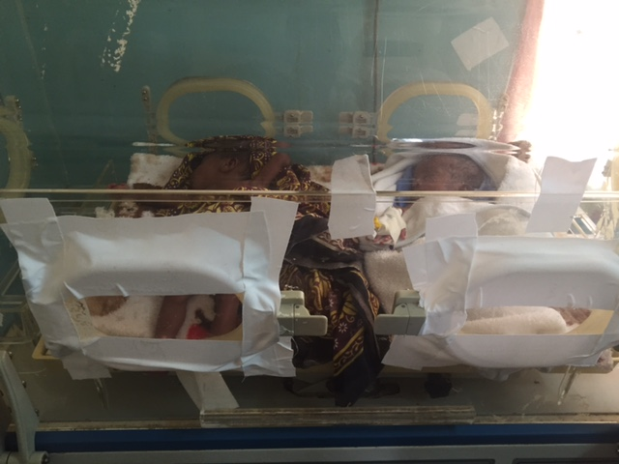
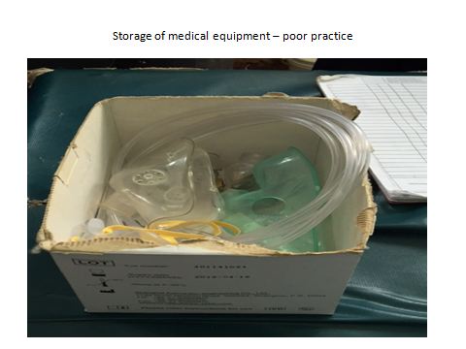
Challenges

Slide 22
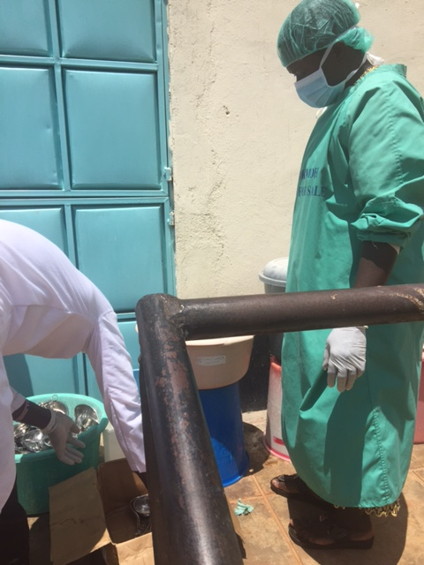
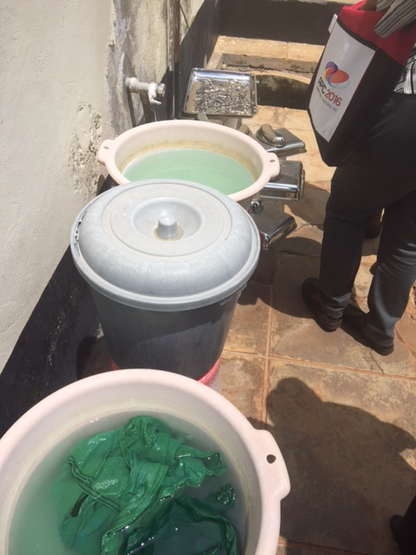
Challenges

Slide 23
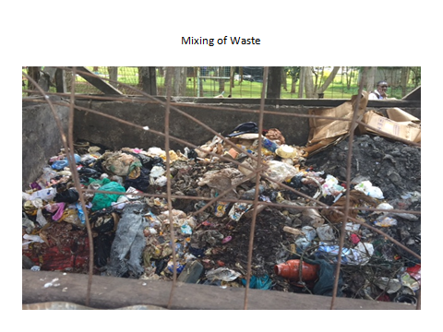
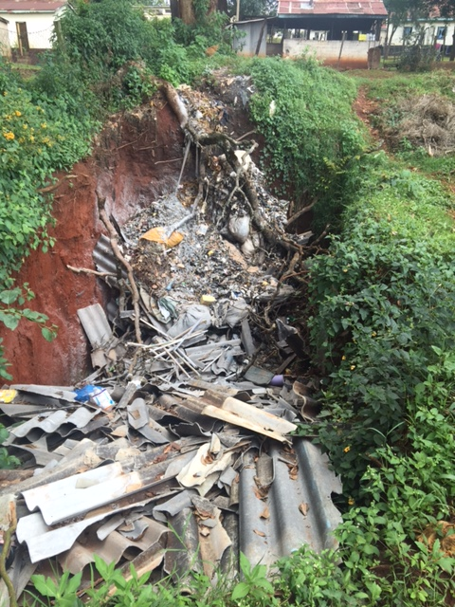
Challenges

Slide 24
IPC program work-plan 2016-2018
Establish IPC model sites
Train and mentor IPC model sites
Develop an online training
Train county TOTs on IPC

Slide 25
Acknowledgment
  NIPCAC
  IPC TWG
  CDC Kenya and CDC Atlanta
  University of Maryland
  County Health Teams

