Slide 1
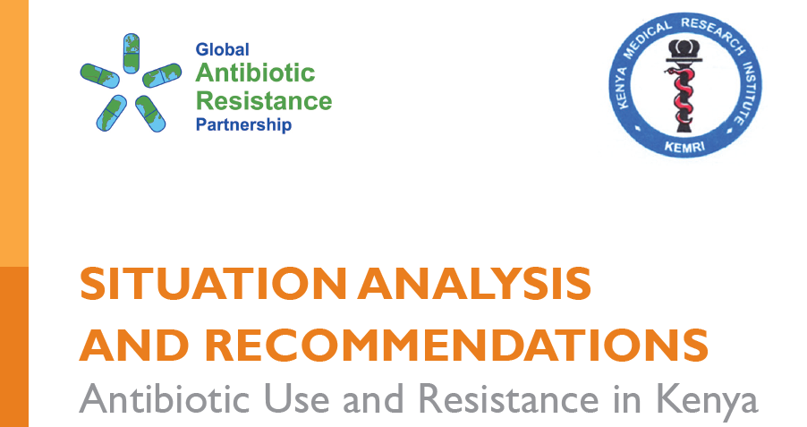
ANTIMICROBIAL RESISTANCE IN KENYA: SITUATION ANALYSIS
Sam Kariuki
Chief Research Officer and Chair, GARP-Kenya

Slide 2
Outline
  Background of AMR globally and in Kenya.
  Some key sentinel surveillance data on AMR in foodborne bacteria.
  The roadmap to implementation of NAP.
  Conclusions.

Slide 3
Introduction
Antimicrobials are used in agriculture mainly in animal production for both therapeutic and non- therapeutic purposes and have also played a critical role in saving lives in humans.
A recent study of antimicrobial usage (AMU) in livestock involving 228 countries conservatively estimated the total AMU in 2010 at 63,151 tons, and projected that AMU will increase by 67% by the year 2030.
Projected that the highest increase in AMU in animal production -low and middle income countries
  rapid growth in populations coupled with favorable economic development
  creates high demand for animal proteins, leading to introduction of intensive farming systems that are often associated with increased AMU.

Slide 4
Global Call to Action on AMR
SIXTY-EIGHTH WORLD HEALTH ASSEMBLY A68/A/CONF./1 Rev.1 Agenda item 15.1 25 May 2015
Global action plan on antimicrobial resistance Draft resolution

Slide 5
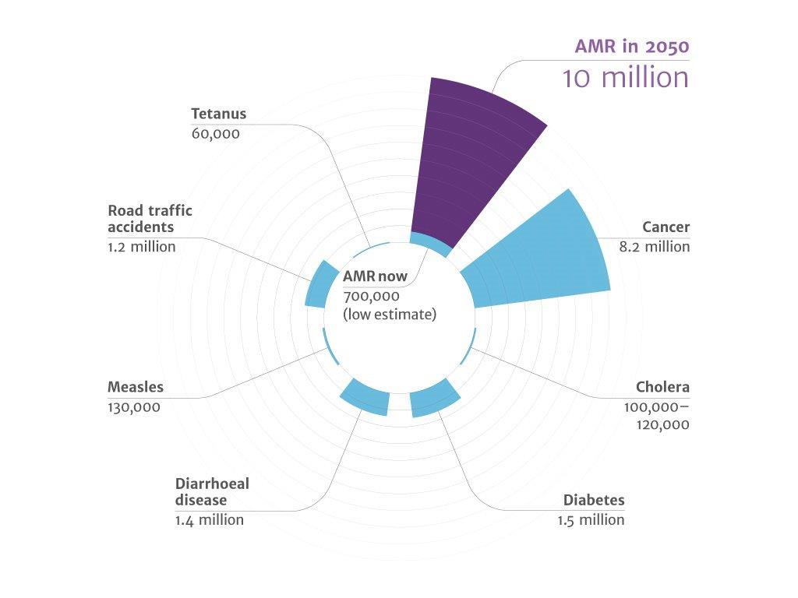
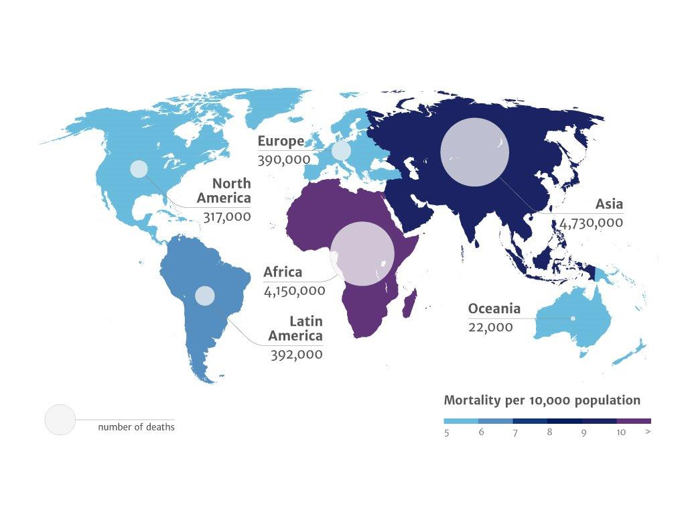
Cumulative deaths by 2050
Distribution of AMR deaths by Region

Slide 6
Resistance is mainly a consequence of selective pressure created by use
Any kind of antimicrobial use, can select for emergence of resistance and further promote the dissemination of resistant bacteria and resistance genes
AMR does not respect phylogenetic, geographical or ecological borders
  Antimicrobial use in one ecological compartment can have consequences for the resistance in another ecological compartment, so need for an integrated inter-sectoral approach
  Antibiotics are societal drugs : Individual usage affects family, community, society

Slide 7
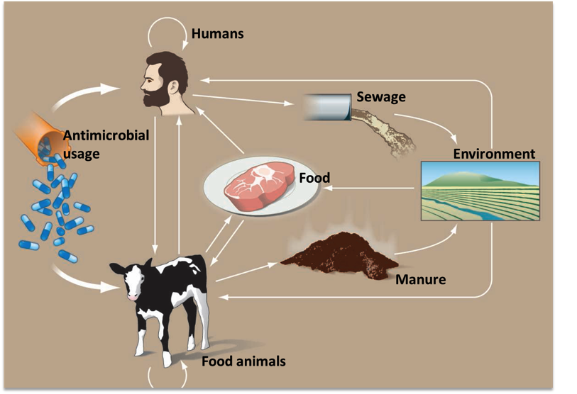
Figure 3. Sources of antimicrobial resistance (source: Woolhouse and Ward 2013).

Slide 8
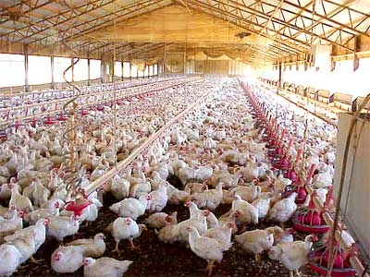
More than 50% of all antimicrobials are used non-therapeutically in animal husbandry
Use of antimicrobials in food animals can lead to Antimicrobial Resistance (AMR) in human pathogen.
In industrial production, antibiotics are added to drinking water for prophylaxis and as growth promoters
  When microbes are exposed to subotimal doses of antibiotics, Antimicrobial Resistance is induced
Antibiotics…"the more you use them, the faster you lose them"

Slide 9
Situation in Kenya
Although no systematic national surveillance is in place, sentinel studies indicate that problem of antimicrobial resistance is a major public health concern.
Antibiotic use in domestic animals not well documented, but massive use in intensive small holder and commercial farming systems.
There is antibiotic overuse in some settings, yet little or no access in others, especially rural and remote places.

Slide 10
ANTIMICROBIAL USE

Slide 11
Veterinary Antimicrobials Imported into Kenya through the Single Window system (July 2015-January 2016)
Antibiotic | Quantity (Kg)
Oxytetracycline Hydrochloride | 2,560,861
Tylocin | 1,026,000
Penicillin + Streptomycin | 830,004
Amprolium | 443,877
Chlorotetracycline | 234,879
Penicillin | 64,654
Ampicillin | 21,652
Gentamycin | 16,200
Sodium sulphadimidine | 11,245
Sulfamethoxaxole + Trimethoprim | 3,322
Ampicillin | 2,346
Cloxacillin | 2,149
Sulfamethoxazole | 1,536
Ampicillin + Cloxacillin | 856
Doxycycline | 321

Slide 12
Summary of Antimicrobial use Patterns among Small-holder Farmers

Slide 13
Antimicrobial use even in remote pastoralist Marsabit County
Type of farming practice | Total No. animals reared in 20 farms visited | Main purpose of using antibiotics | Antibiotic most commonly used and purpose | Main source of antibiotic
Cattle (local) | 120 | Treatment | Oxytetracycline 10% (all for treatment) | Agro-vet
Cattle (grade) | 52 | Treatment | Oxytetracycline 10% Penstrep (all for treatment) | Agro-vet
Goats (local) | 200 | Treatment | Oxytetracycline Penstrep (all for treatment) | Agro-vet
Goats (grade) | 8 | Treatment | Oxytetracycline Penstrep (all for treatment) | Agro-vet
Camels | 280 | Treatment | Oxytetracycline Penstrep | Agro-vet

Slide 14
Data from sentinel surveillance on antimicrobial resistance in health facilities

Slide 15
Antibiotic susceptibility of Staphylococcus aureus isolates, n=731
Omuse et al. BMC Infect Dis. 2014; 14: 669.
Antibiotic | Susceptible | Intermediate | Resistant
 | No. (%) | No. (%) | No. (%)
Penicillin | 57 (7.8%) | 0 (0.0%) | 674 (92.2%)
Oxacillin | 704 (96.3%) | 0 (0.0%) | 27 (3.7%)
Cefoxitin | 707 (96.7%) | 0 (0.0%) | 24 (3.3%)
Erythromycin | 645 (88.2%) | 1 (0.1%) | 85 (11.7%)
Clindamycinª | 658 (90.0%) | 0 (0.0%) | 73 (10.0%)
Gentamicin | 710 (97.1%) | 7 (1.0%) | 14 (1.9%)
Tobramycin | 708 (96.8%) | 5 (0.7%) | 18 (2.5%)
Levofloxacin | 687 (94.0%) | 31 (4.2%) | 13 (1.8%)
Moxifloxacin | 724 (99.1%) | 1 (0.1%) | 6 (0.8%)
Linezolid | 731 (100.0%) | 0 (0.0%) | 0 (0.0%)
Mupirocin | 731 (100.0%) | 0 (0.0%) | 0 (0.0%)
Rifampicin | 725 (99.2%) | 3 (0.4%) | 3 (0.4%)
TMP/SMX^{b} | 423 (57.9%) | 0 (0.0%) | 308 (42.1%)
Tetracycline | 618 (84.5%) | 0 (0.0%) | 113 (15.5%)
Tigecycline | 731 (100.0%) | 0 (0.0%) | 0 (0.0%)
Teicoplanin | 731 (100.0%) | 0 (0.0%) | 0 (0.0%)
Vancomycin | 731 (100.0%) | 0 (0.0%) | 0 (0.0%)

Slide 16
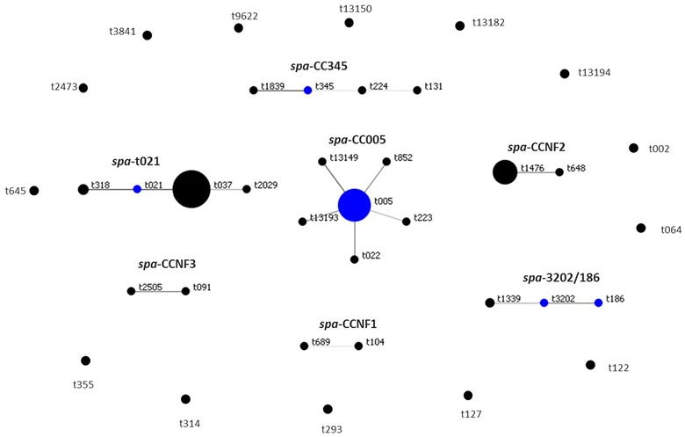
MRSA are heterogenous
Omuse et al., 2016

Slide 17
SALMONELLA BACTEREMIA STUDIES

Slide 18
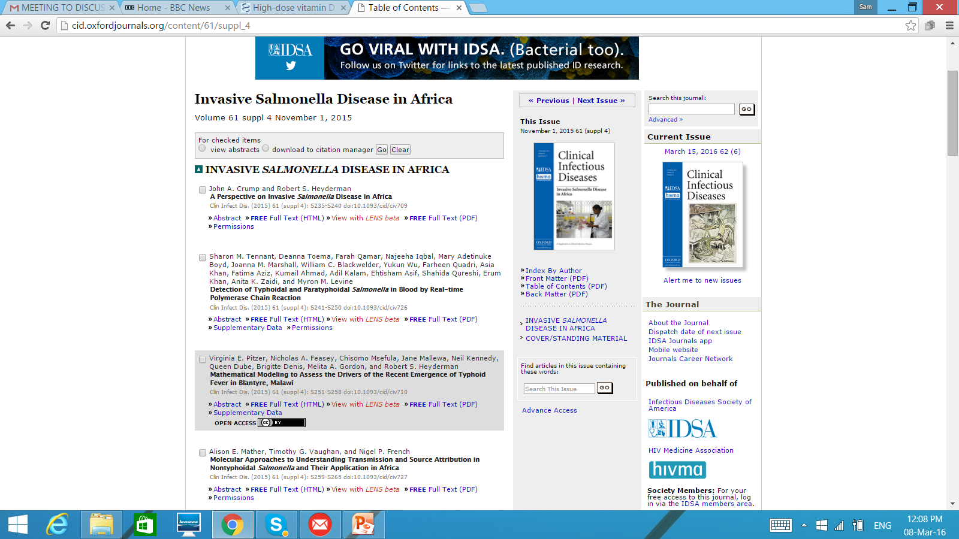
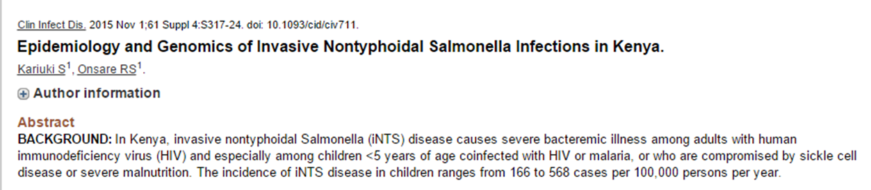
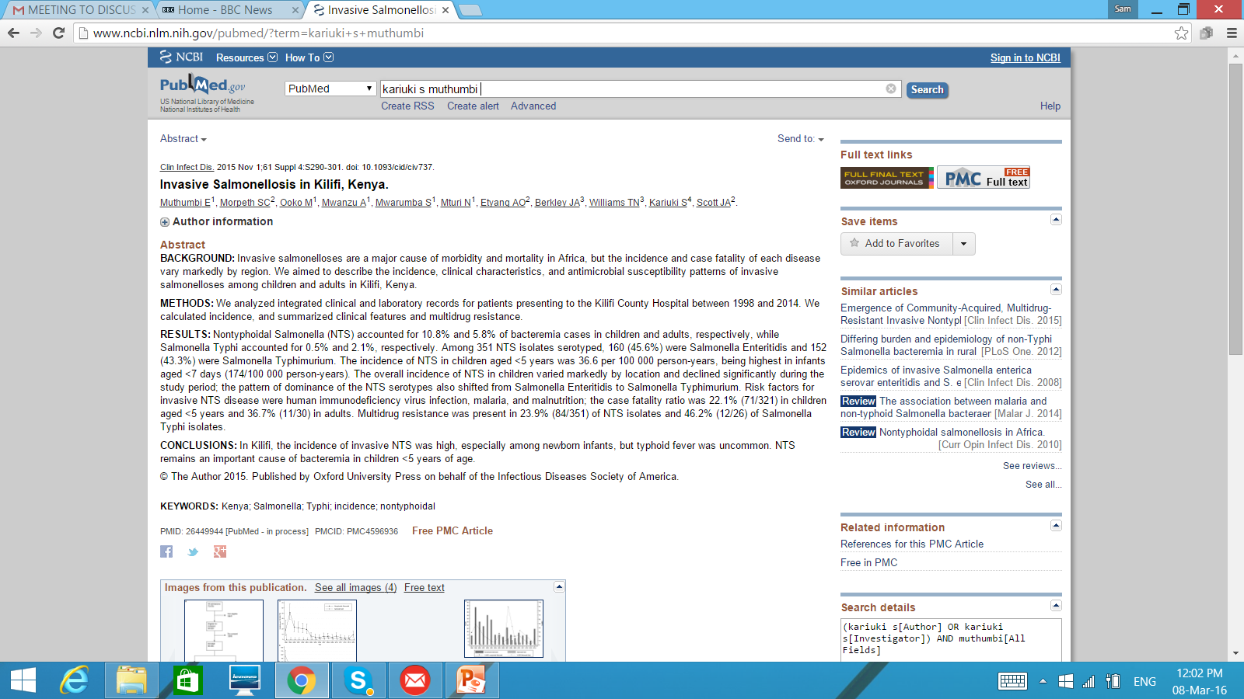
Invasive NTS in Africa: A Killer in Slums and Poor Rural Children.

Slide 19
% Resistance; n=545
% R
ANTIBIOTICS

Slide 20
MDR Invasive S. Typhimurium Hospitalised Children, 2010-2014 (N=325)
______________________________________________________
Antimicrobial MIC (µg/ml)
Agent Range Mode MIC50 MIC90 % R
____________________________________________________________________
Ampicillin 0.25->256 >256 82 64 48
Co-amoxyclav 0.75->256 4 1 16 8
Cefuroxime 2->256 >256 8 32 30
Ceftriaxone 0.094-16 0.064 0.5 2 0
Gentamicin 0.06->256 4 1 8 16
Co-trimoxazole 0.064->32 >32 8 32 46
Chloramphenicol 0.19->256 >256 4 32 26
Tetracycline 0.064->256 3 16 128 49
Nalidixic acid 1.5->256 3 3 3 12
Ciprofloxacin 0.064-4 0.16 0.06 0.125 0
______________________________________________________
Kariuki et al. Vaccine. 2015 Apr 23. pii: S0264-410(15)441-7; Tabu et al. Plos ONE 2012

Slide 21
15 patients treated at AGUH 1 year apart.
12 S. Typhimurium isolates from blood.
Sensitive to – Chloramphenicol, Ciproxin and Cefoxitin.
Resistant to Nalidixic acid, Cotrim, Ampicillin, Ceftriaxone and Aztreonam. MIC Ceftriaxone >256 ; MIC Ciprofloxacin=0.12.
Resistance to β-lactams, including to ceftriaxone, was associated with carriage of a combination of blaCTX-M-15, blaOXA-1, and blaTEM-1 genes on 304 kb plasmid.

Slide 22
MDR Typhi emerging major problem
Only 17.9% were fully sensitive.
The majority (60.5%) were multiply-resistant (MDR) to most commonly available drugs - ampicillin, chloramphenicol, tetracycline (MICs > 256µg/ml) and co-trimoxazole (MIC > 32µg/ml).
Nalidixic resistance and reduced ciprofloxacin susceptibility common

Slide 24
MDR haplotype H58 now well established in the region
Notes:
(a) Radial phylogram based on 1,485 SNPs originally detected among 19 whole genome sequences of S. Typhi (11). Black nodes: sequenced control isolates. Coloured nodes: 94 Kenyan isolates (colours randomly assigned to nodes), scaled to reflect the number of isolates found, precise number is given in brackets. (b) Distribution of haplotypes of Kenyan S. Typhi by year of isolation. Colours indicate S. Typhi haplotype as defined in (a).

Slide 25
% OF RESISTANCE
% R
ANTIBIOTICS

Slide 26
Kenyan cholera epidemics
Since 1971, Kenya has suffered several waves of cholera outbreaks.
1974 to 1989, cholera cases were reported every year with an average case fatality rate of 3.5%.
1997 -1999: The largest Kenyan epidemic with more than 33,400 notified cases, representing 10% of all cholera cases reported from the African continent during this two year period.
2000-2005: Sporadic – epicentre in refugee camps in semi arid Northern Kenya
2005-2015:Sporadic at refugee camps, L. Victoria region.
Mohamed AA, et al., Emerg Infect Dis. 2012 Jun;18(6):925-31. Molecular epidemiology of geographically dispersed Vibrio cholerae, Kenya, January 2009-May 2010.

Slide 27
Antimicrobial Susceptibility 2000-2010
All O1 V. cholerae (clinical and environmentally), subtyped serologically as Inaba, some of the environmental isolates were non-O1/O139
All clinical isolates resistant to nalidixic acid, trimethoprim, sulphamethoxazole, streptomycin and furazolidone
All clinical and environmental V. cholerae isolates susceptible to tetracycline, cefuroxime, chloramphenicol and ciprofloxacin
66% of the environmental isolates resistant to sulphamethoxazole, 15% to furazolidone, 56% to ampicillin and 5% to trimethoprim (p-value < 0.05).

Slide 28
Emergence of ESBL-producing Vibrio cholerae from a refugee camp
Isolate Number | ESBL enzymes present
38/2012 | CTX-M, TEM
39/2012 | none- negative control
57/2012 | CTX-M, TEM
52/2012 | CTX-M
54/2012 | CTX-M, TEM
58/2012 | CTX-M, TEM
64/2012 | CTX-M, TEM
68/2012 | CTX-M, TEM
56/2012 | CTX-M, TEM
43/2012 | CTX-M
74/2012 | CTX-M, TEM
73/2012 | CTX-M, TEM
78/2012 | CTX-M, TEM
75/2012 | CTX-M, TEM
76/2012 | CTX-M, TEM
44/2012 | TEM
41/2012 | CTX-M, TEM
45/2012 | CTX-M, TEM
42/2012 | CTX-M, TEM

Slide 29
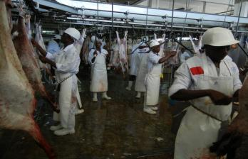
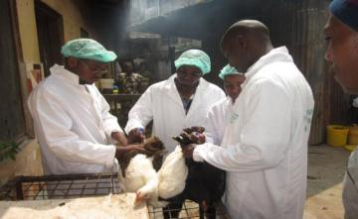
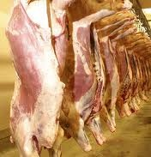
Microbiological Contamination and Antimicrobial Resistance: Meat Value Chains
E. coli, coliforms and other enterics

Slide 30
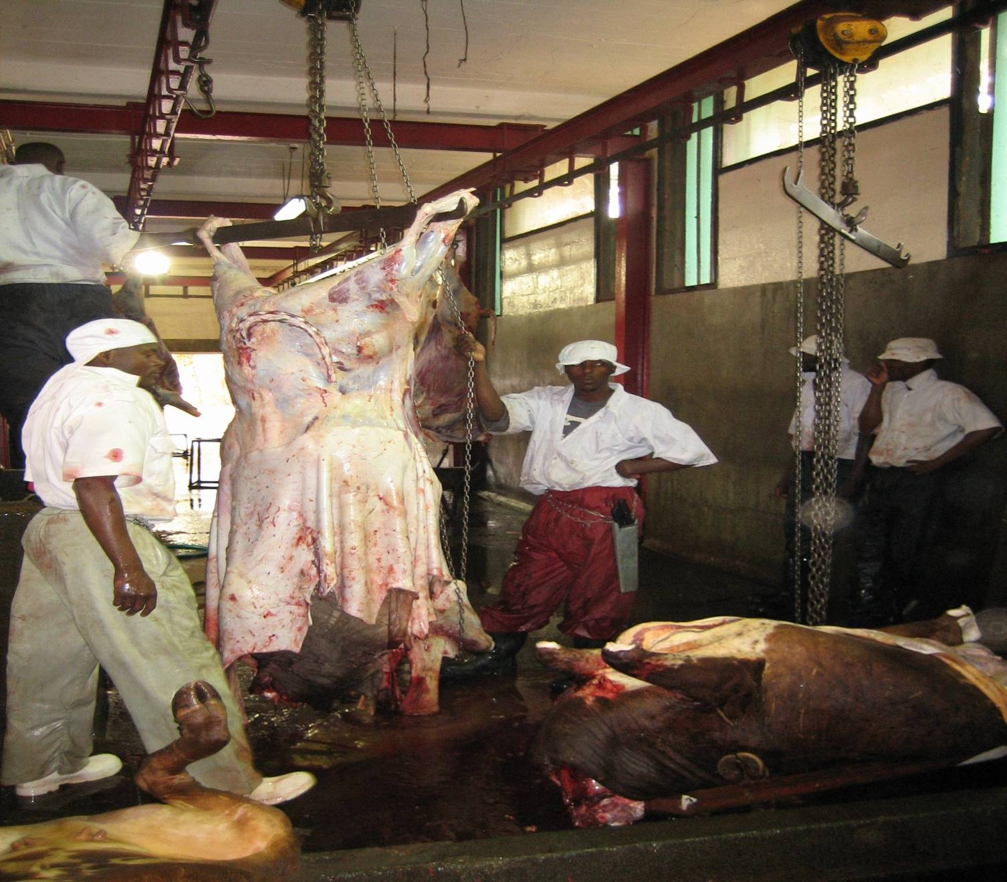
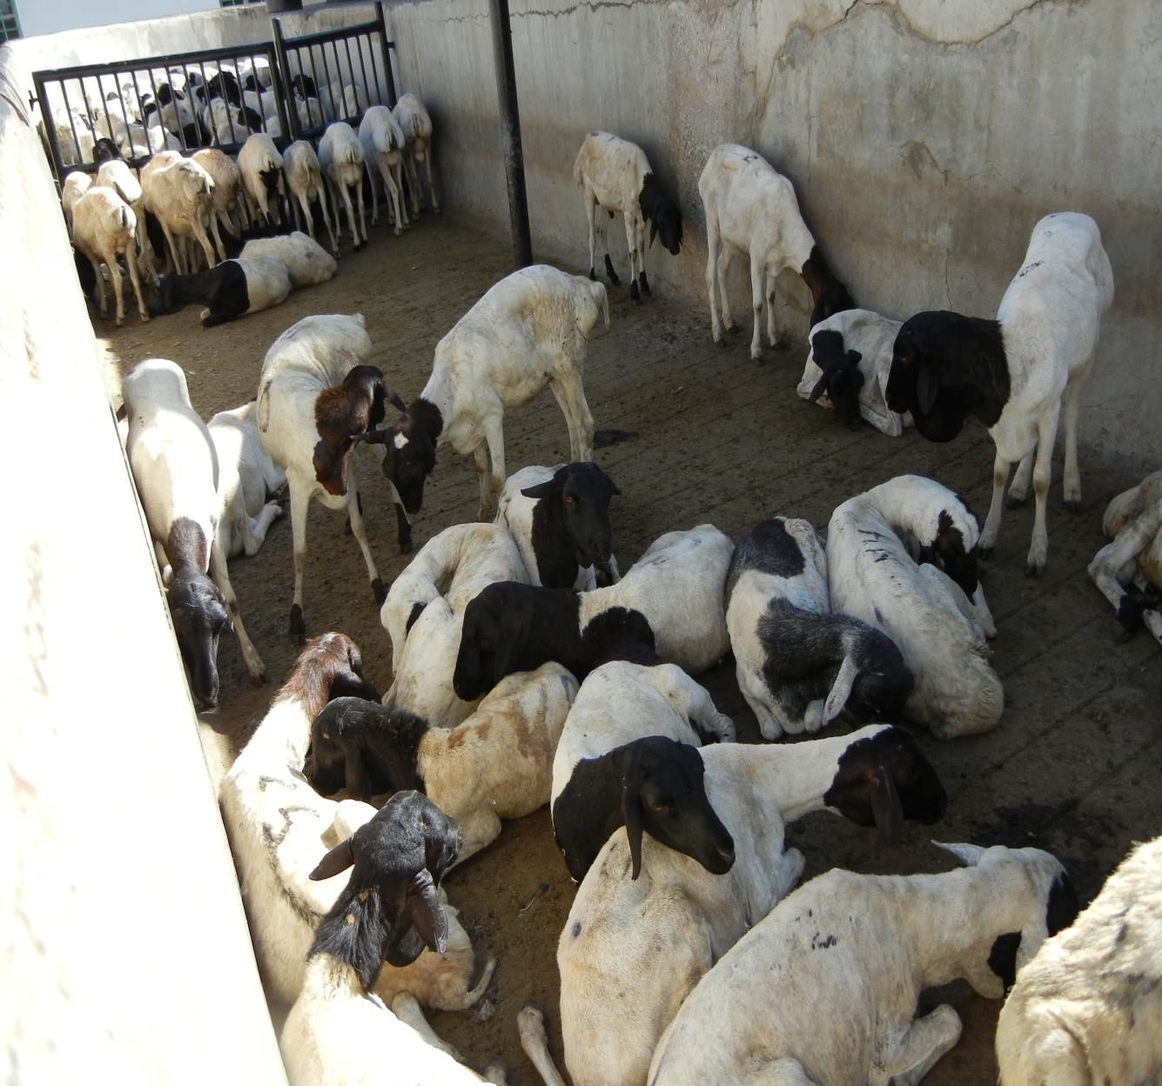
Challenges in small abattoirs

Slide 31
Antibiotic susceptibility patterns for E. coli isolated from poultry in small scale farms in Thika, n=350
Proportion in %
Note small (4%) resistance to ceftazidime, co-amoxiclav (7%), ciprofloxacin (4%)

Slide 32
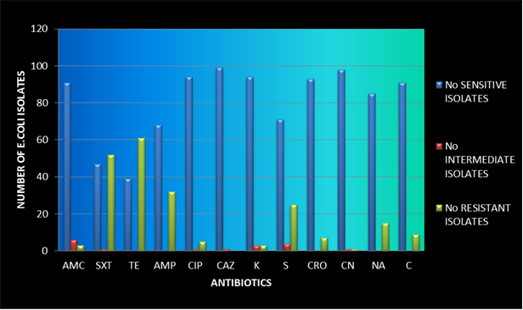
Susceptibility patterns among E. coli isolated in retail chicken from Nairobi region, n=500
Resistance to tetracycline (60%), co-trimoxazole (54%) and ampicillin (30%). In addition, 22% of isolates were resistant to 2 or more antibiotics

Slide 33
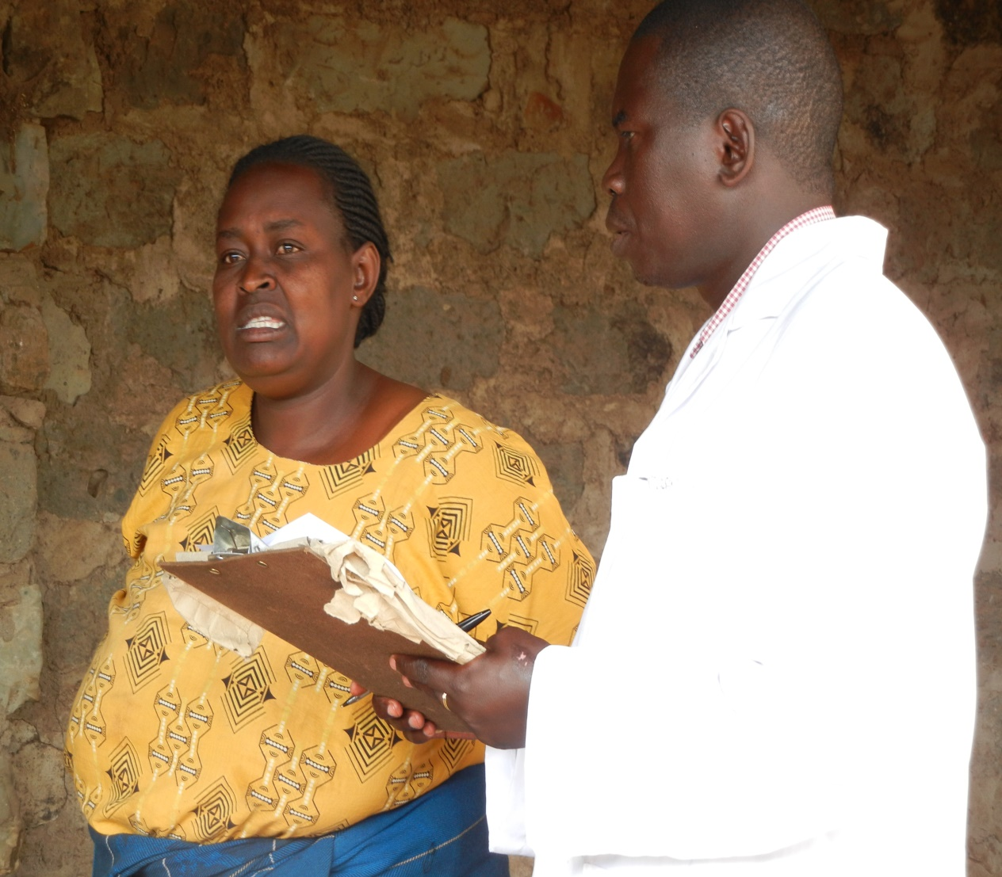
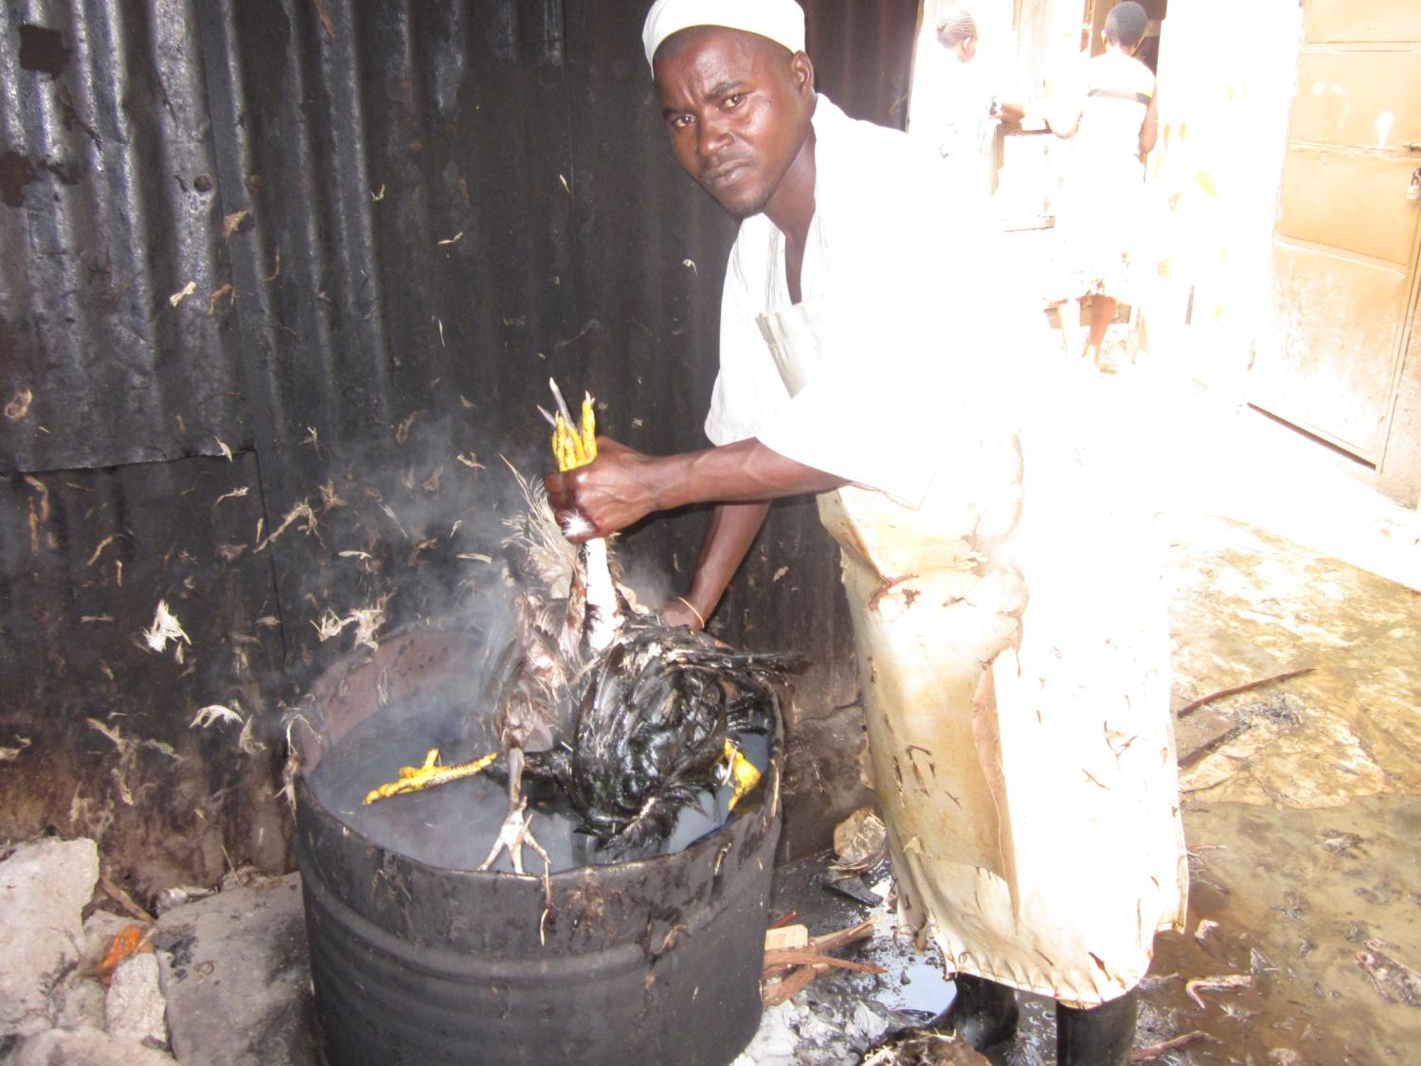

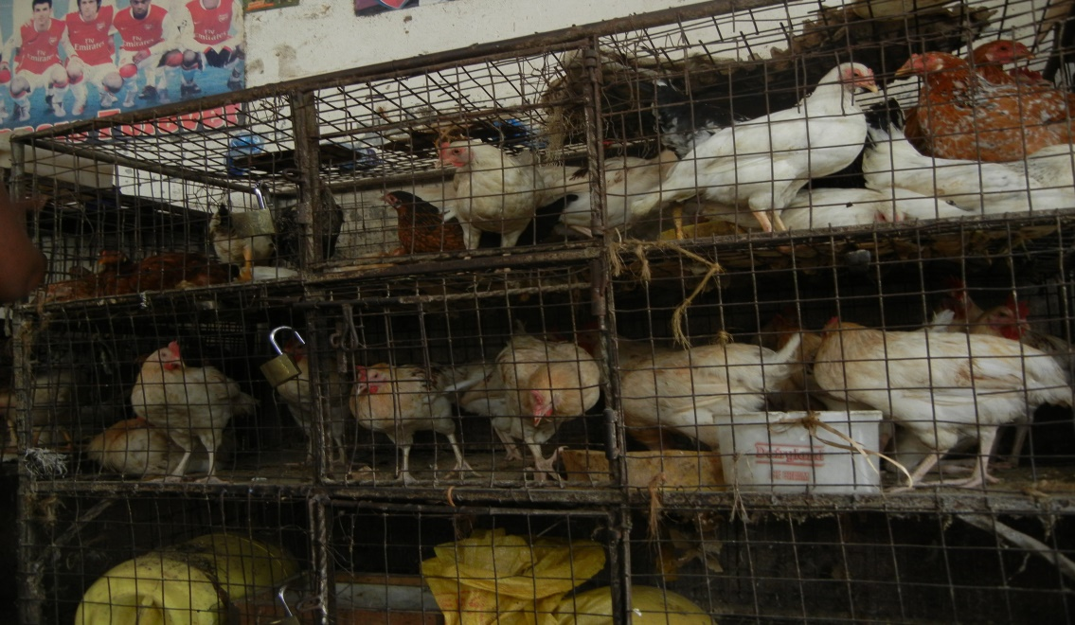

Slide 34
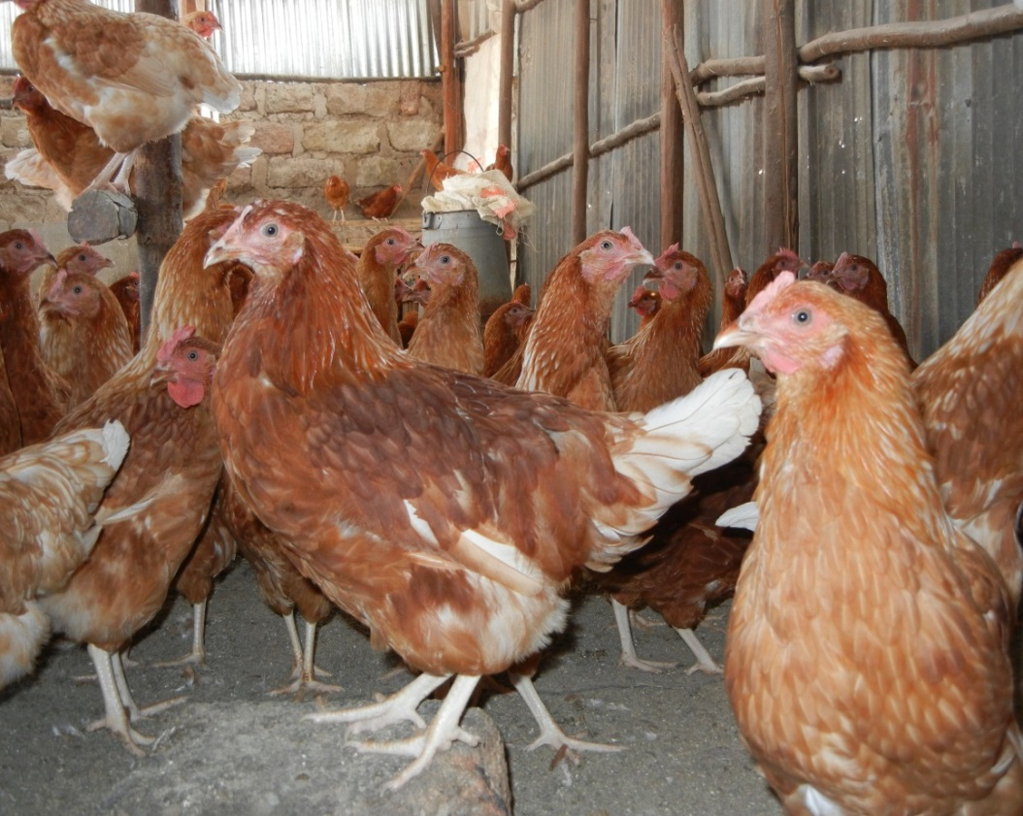
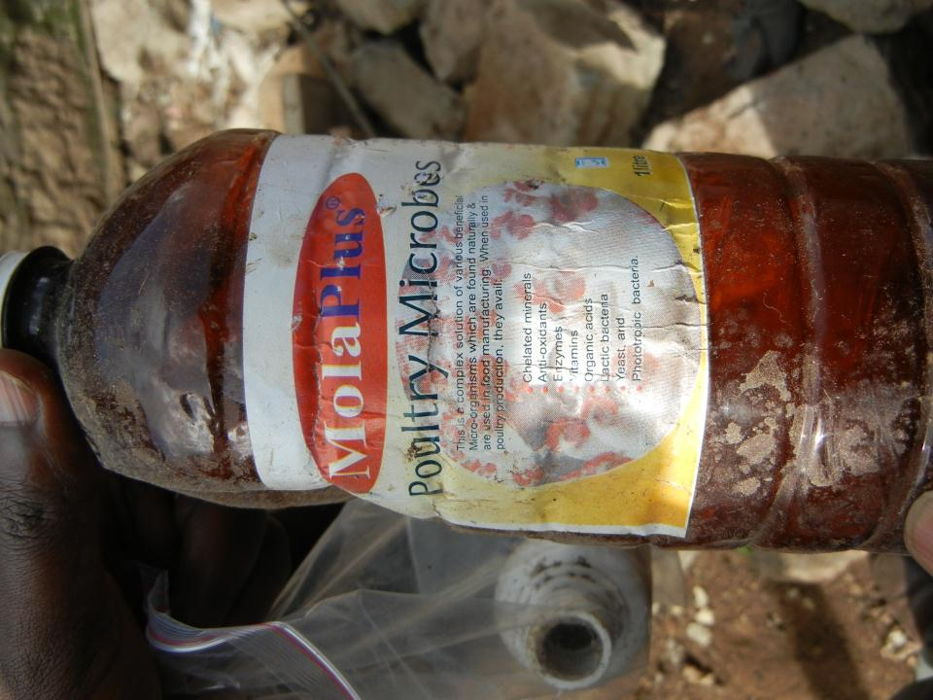
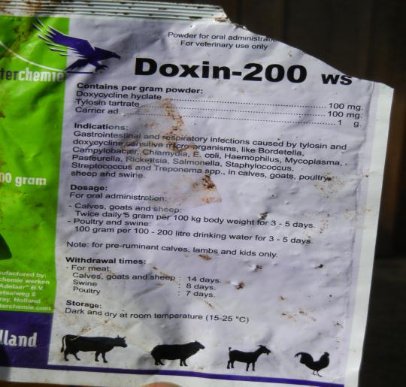
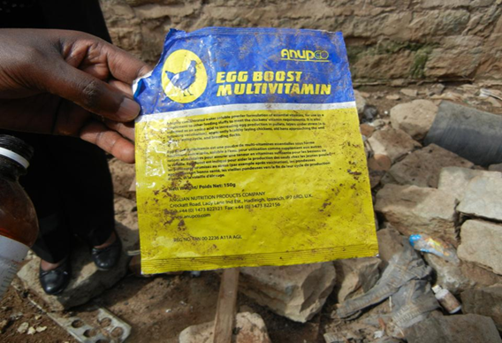
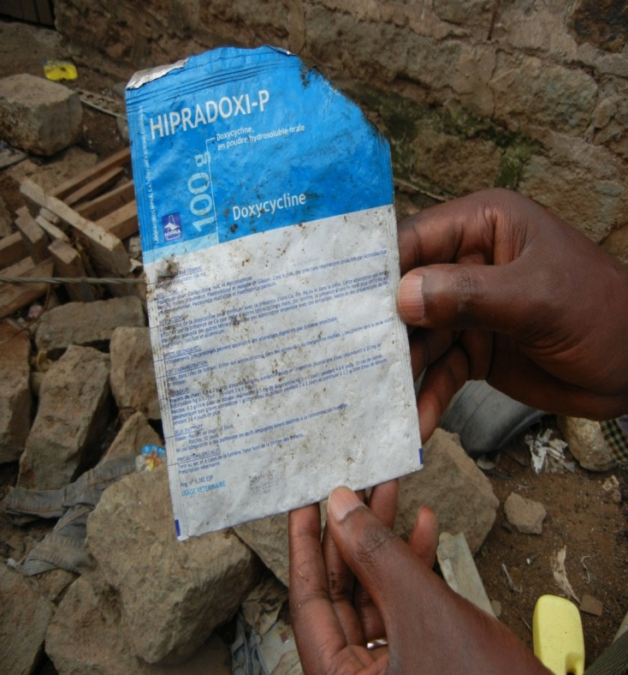
For antibiotic use at small holder settings, evidence abounds everywhere!

Slide 35
Major findings among food animals
Meat products contaminated with E. coli, Salmonella, Campylobacter; highest contamination rates in retail meats at lower end markets
Contamination rates higher in chicken at retail markets compared to the commercial abattoir higher for E. coli, Salmonella and Campylobacter in comparison to beef.
Antimicrobial resistance highest among isolates from poultry, then pigs and cattle
Poor hygiene at local settings major risk factor for contamination and AMR

Slide 36
AMR impact on human health
Most AMR in zoonotic enteric pathogen borne on mobile genetic elements, so transmission happens across species.
Commonly used products in animal production are similar to those used in humans, some are in the of Critically Important Antibiotics for human use.
Effects on severity of infections, prolonged hospitalization, increased costs of treatment and even higher mortality from difficult to treat infections

Slide 37
Typical KAP responses for Level 4 and 5 Hospitals in Kiambu and Nairobi Counties
QUESTION | COMMENTS
Were the Clinicians interviewed aware of AMR as national problem? | The clinical officers were aware of AMR especially as a result of wrong prescriptions and disease misdiagnosis
Which is the most common infection for the outpatient | upper respiratory tract infections a well as urinary tract infections
What’s the attitude on AMR | Aware of the impact of AMR. However the lack of culture tests and ASTs microbiology lab was indeed a major hindrance.
Do they use treatment guides | Clinicians had guides from the MoH
Do they use lab diagnosis | Unfortunately lab diagnosis is not routinely done
Is infection control present | Measures towards infection control are in place
What do they consider as they prescribe drugs in relation to drug companies | The prescribers of drugs use the basic essential medicines while prescribing. There is no relation between the prescriptions and medical reps
Is the pharmacist aware of AMR | The pharmacist receive complains from patients that the drugs prescribed and administered haven’t worked. However when some patients come back they are treated as new cases

Slide 38
Typical KAP responses for Level 4 and 5 Hospitals in Kiambu and Nairobi Counties
Does the pharmacy have control or restriction of prescribing drugs in the facility? | The pharmacy has restrictions on prescriptions of drugs such as ceftriaxone and carbapenems which can only be administered if first line treatment has failed
Does the pharmacy have an economic consideration while prescribing the drugs | The pharmacists prescribe superior antimicrobials to those patients who can afford and essential medicines to those who
What was the performance evaluation on income for departments | The hospital uses the work load and revenue generated by each department to evaluate them. The hospital also uses expiries of supplies to evaluate the pharmacy
Is the lab used for culture and AST | Cultures and ASTs are not conducted in their lab due to lack of resources and limited space too
Is the lab aware of AST as tool for AMR monitoring | ASTs not done routinely hence they lack a set surveillance system for monitoring AMR cases
Are lab results shared effectively | The lab results often do not form a basis for prescription, referrals are done to private labs
Are lab reports for AMR available | They weren’t any reports for AMR surveillance available

Slide 39
Veterinary antimicrobials imported into Kenya through the Single Window system (July 2015-January 2016)
Antibiotic | Quantity (Kg)
Oxytetracycline Hydrochloride | 2,560,861
Tylocin | 1,026,000
Penicillin + Streptomycin | 830,004
Amprolium | 443,877
Chlorotetracycline | 234,879
Penicillin | 64,654
Ampicillin | 21,652
Gentamycin | 16,200
Sodium sulphadimidine | 11,245
Sulfamethoxaxole + Trimethoprim | 3,322
Ampicillin | 2,346
Cloxacillin | 2,149
Sulfamethoxazole | 1,536
Ampicillin + Cloxacillin | 856
Doxycycline | 321

Slide 40
AMU in Veterinary Practice
KAP survey conducted in Marsabit in Northern region of Kenya among 10 camel farmers, three quarters acknowledged self-treatment of their animals upon sighting any illness and without reference to a veterinarian.
Most commonly purchased and used antimicrobial was oxytetracycline followed by penicillin-streptomycin combination.
DAIRY FARMING
Most of the antibiotics commonly used by these dairy farmers were oxytetracycline for nonspecific diagnosis, penicillin-streptomycin and gentamycin.

Slide 41
County/Sub-County | Total No. of poultry reared | Most common antibiotics used for treatment/prophylaxis/ growth promotion
Thika west | 3100 | Enrofloxacin; Trimethoprim- Sulphamethoxazole, Fosfomycin
 | 6524 | Enrofloxacin, Oxytetracycline
 | 1000 | Amoxicillin, Fosfomycin
Gatundu North | 7760 | Oxytetracycline, Furadolidone
 | 4780 | Trimethoprim, Oxytetracycline
Kisumu East | 127 | Trimethoprim
Kisauni | 90,000 | Oxytetracycline, Fosfomycin
Kwale | 4300 | Oxytetracycline

Slide 42
Antimicrobial use in livestock in Marsabit County
Type of farming practice | Total No. animals reared in 20 farms visited | Main purpose of using antibiotics | Antibiotic most commonly used and purpose | Main source of antibiotic
Cattle (local) | 120 | treatment | Oxytetracycline 10% (all for treatment) | Agro-vet
Cattle (grade) | 52 | treatment | Oxytetracycline 10% Penstrep (all for treatment) | Agro-vet
goats (local) | 200 | treatment | Oxytetracycline Penstrep (all for treatment) | Agro-vet
goats (grade) | 8 | treatment | Oxytetracycline Penstrep (all for treatment) | Agro-vet
camels | 280 | treatment | Oxytetracycline Penstrep | Agro-vet

Slide 43
What Are We Doing About AMR in Kenya?
Roadmap to implementing the NAP

Slide 44
Principles of the Global Action Plan on AMR
to improve awareness and understanding of antimicrobial resistance;
to strengthen knowledge through surveillance and research;
to reduce the incidence of infection;
to optimize the use of antimicrobial agents; and
develop the economic case for sustainable investment that takes account of the needs of all countries, and increase investment in new medicines, diagnostic tools, vaccines and other interventions.

Slide 45

http://www.cddep.org/publications/situation_analysis_and_recommendations_antibiotic_use_and_resistance_kenya
Notes:
Cover page of the Situation analysis conducted and disseminated in 2011

Slide 46
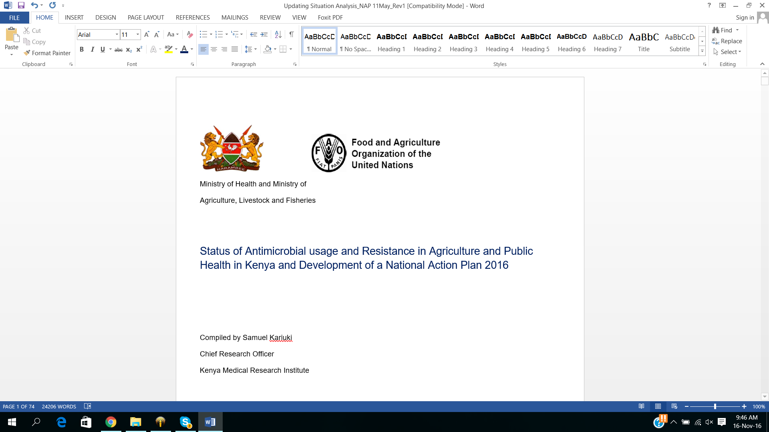

Slide 47
The National Policy for Prevention and Containment of AMR
October, 2016

Slide 48
Scope of the Policy
Introduction to awareness on antimicrobial resistance, policy and legislative focus, situational analysis, rationale, goals and objectives.
The policy proposes interventions that will help reduce misuse and minimize emergence of AMR.
Provides for a National Action Plan that will guide all the stakeholders in playing their respective roles.

Slide 49
Policy Implementation Framework
National Action Plan
A comprehensive National Action Plan (NAP) has been developed in line with the Global Action Plan (GAP) on AMR to effectively implement the AMR policy.
Financing
The National and County Governments in collaboration with development partners will ensure that adequate funding is available to enable the implementation of sustainable AMR interventions identified in the policy and National Action Plan.
The budget for AMR activities will be across multi-agency and directly aligned to the National Action plan, operational plans and Monitoring and Evaluation plan.

Slide 50
Policy Implementation Framework
Monitoring and Evaluation(M&E)
The objective of Monitoring and Evaluation will be to ensure prudent AMU and reduction of AMR against set targets and document useful lessons for planning purposes.
Communication Strategy
A communication strategy is essential for creating awareness, influencing behavior change and controlling AMR.

Slide 51
Summary
AMU in public health and livestock sectors not well documented, but abuse is commonly observed in both sectors.
AMR huge issue in enteric bugs as they acquire MGE with ESBL and other key R-genes.
For some life-threatening illnesses, we are gradually running out of treatment options.
A NAP encompassing all sectors will be crucial to stem AMR.

Slide 52
Acknowledgement
FAO
MOH/MALF
GARP
KEMRI

