Slide 1
Surveillance of Healthcare-Associated Infections Global Perspective
Ulzii Luvsansharav, MD, PhD
International Infection Control Program
Division of Healthcare Quality Promotion, CDC
5th IPNET-Kenya Infection Prevention and Control Conference
16 November 2016
Machakos, Kenya

Slide 2
Outline
Burden of healthcare-associated infections (HAIs)
HAI surveillance (history, purposes and recommended practices)
Examples of HAI surveillance systems
Thoughts for HAI surveillance in Kenya

Slide 3
Burden of HAI

Slide 4
What is HAI?
Healthcare-associated infections (HAIs)–infections that patients acquire during the course of receiving treatment for other conditions or that healthcare workers acquire while performing their duties within a healthcare setting.
Synonyms:
  Hospital-associated infections
  Hospital-acquired infections
  Nosocomial infections
https://www.cdc.gov/hai/surveillance/index.html

Slide 5
Prevalence of HAI in high-income countries,
1995–2010
7.6%
WHO. Report on the Burden of Endemic HAI worldwide. 2011. http://apps.who.int/iris/bitstream/10665/80135/1/9789241501507_eng.pdf

Slide 6
Prevalence of HAI in low- and middle-income countries, 1995–2010
15.5%
WHO. Report on the Burden of Endemic HAI worldwide. 2011. http://apps.who.int/iris/bitstream/10665/80135/1/9789241501507_eng.pdf

Slide 7
Comparison of device-associated infection densities in adult ICUs, 1995–2008
Allegranzi B. et al. Burden of endemic Health-care-associated infection in developing countries: systematic review and meta-analysis. Lancet, 2011

Slide 8
Comparison of procedure-associated HAIs
High-income countries
Cumulative incidence of SSI
  2.9 per 100 procedures (Europe)
Low/middle-income countries
  1.2-23.6 per 100 procedures
Allegranzi B. et al. Burden of endemic Health-care-associated infection in developing countries: systematic review and meta-analysis. Lancet, 2011

Slide 9
Impact of HAI
Prolonged hospital stay
  16 million extra-days (Europe)
Excess mortality
  37,000 deaths attributable deaths (EU)
Excess costs
  US$9.8 billion per year (US)
WHO. Report on the Burden of Endemic HAI worldwide. 2011. http://apps.who.int/iris/bitstream/10665/80135/1/9789241501507_eng.pdf
Zimlichman E. et al. A Meta-analysis of Costs and Financial Impact on the US Health Care System. JAMA Intern Med. 2013

Slide 10
HAI data source
Developed countries:
  13 of 28 (46%) high income countries in Europe report to ECDC
  USA, Germany, Australia etc. have national surveillance systems
Developing countries:
  23 of 147 (16%) counties have functioning HAI surveillance system
  97 of 147 (66%) countries have no published data at all
WHO. The burden of HAI worldwide: a summary. 2010. http://www.who.int/gpsc/country_work/summary_20100430_en.pdf

Slide 11
HAI surveillance

Slide 12
What is surveillance?
Surveillance-the ongoing, systematic collection, analysis, and interpretation of health data essential to the planning, implementation, and evaluation of public health practice, closely integrated with the timely dissemination of these data to those who need to know.
Thacker S.B. et al. Public Health Surveillance in the United States: Evolution and Challenges. MMWR, 2012

Slide 13
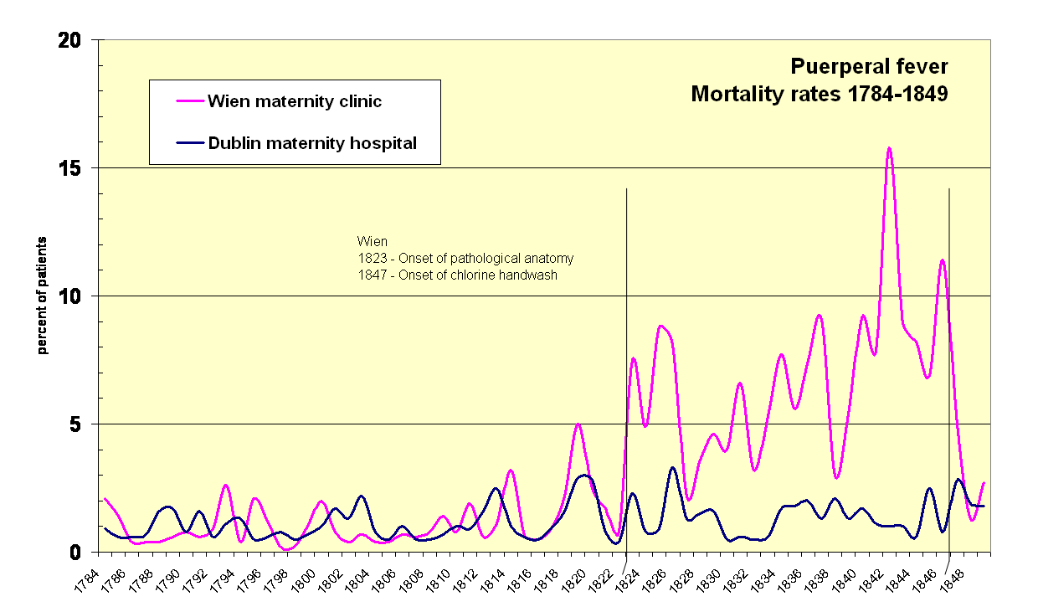
HAI surveillance history
https://en.wikipedia.org

Slide 14
HAI surveillance history
https://en.wikipedia.org

Slide 15
HAI surveillance elements
Retrospective surveillance to identify problem
Analysis of data: time, place, person
Controlled comparison of high- and low-risk groups
Formulation and application of control measures
Prospective surveillance
  Monitor problem
  Evaluate effect of control measures

Slide 16
HAI surveillance purposes
Reduce HAI and improve patient outcomes
Determine baseline or endemic rates of HAIs
Identify outbreaks
Evaluate prevention and control measures
Educate healthcare personnel
Meet requirements of accrediting agencies
Determine research/study needs etc.
Jarvis W. R. Bennet & Brachman’s Hospital Infections. 6th edition. 2013
APIC Text of Infection Control and Epidemiology. Volume 1

Slide 17
Recommended practices for surveillance
Assessing your population
Selecting the outcome or process for surveillance
Using surveillance definitions
Collecting surveillance data
Calculating and analyzing surveillance rates
Applying risk stratification methodology
Reporting and using surveillance information
Lee TB et al. Recommended practices for surveillance. Am J Infect Control 2007

Slide 18
Examples of HAI surveillance systems
National Healthcare Safety Network- NHSN
HAI Surveillance Network-HAI-Net
International Nosocomial Infection Control Consortium-INICC

Slide 19

NHSN overview
A web-based system for monitoring HAI
Facilities use the NHSN web portal to enter, analyze, and share data
Data is used by a variety of stakeholders
  Facility – local quality improvement efforts
  State health departments – identify/support low-performing facilities
  National – magnitude of HAIs as a public health problem (CDC)
  National – financial bonus and/or penalties to hospitals based on HAI performance

Slide 20
NHSN reporting options for hospitals
Infections:
  Central-line associated BSI
  Catheter-associated UTI
  Ventilator-associated events
  Surgical site infections
  Laboratory-confirmed MRSA, CRE, and C. difficile
Other :
  Central line insertion practices
  Antimicrobial use
  Healthcare worker influenza vaccination
  Adverse reactions to blood and blood products

Slide 21
NHSN hospital enrollment

Slide 22
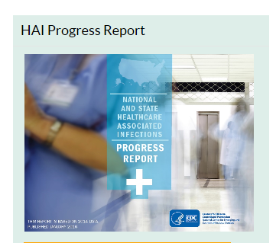
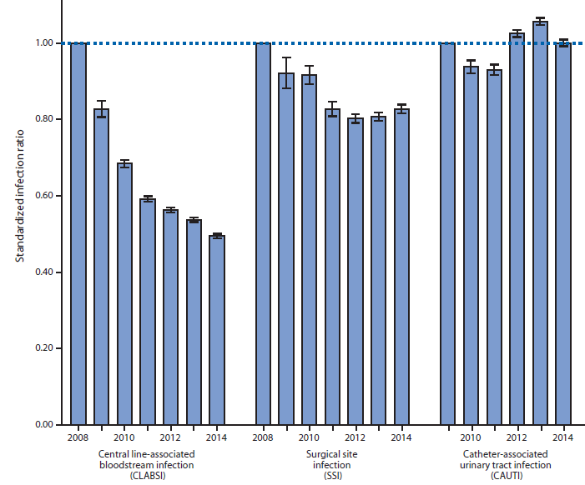
NHSN progress reports
National and state level data from hospitals
  Central line-associated BSI
  Catheter-associated UTI
  Surgical site infections
  Clostridium difficile infection
  MRSA bacteremia
Allows facilities to compare themselves to national data
https://www.cdc.gov/hai/surveillance/progress-report/index.html

Slide 23
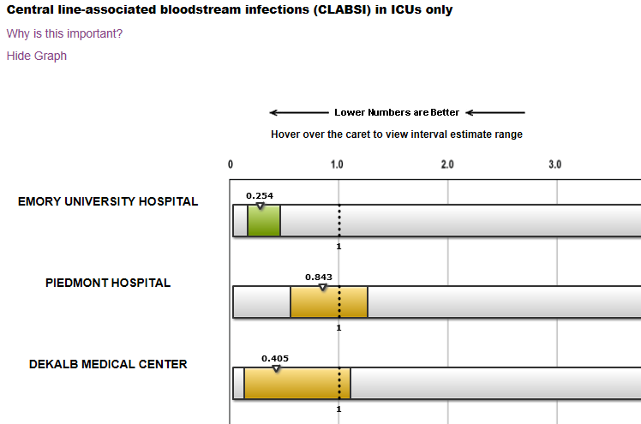
NHSN data posted on a public website
https://www.medicare.gov/hospitalcompare/search.html

Slide 24
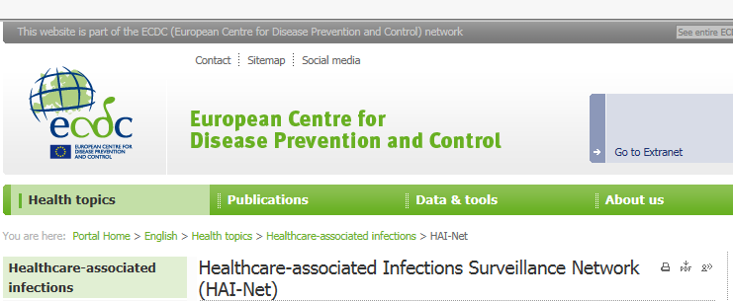
HAI Surveillance Network (HAI-Net)
European network for HAI surveillance and coordinated by ECDC
  Point prevalence survey
  Surveillance of Surgical site infections
  Surveillance of HAI in ICUs
  Data reported to TESSy and HelicsWin.Net free software

Slide 25
HAI-Net annual reports
Surveillance of Surgical Site Infections
  16 countries in 2013–2014;
  7 types of surgical procedures
Surveillance of HAI in ICUs
  754 hospitals in 13 countries in 2007
  Types: pneumonia, BSI, UTI, central
  venous catheter-related infections)
http://ecdc.europa.eu/en/healthtopics/Healthcare-associated_infections/surgical-site-infections/Pages/Annual-epidemiological-report-2016.aspx

Slide 26
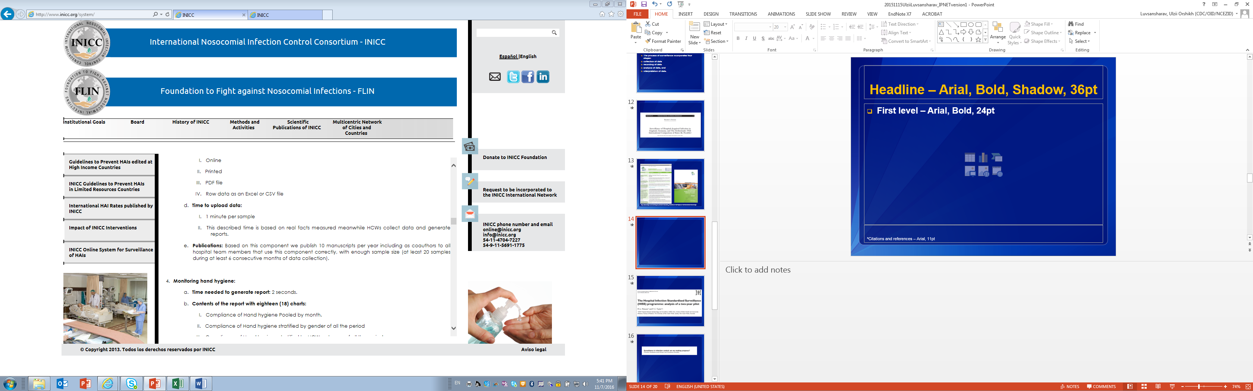
International Nosocomial Infection Control Consortium (INICC)
2,000 healthcare facilities in 66 countries from 4 continents in 2015
  Argentina, Brazil, Mexico, Colombia, India etc.
  1 hospital from Nairobi
Uses US CDC definitions for HAI
Data collected to “INICC Online System”
http://www.inicc.org/

Slide 27
INICC
Detailed report with tables and graphs generated
  Global HAI rate (%, 1,000 bed-days)
  Specific HAI rates per 1,000 device-days
  Microbiological profile and resistance
  Extra mortality and extra length of stay etc.
>300 scientific papers published and presented
Publications available online
http://www.inicc.org/

Slide 28
Thoughts for HAI surveillance in Kenya

Slide 29
Constraints when conducting HAI surveillance
Case definitions
  Complex (time consuming)
Laboratory
  Limited laboratory capacity (equipment, technical staff, logistics etc.)
Information
  Medical Records not well maintained
Human resources
  Labor intensive, hospital epidemiologist needed, staff not motivated
Politics
  Confidentiality of data, commitment of resources

Slide 30
Thoughts for HAI surveillance in Kenya
Improve reporting of information in clinical records
Improve capacity building for microbiological laboratories
Adapt and validate definitions of HAI and protocol
Ensure core components of infection control are in place
Promote staff education on infection control and surveillance of HAI
Use a phased approach to implementing surveillance
Allegranzi B. et al. Burden of endemic Health-care-associated infection in developing countries: systematic review and meta-analysis. Lancet, 2011

Slide 31
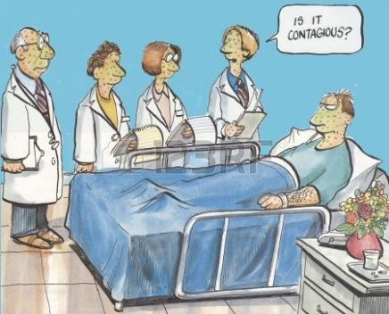
Thank you!
https://www.123rf.com/photo_24143216_is-it-contagious.html

Slide 32
Surveillance evaluation
Quality of a surveillance system and data it generates is defined by below attributes
  Usefulness
  Simplicity
  Flexibility
  Acceptability
  Sensitivity
  Specificity
  Representativeness
  Timeliness
CDC. MMWR. Surveillance system evaluation

