Slide 1
Paediatric Antibiotic
Stewardship: Challenges & Lessons learnt
Monica Mirigo Gichuhi,
Pharmacist at Gertrude’s Children Hospital,
Muthaiga

Slide 2
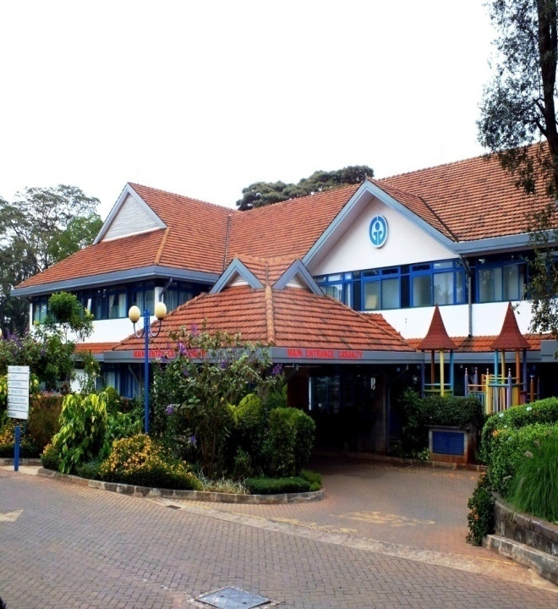
Gertrude’s Children’s Hospital
Established in 1947
103-bed hospital providing care to children from birth to 21 years
  10-bed PCCU
  4-bed HDU
  16-bed surgical ward
  1 theatre
  6 medical wards
13 Branches: Buruburu, Donholm, Embakasi, Kitengela, Komarock, Lavington, Mombasa, Nairobi West, Rongai, Pangani, Thika, TRM and Muthaiga
Attends to over 300,000 children as outpatients and admits 6,000 patients on average per year

Slide 3
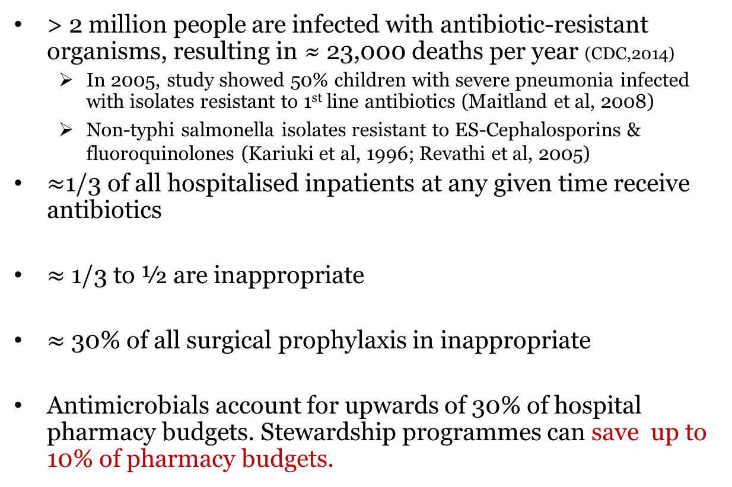
Why antimicrobial stewardship?
> 2 million people are infected with antibiotic-resistant organisms, resulting in ≈ 23,000 deaths per year (CDC,2014)
  In 2005, study showed 50% children with severe pneumonia infected with isolates resistant to 1st line antibiotics (Maitland et al, 2008)
  Non-typhi salmonella isolates resistant to ES-Cephalosporins & fluoroquinolones (Kariuki et al, 1996; Revathi et al, 2005)
$≈$1/3 of all hospitalised inpatients at any given time receive antibiotics
$≈$ 1/3 to ½ are inappropriate
$≈$ 30% of all surgical prophylaxis in inappropriate
Antimicrobials account for upwards of 30% of hospital pharmacy budgets. Stewardship programmes can save up to 10% of pharmacy budgets.

Slide 4
Aim of Antimicrobial Stewardship
Improve the quality of patient care and patient safety through:
  increased infection cure rates,
  reduced treatment failures
  increased frequency of correct prescribing for therapy and prophylaxis.
  Reduce hospital rates of C.difficile
  Save the hospitals and patients’ money.

Slide 5
Antimicrobial Stewardship Program (ASP)
Implemented from September 2014
Board
Medical Advisory Committee
Medicines & Therapeutics Committee
Credentialing Committee
Chief Executive Officer
Antimicrobial Stewardship Committee
Standards & Ethics Committee
MAC Divisions & Departments
Institutional Ethical Review Board
Executive QPS Committee

Slide 6
Antimicrobial Stewardship Committee
Infectious Diseases expert (Paediatrician)-Chairperson
Chief Pharmacist
Consultant Microbiologist/Pathologist
Nurse, IPC Coordinator
Pharmacist -Secretary

Slide 7

ASP Strategies
Antibiotic Use Guidelines
    Gertrude’s Children’s Hospital Standard Treatment Guidelines*
    Proposed Gertrude’s Children’s Hospital Antibiotic Policy
    Proposed Surgical Prophylaxis guidelines
    Proposed Aminoglycosides Policy and Procedures
    Proposed Vancomycin Policy and Procedures
Notes:
*- only one currently in use

Slide 8
ASP Strategies…
Prospective Audit and Feedback for Reserve Antibiotics
  EPN project
  Reserve antibiotic use surveillance*
  GARPEC (Global Antimicrobial Resistance, Prescribing, Efficacy among Neonates and Children) project*
Staff Education – Hospital CPD programs (CMEs)
Notes:
Restriction on who can prescribe reserve antibiotics not well enforced
Ceftazidime
Cefepime
Linezolid
Meropenem
Piperacillin/Tazobactam
Vancomycin

Slide 9
Specific Challenges
Diagnostic uncertainty- Negative blood cultures and viral infections
Unnecessary prolongation of therapy
Both discontinuing and narrowing the spectrum are difficult to achieve
Lack of knowledge of local resistance patterns- prevent escalation to unnecessary broad spectrum agents, especially empirically
Notes:
especially in pediatrics when viral infections and non-specific syndromic presentations and when bacterial cultures are negative
this knowledge is potentially critical to prevent escalation to unnecessarily broad spectrum agents, especially empirically
Point 4: Case study on combination of meropenem, vancomycin and clarithromycin not effective but floxapen effective

Slide 10
General Challenges…
Difficulty in holding regular ASC meetings
  Added responsibility to ASC members; not their ‘core business’
Perceived physician resistance to control of prescribing - Fear of antagonizing prescribers
Lack of appreciation of the threat of resistance development

Slide 11
Lessons Learnt
Amend approach in use.
Commitment to the cause- Antimicrobial Stewardship Team
Rigorous surveillance on reserve antibiotics use - Pharmacist
Guidelines on surgical prophylaxis guidelines- IP Nurse
“Forcing function” in the online prescribing software

Slide 12
Conclusion
Paediatric Antibiotic Stewardship Programs play an important role in our setting in spite of the challenges.
There remains a need to establish antibiotics preservation mechanisms ….. Evidence-Based Antibiotics Use Policy & Guidelines!

Slide 13


