Slide 1
perceptions of HEALTHCARE WORKERS towards Antimicrobial stewardship AT KILIFI COUNTY REFFERAL HOSPITAL.
Dr.Warda Nassir Pharmacist Kilifi County Referral Hospital

Slide 2
INTRODUCTION
Antimicrobial Resistance (AMR) is an important global health concern, projected to have contributed to almost 5 million human deaths worldwide in 2019¹.
AMR occurs when bacteria, viruses, fungi and parasites change over time and no longer respond to medicines
Notes:
Antimicrobials includes antibiotics, antifungals, antiparasites and antiviral

Slide 3
OBJECTIVES
To determine the knowledge, behaviours and attitudes among health care workers (HCWs) towards AMR
To assess rational use of antibiotics among HCWs

Slide 4
METHODOLOGY
An online cross-sectional survey was conducted among HCWs in Kilifi County Referral Hospital (KCRH).
Questions were populated on an online Google form and shared among the HCWs via WhatsApp™.
A total of 37 responses were collected and analysed.
Notes:
Situational analysis was done at KCRH to asses the perceptions of HCWs

Slide 5
RESULTS AND DISSUCION

Slide 6
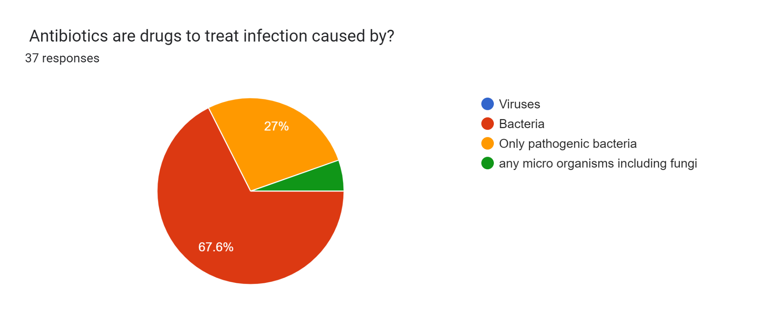
RESULTS Survey questions and responses
5.4%
67.6% of HCWs agreed that antibiotics kills all bacteria even normal flora,
While 27% believed they only target pathogenic bacteria.
Interestingly, 5.4% of respondents believed that antibiotics kills all micro-organisms including fungi
Notes:
Several questions were asked and some which stand up which includes….
Antibiotics are used to treat infections caused by only Bacteria and not any micro organisms
However antibiotics can also kill beneficial bacteria i.e normal flora that reside in the human body, leading to disruption of normal microbial communities & potentially causing adverse health effects

Slide 7
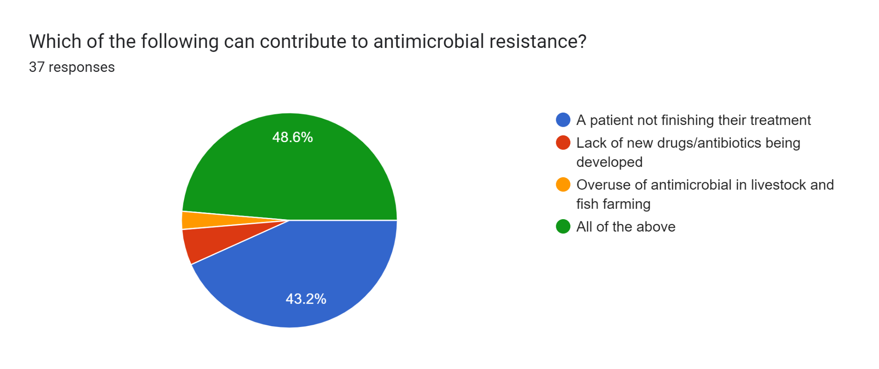
RESULTS (cont.)
2.7%
5.4%
Over half of respondents failed to recognize that all the listed factors contribute to the development of AMR i.e., lack of new agents, poor compliance and overuse in agriculture and fisheries sectors
Notes:
5.4% lack of new drugs
2.7% over us antimicrobial in livestock and fish farming

Slide 8
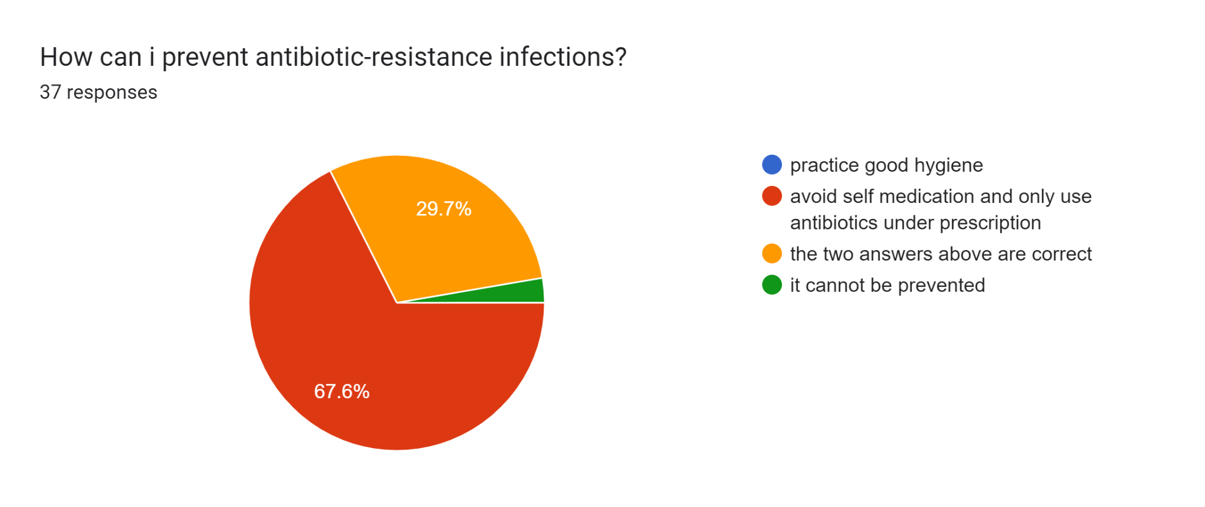
RESULTS (cont.)
2.7%
Majority of respondents (67.6%) agreed that avoiding self medication and only using antibiotics under prescription was a way to prevent AMR
While 29.7% agreed on above and practising good hygiene as a way of preventing AMR infections
However 2.7% believed that AMR cannot be prevented.
Notes:
Good hygiene prevents antimicrobial resistant infection from spreading
Practising good hygiene is the first most way of preventing AMR..I.e. hand washing prevents spread of germs
Vaccination is also a way of preventing AMR

Slide 9
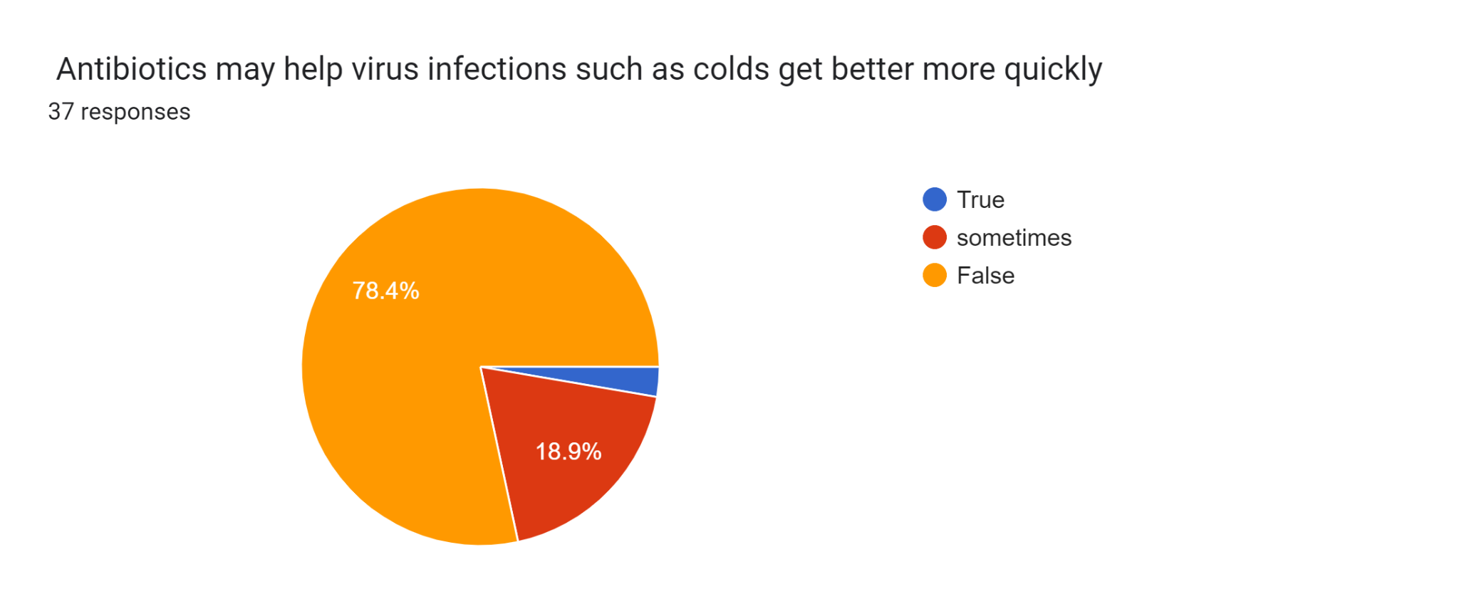
RESULTS (cont.)
2.7%
As majority of respondents (78.4%) disagree with the statement that antibiotics can be used to treat viral infections e.g., colds
However, 2.7% agreed that antibiotics help treat virus infections. While, 18.9% of respondents suggested that they ‘sometimes’ treat virus infections.

Slide 10
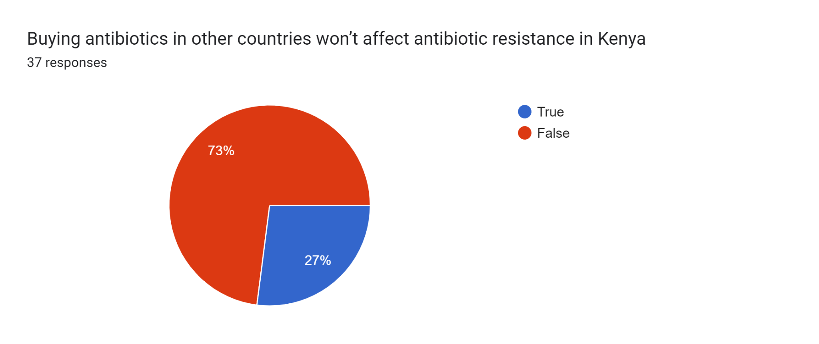
RESULTS (cont.)
73% agreed that irrespective of which country one buys the antibiotics they can still cause AMR in Kenya, while 27% disagreed.

Slide 11
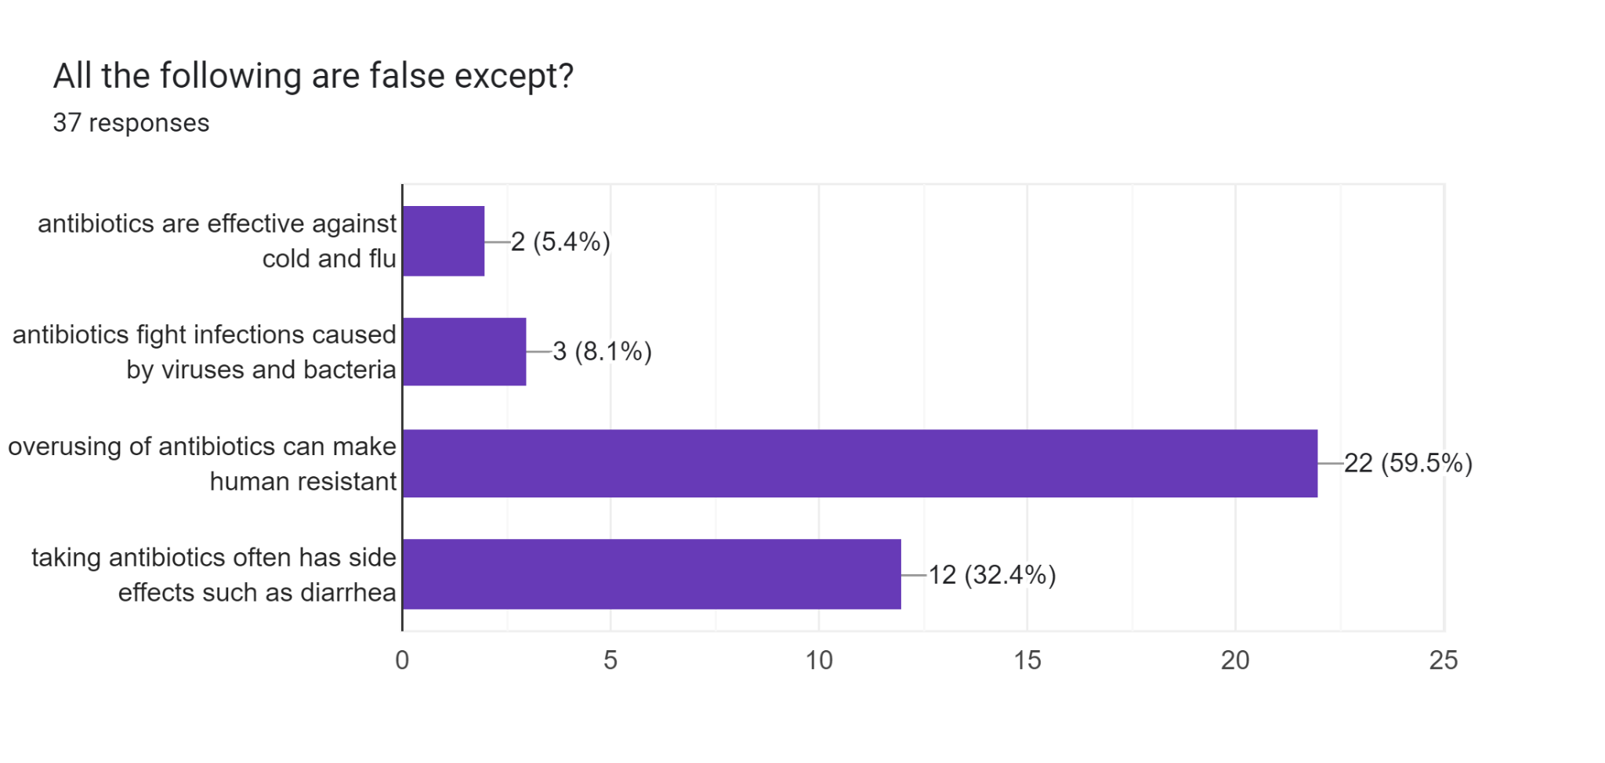
RESULTS (cont.)
5.4% believed that antibiotics are effective against cold and flu,
While majority (59.5%) assumed that overusing antibiotics make humans resistant.
Only 32.4% correctly responded that taking antibiotics can cause side effects such as diarrhea
Notes:
overusing antibiotics makes the bacteria resistant and not humans

Slide 12
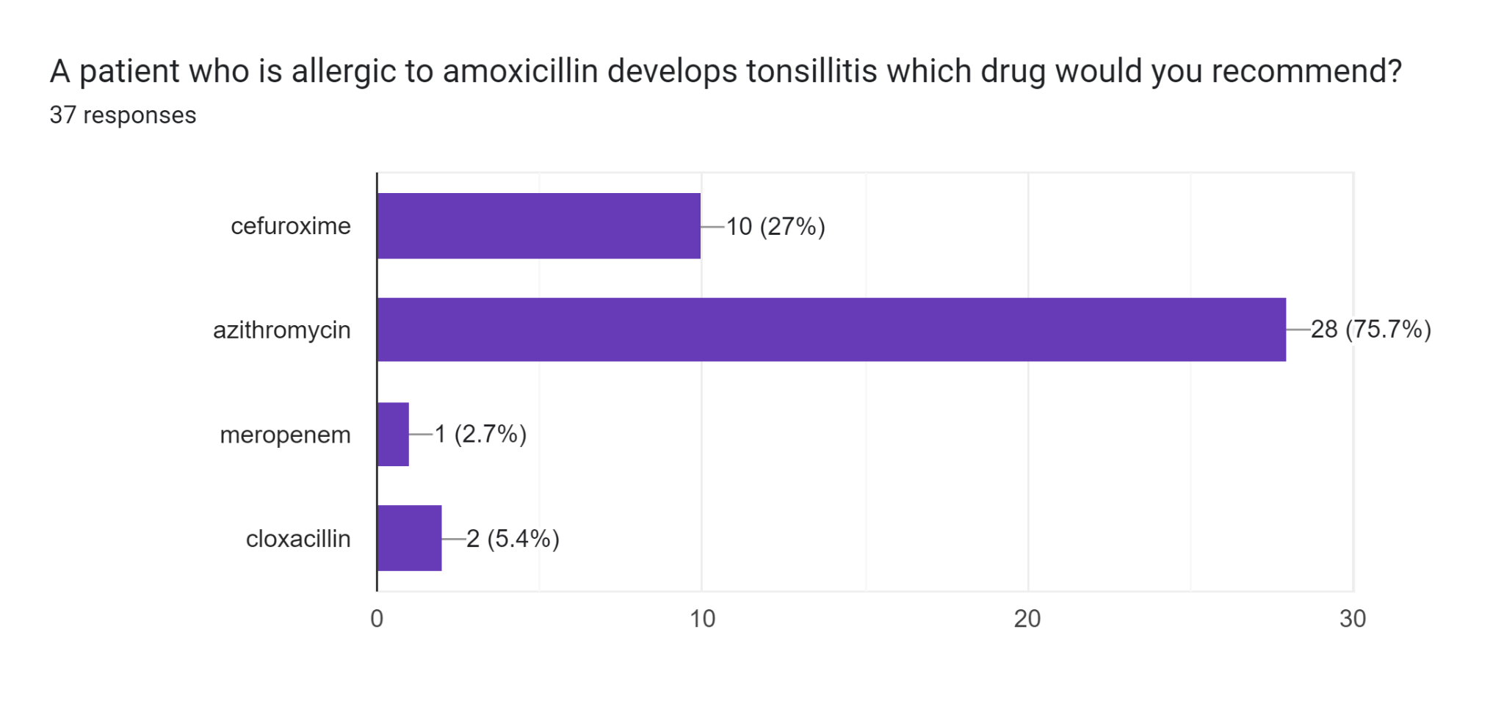
RESULTS (cont.)
75.7% selected azithromycin which is a macrolide
While the rest still choose other agents including another penicillin or cephalosporins which may display cross-sensitivity allergic reactions i.e. cefuroxime, meropenem and cloxacillin.

Slide 13
DISCUSSION
The findings shows that approximately one third of respondents were not aware that these medicines not only kill the pathogenic bacteria but also the normal flora and are associated with serious resistance patterns.
There is a need to upscale the education of HCWs on the appropriate use of antimicrobials; particular focus will be to sensitize HCWs on the inappropriate use of antibiotics for treatment of colds and flus; as they are largely caused by viruses.
Limitation:
The small sample size draws limitations in extrapolating conclusions because of the bias imposed by a lower power and its diversity as it included only prescribers from one facility. However, despite the small cohort we can safely conclude that we must improve on awareness and enhance perceptions through coordinated AMS committee efforts

Slide 14
CONCLUSION
The survey indicated that there is good knowledge on AMR among the HCWs, however it is evident there are still gaps
There is need for more awareness activities including sensitizations on the factors that contribute to AMR, practices to prevent the occurrence or spread AMR and on the rational use of antimicrobials..
KCRH has set up a robust multi-disciplinary AMS committee, which is tasked with creating awareness on AMR and improving these perceptions. This committee will work to ensure the gaps in knowledge identified in this survey are addressed.

Slide 15
REFERENCES
Global action plan on antimicrobial resistance. World Health Organization 2015
https://www.who.int/news-room/fact-sheets/detail/antimicrobial-resistance

Slide 16
ACKNOWLEDGEMENT
Kilifi County
Kilifi County Referral Hospital
MTC/AMS Committee at KCRH
USAID MTaPS team for their technical and financial assistance and collaboration
ASANTENI
Questions?

