Slide 1
THE 10TH IPNET KENYA CONFERENCE
VENUE: THE SAI ROCK HOTEL MOMBASA
THEME: INNOVATIVE INTEGRATION OF IPC IN DISEASE OUTBREAKS AND ROUTINE HEALTHCARE SERVICES.
SUB THEME: IPC PRACTICE: IMPLEMENTATION, MONITORING & QUALITY IMPROVEMENT
TITLE: WHAT IS THE INCIDENCE OF NEEDLE STICK INJURIES AT MERU COUNTY REFERRAL HOSPITAL-KENYA?
AUTHORS: REUBEN MURIANKI, OSCAR IRERI, FAITH KANANA, DORIS MURIUKI,

Slide 2
BACKGROUND
MeTRH is a level 5 county referral hospital serving the regional counties of Meru, Marsabit, Isiolo, Laikipia, and Tharaka Nithi. It offers many specialized services and serves as a teaching hospital for MUST and KEMU universities as well as many colleges. The hospital has a bed capacity of 330 beds and an average occupancy rate of between 95 and 125%.
Approximately 16 billion injections are administered annually worldwide. The incidence of needle stick injuries (NSIs) among healthcare workers was 43% in Africa. Healthcare workers run the risk of accidental injuries from the needles and exposure to harmful pathogens while offering services. In Kenya, there is little information on needle stick injuries. The aim of this study was to assess the extent of the problem at Meru Teaching and Referral Hospital.

Slide 3
OBJECTIVES
BROAD OBJECTIVE: TO ESTABLISH THE INCIDENCE OF NEEDLE STICK INJURIES AMONG HEALTHCARE WORKERS AT MeTRH BETWEEN JANUARY AND DECEMBER 2022,
Specific objectives.
To audit incidence registers for the number of staff reporting needle stick injuries among healthcare workers.
To identify the department with the most alarming incidents.
.

Slide 4
METHODS
We conducted a retrospective cross-sectional study by reviewing the healthcare workers’ needle stick injury incident register at Meru Teaching and Referral Hospital between January and December 2022.
The incidence rate was calculated using the National Institute of Health formula. Data were analyzed using Excel and presented in graphs.

Slide 5
results

Slide 6
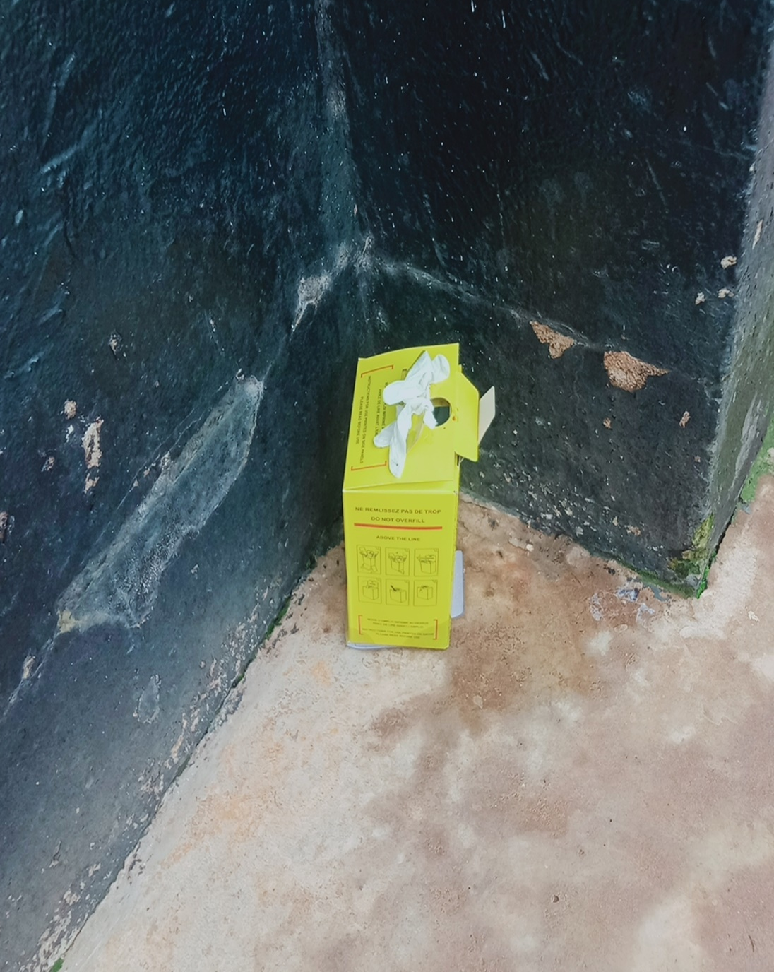
SOME OF THE HIGHLY HAZARDOUS INJECTION PRACTICES OBSERVED DURING THE STUDY.
Dangerously overfilled sharp boxes
Poorly assembled sharps box left outside.

Slide 7
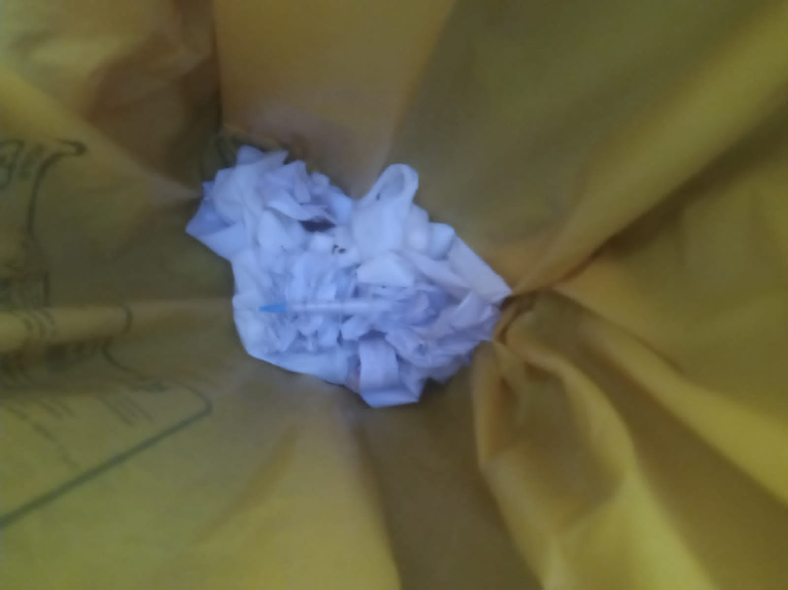
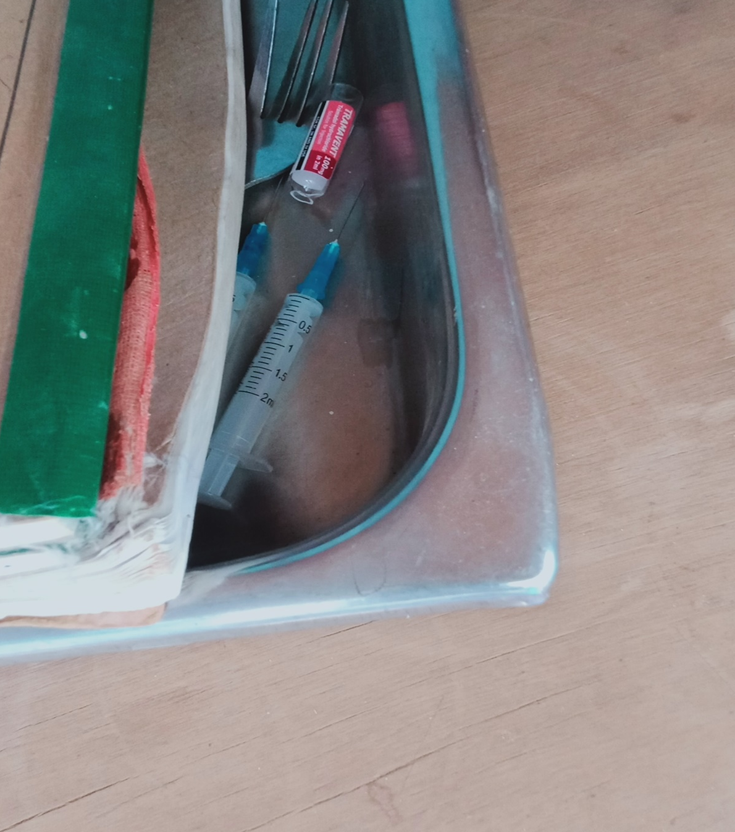
SOME OF THE HIGHLY HAZARDOUS INJECTION PRACTICES OBSERVED DURING THE STUDY.
Naked used needles and syringes were discarded in the yellow bin.
Naked used needles and syringes left carelessly in a tray hidden under a register.

Slide 8
CHALLENGES
Many unreported cases missed out. 4 student cases were reported verbally in retrospect.
Data quality issues led to the exclusion of some incidents that were possibly supposed to be included.
Possible data contamination by false reporting of needle stick injury in order to obtain PeP for different exposure.

Slide 9
OPPORTUNITIES
An existing incidence reporting culture made data collection relatively easy.
The buy-in by unit chargers and staff made access to the registers containing personal details easy.
The staff was receptive when feedback was shared and felt concerned about the risk communicated by the statistics.

Slide 10
conclusion
Needle stick injuries are a high-risk problem among healthcare workers at MeTRH.
If urgent measures are not taken to address the problem, the incidence will keep rising.

Slide 11
recommendations
The hospital administration should allocate resources to investigating and addressing the root causes of the alarmingly high incidence of needle stick injuries among healthcare workers.
All healthcare institutions should monitor and consume needle stick injury incidence data to promote patient and healthcare worker safety.

Slide 12
ACKNOWLEDGEMENT
We are grateful to the MeTRH administration for the support of the program and facilitation to attend this event.
We acknowledge the County Government of Meru has, through the CIPCC supported the program at our facility in a big way.
We are grateful to GoK MOH for training support in IPC that opened our eyes to IPC threats we should investigate.

Slide 13
references
National Infection Prevention And Control Guidelines 2015
MeTRH NIs report, December 2022.
National Institute of health needle stick injuries article. https://www.ncbi.nlm.nih.gov/pmc/articles/PMC3813677/

Slide 14
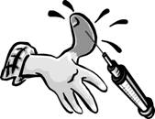
DON’T BE A STATISTICK. STICK TO
STICK THE STICK WHERE STICKS BELONG.
THANK YOU

