Slide 1
Functionality of hand wash station at the patient care areas in Kitale County Referral Hospital
Authors: Grace Mzee
Nancy Koech
Stella Mamuti

Slide 2
Introduction
Good hand hygiene requires:-
Presence of functional and well-maintained hand washing stations located in all treatment and recovery wards.
World Health Organization (WHO) recommended sink to bed ratio 1:10
Non-functional hand wash points at point of care is a significant barrier for compliance with hand hygiene protocols.
Study aim: to assess the functionality of hand wash stations at the various patient care areas at Kitale County Hospital

Slide 3
Methods
A cross sectional study conducted at inpatient point of care areas of Kitale County Hospital in February 2023
WHO hand hygiene infrastructure tool used
Key variables assessed:
- availability of sink with running water, soap and paper towel
- bed to hand wash point ratio
- and the functionality of the hand wash points.
Data was summarized in proportions

Slide 4
Sink to bed ratio in all wards

Slide 5
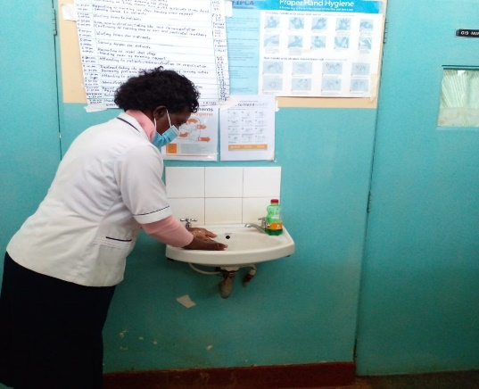
Functional Handwashing stations

Slide 6
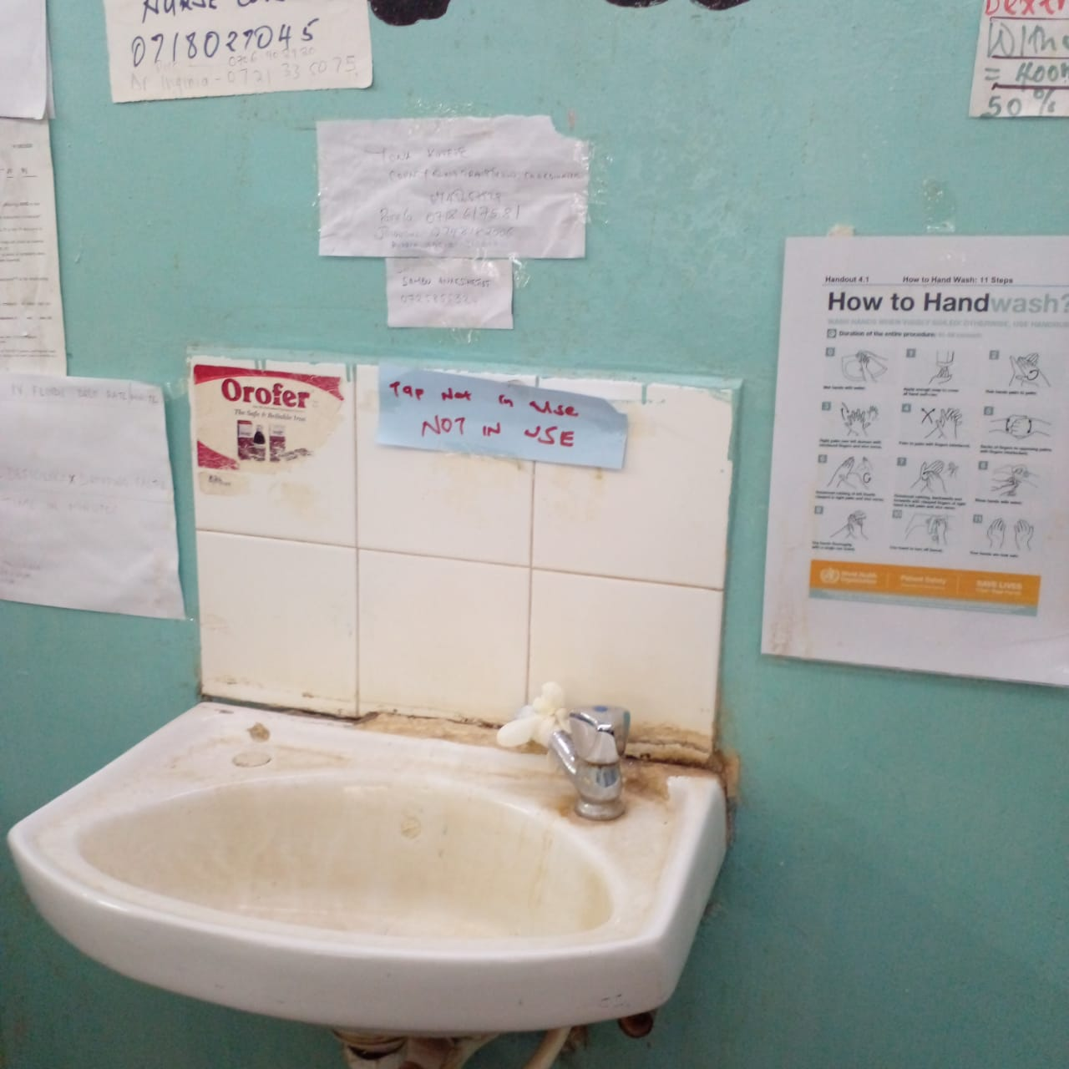
Faulty sinks

Slide 7
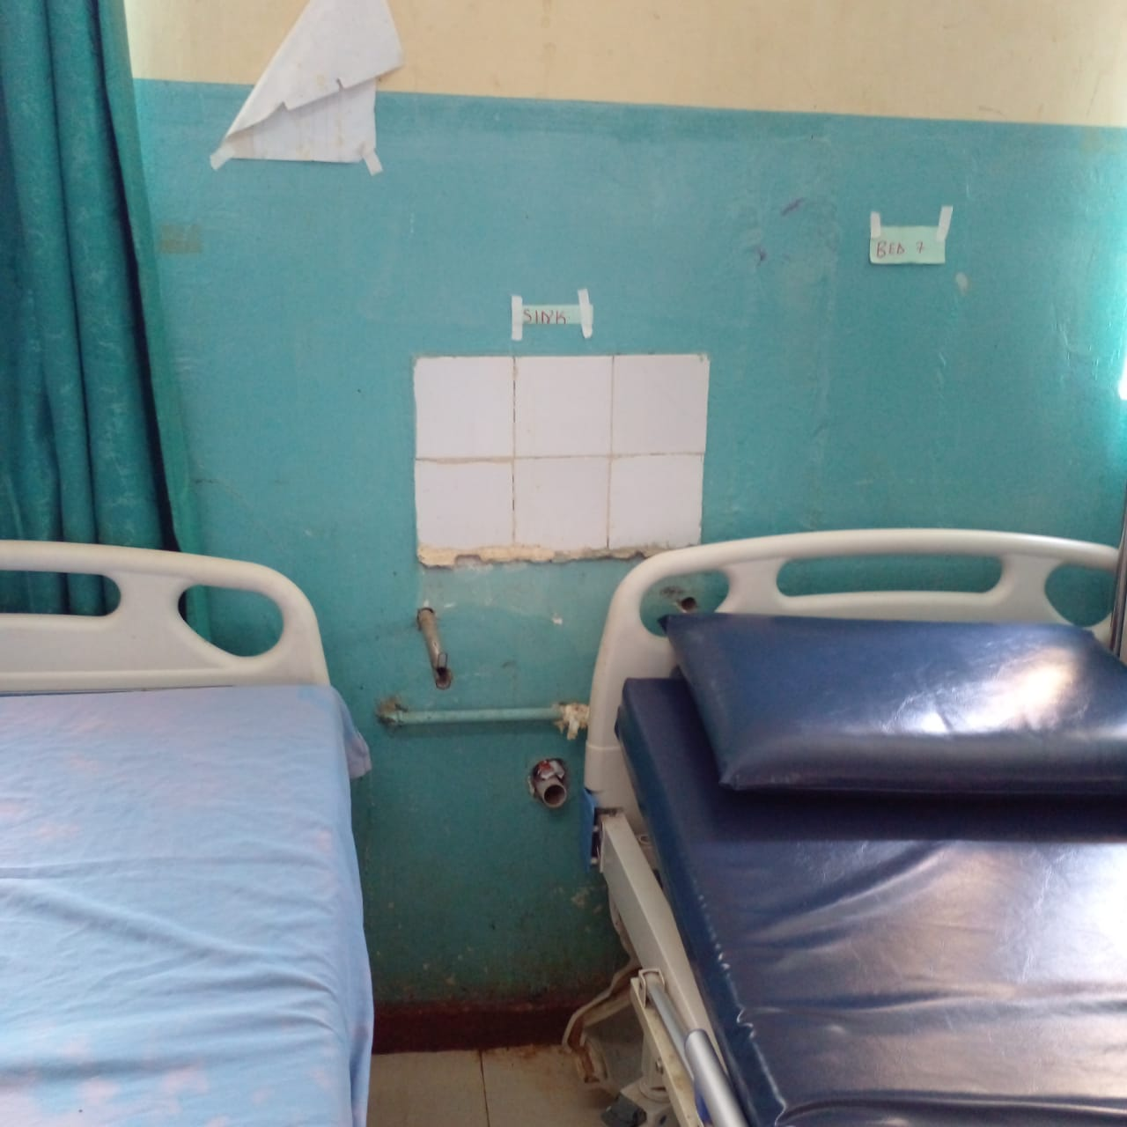
Bed spacing and Nonfunctional Sink

Slide 8
Conclusion
Functional hand wash stations according to WHO require
Availability of running water
Soap
Disposal paper towel.
There were no functional hand wash stations.
Improving hand hygiene requires sustained action in multiple levels, to improve
knowledge
supplies
infrastructure.

Slide 9
Recommendation
We recommend:
maintenance of hand wash points in the wards
ensuring availability of hand wash supplies for sustained
improved hand wash practice.

Slide 10
Acknowledgement
KCRH
AMPATH

