Slide 1
Evaluation Of Upper Respiratory Tract Infection Management To Understand The Drivers Of Antimicrobial Resistance Amongst Kitagwa And Tigoi Community Units Residents In Hamisi Sub-county, Vihiga County, Kenya
10TH IPNET-KENYA ANNUAL CONFERENCE, 2023 , Mombasa Kenya
Theme: “3i” Innovative Integration Of IPC In Disease Outbreaks And Routine Healthcare Services.
Sub-theme: Healthcare associated infections
Authors: Obino Tai¹, George Agogo², Linus Ndegwa²
Affiliation:
¹Vihiga County, Department Of Health
²US Centers For Disease Control And Prevention-Kenya

Slide 2
Global burden?
Antimicrobial resistance (AMR) is a serious global public health hidden threat.
Diagnosed?
Documented?
Data Collected?

Slide 3
Indiscriminate use of antibiotics has increasingly contributed to AMR burden:
threatening effective treatment
leading to prolonged duration of illness
consequently increasing health care costs and mortality rates

Slide 4
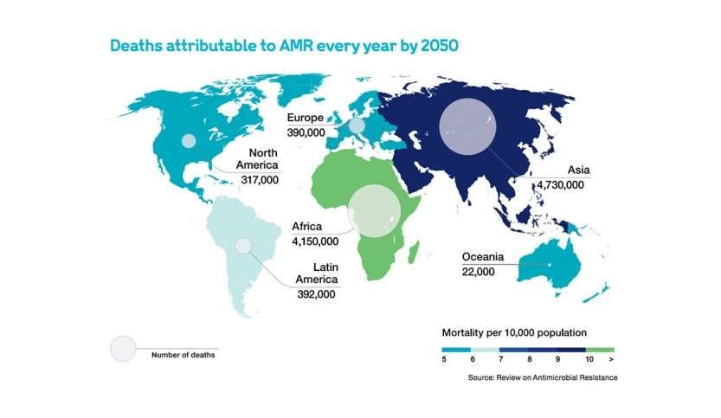
2.7million deaths in 2019,were associated with AMR, 255,000 of these were recorded in sub-Saharan Africa (By Charles Murray)

Slide 5
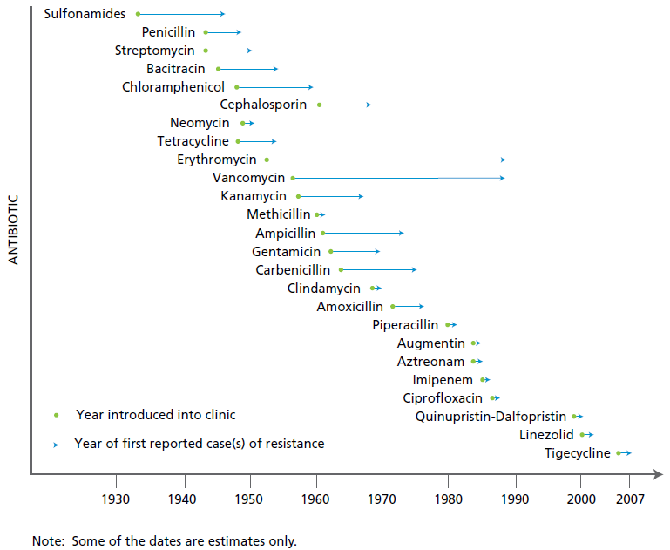
Evolution of Antibiotic Resistance

Slide 6
What is the Challenge?

Slide 7
Most upper respiratory tract illnesses (URTI) are caused by viruses and diagnosis to differentiate between bacteria and virus is very difficult.
Antibiotic self treatment occurs due to easy access without a prescription.
We assessed the perception of URTI management and antibiotics use in order to develop stewardship messages.

Slide 8
Methods 1/2
Cross-sectional study
Done Between 10th May-30th July 2022
Subjects:
residents of Tigoi and Kitagwa (CU)
aged 18 years and above.
Sample size of(n131)
Received approval of the study from hospital management
A structured questionnaire in English was administered on;
URTI management perceptions
Availability of health insurance
Antibiotics use and their source

Slide 9
Methods 2/2
Respondents were picked randomly among clients at Tigoi health Centre whose residence was Tigoi and Kitagwa CU. Results were presented;
using frequencies and percentages
chi-square statistics were used to test for significant (p<0.05) differences between groups .

Slide 10
Results 1/3

Slide 11
Results 2/3

Slide 12
Results 3/3

Slide 13
Discusions 1/2
Among 131 respondents who participated in the assessment, 94(72%) were female, 124(53%) had upto primary education level, and 7(5%) secondary. Ninety three (71%) of respondents had no insurance coverage, and 104 (79%) reported self treatment with antibiotics to manage URTI. When examining the dangers of using antibiotics 78 (60%) didn’t know, while 28 (21%) were unsure. One twenty four (94.7%) purchased antbiotics of which 66(53.2%) had a prescrption.

Slide 14
Discusions 2/2
Antibiotic use was highest among respondents:
With no education (n=55, 53%, p-value <0.0001)
Without insurance coverage (n=66, 63%, p-value =0.0002)
Female (n=86, 83%, p-value <0.0001)
Without knowledge on dangers of antibiotic use (n =78, 75%, p-value < 0.0001)
Those who perceived antibiotics to make them feel better (n=92, 89%, p-value < 0.0001)

Slide 15
Conclusion
Self treatment of URTI with antibiotics is common among respondents.
Knowledge on dangers of antibiotics use and medical coverage may be points of intervention.
Sustained multisector involvement on AMR stewardship is necessary to ultimately influence behaviour change to address AMR.
Notes:
70% of the respondents have no Health insurance cover

Slide 16
Parting Shot
“If we use antibiotics when not needed, we may not have them when they are most needed.”
Tom Frieden, MD, Former Director U.S. CDC
Notes:
Use only ABs if they is prove….giving a patient Pain killers only is not a crime, Dx should be based on Hx and lab works they way we fought Malaria management the same effort should be encouraged.

Slide 17
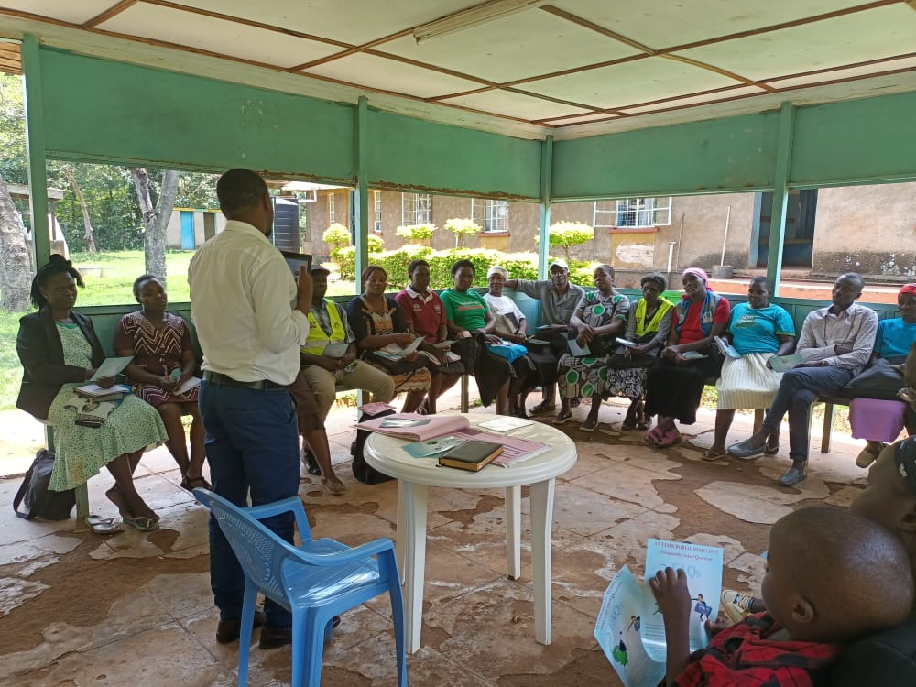
Acknowledgements

Slide 18
THANK YOU

