Slide 1
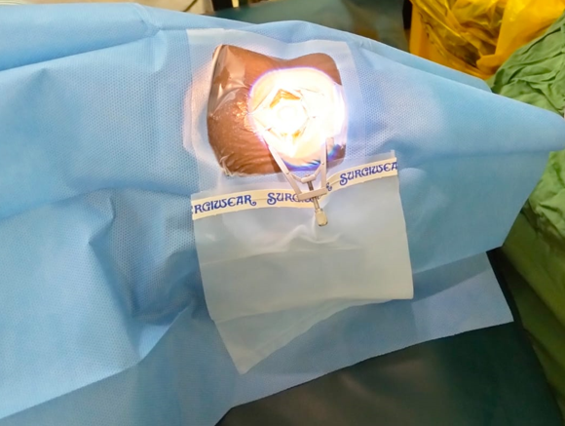
Interventions and Innovations in Preventing Surgical Site Infections in Post Eye Surgery at Kitale County Hospital
Fidelis Gatimu

Slide 2
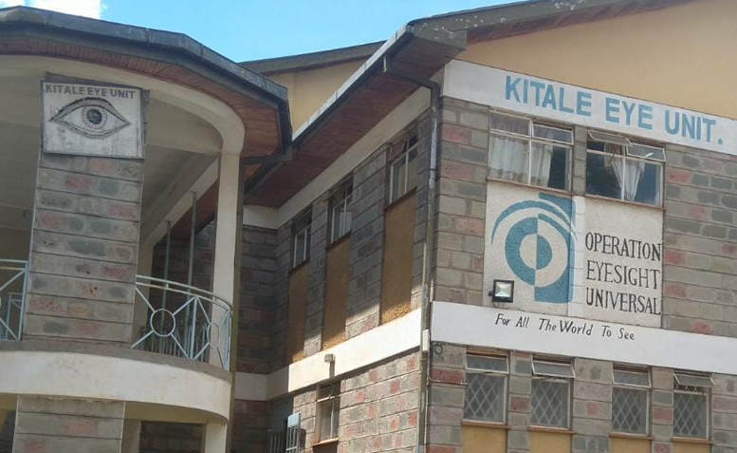
Background
Surgical Site Infection (SSI) burden in low-income countries; 2-20%
Eye unit operationalized in 2010
One SSI post-eye surgery reported in 2021

Slide 3
Study Objectives
To estimate the SSI rates post-eye surgery,2019 -2022
To identify interventions and innovations implemented to prevent infections

Slide 4
Methodology
Retrospective review; 2019 to 2022
Standardized data abstraction tool used
Variables collected:
number and types of surgeries,
SSI recorded
Interventions and innovations
Semi-structured questionnaire
observations of the eye unit
Categorical variables summarized using proportions
Qualitative data were summarized using themes

Slide 5
Eye Surgeries per year
Type of surgery | 2019 N=485 (%) | 2020 N=450 (%) | 2021 N=478 (%) | 2022 N=492 (%) | Total N=1905 (%)
Cataract removal | 455(93.8) | 390(86.7) | 409(85.6) | 453(92.1) | 1707(89.6)
Corneal repair | 22(4.5) | 43(9.6) | 40(8.4) | 20(4.1) | 125(6.6)
Trabeculectomy | 6(1.2) | 2(0.4) | 2(0.4) | 3(0.6) | 13(0.7)
Redialiang | 2(0.4) | 2(0.4) | 12(2.5) | 7(1.4) | 23(1.2)
Intravitreal injection | 0(0) | 13(2.9) | 15(3.1) | 9(1.8) | 37(1.9)
SSI | 0(0) | 0(0) | 1(0.2) | 0(0) | 1(0.1)

Slide 6
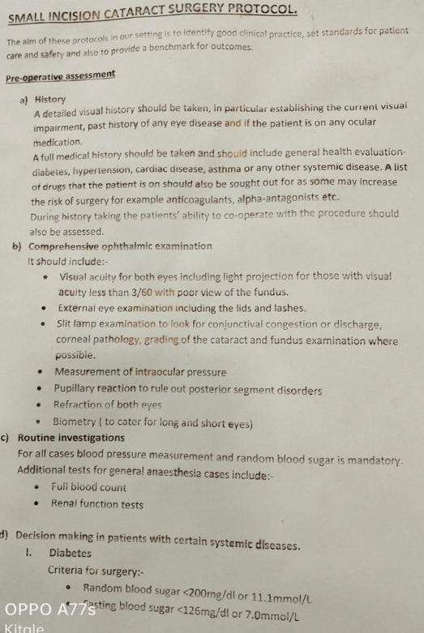
Interventions being implemented
Surgical care bundles
Surgical antibiotic prophylaxis
Monitoring of blood glucose levels
Monitoring of all vital signs
Eye preparation before and after anesthesia

Slide 7
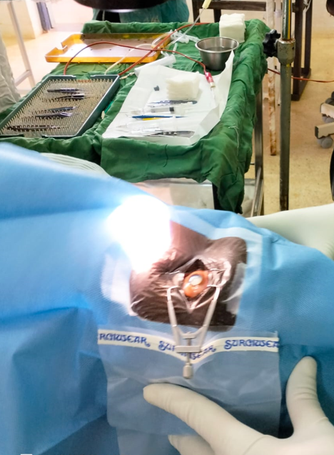
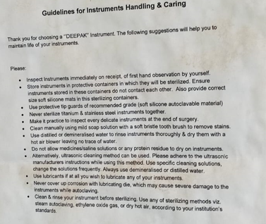
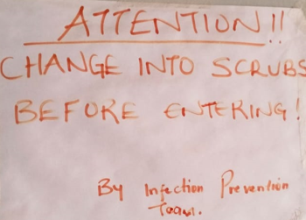
Interventions being implemented
Adherence to IPC measures
Availability of IPC guidelines
Surgical scrubbing
Daily theatre scrubbing
Instruments reprocessing
Theatre traffic flow

Slide 8
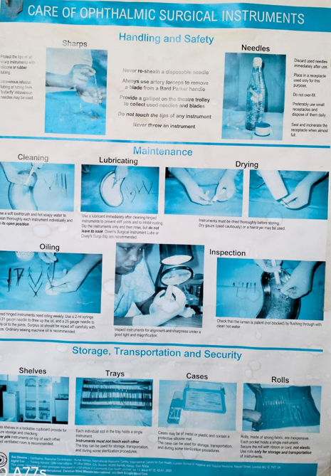
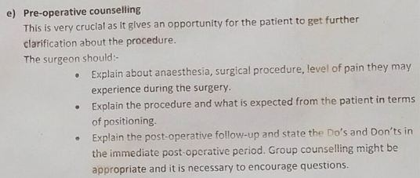
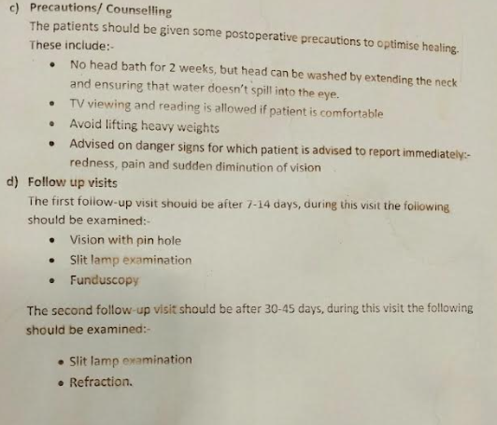
Innovations being implemented
Standardized material for:
Patient education
Staff orientation
Availability of pictorial Standard Operating Procedures

Slide 9
Conclusion and Recommendations
Conclusion
Surgical care bundle with additional Infection Prevention Innovations prevent SSIs
Consistent implementation important for sustained prevention
Recommendations
Promote consistent implementation surgical care bundles
Innovative adherence to IPC measures

Slide 10
Acknowledgement
KCRH
Eye Unit
ITECH

