Slide 1
SAFE INJECTION PRACTICE AMONG NURSES IN BUNGOMA COUNTY
BY: PASCALIA OKOITI KISIANGANI
KECHN,KRCHN,BSCN & MANP (COMMUNITY HEALTH)

Slide 2
INTRODUCTION
Safe Injection practice is a set of measures taken to perform injections in an optimally safe manner for patients, healthcare personnel, and others.
Globally, injection procedure accounts for 16-20 billion injections annually of which 50% are unsafe (CNSSN, 2000).
Developing countries,70% of injections are not safe
(WHO,2010).
In Kenya poor leadership and lack of experience among the nurses in public hospital contribute to unsafe injections (KAIS, 2012).
To determine safe injection practice among nurses in Bungoma County
Notes:
A descriptive-analytical cross-sectional study in Bungoma County.
Practicing nurses in both public and private facilities.
Sampling technique: A multistage sampling method was used.
Sample size 120 Nurses: The desired sample size was arrived at using “Modified EPI” formula MOH, (2016). Research Instruments: Structured questionnaires and Observation tool.
Data entry and analysis: Done using and SPSS Version 25 software.
Descriptive and inferential statistics : Used for analysis a p-value of ≤ 0.05 was considered as statistical significance threshold.

Slide 3
RESULTS : KNOWLEDGE
Notes:
Out of the 110 nurses (10 M 100 F ) who responded, ( 106 nurses) 96% had not attended injection safety training.
Trained on injection safety was (4 nurses) 4%.

Slide 4
ATTITUDE
Notes:
72.8 %
( 77/106 nurses) showed positive attitude .
27.2%
( 29/106 nurses)
showed negative attitude
Towards
injection
safety.

Slide 5
PRACTICE
Notes:
Compliance to five moments of hand washing ( 56 nurses) 51.2%.
Use of approved antiseptic swab on the rubber septum and patient before injection (77 nurses) 69.9%.
injection preparation done in the right place (65 nurses ) 59%.
(12 nurses) 11% recap needles.

Slide 6
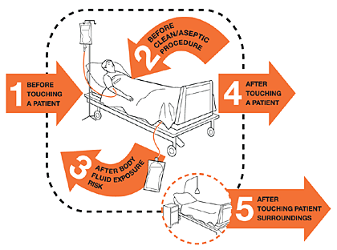
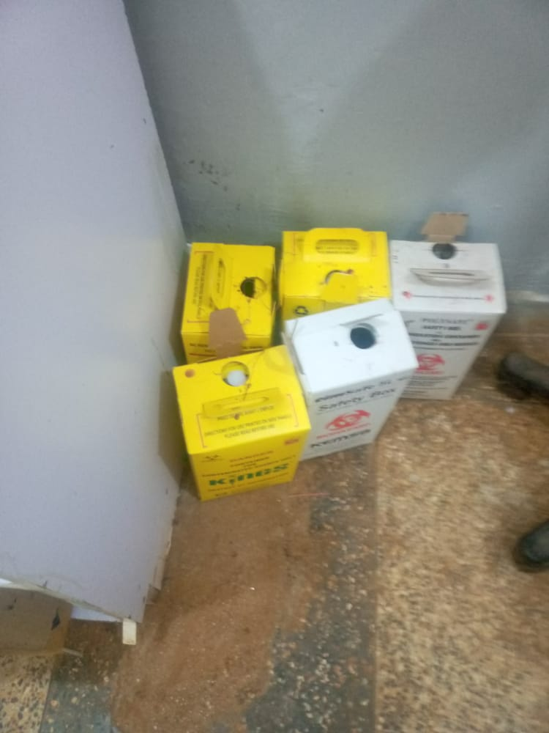
PRACTICE
Notes:
Safety boxes over three quarter filled (77 Nurses ) 70%.
Non touch technique
( 98 nurses) 89.9%.

Slide 7
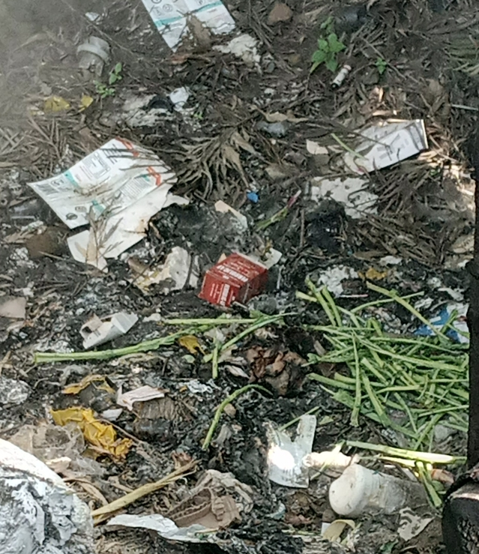
PRACTICE CT.
Notes:
Correct disposal/
incineration of the hazardous waste (87 Nurses) 78.9%.
waste segregation (93 nurses)
84%.

Slide 8
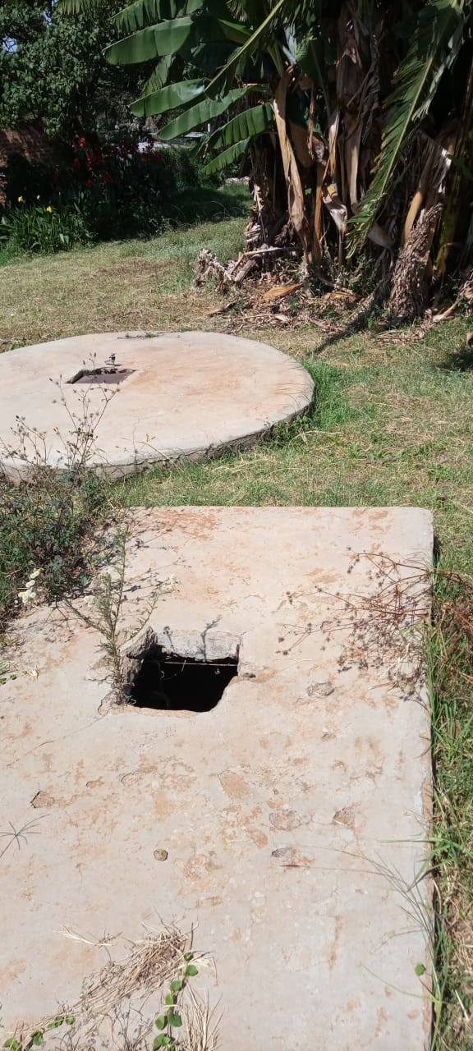
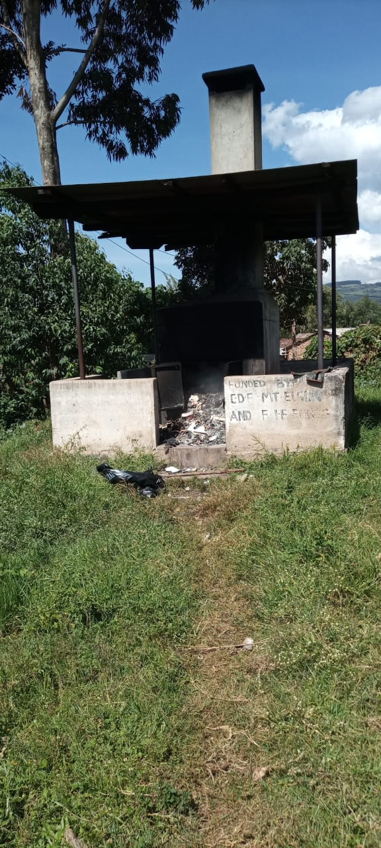
PRACTICE CT.
Notes:
Correct disposal/
incineration of the hazardous waste (87 Nurses) 78.9%.
waste segregation (93 nurses)
84%.

Slide 9
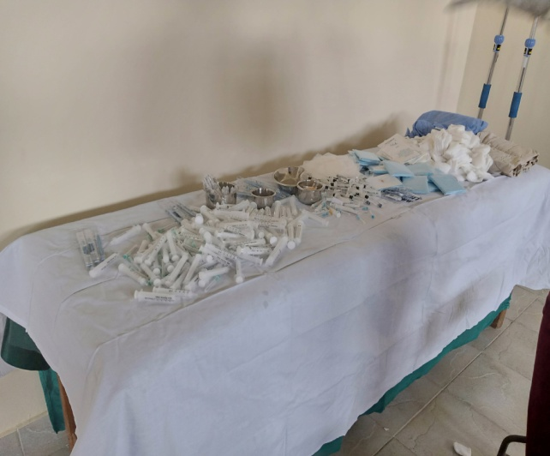
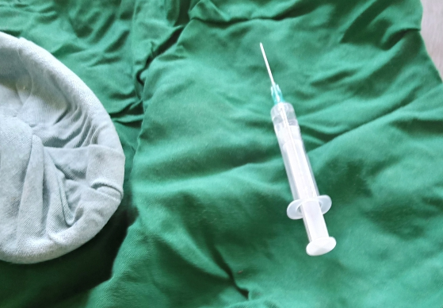
PRACTICE CT.
Notes:
Correct processing
of instruments as per the WHO standards 70%,
Occupation safety measures 70%.

Slide 10
CONCLUSION
High rate of unsafe injection practice were noted especially in MCH/FP, Maternity and OPD/ Casualty departments.
Positive attitude was shown among the nurses.

Slide 11
RECOMMENDATION FOR PRACTICE
There is need for IPC training in Bungoma.
The partners to incorporate IPC in their programme activities.

Slide 12
REFERENCE
Adler, Patricia A. & Adler, Peter (1994). Observations techniques
(Safe Injection Global Network) www.safeinjection.or (accessed July, 2022).
Audu Onyemocho, Joshua Istifanus, Anekoson, &EnokelaOnum Pius (2013); Knowledge and Practice of Injection Safety among Workers o Knowledge and Practice of Injection Safety among
Workers of Nigerian Prison Service Health Facilities in Kaduna State, American Journal of Public Health Research.
Centers for Disease Control and Prevention (2011): injection safety:www.cdc.gov/ncidod/dhap/bg)
World Health Organization (WHO) (2010): WHO best practice for injections and related procedures toolkit? www.who.int/infection-prevention

