Slide 1
Common source outbreak of Multi-Drug Resistant Acinetobacter baumanni associated with surgical site infections at Kitale County Hospital Female Surgical Ward.
OGARO M. HENRY

Slide 2
Outline
Background information
Objective
Materials and methods
Results
Discussion
Conclusion
Recommendation

Slide 3
BACKGROUND
Common source multi-drug resistant Acinetobacter baumanni outbreak poses a great challenge in healthcare epidemiology in terms of;
prevention and control of the etiological agent and management of patients with multi-drug resistant organisms.

Slide 4
Objective
The study sort to trace the pathogen to the possible source.
To stop the outbreak.

Slide 5
Materials and methods
A cross sectional retrospective analysis of archived Laboratory data of pus swabs samples (deep subcutaneous tissues) collected between November to December 2021: performed using standardized culture method using blood and MacConkey Agar,

Slide 6
Materials and methods
Isolate identification done using ;
Gram stain -Negative
Analytical Profile Index 20NE (API) Non-Enterobactereciae,
Kirby Bauer disk diffusion method for Antimicrobial Susceptibility Testing (AST),
Patient demographics and medical data was obtained from medical files.

Slide 7
Results
Female surgical Patients | N=8
Age | Range | 12-29 years
 | Median | 22.5 years
 | Mean | 22.1 years
Emergency surgery (8) 100%
Re-admission to hospital after surgery |  | 6±1 days
Hospital stay | Range | 8-15 days
 | Mean | 10 days
Pus swabs (deep subcutaneous tissue) | 8

Slide 8
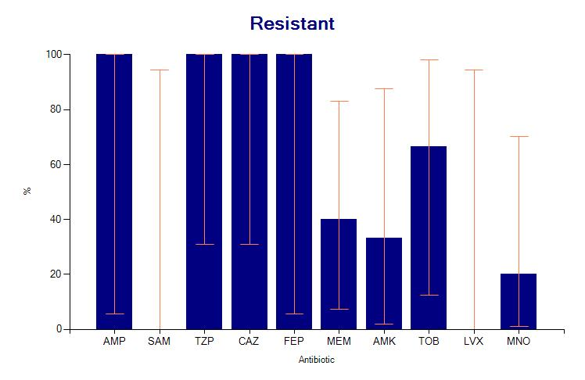
1. AMP- Ampicilin, 2. TZP- Tobramycin, 3. CAZ-Ceftazidime, 4. FEP- Cefepime

Slide 9
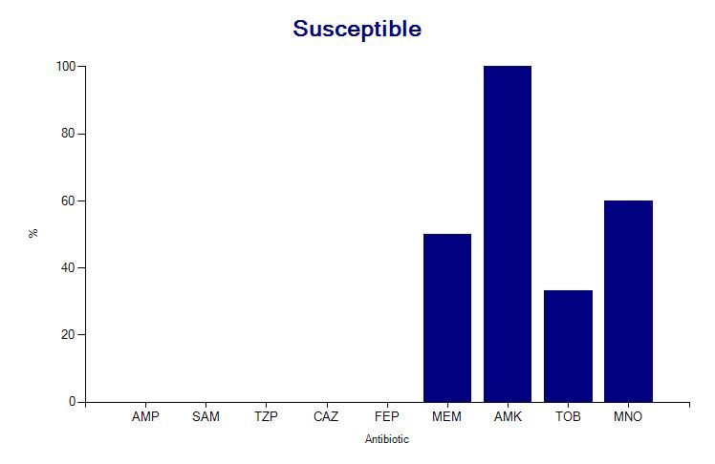
AMK (Amikacin) 100%
MEM (Meropenem)
TOB (Tobramycin)
MNO (Minocycline)

Slide 10
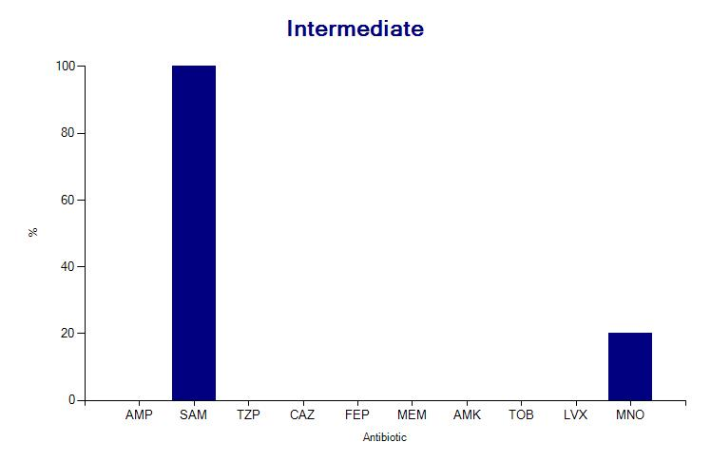
SAM(Ampicillin/ sulbactam)
MNO (Minocyclin)

Slide 11
What was done
Staff from
theater,
wards,
Central Sterile Supply Department (CSSD)
and laundry
were informed and sensitized on;
infection prevention and surgical bundles.
Root cause analysis was performed on the fifth patient.
Patient and ward cleanness was emphasized and
rodents, insects and vermin were eliminated in the wards.

Slide 12
Discussion
The complex nature of hospital environment
Investigation of common source outbreaks in healthcare facilities requires a multi-disciplinary approach to detect the source of the pathogen of concern.
Detection of the first case is important to prevent outbreak status of hospital-acquired infections.
Insect and rodent elimination disrupts the source and chain of infection.

Slide 13
Conclusion
There is a relationship between the demographic characteristics of the patients, the environment, the isolate, and its antimicrobial susceptibility characteristics.

Slide 14
Recommendation
Genomic sequencing is required to confirm single-source isolate relatedness.

Slide 15
ACKNOWLEDGEMENT
MINISTRY OF HEALTH
COUNTY GOVERNMENT OF TRANS NZOIA
KITALE COUNTY HOSPITAL
KITALE COUNTY HOSPITAL LABORATORY STAFF
INFECTION PREVENTION NETWORK KENYA
ITEC

