Slide 1
Evaluation of Application of Aseptic technique by Thika Level 5 Hospital
Lucy Waweru
MScN

Slide 2
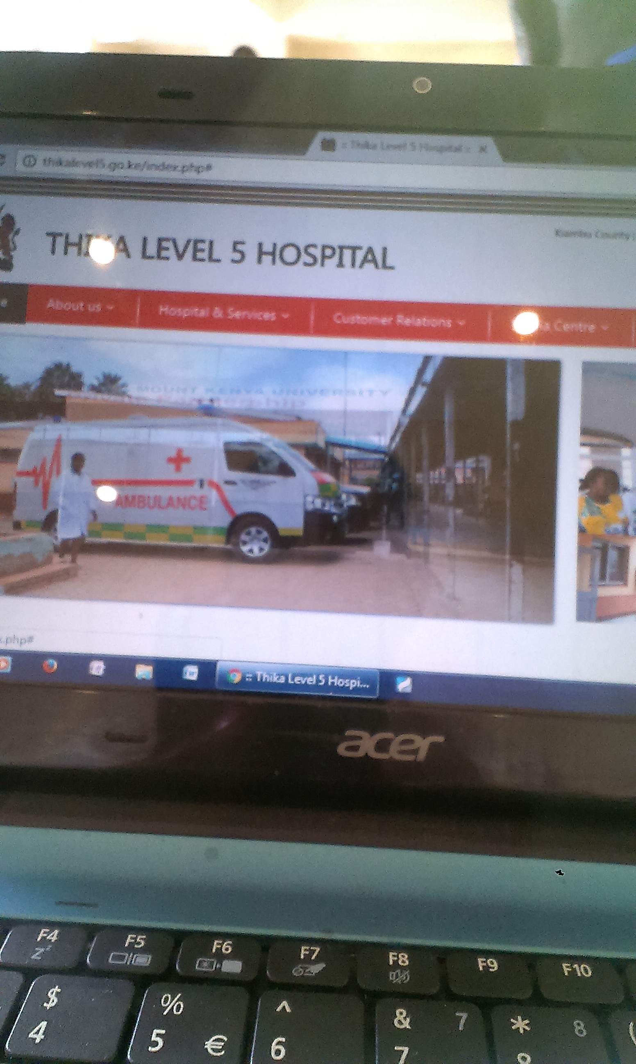

Slide 3
Introduction
Aseptic technique is a combination of efforts to prevent entry of microorganisms into any area of the body where they are likely to cause infection.
This is one of the ways IPC use to reduce nosocomial infections during patient care procedures
( National Infection and Control Guidelines for health care services-Kenya 2010).

Slide 4
Ct.
The researcher had observed a few occasions where aseptic technique was not observed
Nosocomial infections could cause considerable morbidity and sufferings, and mortality in patients,
Increase treatment costs, and increase the length of hospital stay for patients
if IPC precautions are not applied in hospital setting (Spengler & Greenough, 1978).

Slide 5
Ct.
Primary way of transmission of the pathogens is by contact with hospital staff
Infections due to' indwelling urinary catheters and
vascular cannulae are other common predisposing factors.
The common nosocomial infections are urinary tract infections, wound infections, pneumonia, and bacteraemias
(Zulkifli, Thayaparan, Fatimah & Salamah,1996).

Slide 6
Ct.
Important IPC measure for best practices are adherence to aseptic technique by health staff
in patients’ procedures such as hand washing, gloving, gowning,
I.M injection, venepuncture and bladder catheterization

Slide 7
Objectives of the evaluation
To find out if the health workers observe aseptic technique during patient care procedure
Make relevant recommendation to improve IPC standards precautions compliance in the hospital

Slide 8
Justification
IPC is one of the measures taken in provision of quality care in any hospital in the world.
Thika Level 5 hospital is one of such hospitals and has embraced IPC guidelines for its protocols in patient care.
This hospital is a teaching hospital which needs to uphold standards and guidelines.
It is therefore important to regularly check how well this practice is done
and if gaps are found necessary recommendations be done for the hospital to take necessary action to improve on patient care.

Slide 9
Methodology
Study site: Thika Level 5 is Kiambu County’s referral and teaching Hospital
The study used a cross-sectional descriptive method.
Data collection tool was by observational check list which was filled by the researcher.

Slide 10
Ct.
Observation was done by observing the health workers as they performed their patient care procedures without their knowledge
This was done in the months of July-to September 2015.
Data analysis was done by use of qualitative method.
Results was presented in photos and video

Slide 11
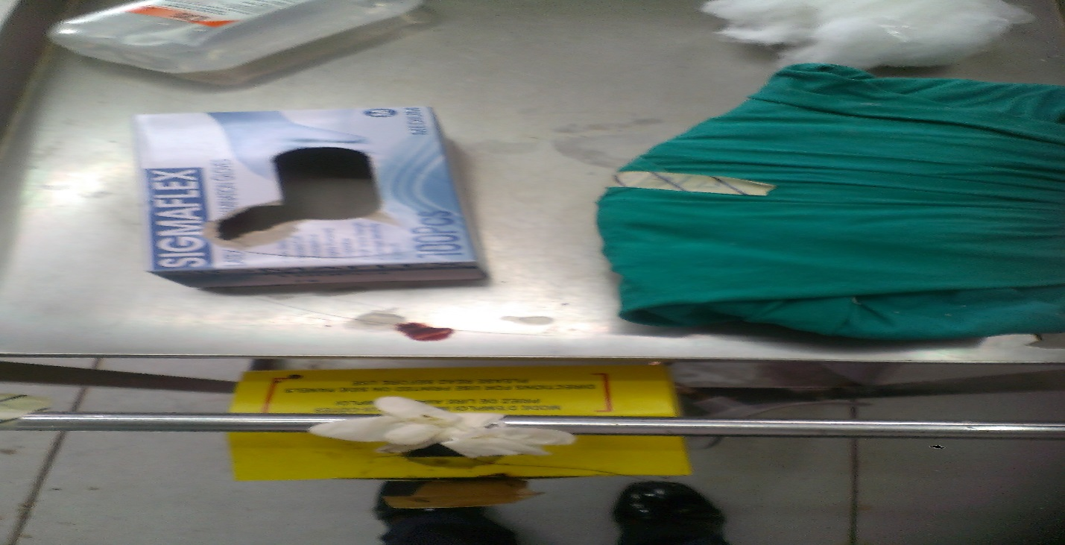
Results/finding
Figure 2: delivery pack placed on a trolley with spot
of blood ready for the next patient

Slide 12
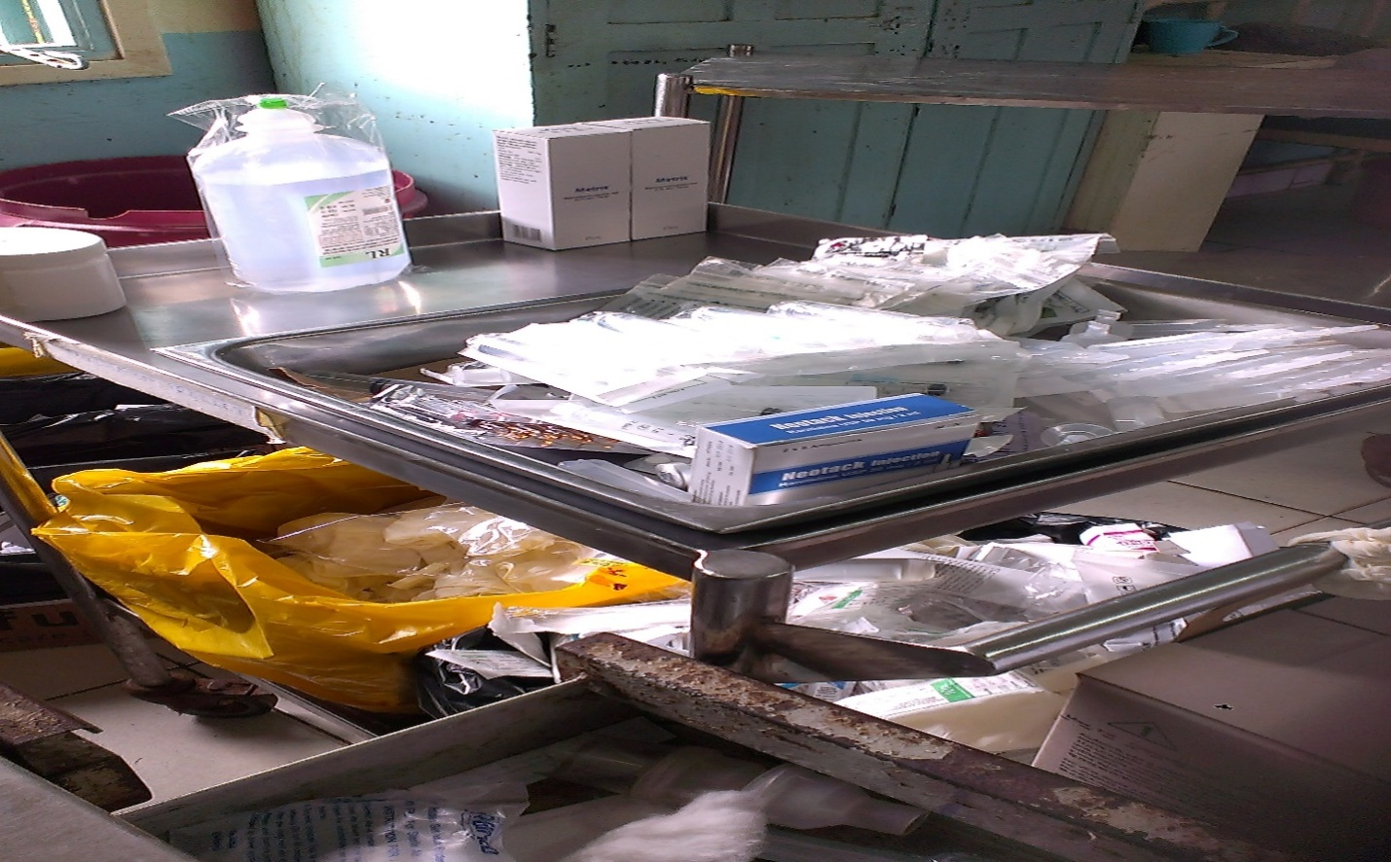
Figure 4: treatment trolley for injectable drugs with no kidney dish for carrying prepared drug to the patient

Slide 13
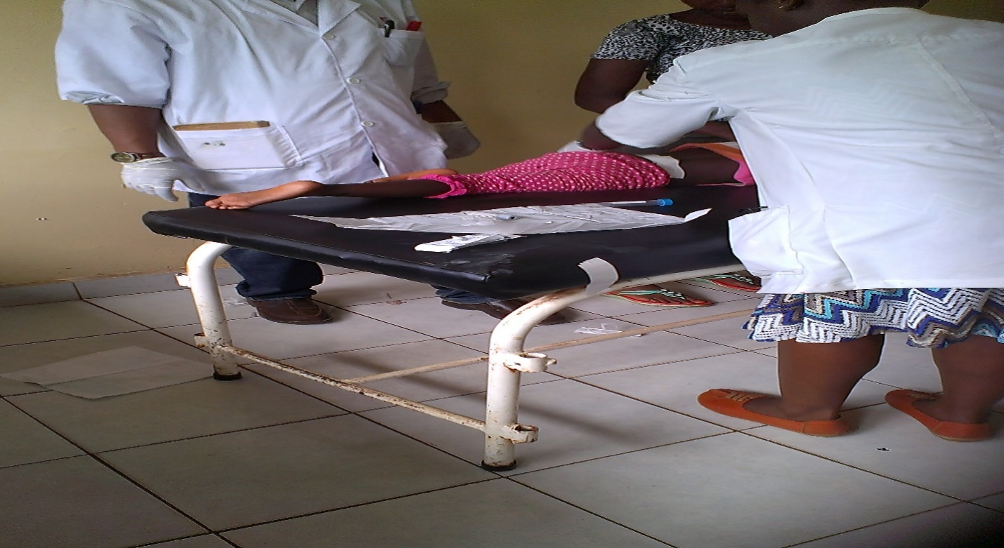
Figure 5: Lumber puncture procedure without sterile tray

Slide 15
Other observed behaviors
In some wards hand sanitizers were placed in the tea room next to the sink while none was in the ward.
There were no saucers for placing drugs for patients
No jugs for carrying clean water for patients
In many wards staff did not wash/sanitize their hands as they changed gloves between patients

Slide 16
Conclusion
There are gaps in application of aseptic technique by both qualified and students health workers.
This could compromise quality of care given to our patient by introducing nosocomial infection to the patients.

Slide 17
Recommendations
Share the findings with all departments through CME
Sensitize staff on aseptic technique during hospital CMEs
IPC committee to Make standard operating procedure for all invasive procedures to follow aseptic technique as provided for by National IPC guidelines for health workers

Slide 18
Action taken
Findings shared with staff through meetings and CME platforms
Preparation of aseptic technique SOP
Assembling of patient care equipment to standard to support aseptic technique practice.

Slide 19
The end
Thank you

