Slide 1
AMR and IPC
Prof. Gunturu Revathi
Consultant Microbiologist
The Aga Khan University Hospital, Nairobi
IPNET Conference
16-11-2011
Gelian Hotel
Machakos

Slide 2
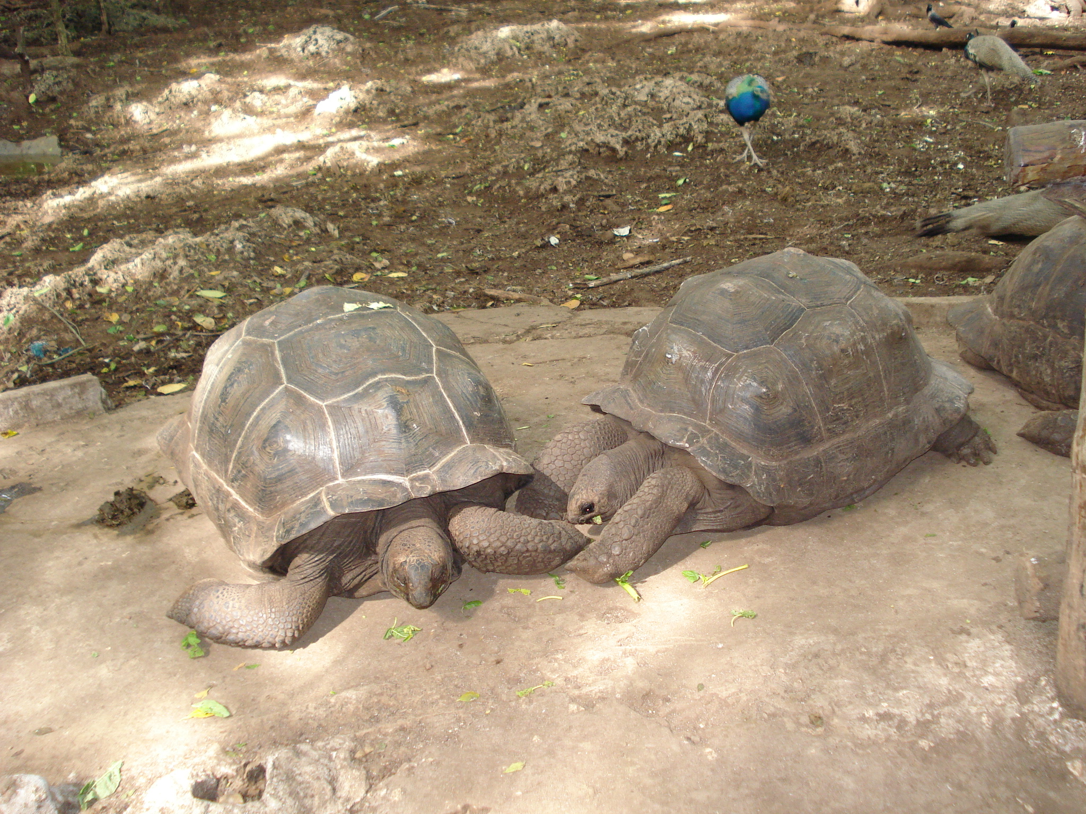
IPC
AMR

Slide 3
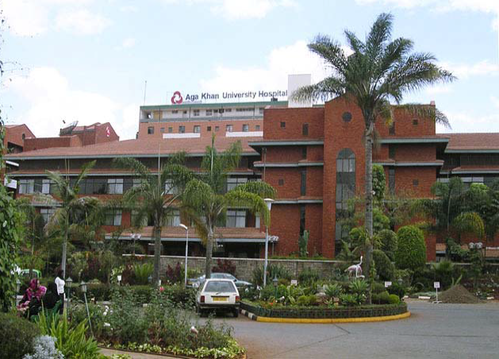

Slide 4
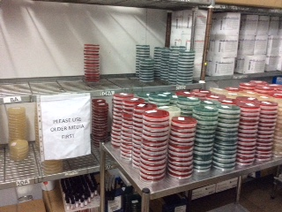

Slide 5
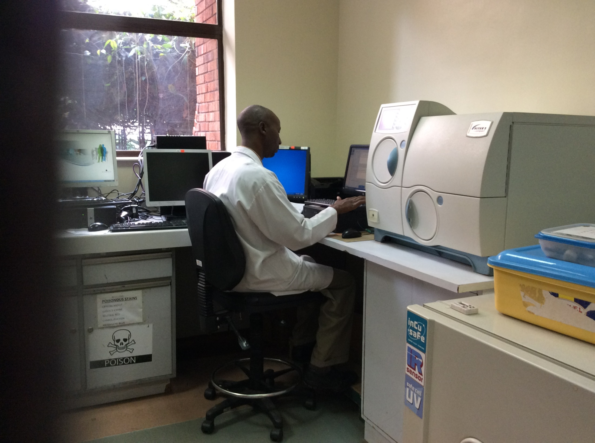

Slide 6
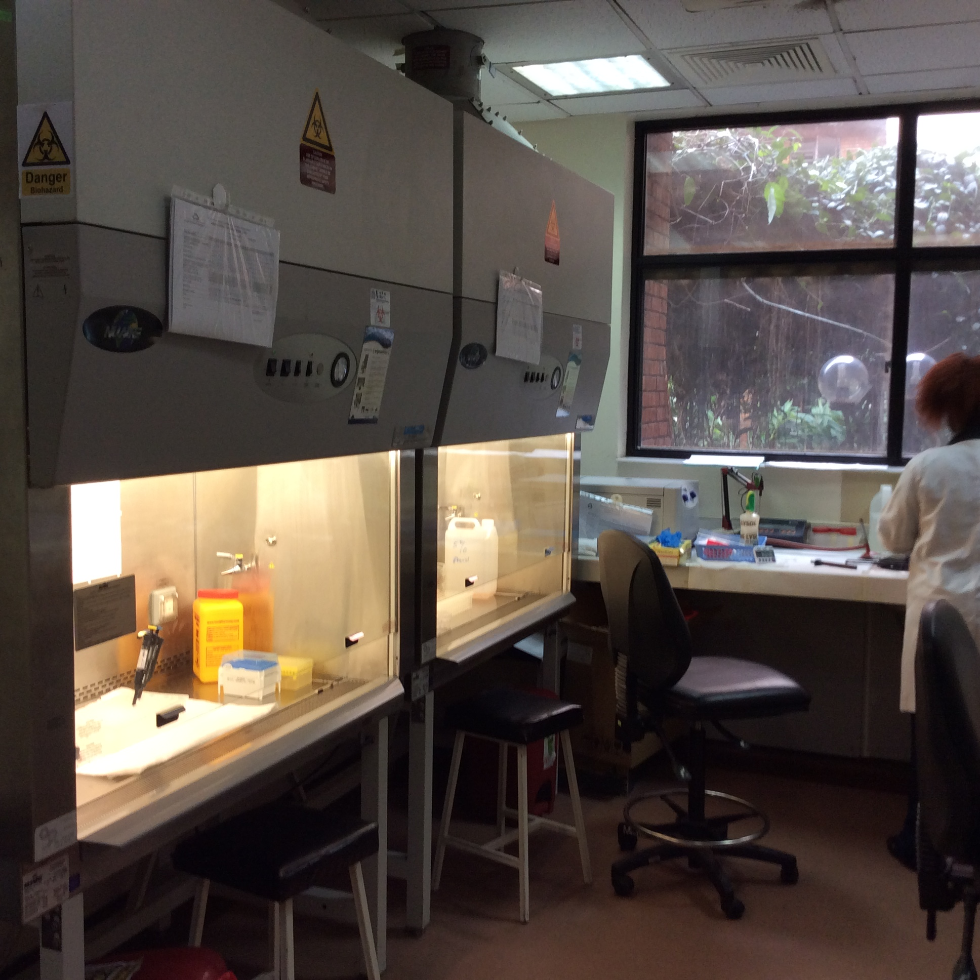

Slide 7
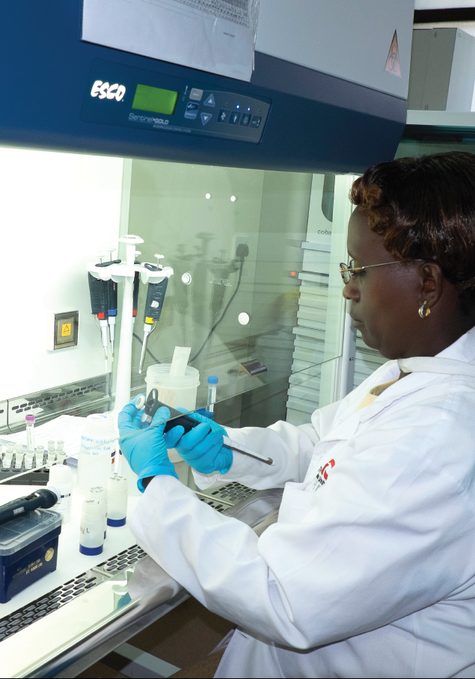

Slide 8
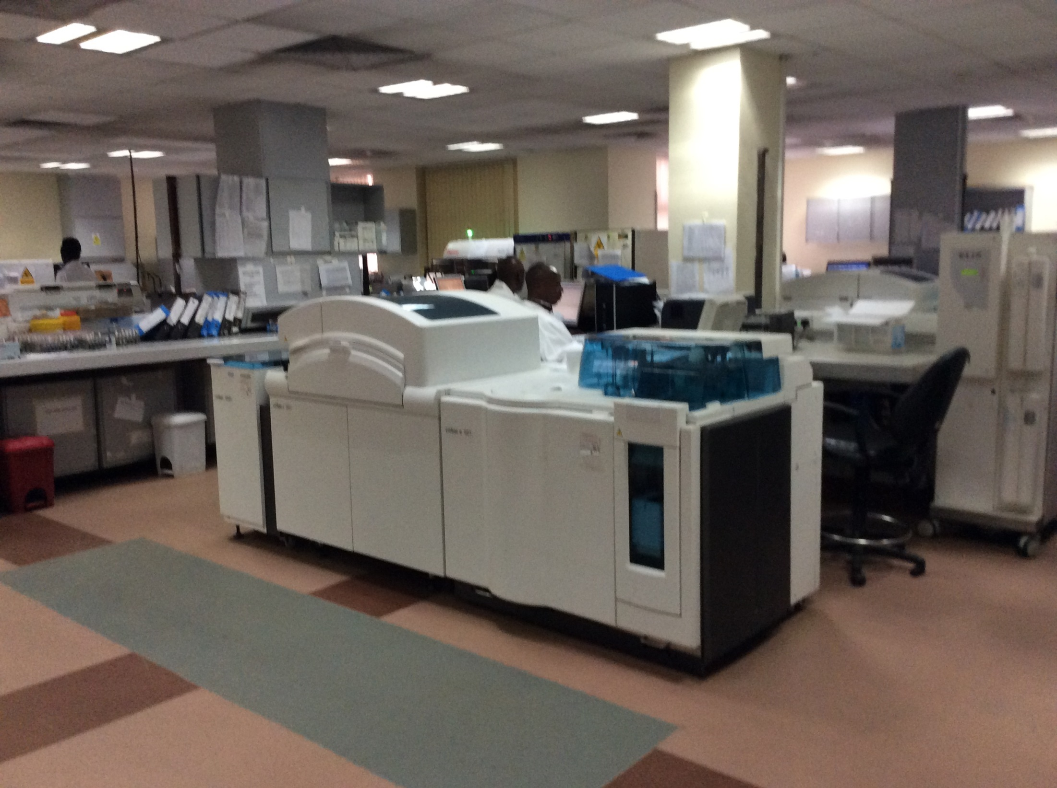

Slide 9
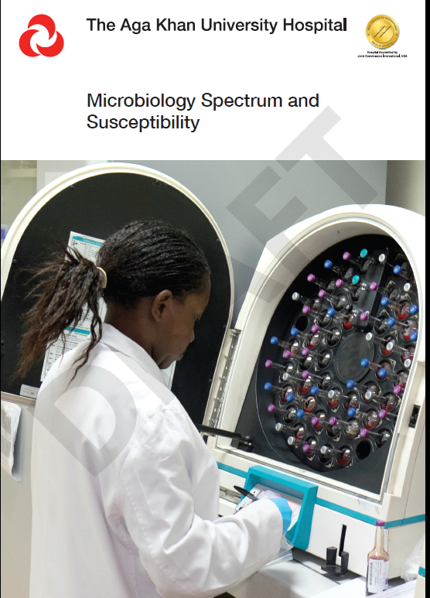

Slide 10
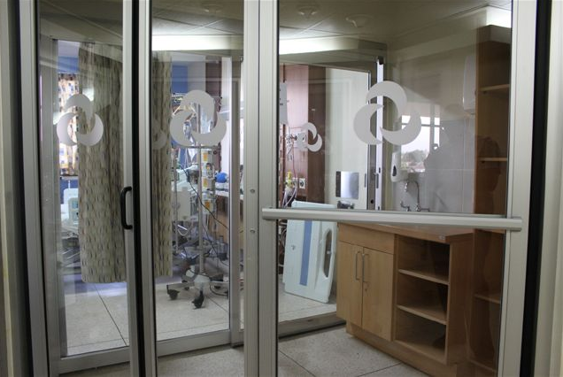

Slide 11
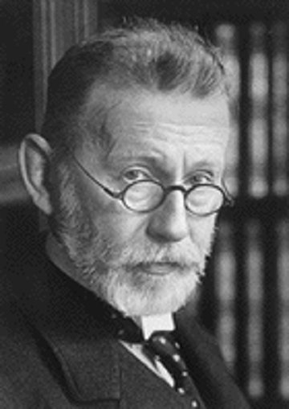
“Drug resistance follows the drug like a faithful shadow.”
- Paul Erhlich 1854-1915
Notes:
Paul Erhlich, a German-born physician and scientist in the fields of hematology, immunology, and chemotherapy and Nobel Prize winner in 1908, recognized early on that drug-resistance was a complicating issue when treating certain disease states. Now, although his statement of “Drug Resistance follows the drug like a faithful shadow” was more relevant at that time to cancer-chemotherapy, he recognized this as being important for antimicrobial therapy as well – he originally discovered Arsphenamine, or Salvarsan, the first known medical treatment of syphilis.

Slide 12
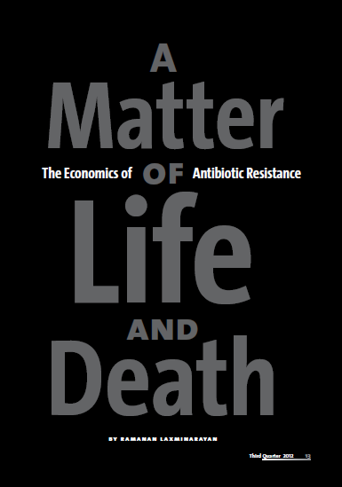

Slide 13
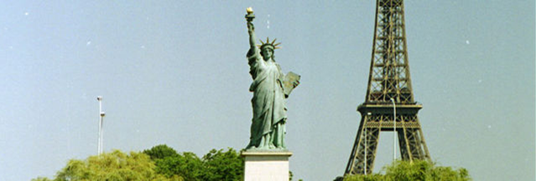
Fact Sheet: Obama Administration Releases National Action Plan to Combat Antibiotic-Resistant Bacteria
Posted on March 30, 2015
The White House. Office of the Press Secretary. March 27, 2015.
.

Slide 14
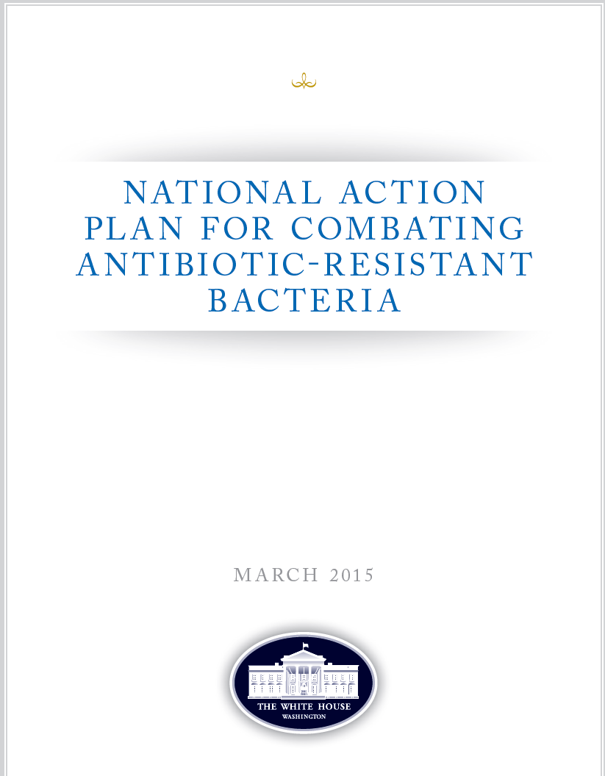

Slide 15
Five strategic objectives:
Improve awareness and understanding
Strengthen the knowledge through surveillance and research
Reduce the incidence of infection
Optimize the use of antimicrobial medicines
Ensure sustainable investment

Slide 16
Five strategic objectives my translation:
EAAD / WAAW: handle AB with care
Set up lab and surveillance and report
Good IPC in hospital
AB: only prescription & instruction & duration
Invest in R&D

Slide 17
How were measures selected for the study?
Five Objectives of the Global Action Plan on AMR:
The main objectives that the study aims to support are bolded
Risk awareness (communications, education, training)
Knowledge, surveillance, research
Prevention of infections
Optimize use
Investment case – R&D, country-level measures
Today’s consultation is on case studies on:
1. Laboratories & surveillance (ongoing),
2. Human health care - use and prescriptions (ongoing),
3. a. Animal health, drug use, and production (ongoing),
3. b. Optimize use in livestock production: User charge, for antibiotics (not yet started)

Slide 18
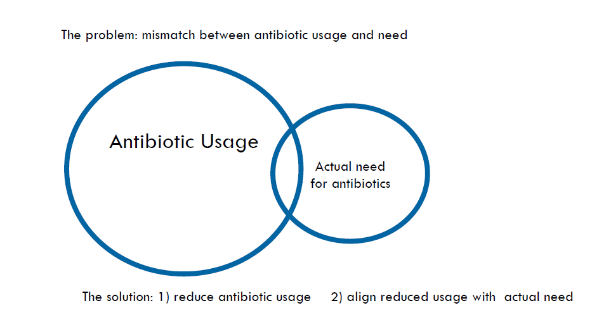

Slide 19
Antibiotic Guidelines

Slide 21
MBL
IMP
(1992)
VIM
(1999)
SPM-1
(2002)
GIM-1
(2004)
SIM-1
(2005)
AIM-1
(2008)
KHM-1
(2008)
NDM-1
(2008)
DIM-1
(2009)
Notes:
21

Slide 22
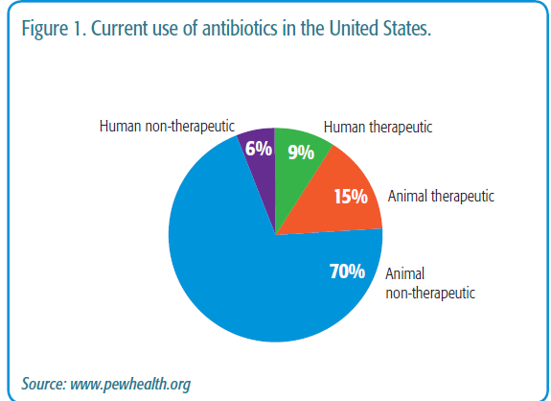

Slide 23
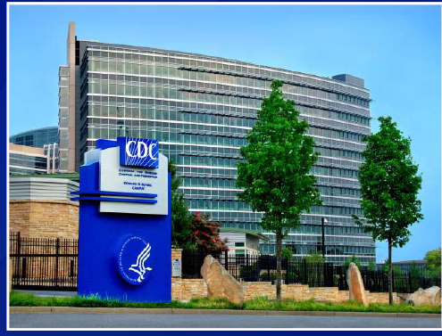

Slide 24
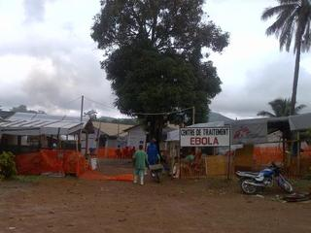

Slide 25
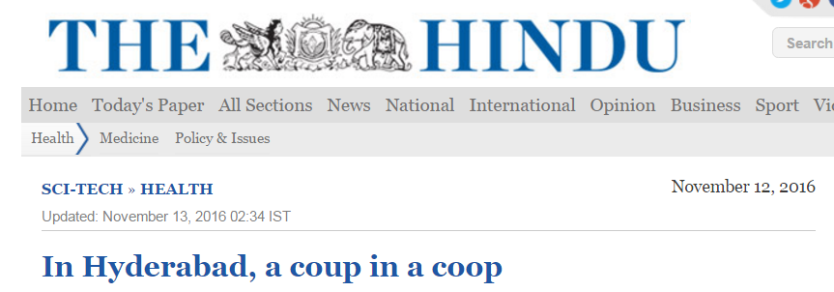
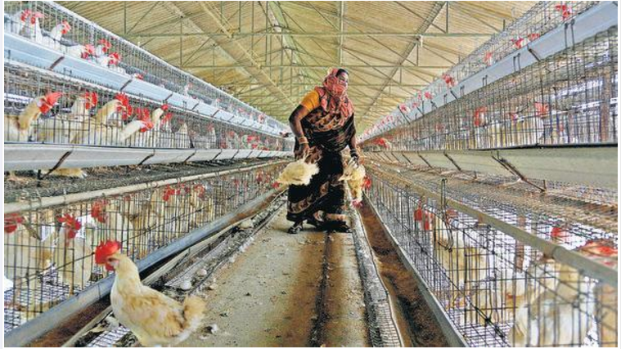

Slide 26
Researchers isolate a bacterium in chicken that may well be the source of transmission of the drug-resistant pathogen to humans.
The pathogen, called Helicobacter pullorum, was found in broiler and free-range chickens from markets in the city, which — besides being untreatable — could also be cancer-causing.
Applied and Environmental Microbiology,
American Society for Microbiology,
first data on prevalence and isolation of H. pullorum in India.

Slide 27
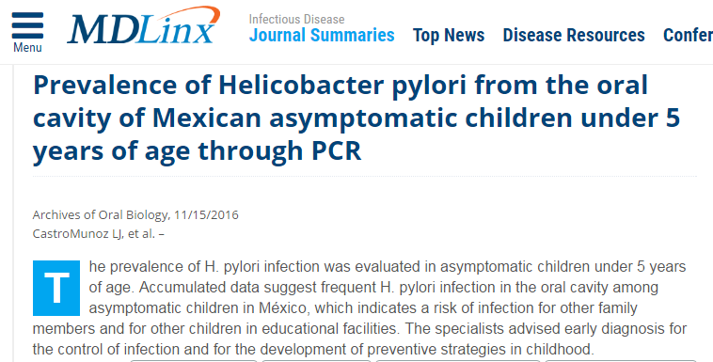

Slide 28
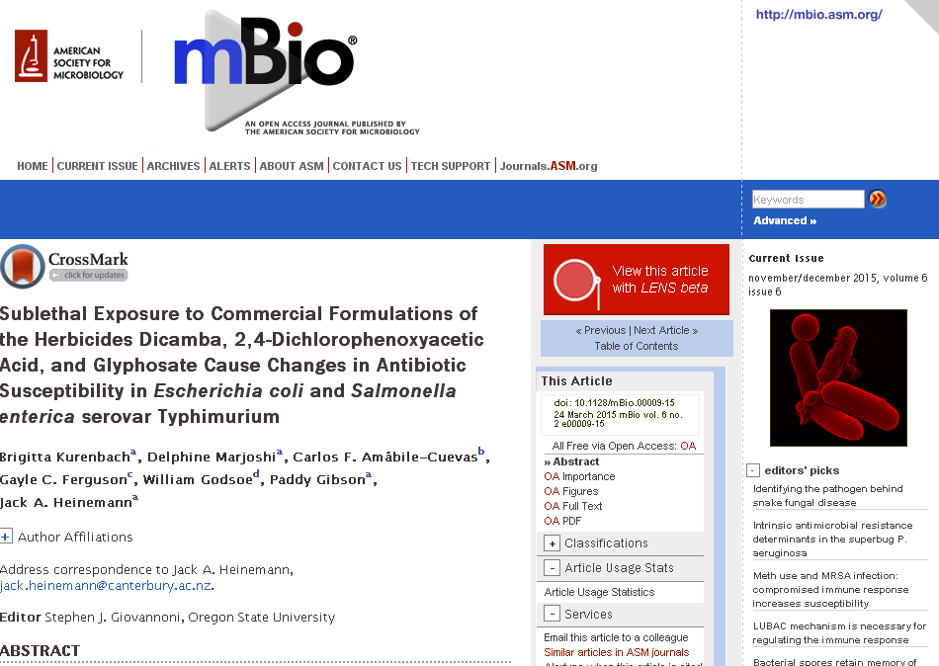

Slide 29
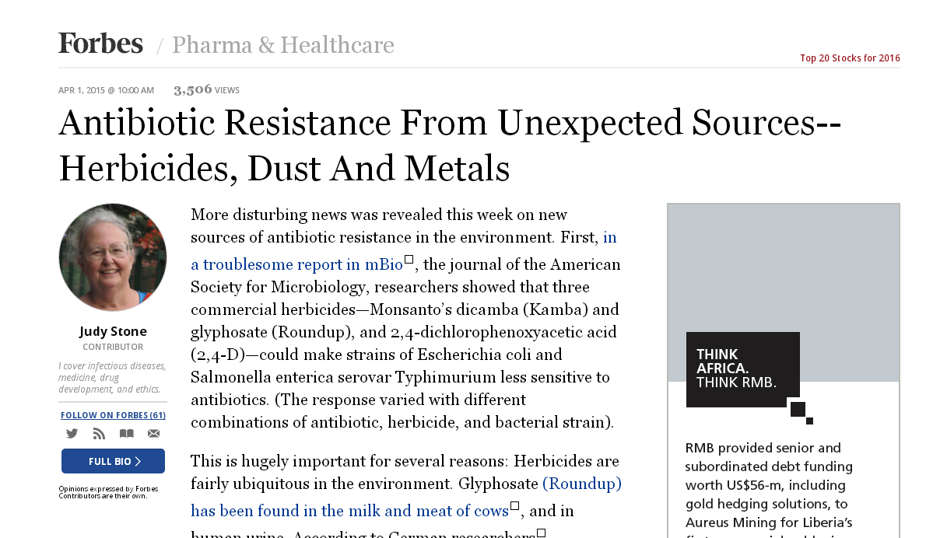

Slide 30
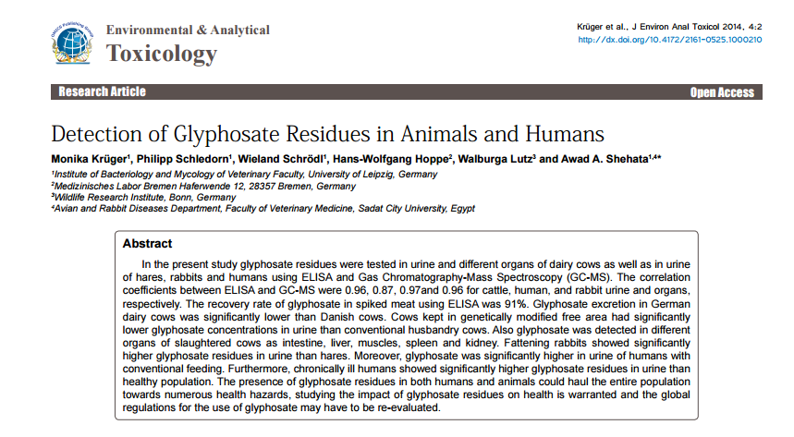

Slide 31
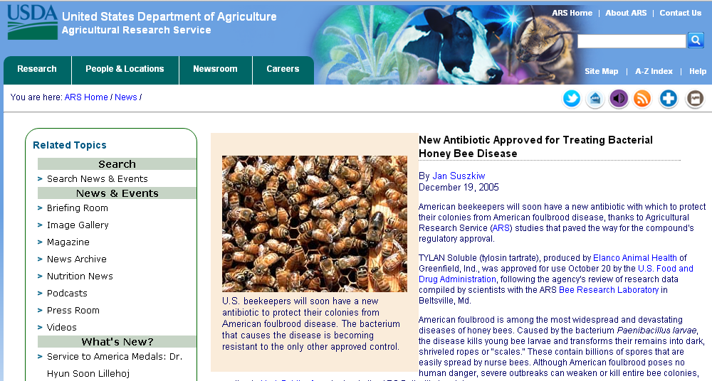

Slide 33
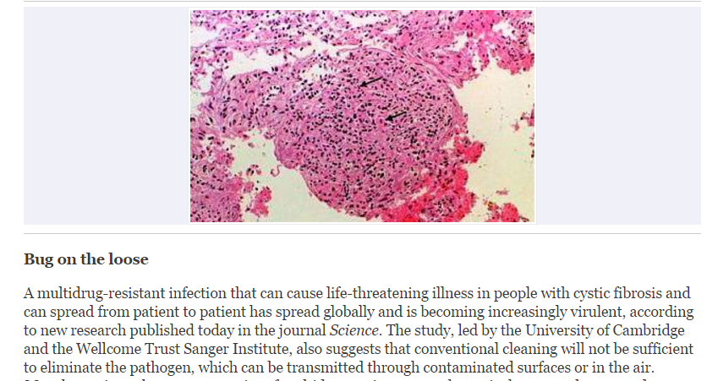

Slide 34
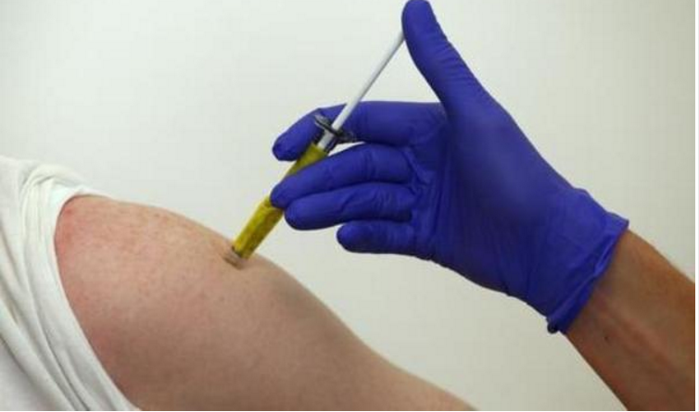

Slide 35
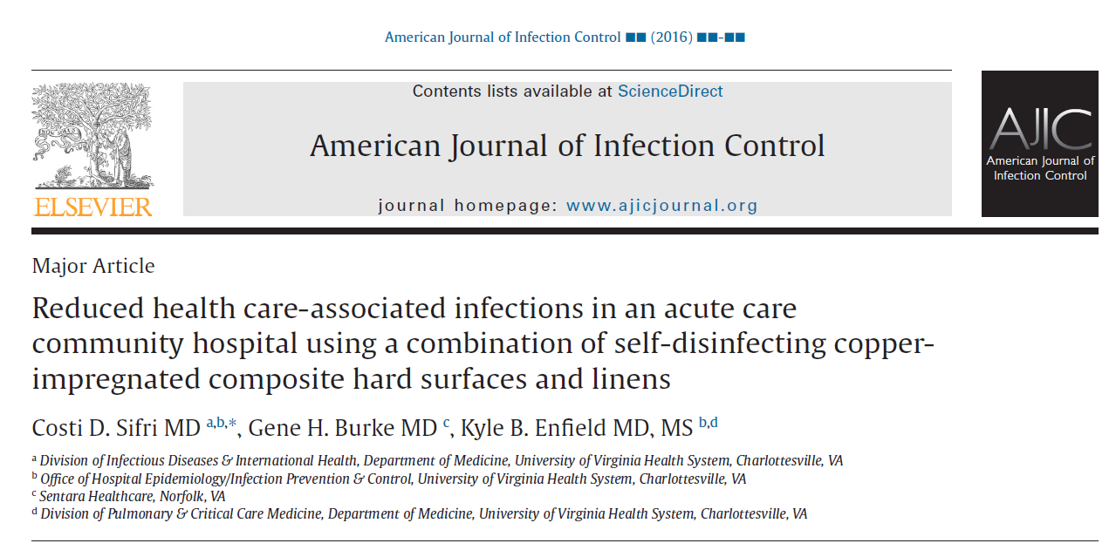

Slide 36
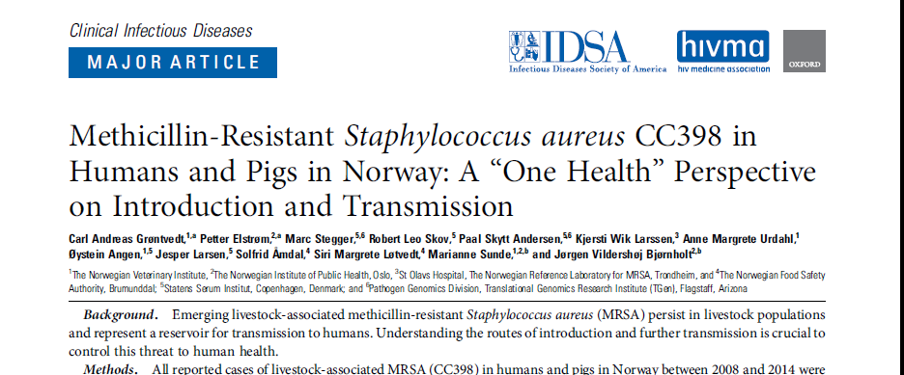

Slide 37
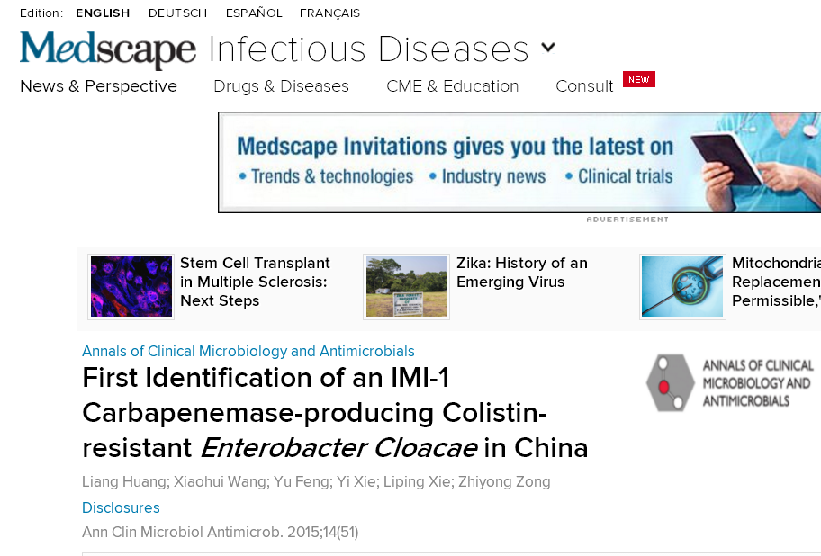

Slide 39
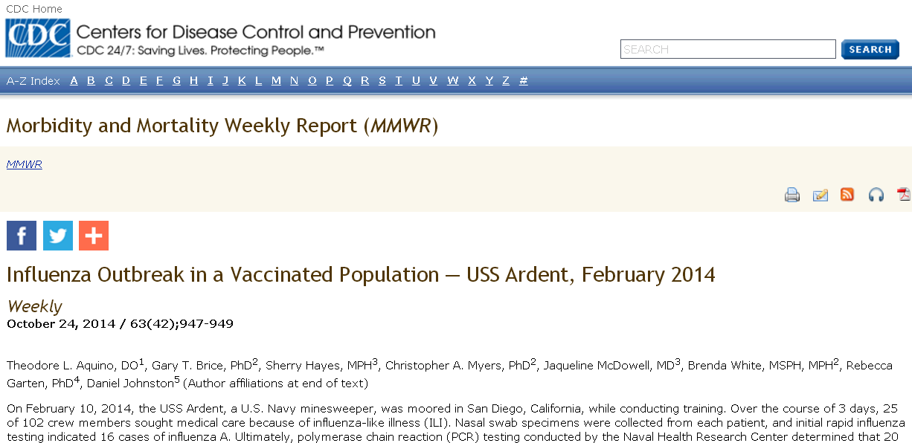

Slide 40
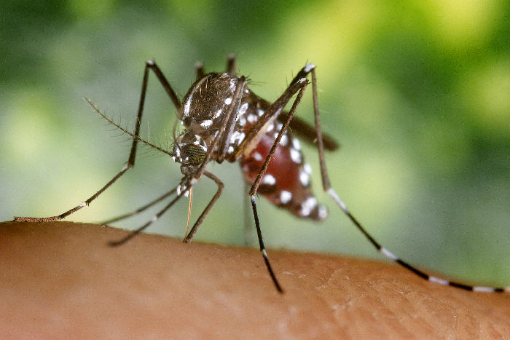
Aedes aegypti mosquito
Mosquitoes Could Carry Viral Triple Threat
The real possibility that in multidisease endemic regions, mosquitoes could carry Zika, dengue, and chikungunya viruses concurrently, transmitting them all at once.

Slide 41
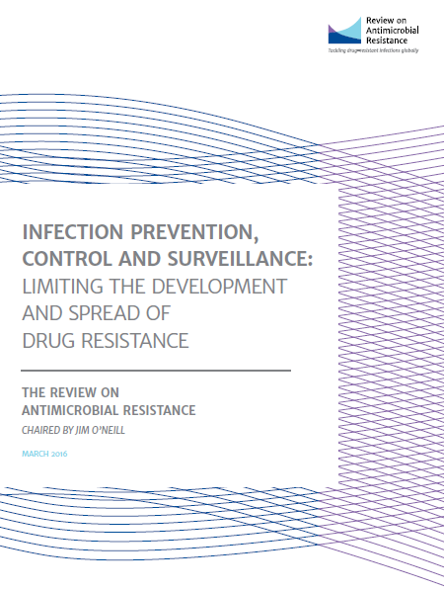

Slide 42
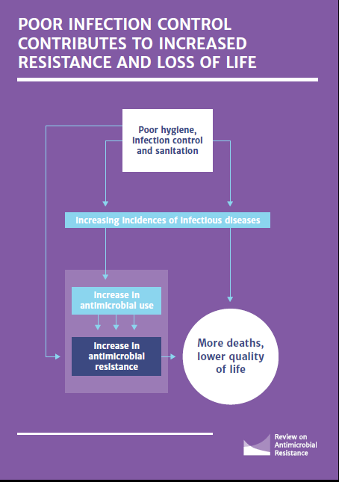

Slide 43
Scope of infection control
Offices
Shops
Factories
Hotels
Eateries
Farms
Agricultural
Poultry
Diary farms
Community
Hospital
Special settings Schools
Colleges
Day care centers
Hostels
Play grounds
Churches
Temples

Slide 44
Linear Causation Process Single intervention is effective e.g. vaccination

Slide 45
ZERO tolerance
Preventable Healthcare associated Infections
IS THIS TARGET POSSIBLE WITHOUT MICROBIOLOGY LAB?
IS SURVEILNACE OF AMR POSSSIBLE?

Slide 46
Surveillance
(Outcome & Process)
INFECTION CONTROL
Isolation of patient & Use of Personal Protective Equipment
Aseptic technique sterile equipment
Hand Hygiene
Antibiotic Policy
Environment
Cleaning, waste disposal etc
from : Damani N N, 2003

Slide 47
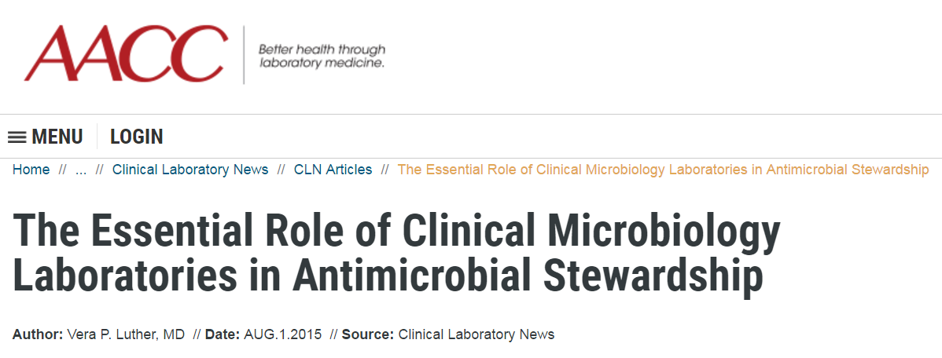

Slide 48
Situations where antimicrobials are used
excessively
Acute Upper respiratory tract infections.
Acute gastroenteritis.
Acute urinary tract infection.
Surgical prophylaxis.
Pyrexia of unknown origin.
Undiagnosed fever in the immune-suppressed.

Slide 49
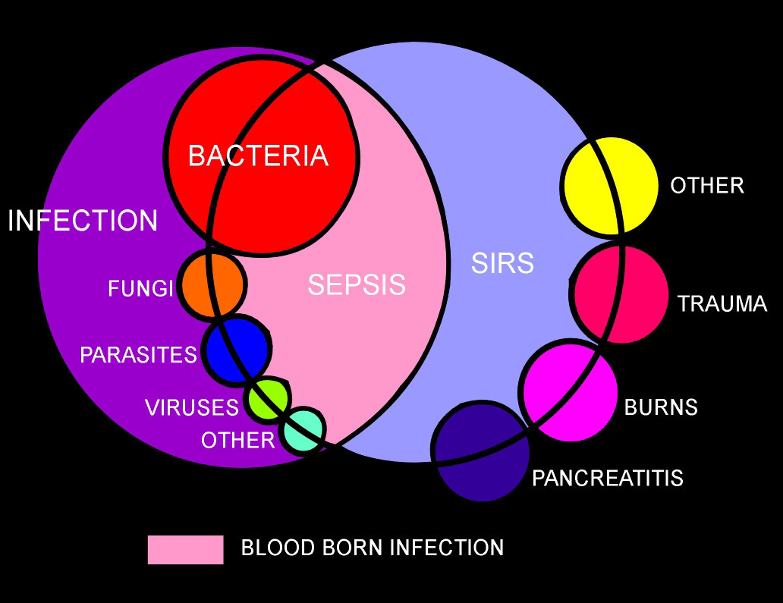

Slide 50
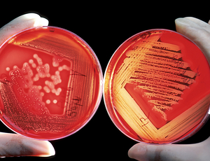
Definitions (cont’d)
Primary Bacteremia – blood stream bacterial invasion with no preceding or simultaneous site of infection with the same microorganism
Secondary Bacteremia – isolation of a microorganism from blood as well as other site(s)

Slide 51
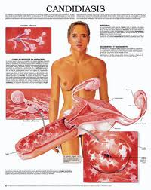
Bacteremia and Fungemia Episodes
Transient
Comes and goes
Usually occurs after a procedural manipulation (ex. Dental procedures)
Intermittent
Can occur from abscesses at some body site that is “seeding” the blood
Continuous Bacteremia

Slide 52
Blood culturing most important and life saving Investigation
Needs optimal Methods for Diagnosis of Blood Borne Pathogens

Slide 53
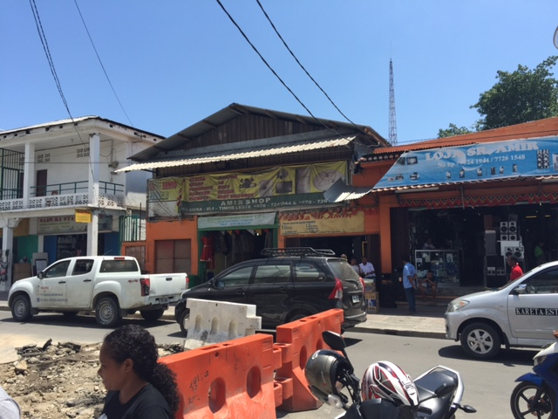
Source: Presentation on progress of global action plan on AMR by
Dr. Marc Sprenger, Director AMR Secretariat, WHO (December 2015)
After 20h flight: reality check
No medical microbiology lab in main hospital
No infection and prevention control in hospital
No drug regulation
No knowledge, no awareness
No money for GP
But committed local people and Country Office WHO

Slide 54
A lot of empirical prescribing in private clinics In public sector by clinical officers with limited training and scanty updating of medical knowledge Lab facilities not available / not accessible / too expensive

Slide 55
Good quality microbiology service is essential for an effective implementation IPC and
antibiotic stewardship programme

Slide 56
ID surprises in Kenya
MRSA is minimal
No C. diff
No VRE
No Legionella
No listeria spp. extremely rare.
Minimal GBS in neonatal sepsis
< 3% PRP

Slide 57
Figure 43-2 Organizational structure of a comprehensive antimicrobial management program. (Adapted from John JF Jr, Fishman NO. Programmatic role of the infectious diseases physician in controlling antimicrobial costs in the hospitals. Clin Infect Dis. 1997;24:471.)
© 2007 Elsevier
Downloaded from: Principles and Practice of Infectious Diseases (on 21 May 2007 03:18 AM)

Slide 58
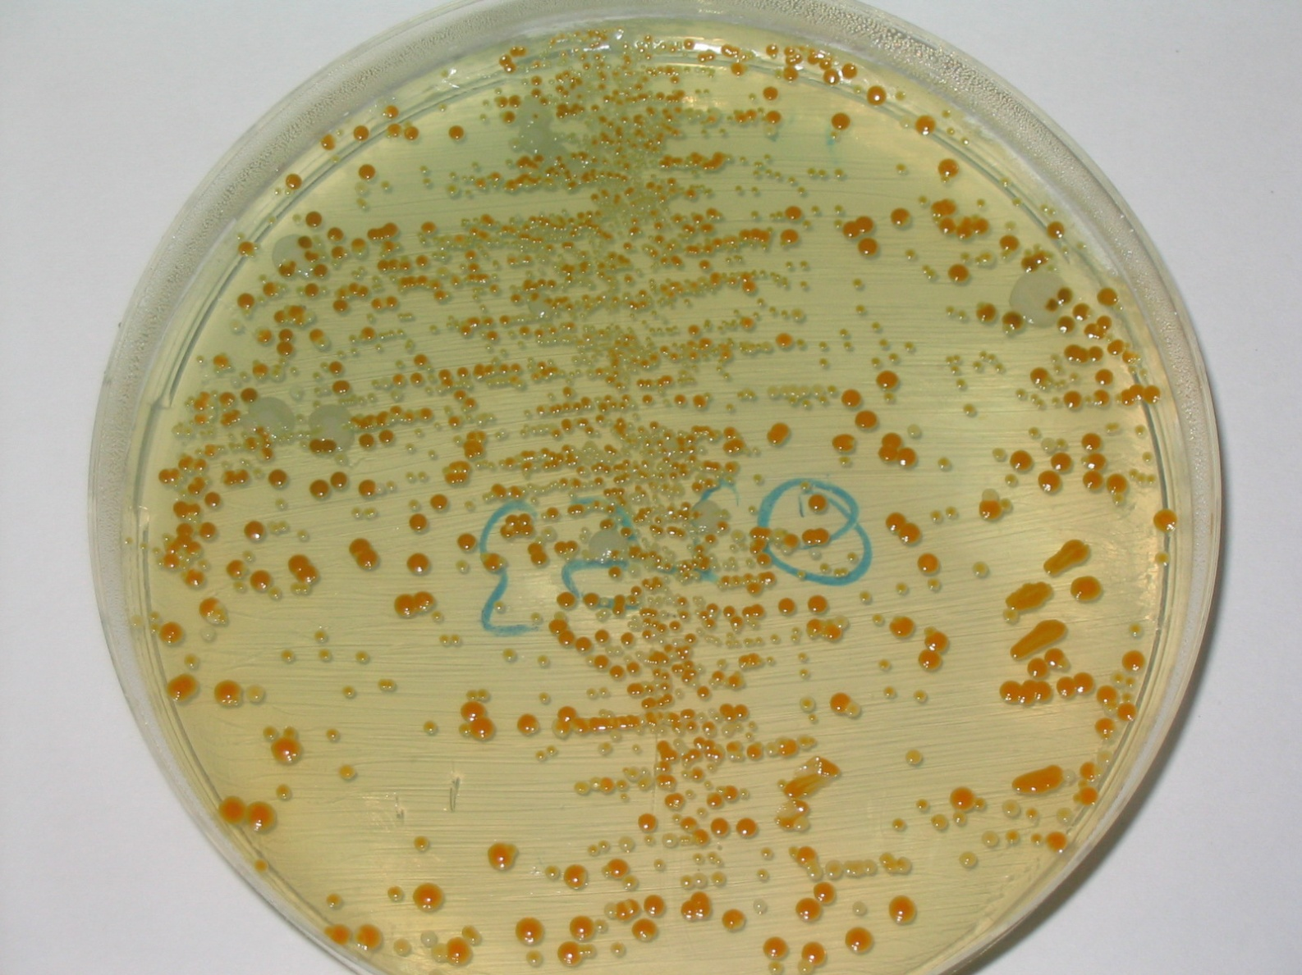
HEAVY MIXED GROWTH OF THREE TYPES OF COLONIES

Slide 59
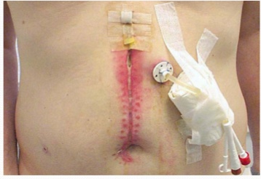

Slide 60
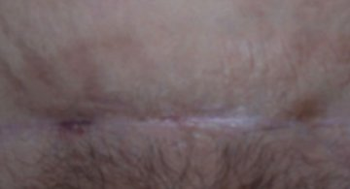
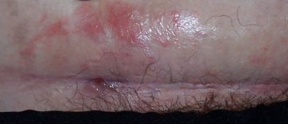
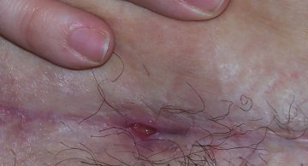
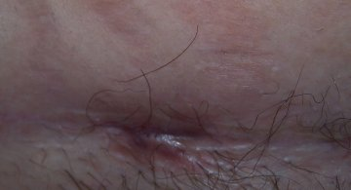
PHOTOS TAKEN between 3 & 4 months after the operation, over three weeks, during a 5th antibiotic treatment for wound infection. This was a 3rd caesarean during a 3rd pregnancy carried out in UK.MOTHER AGED 38 yearsHEIGHT 5 ft 3 in / 159 cm tall
WEIGHT 216 lbs / 15 stone 6 lbs / 98 kg

Slide 62
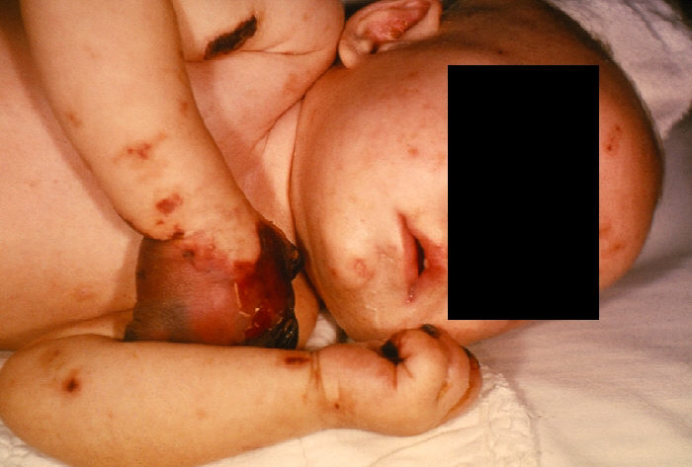
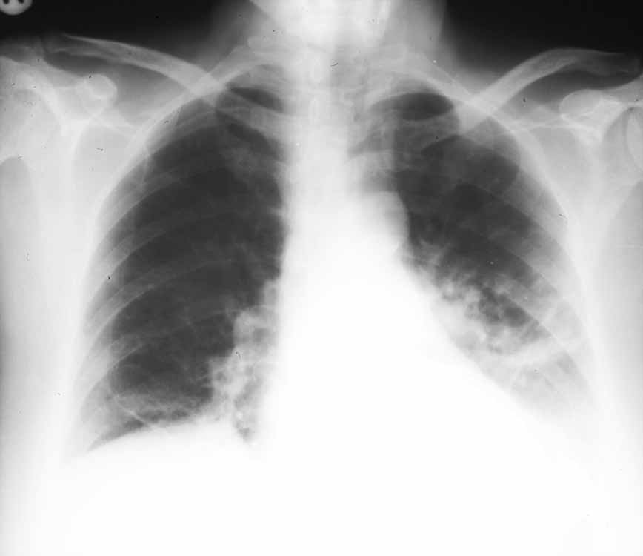
Is this disease…..
really the same as
this disease?

Slide 63
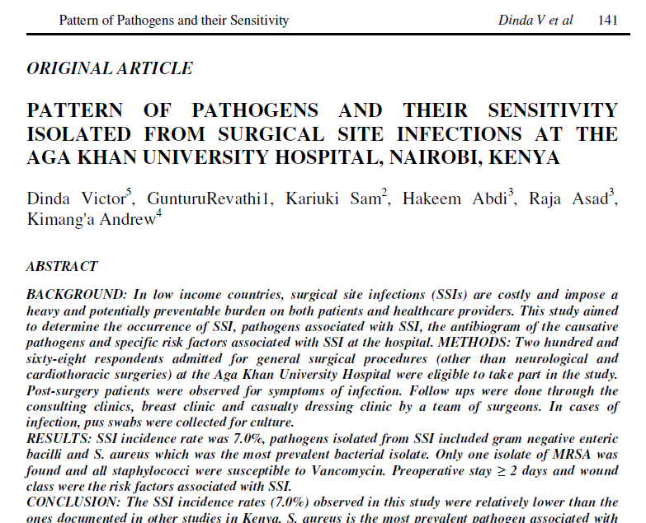

Slide 64
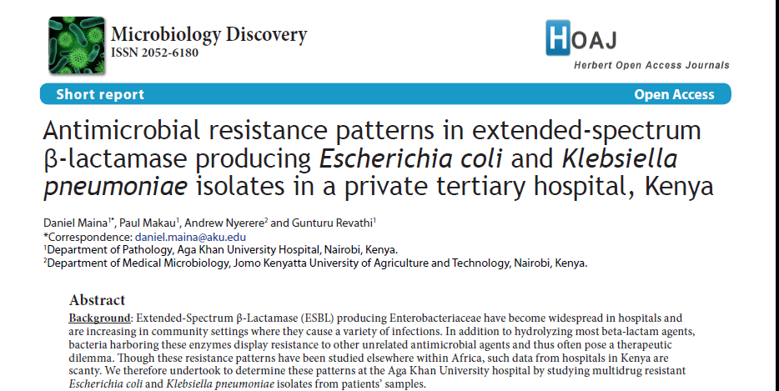

Slide 65
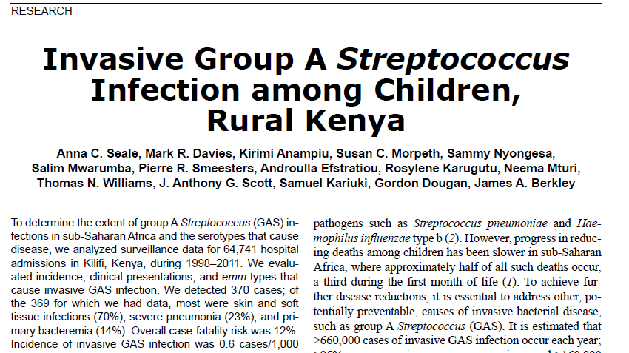

Slide 68
Pressures on the primary care physician
Peer groups / prescribing and pharmacy advisors
Pharmaceutical representatives
(Industry spends 35% of profits on marketing)
Regulatory control mechanisms
Patients’ demands
and
physician aspirations
Hospital experts, formularies and guidelines

Slide 69
Challenges of infection control in LMI countries
1. Constraints and outcomes - Resources and incomes
Limited resources - the main challenge for governments
Funds Allocation to visible targets not to Health Care / HAIs
2. Health care system and society
Hospital based system – Resources concentration in one city
3. Corruption and non-formal payments
4. Poverty, war, economic and political disturbances
5. Infection control not a medical or nursing specialty

Slide 70
Should restrict and rationalize antibiotic use
Antimicrobial stewardship
+
Infection control program
Can limit the emergence and transmission of antimicrobial-resistant bacteria

Slide 73
EBM
Evidence is needed for
Efficacy (“Can it work?”),
Effectiveness (“Does it work in practice?”)
Efficiency (“Is it worth it?”)
All of these need to be considered.

Slide 74
Most trials test for efficacy in ideal situations using
Detailed protocols,
Carefully selected patients
Placebo controls,
Good treatment compliance
And intensive follow-up.

Slide 75
These ideals - rarely achievable in routine clinical practice with
Poor diagnostic accuracy,
Poor patient compliance
And partial patient coverage

Slide 76
The current scenario in developing countries makes antibiotic stewardship quite challenging.
Absence of lab services of any kind.
Diagnosis of serious infective conditions including acute meningitis, childhood TB, is made based on clinical algorithms.
Majority of the public health care facilities operate with out a clinical laboratory.

Slide 77
Lack of emphasis on lab diagnosis of infectious diseases – clinician apathy and a culture of syndromic approach
Concept that microbiology is expensive and time consuming
Perceptions that Lab results can not be trusted - Justified indeed!

Slide 78
Why is there an “increase” in the diagnosis of Enteric Fever (Typhoid)?
Motivated by money-making ideas e.g. to sell the Widal Test kits
Increased unprofessionalism
Presence of many fake laboratories & quacks
Presence of fake reagents
Lack of supervision/prosecution

Slide 79
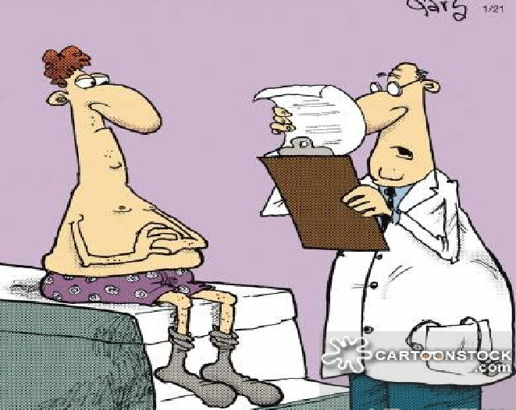
I AM CONCERNED ABOUT THE HIGH LAVELS OF BLOOD
WE FOUND N YOUR BLOOD TEST

Slide 80
Aedes aegypti mosquito
Mosquitoes Could Carry Viral Triple Threat
The real possibility that in multidisease endemic regions, mosquitoes could carry Zika, dengue, and chikungunya viruses concurrently, transmitting them all at once.

Slide 83
Do not use antibiotics in asymptomatic bacteriuria
Do not take a swab or use antibiotics for the management of a leg ulcer without clinical infection
Avoid prescribing antibiotics for upper respiratory tract infection

Slide 84
Don’t initiate an antibiotic without an identified indication and a predetermined length of treatment or review date

Slide 85
Do not use antimicrobials to treat bacteriuria in older adults where specific urinary tract symptoms are not present

Slide 86
Consider antibiotic de-escalation daily

Slide 88
Why the empirical antibiotic therapy over rules diagnostic microbiology

Slide 100
Summary
Antimicrobial resistance has reached dangerous levels.
Prescribing practices have to change.
Adherence to the principles of Evidence Based Practice is essential.
AMR Surveillance is crucial.
Diagnostics have to improve
Control of antibiotics imperative in human & animal use.
Intense need to discover new antimicrobials & vaccines and new rapid, reliable and cost effective diagnostics for infectious diseases.

Slide 102
Thank you for your attention !!!

