Slide 1
AMS Round Table
Prof. Gunturu Revathi
Consultant Microbiologist
The Aga Khan University Hospital, Nairobi
IPNET Conference
16-11-2011
Gelian Hotel
Machakos

Slide 2
Should restrict and rationalize antibiotic use
Antimicrobial stewardship
+
Infection control program
Can limit the emergence and transmission of antimicrobial-resistant bacteria

Slide 3
Antibiotic Guidelines

Slide 4
ZERO tolerance
Preventable Healthcare associated Infections
IS THIS TARGET POSSIBLE WITHOUT MICROBIOLOGY LAB?
IS SURVEILNACE OF AMR POSSSIBLE?

Slide 5
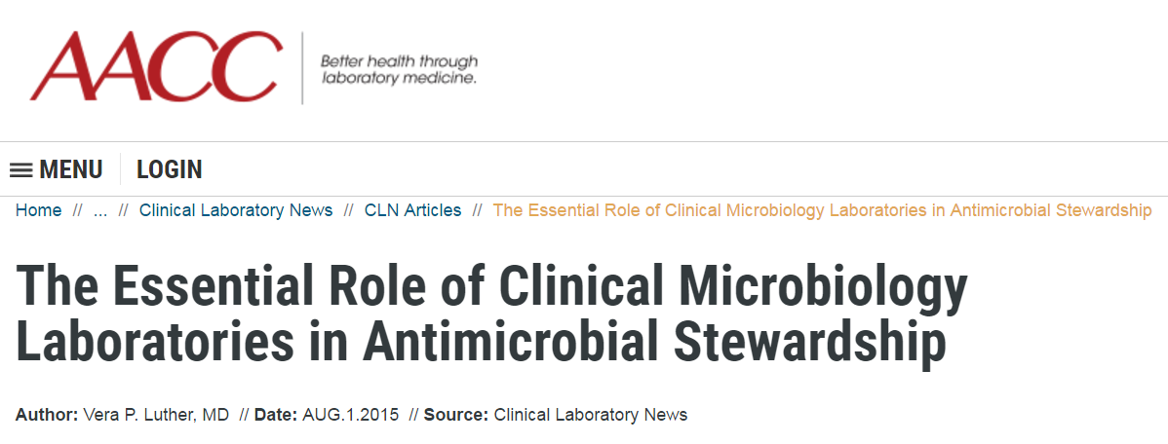

Slide 6
Situations where antimicrobials are used
excessively
Acute Upper respiratory tract infections.
Acute gastroenteritis.
Acute urinary tract infection.
Surgical prophylaxis.
Pyrexia of unknown origin.
Undiagnosed fever in the immune-suppressed.

Slide 7
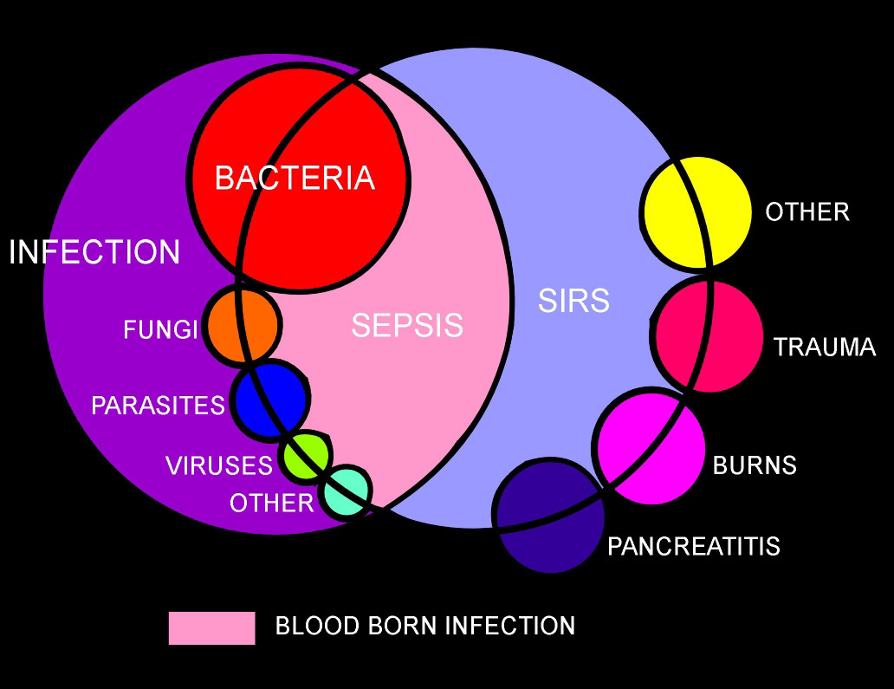

Slide 8
Definitions (cont’d)
Primary Bacteremia – blood stream bacterial invasion with no preceding or simultaneous site of infection with the same microorganism
Secondary Bacteremia – isolation of a microorganism from blood as well as other site(s)

Slide 9
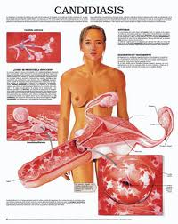
Bacteremia and Fungemia Episodes
Transient
Comes and goes
Usually occurs after a procedural manipulation (ex. Dental procedures)
Intermittent
Can occur from abscesses at some body site that is “seeding” the blood
Continuous Bacteremia

Slide 10
Blood culturing most important and life saving Investigation
Needs optimal Methods for Diagnosis of Blood Borne Pathogens

Slide 11
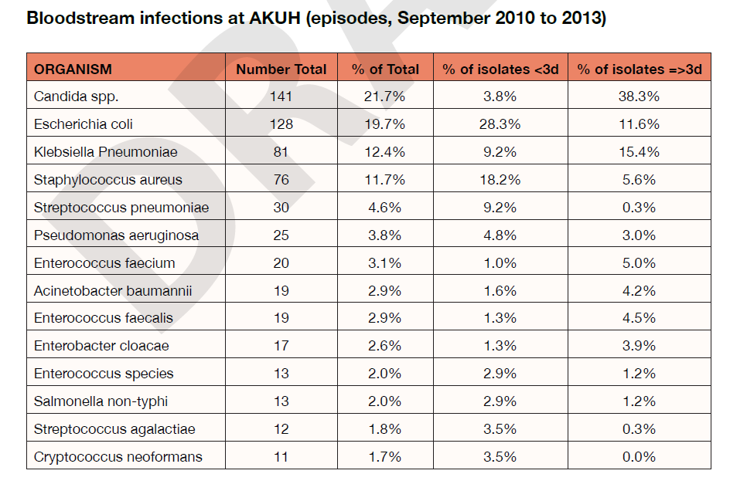

Slide 12
ID surprises in Kenya
MRSA is minimal
No C. diff
No VRE
No Legionella
No listeria spp. extremely rare.
Minimal GBS in neonatal sepsis
< 3% PRP
Enterobacter spp. not prominent

Slide 13
Figure 43-2 Organizational structure of a comprehensive antimicrobial management program. (Adapted from John JF Jr, Fishman NO. Programmatic role of the infectious diseases physician in controlling antimicrobial costs in the hospitals. Clin Infect Dis. 1997;24:471.)
© 2007 Elsevier
Downloaded from: Principles and Practice of Infectious Diseases (on 21 May 2007 03:18 AM)

Slide 14
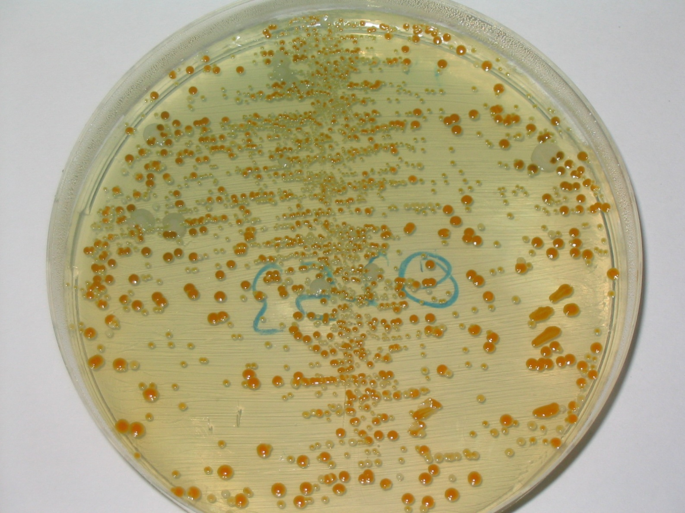
HEAVY MIXED GROWTH OF THREE TYPES OF COLONIES

Slide 15
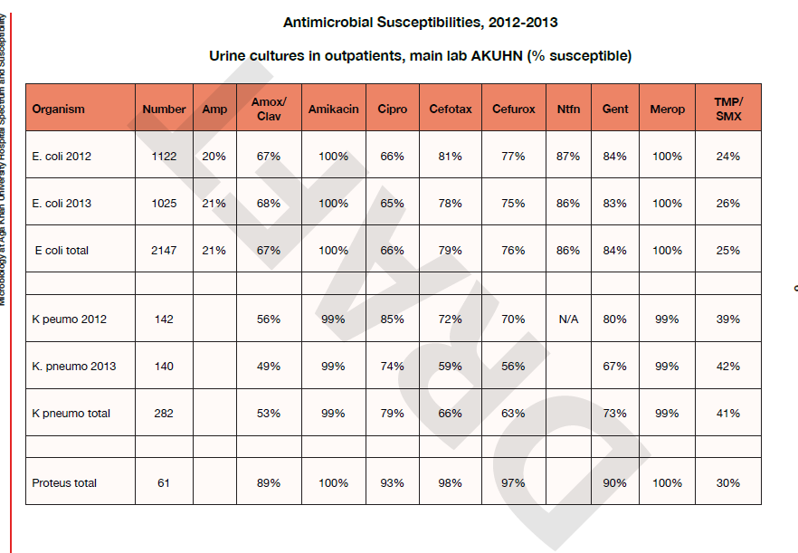

Slide 16
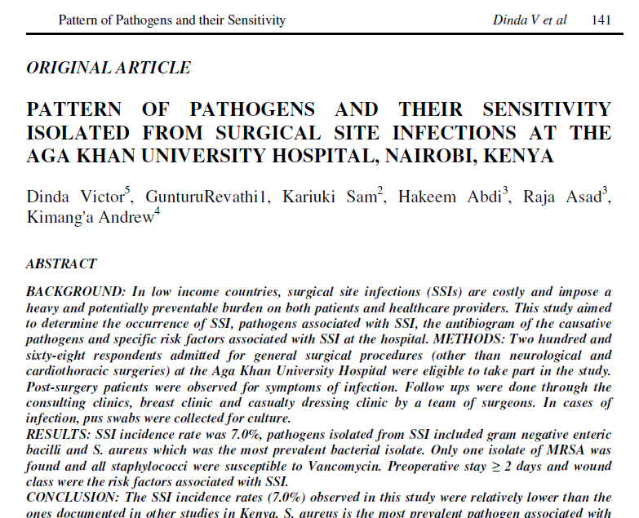

Slide 17
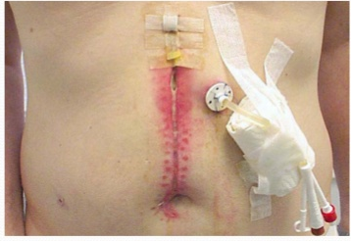

Slide 18
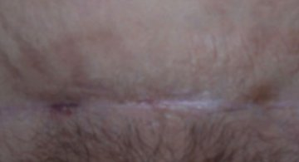
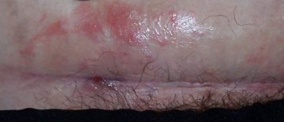
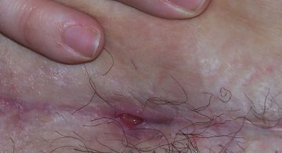
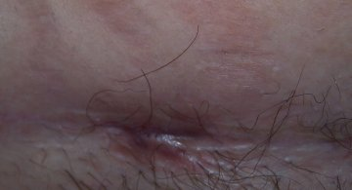
PHOTOS TAKEN between 3 & 4 months after the operation, over three weeks, during a 5th antibiotic treatment for wound infection. This was a 3rd caesarean during a 3rd pregnancy carried out in UK.MOTHER AGED 38 yearsHEIGHT 5 ft 3 in / 159 cm tall
WEIGHT 216 lbs / 15 stone 6 lbs / 98 kg

Slide 21
Pressures on the primary care physician
Peer groups / prescribing and pharmacy advisors
Pharmaceutical representatives
(Industry spends 35% of profits on marketing)
Regulatory control mechanisms
Patients’ demands
and
physician aspirations
Hospital experts, formularies and guidelines

Slide 23
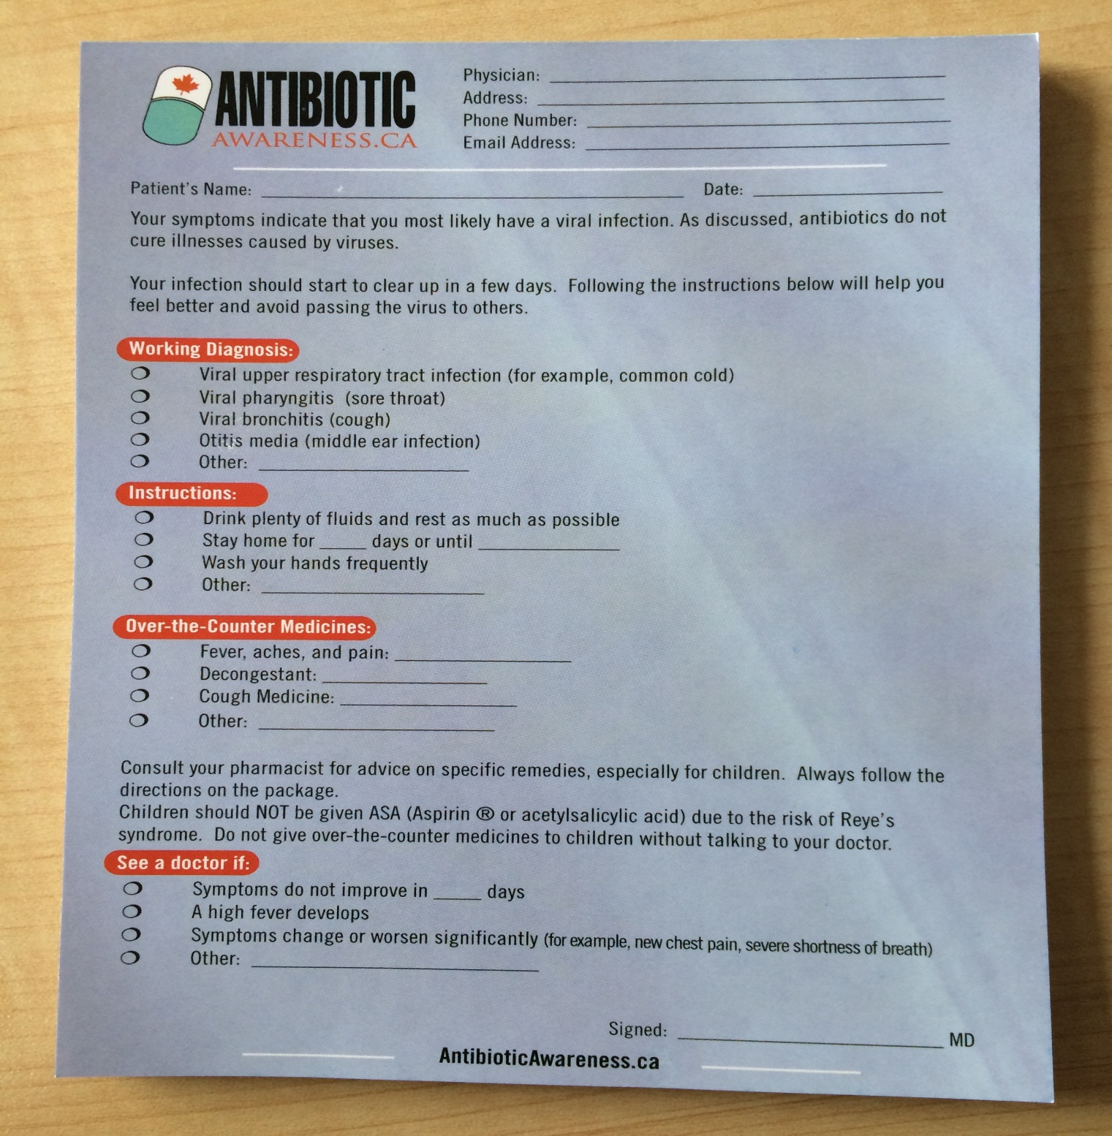

Slide 25
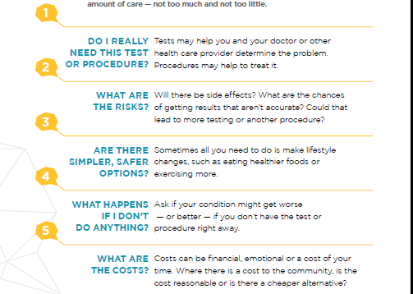

Slide 26
Do not use antibiotics in asymptomatic bacteriuria
Do not take a swab or use antibiotics for the management of a leg ulcer without clinical infection
Avoid prescribing antibiotics for upper respiratory tract infection

Slide 27
Don’t initiate an antibiotic without an identified indication and a predetermined length of treatment or review date

Slide 28
Do not use antimicrobials to treat bacteriuria in older adults where specific urinary tract symptoms are not present

Slide 29
Consider antibiotic de-escalation daily

Slide 31
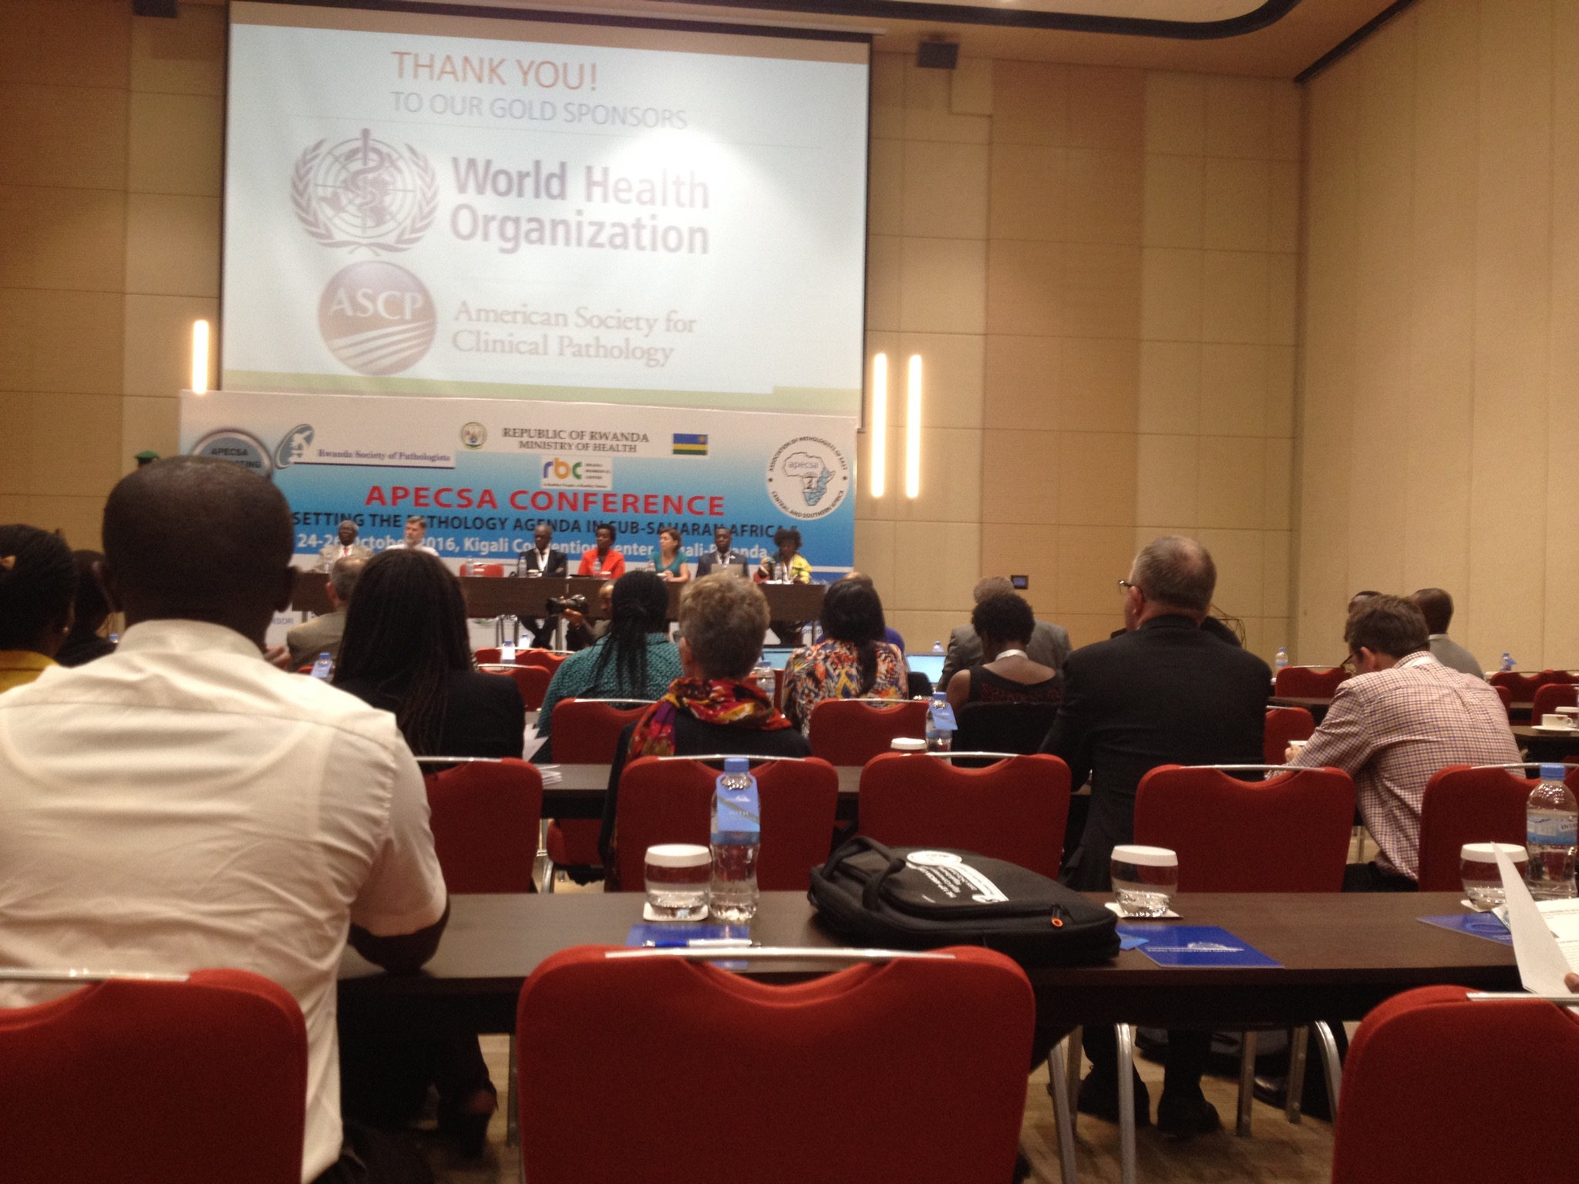

Slide 32
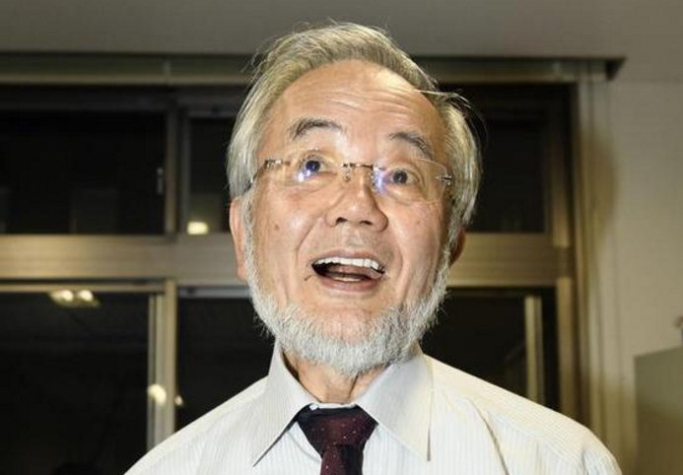

Slide 34
Thank you for your attention !!!

